Slide 1
The Boyne Island smelter: a case study
Patrick O’Callaghan and John Mangan
AIBE, University of Queensland

Slide 2

Economic Modelling with Sector-specific Euler Equations ``emsee’’ model overview

Slide 3
CGE model with forward-looking dynamics:
General equilibrium: supply = demand at each region, sector, time, …
Capital is optimally replenished using inputs from all sectors
Balanced growth paths: each sector grows in range 1% to 2%
Computation: sequence of overlapping nonlinear dynamic programs (Cai–Judd; Na et al.; 2021)
Sector-specific Euler Eq’ns:
When the SEE hold, capital is optimally allocated across sectors
Testable: ``value capital today’’ = ``expected value of capital in the future’’
Absent: in intersectoral models such as CoPS; Atalay; Cesa-Bianchi et al; Baqaee and Farhi
Transition to net zero: lots of rapid change and uncertainty
Behavioural economics: decisions are hard in such settings, so some of the SEE will fail to hold.
When some of the SEE fail to hold:
Sector-specific shocks lead to corrections that spill over to other sectors
more capacity for adaptation: more opportunities to nudge economy to new equilibria

Slide 4
Aluminium Industry and Boyne Smelters Limited (BSL)

Slide 5

Australia: energy-abundant with a fully integrated Aluminium supply chain
One of only three countries in the world along with Brazil and Venezuela.
Qld: Weipa Bauxite 50% to Gladstone; AlOx refining; Al smelting at BSL
Gladstone AlOx (Alumina) refineries sell 15% to BSL
Recent investment in Weipa and increase in capacity in Gladstone
No obvious threat to overall supply chain as Rio Tinto is majority owner
BSL: consumes 1/8 of Qld’s electricity; large energy subsidy ($250m+)
One of four smelters in Australia NSW, Victoria and Tasmania
Kurri Kurri, NSW closed in 2012
Tiwai Point, New Zealand, Rio Tinto nearly closed in 2020-2021
Qld Energy and Jobs Plan:
Sustaining heavy industry in Qld is a key part of the transition
Notes:
To give context, the Gladstone Power Station has the capacity to supply one-sixth of Queensland’s power

Slide 6
Gladstone, Central Queensland

Slide 7
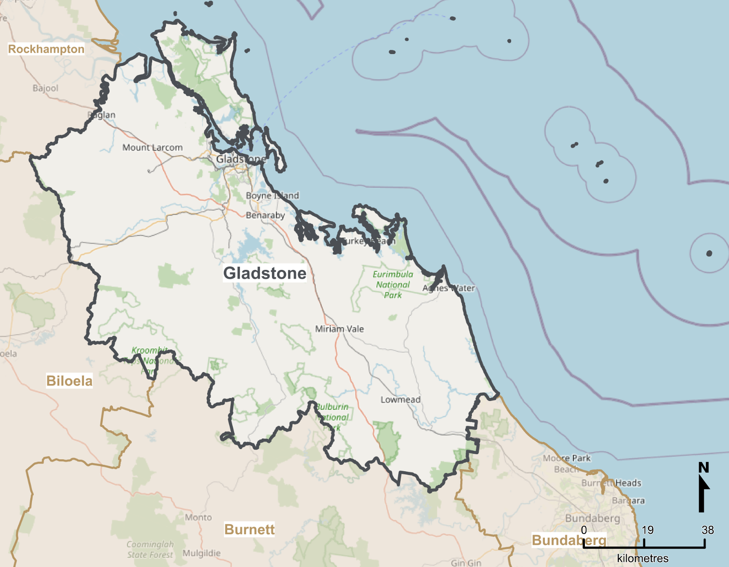

Gladstone (2018-19 economy, SA3/LGA):
$15.5bn output: approx. 25% of Central Qld, 2% Qld
29k FTE: approx. 28% of Central Qld, 1.3% of Qld
Gladstone is Qld’s regional manufacturing hub:
Other Heavy industry: Ammonia, Cement, LNG, Oil refinery
Growth industries: ag-tech, AlOx batteries, aquaculture, Mining Serv., green {…}
BSL represents approx. ¼ of Manufacturing activity (large energy consumption)

Slide 8
Data sources

Slide 9
Regionalisation to a 19-sector (ANZSIC divisions) Gladstone economy
Investment flows between sectors: method of Atalay (2017)
Adapt investment flows tables from US data
BLADE (and Remplan): for output per sector for Gladstone 2019
Jobs in Australia ABS data: labour per sector for Gladstone 2019.
Input-output flows between sectors: ABS tables 5 and 8 for Australia
Gross Fixed Capital Formation by Industry by type of Asset: ABS for Australia
Gladstone Port data for Bauxite, Alumina, Aluminium and Coal
Rio Tinto accounts
Studies on aluminium production e.g.
Gagne and Nappi 2000
Best Available Techniques 2017

Slide 10
Experiments and shocks

Slide 11
Experiment (1) all 19 SEE hold
1st phase: tune/regionalise parameters
2nd phase: capital evolves towards a balanced growth path;
3rd phase: continue and generate
``status quo’’ path
``shock’’ (BSL closure) path
Experiment (2) not all 19 SEE hold
1st phase: tune/regionalise parameters;
2nd phase: capital evolves towards a balanced growth path;
3rd phase: continue and generate
``status quo’’ path
``shock’’ (BSL closure) path
Shock Type (a): one-off ``MIT shock” agents don’t see coming
1/4 decrease in Manufacturing productivity, capital and exports
5/6 decrease in Utilities (energy + water) purchases by Manufacturing
No exogenous decommissioning or replacement activity

Slide 12
Summary of Results

Slide 13
Experiment (1a) Results
Shock is sector-specific
Utilities prices fall:
Increasing Agriculture and Consumption
Economy preserves the status quo:
Manufacturing employment actually rises
(Compensation of Employees does indeed fall)
Experiment (2a) An example of Results
Shock is more dispersed
Utilities and Manufacturing prices fall
Increasing Agriculture, Mining, …, Consumption
Economy departs from the status quo:
Agriculture and Mining employment rise
(Manufacturing employment falls)
Aggregate Output -$1.7bn
Manufacturing | Others
-$1.59bn | -$0.1bn
Aggregate Output -$0.85bn
Manufacturing | Others
-$1.14bn | +$0.29bn

Slide 14
Graphical comparison of experiments (1a) (2a) All 19 SEE hold Not all 19 SEE hold

Slide 15
Experiment-shock (1a): % change relative to status quo,
Aggregates
Experiment-shock (2a): % change relative to status quo,
Aggregates
Aggregate Capital permanently down;
Aggregate Output permanently down by 10%;
Consumption falls as aggregate price levels rise
Aggregate Capital falls, but then rises above status quo;
Output initially falls by 6% before rising;
Consumption is 3.5% higher in the long run

Slide 16
Experiment-shock (1a): % change relative to status quo,
Manufacturing
Experiment-shock (2a): % change relative to status quo,
Manufacturing
Manufacturing capital quickly recovers;
Consumption falls (prices rise)
Manufacturing capital slowly recovers;
Consumption rises (prices fall)

Slide 17
Experiment-shock (1a): % change relative to status quo,
Utilities
Experiment-shock (2a): % change relative to status quo,
Utilities
Consumption up (price down) temporarily
Gladstone is connected to NEM …
Consumption up (price down) 10% and permanently
Gladstone is connected to NEM …

Slide 18
Experiment-shock (1a): % change relative to status quo,
Agriculture (Similar pictures for Mining.)
Experiment-shock (2a): % change relative to status quo,
Agriculture
Capital up, Output up and consumption down
Capital up by over 15% in the long run.

Slide 19
Key takeaways

Slide 20
BSL is important to Gladstone’s economy and the overall supply chain
Transition needs to be handled with care: BSL needs to be in close proximity of energy supply
Gladstone Aluminium: internationally competitive (given right energy transition)
June 2022: Rio Tinto calls for clean Gladstone Aluminium by 2030.
September 2022, Qld Energy Plan: supergrid can keep Gladstone in proximity of energy supply
Economic modelling with SEE:
Testable equations with long history in macroeconomics / finance (absent in CGE)
If the SEE hold, then the shock is more sector-specific (less macroeconomic)
Transition to net zero:
Some SEE will not hold (given high uncertainty and out-of-date capital)
Greater propagation of shocks, but also greater opportunity for change
Policy implications:
We can estimate how the SEE fail and identify paths of least resistance for economic transformation.

Slide 21
References

Slide 22
Short list of Articles:
Atalay, E. (2017). How important are sectoral shocks?. American Economic Journal: Macroeconomics, 9(4), 254-80.
Baqaee, D. R., & Farhi, E. (2019). The macroeconomic impact of microeconomic shocks: Beyond Hulten's theorem. Econometrica, 87(4), 1155-1203.
Cai, Y., & Judd, K. L. (2021). A Simple but Powerful Simulated Certainty Equivalent Approximation Method for Dynamic Stochastic Problems (No. w28502). National Bureau of Economic Research.
Cusano, G., Rodrigo Gonzalo, M., Farrell, F., Remus, R., Roudier, S., Delgado Sancho, L. (2017). Best Available Techniques (BAT) Reference Document for the Non-Ferrous Metals Industries. Industrial Emissions Directive 2010/75/EU (Integrated Pollution Prevention and Control) (No. JRC107041). Joint Research Centre (Seville site).
Dixon, P., & Rimmer, M. T. (2020). Developing a DSGE consumption function for a CGE model. Centre of Policy Studies (CoPS), Victoria University.
Gagné, R., & Nappi, C. (2000). The cost and technological structure of aluminium smelters worldwide. Journal of Applied Econometrics, 15(4), 417-432.
Na, S., Anitescu, M., & Kolar, M. (2021). A fast temporal decomposition procedure for long-horizon nonlinear dynamic programming. arXiv preprint arXiv:2107.11560.
Data:
Australian Bureau of Statistics (ABS), 2018-2019. Tables 5 and 8: Industry by Industry Flow Table. Released May 2021.
Australian Bureau of Statistics, Business Longitudinal Analysis Data Environment (BLADE), 2018-2019, https://www.abs.gov.au/about/data-services/data-integration/integrated-data/business-longitudinal-analysis-data-environment-blade
Bureau of Economic Analysis (2003). Capital flow data for 1997. https://www.bea.gov/news/2003/capital-flows-us-economy-1997
Gladstone Regional Council. https://www.gladstone.qld.gov.au/downloads/file/3466/gladstone-region-investment-prospectus . Retrieved October 2022
Queensland Government (2022). Energy and Jobs Plan. https://www.epw.qld.gov.au/energyandjobsplan . Retrieved October 2022
Queensland Government. https://yoursayhpw.engagementhq.com/understand-qrez/news_feed/central . Retrieved October 2022
Port of Gladstone, “Trade Statistics Data,” https://www.gpcl.com.au/trade-statistics . Retrieved April 2020
Rio Tinto, (2019). Annual Report Production, Reserves and Operations. Retrieved in April 2020.

