Slide 2
1.1 - Wed
Open Accuterm
Use saved Session – c:\jbase\z2018\z2018.atc
Login using jbaseadm
CTRL-F1 – This will setup the account
LOGTO Z2018

Slide 3
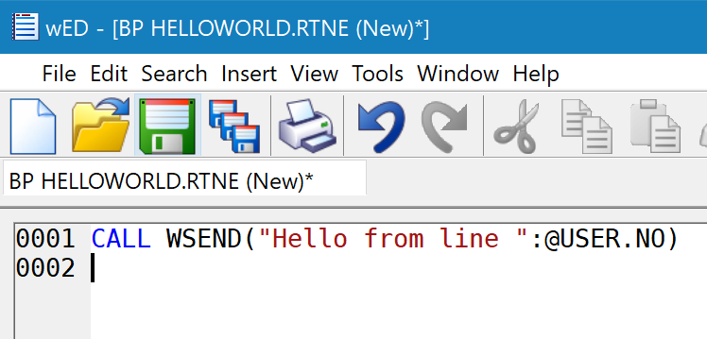
1.2 Open Second Session
Fire up second accuterm in same window (tab)
Log in as jbaseadm
Logto Z2018
Launch WED BP HELLOWORLD.RTNE

Slide 4
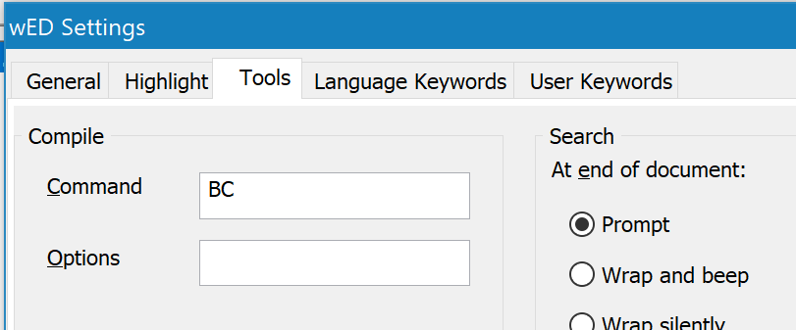
1050 - Compile
Use BC to compile
Compile program

Slide 5
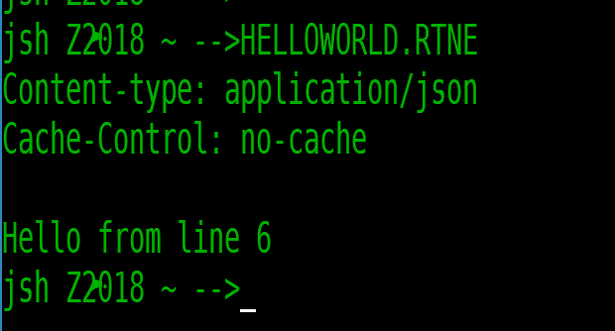
1060 – Run program
Use First accuterm session
HELLOWORLD.RTNE

Slide 6
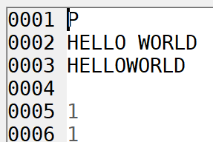
1070 – Add wdb resource
WED – OPEN WDB.RESOURCES API*HELLOWORLD
Make sure 7 also has a 1

Slide 7
1080 – Launch jagent
Start a third jbase session
LOGTO Z2018
Jbase_agent –config=.\jagent_config
Or ctrl-f2

Slide 8
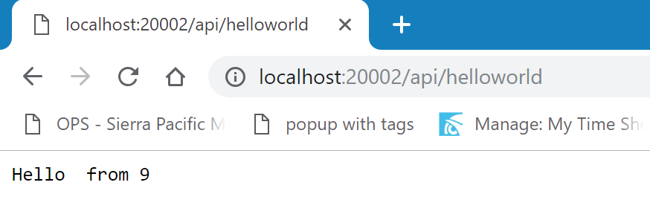
1090 – Launch in chrome
url: http://localhost:20002/api/helloworld

Slide 9
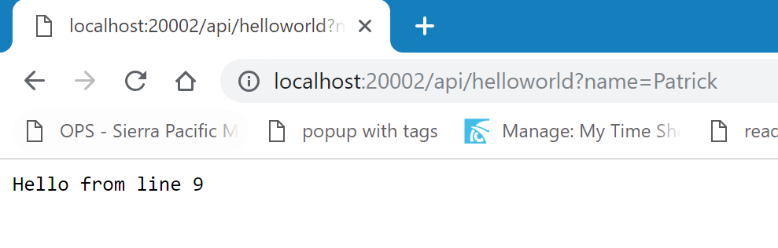
1100 – Add name to url bar
url: http://localhost:20002/api/helloworld?name=Patrick

Slide 10
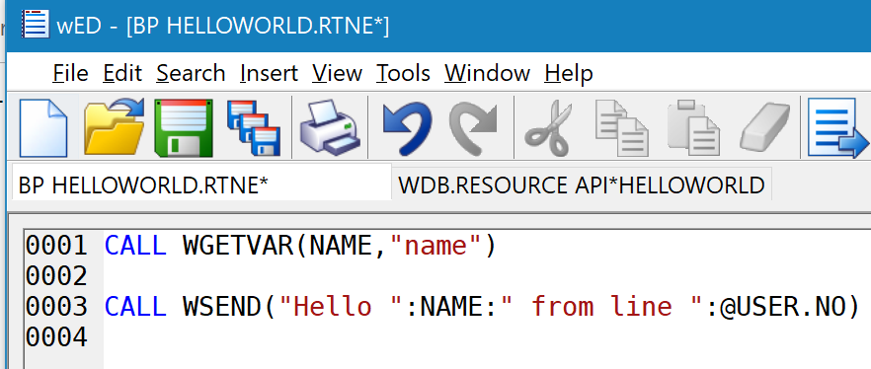
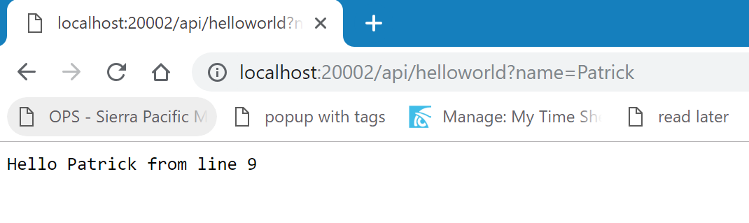
1110 – Add to helloworld
Add wgetvar to program
Compile program
Refresh browser

Slide 11
1120 – run in wdebug
Go back to accuterm session
Launch wdebug
Show how you can view a call

Slide 12
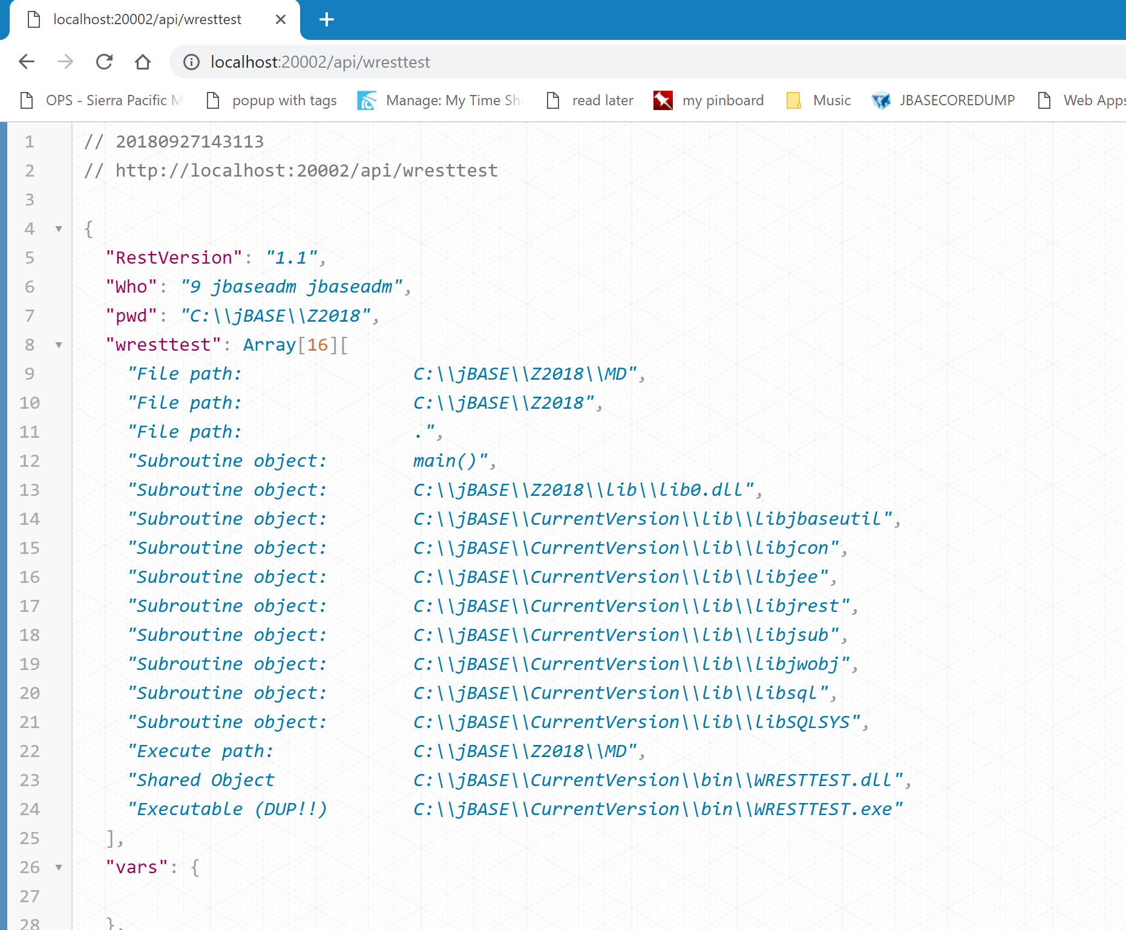
1130 – change to wresttest
Change in chrome
Discuss prettification

Slide 13
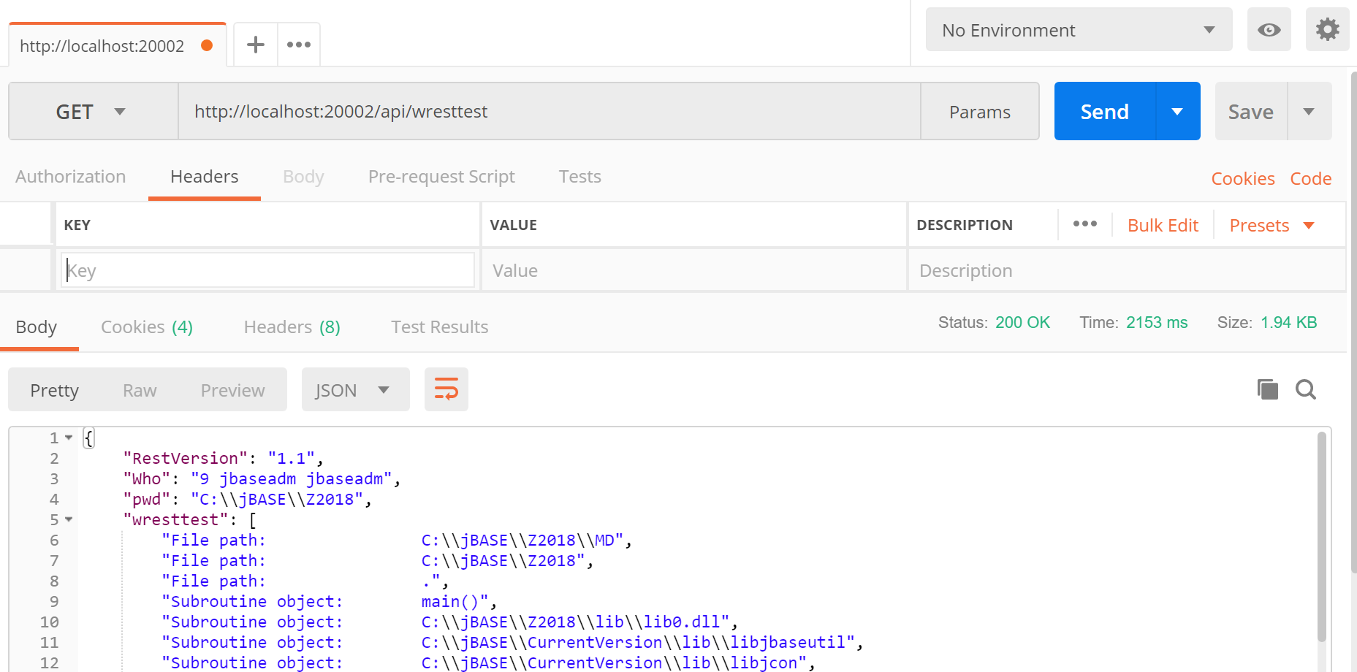
1140 - postman
Launch Postman
Talk about Postman
Call helloworld?name=patrick
Change to post, x-www-form-urlencoded
Add field name, use different name=Patrick Payne
Remove from URL bar
Run Program.

Slide 14
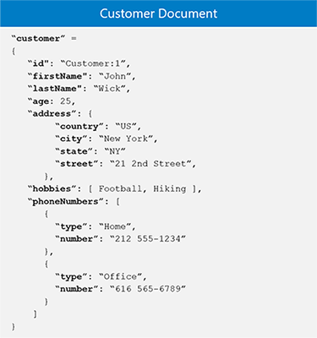
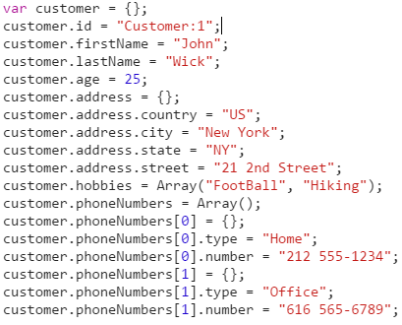
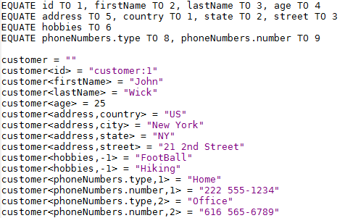
1150 Introduction to Objects – 5 minutes
Data Object
Object as JSON
Pick Object

Slide 15
1160 – Add WOBJ to helloworld.rtne 5 Minutes
Add CONTENT TYPE
ADD CREATION OF RESPONSEOBJ
MODIFY WSEND TO BUILD MSG VARIABLE
SET MESSAGE INTO RESPONSE OBJ
CONVERT RESPONSEOBJ TO JSON
WSEND JSON
Run from tcl – discuss cached code
Run from postmap

Slide 16
1170 – Show sending name as body entry
Adjust postman to send name in body
Add getbody
Make sure postman content type is json
Get name
Adjust code
Call from postman

Slide 17
1171 – Python example
Python Example
C:\jbase\z2018\samples\1171
Python helloworld.py
Need to run from normal c: prompt (environment issue)

Slide 18
1172 - .net example
I will demo this
Console app
Restsharp
C#

Slide 19
1173
Curl is in the bin directory
1173.bat
Discuss that this can be used to call other rest services

Slide 20
2000 – Open up app studio – 5 minutes
Load App Studio
Discuss frameworks
Single Page vs Multi-Page and Hybrid
What is App Sudio –
VB6 clone – transpiles basic to javascript – jquery based
Similar to other frameworks but uses a IDE

Slide 21
2010 – Build helloworld app – 10 minutes
Responsive
Drop two input boxes (do not change names)
Drop Button
Add code to call rest service
Launch in Browser
Open Debugger
Try sending something
Assistance on debugging

Slide 22
2010-part 2 - debugging
Assistance on errors
Redeploying – launches new tab – just close and refresh original (demo version)
After this is working show console output
Discuss and fix error Access-Control-Allow-Origin
Fix in code
Call again
CALL WSETHEADER("Access-Control-Allow-Origin","*")

Slide 23
2020 – Helloworld – json payload
Add payload to appstudio
Dim payload={}
payload.name=Input.value
Ajax("http://localhost:20002/api/helloworld","POST", JSON.stringify(payload) ,ajaxresponse)
Run and show CORS issue – Did not generate Cors error??

Slide 24
2030 – Helloworld – json – application/json
Adjust call to set content type to json
Show cors issue
Fix helloworld to handle cors
Show how response json is different
Adjust helloworld program

Slide 25
2040 – Helloworld – Add Panel – 5 minutes
Add Panel
Drag controls into panel
Change title of panel – HelloWorld
Change Footer – Zumapalooza 2018
Width 300
Margin left/right - auto
Change Button – Send
Change Button big
Run

Slide 26
2050 – Add header
Drop header
Move up
Background color-black
Font color –white
Add Zumapooza 2018
Width auto
Panel margin 5px
Show in chrome device toolbar – Iphone 6

Slide 27
2060 – Add second form
Add form2
Adjust colors
Content Zumapalooza about
Add back button
Margin 2px, info, back, align: left
Add code changeform(form1)
Add button to main form
Change form(form2)
Add Panel, remove footer, info

Slide 28
3000 – Introduce Crud Services – 10 minutes
Web bp NW.ORDERS.RTNE
Review code. Talk to the general template of a rest service
Postman – Do a post against service – Show errors, POST, NO RECORD
CALL WOBJ(ORDER.OBJ,"FROMSTRING","","{}","",RERR)
CALL WOBJ(ORDER.OBJ,"SET" ,"orderid" ,ID ,"",RERR)
CALL WOBJ(ORDER.OBJ,"TOSTRING","",ORDER.JSON,"",RERR)
CALL WOBJ(RESPONSE.OBJ,"SET.OBJECT","records[-1]",ORDER.JSON,"",RERR)
Pull a record 10250
Discuss json and wobj

Slide 29
3010 – Add the rest of the lines – cut and paste 5 minutes
Open 3010.pick
Copy and paste lines needed
Recompile
Pull from postman

Slide 30
3020 – Add inventory items
Add following lines
NUMBER.ITEMS=DCOUNT(RECORD<10>,@VM)
CALL WOBJ(ORDER.OBJ,"SET.ARRAY" ,"items" ,"[]" ,"",RERR)
FOR V=1 TO NUMBER.ITEMS
CALL WOBJ(ITEMS.OBJ,"FROMSTRING" ,"" ,"{}" ,"",RERR)
CALL WOBJ(ITEMS.OBJ,"SET" ,"productid" ,RECORD<10,V> ,"",RERR)
CALL WOBJ(ITEMS.OBJ,"TOSTRING" ,"" ,ITEMS.JSON ,"",RERR)
CALL WOBJ(ORDER.OBJ,"SET.OBJECT" ,"items[-1]" ,ITEMS.JSON ,"",RERR)
NEXT V

Slide 31
3030 – Add rest of inventory items – 5 minutes
Open sample 3030.pick
Cut paste lines in OR just use program as is
Compile
Show
Mention other set options for numbers
Discuss again that we are convert pick multi-value to objects
You can do this outside pick but doing it inside pick
Faster
Access to all pick conversion functions
Access to business logic
Re-usable

Slide 32
3040 – Add Get all – 15 minutes
Add
CASE REQUEST.METHOD="GET" AND ID = ""
* Get all ids.
GOSUB get.all.records
Add at bottom
*******************************
get.all.records: *
*******************************
* Do our select, get our list of IDS and for each record call the get.all.todo
EXECUTE "SSELECT NW.ORDERS BY-DSND ORDERDATE"
LIMIT=50
LIMIT.CNTR=0
LOOP
READNEXT ID ELSE EXIT
LIMIT.CNTR+=1
IF LIMIT.CNTR > LIMIT THEN
CLEARSELECT
RETURN
END
GOSUB get.one.record
* DEBUG
REPEAT
RETURN

Slide 33
3100 – Add Delete Function
Add delete code
Show postman delete

Slide 34
3200 – Create Update function
Open sample and cut and paste. We don’t have time to do all the coding.
Open postman, read in record 10250
Copy html
Create post update using same record and change information

