Slide 2
1.1 - Wed
Open Accuterm
Use saved Session – c:\jbase\z2018\z2018.atc
Login using jbaseadm
CTRL-F1 – This will setup the account
LOGTO Z2018

Slide 3
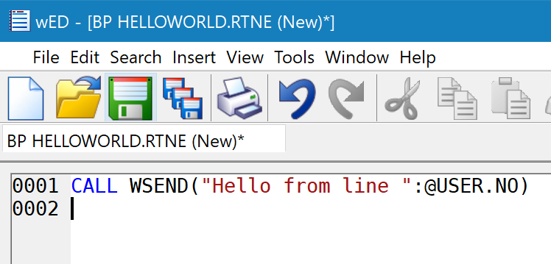
1.2 Open Second Session
Fire up second accuterm in same window (tab)
Log in as jbaseadm
Logto Z2018
Launch WED BP HELLOWORLD.RTNE

Slide 4
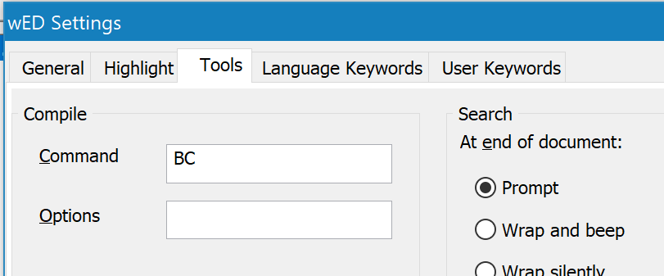
1050 - Compile
Use BC to compile
Compile program

Slide 5
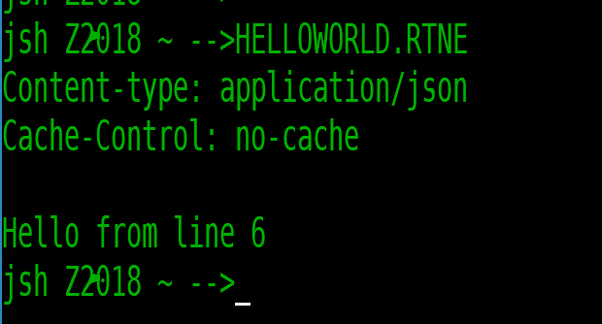
1060 – Run program
Use First accuterm session
HELLOWORLD.RTNE

Slide 6
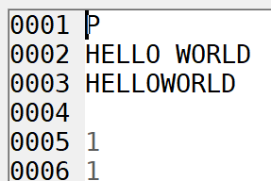
1070 – Add wdb resource
WED – OPEN WDB.RESOURCES API*HELLOWORLD
Make sure 7 also has a 1

Slide 7
1080 – Launch jagent
Start a third jbase session
LOGTO Z2018
Jbase_agent –config=.\jagent_config
Or ctrl-f2

Slide 8
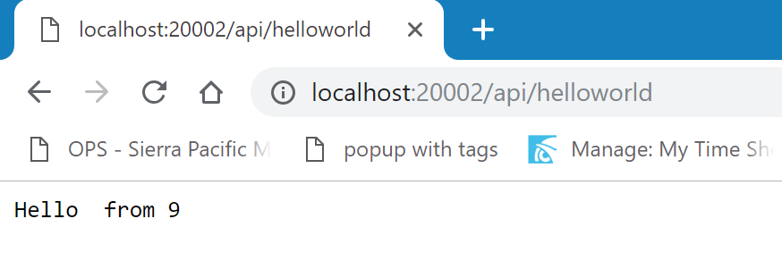
1090 – Launch in chrome
url: http://localhost:20002/api/helloworld

Slide 9
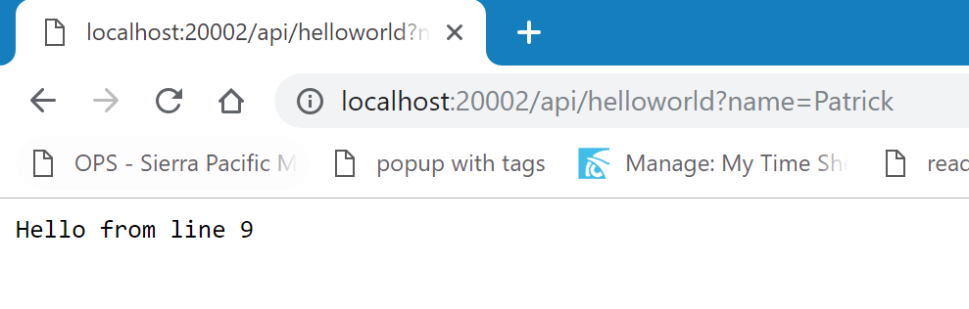
1100 – Add name to url bar
url: http://localhost:20002/api/helloworld?name=Patrick

Slide 10
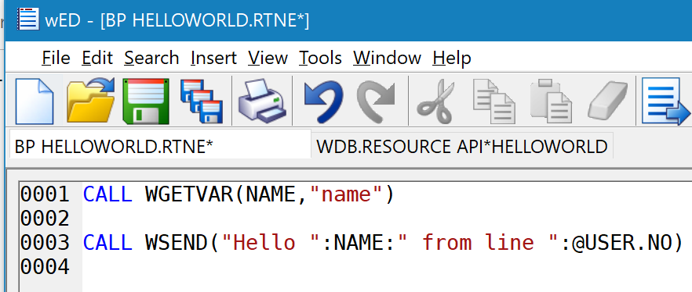
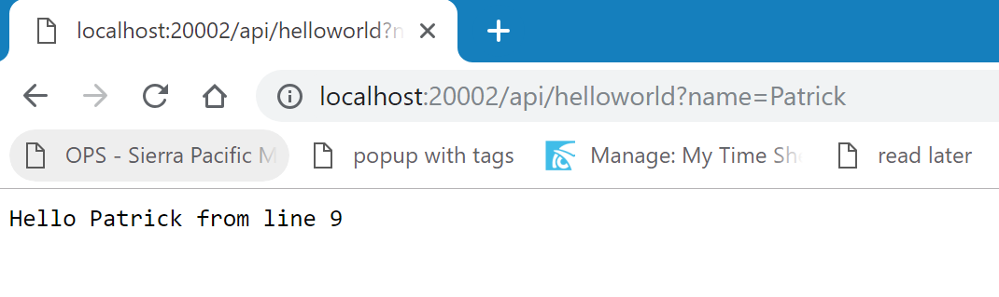
1110 – Add to helloworld
Add wgetvar to program
Compile program
Refresh browser

Slide 11
1120 – run in wdebug
Go back to accuterm session
Launch wdebug
Show how you can view a call

Slide 12
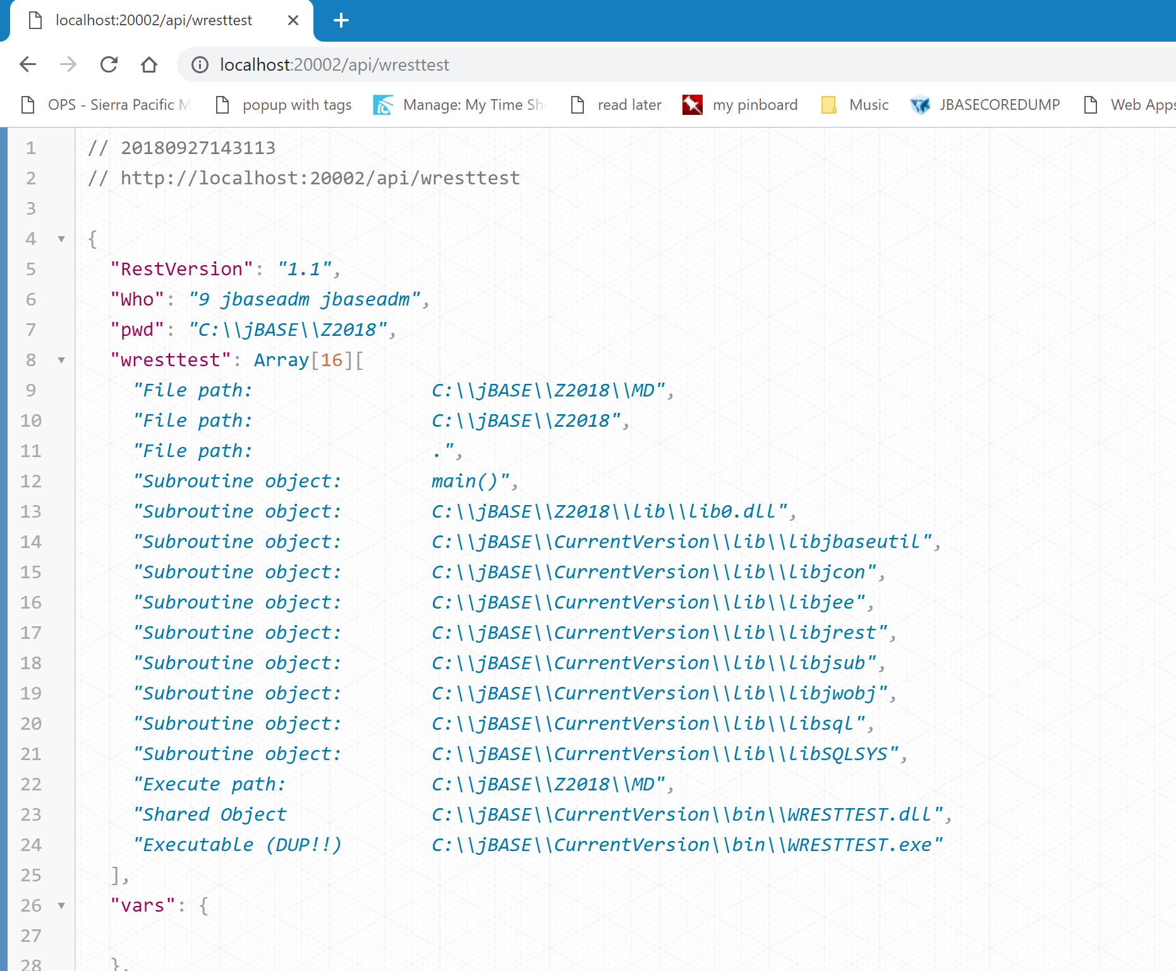
1130 – change to wresttest
Change in chrome
Discuss prettification

Slide 13
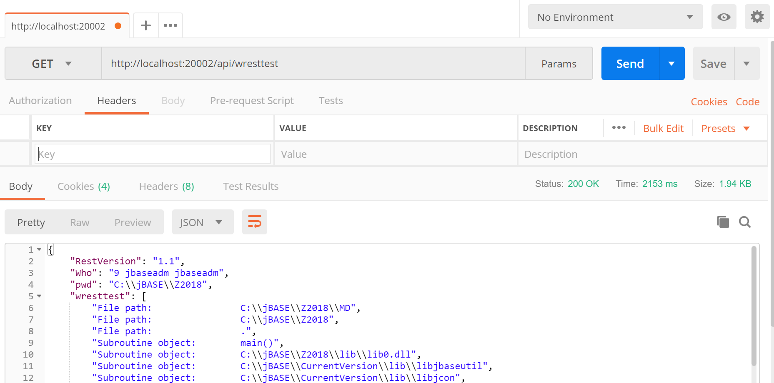
1140 - postman
Launch Postman
Talk about Postman
Call helloworld?name=patrick
Change to post, x-www-form-urlencoded
Add field name, use different name=Patrick Payne
Remove from URL bar
Run Program.

Slide 14
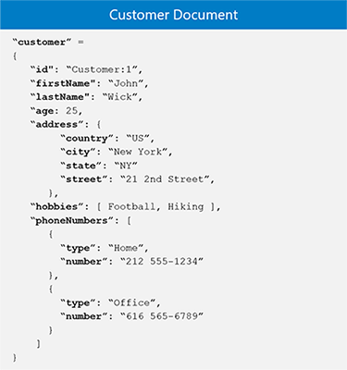
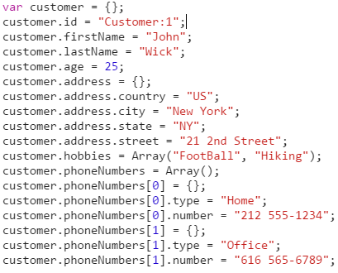
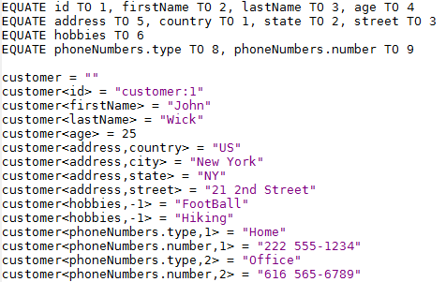
1150 Introduction to Objects – 5 minutes
Data Object
Object as JSON
Pick Object

Slide 15
1160 – Add WOBJ to helloworld.rtne 5 Minutes
Add CONTENT TYPE
ADD CREATION OF RESPONSEOBJ
MODIFY WSEND TO BUILD MSG VARIABLE
SET MESSAGE INTO RESPONSE OBJ
CONVERT RESPONSEOBJ TO JSON
WSEND JSON
Run from tcl – discuss cached code
Run from postmap

Slide 16
1170 – Show sending name as body entry
Adjust postman to send name in body
Add getbody
Make sure postman content type is json
Get name
Adjust code
Call from postman

Slide 17
1171 – Python example
Python Example
C:\jbase\z2018\samples\1171
Python helloworld.py
Need to run from normal c: prompt (environment issue)

Slide 18
1172 - .net example
I will demo this
Console app
Restsharp
C#

Slide 19
1173
Curl is in the bin directory
1173.bat
Discuss that this can be used to call other rest services

Slide 20
2000 – Open up app studio – 5 minutes
Load App Studio
Discuss frameworks
Single Page vs Multi-Page and Hybrid
What is App Sudio –
VB6 clone – transpiles basic to javascript – jquery based
Similar to other frameworks but uses a IDE

Slide 21
2010 – Build helloworld app – 10 minutes
Responsive
Drop two input boxes (do not change names)
Drop Button
Add code to call rest service
Launch in Browser
Open Debugger
Try sending something
Assistance on debugging

Slide 22
2010-part 2 - debugging
Assistance on errors
Redeploying – launches new tab – just close and refresh original (demo version)
After this is working show console output
Discuss and fix error Access-Control-Allow-Origin
Fix in code
Call again
CALL WSETHEADER("Access-Control-Allow-Origin","*")

