Slide 1
Recipe Scanner
Midterm Pitch to Technical + Business Leadership
Speaker A | 0:45
Decision ask: Greenlight continuation with focused execution on screenshot-noise risk reduction.
Board-Level Agenda
• Customer proof
• Business hypothesis
• Technical process
• Risk-adjusted plan
Repository: https://github.com/patrickpetty23/recipe-app
Recipe Scanner Midterm | https://github.com/patrickpetty23/recipe-app
1

Slide 2
Executive Narrative
Simple story: pain -> proof -> decision
Speaker A | 1:00
Pain
Proof
Decision
Users repeatedly retype ingredient lists, losing time and missing items.
Pilot data shows 41% faster list creation vs manual baseline.
Continue direction; prioritize screenshot-noise reduction.
Recipe Scanner Midterm | https://github.com/patrickpetty23/recipe-app
2

Slide 3
Customer Deep Analysis
Primary fit: roommate undergrads + ELS students
Speaker A | 1:05
Segment Prioritization Matrix
Segment
Fit
Reason
Roommate undergrad cooks
5/5
High frequency, screenshot-heavy, manual workflow pain
ELS/international student cooks
5/5
Mixed-language ingredient friction + translation effort
Recipe app power users
2/5
Already have structured recipe systems
Delivery-first users
1/5
Low grocery-list building frequency
Recipe Scanner Midterm | https://github.com/patrickpetty23/recipe-app
3

Slide 4
Voice of Customer
3 real roommate interviews
Speaker B | 1:15
U1 | Undergrad roommate
U2 | Undergrad roommate
U3 | ELS roommate from Peru
1m 56s
Time to list
Interview completed
2m 18s
Time to list
Interview completed
2m 04s
Time to list
Interview completed
"Faster than Notes, but I verify fractions."
"Great import flow. Social text noise is the pain."
"Checklist persistence matters most. Keep it simple."
Recipe Scanner Midterm | https://github.com/patrickpetty23/recipe-app
4

Slide 5
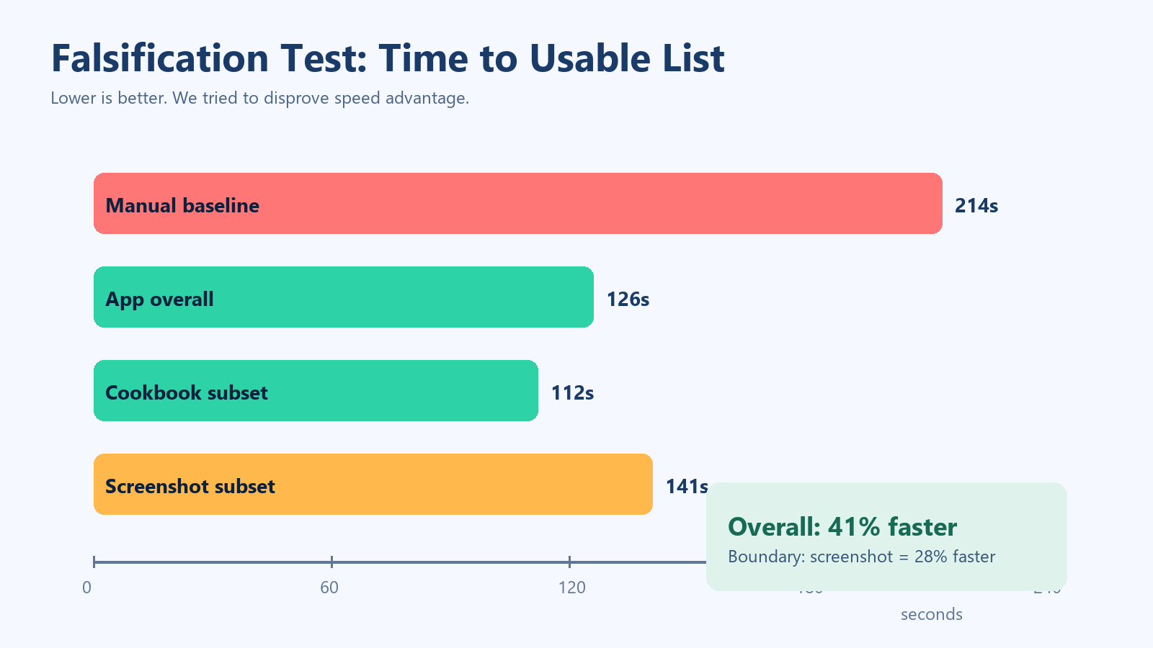
Hypothesis and Falsification
We actively tried to prove ourselves wrong
Speaker B | 1:20
Hypothesis
If list creation speed improves by >=30%, users adopt weekly even with imperfect OCR.
• Manual baseline: 3m 34s
• App overall: 2m 06s (41% faster)
• Screenshot subset: 28% faster (risk boundary)
Recipe Scanner Midterm | https://github.com/patrickpetty23/recipe-app
5

Slide 6
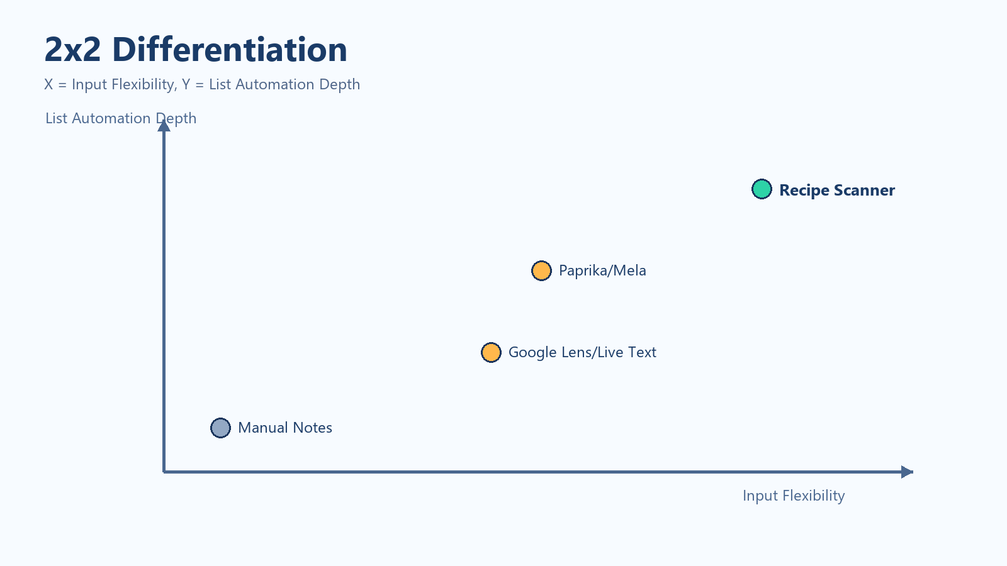
2x2 Differentiation
Positioning for business leaders
Speaker B | 1:00
Strategic Readout
• Gap: flexible input + structured list output in one flow
• Competitors split this value across separate tools
• Winning condition: keep speed and trust under noisy inputs
Recipe Scanner Midterm | https://github.com/patrickpetty23/recipe-app
6

Slide 7
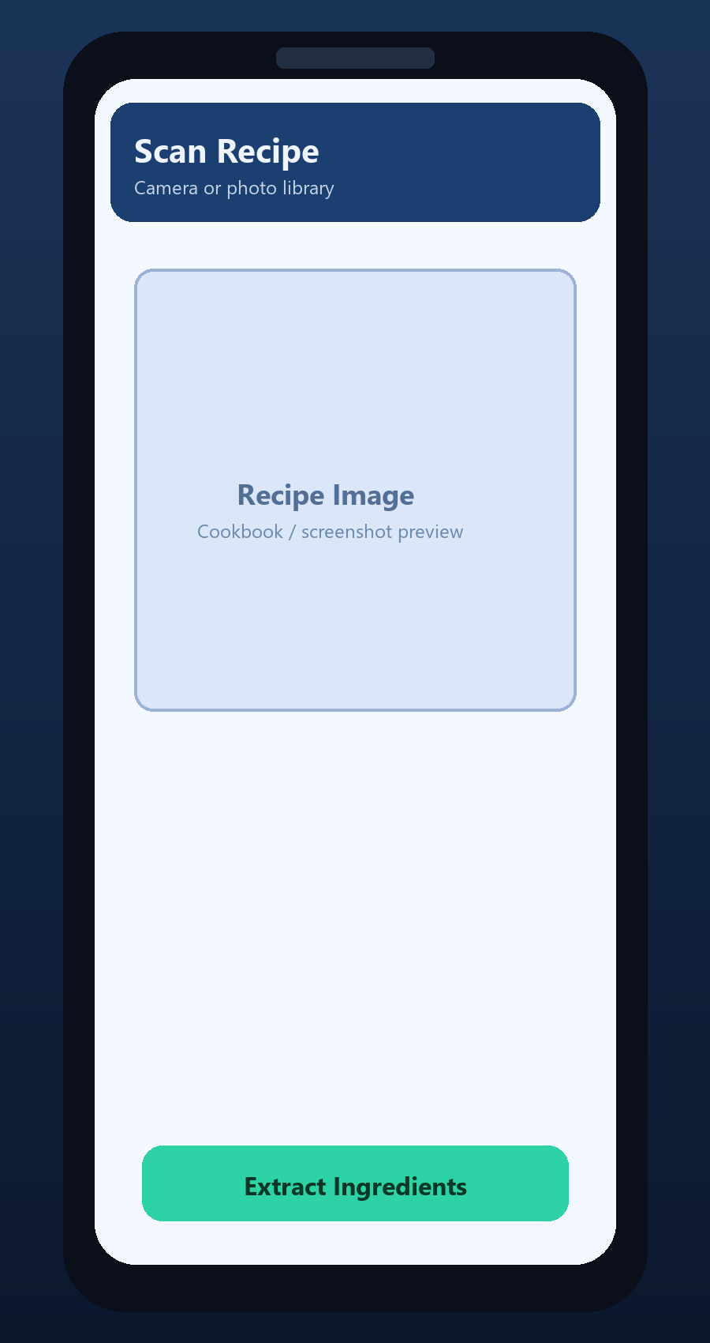
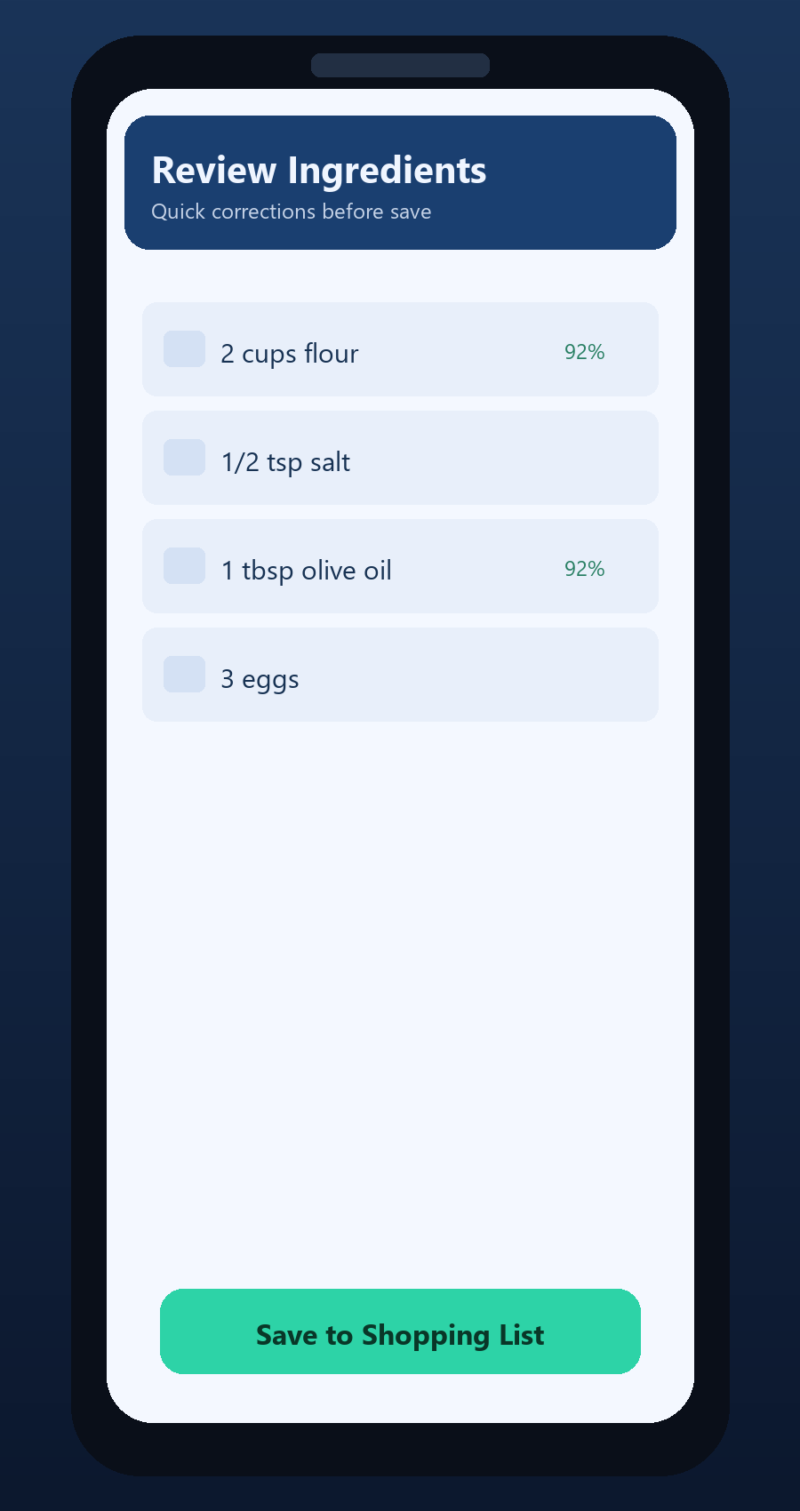
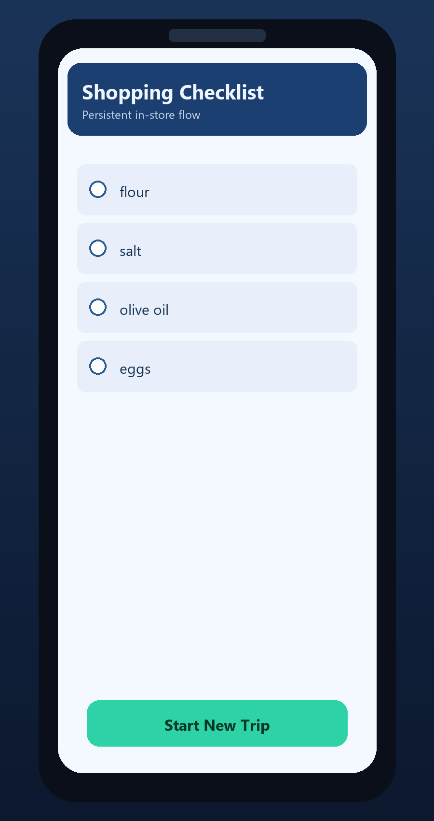
Product Demo Storyboard
Actual workflow shown as product sequence
Speaker C | 1:10
Scan -> Review -> Shop (the same sequence used in testing and customer sessions)
0.82
Median OCR confidence
91.3%
Field accuracy
26.9s
Median saved-list time
Recipe Scanner Midterm | https://github.com/patrickpetty23/recipe-app
7

Slide 8
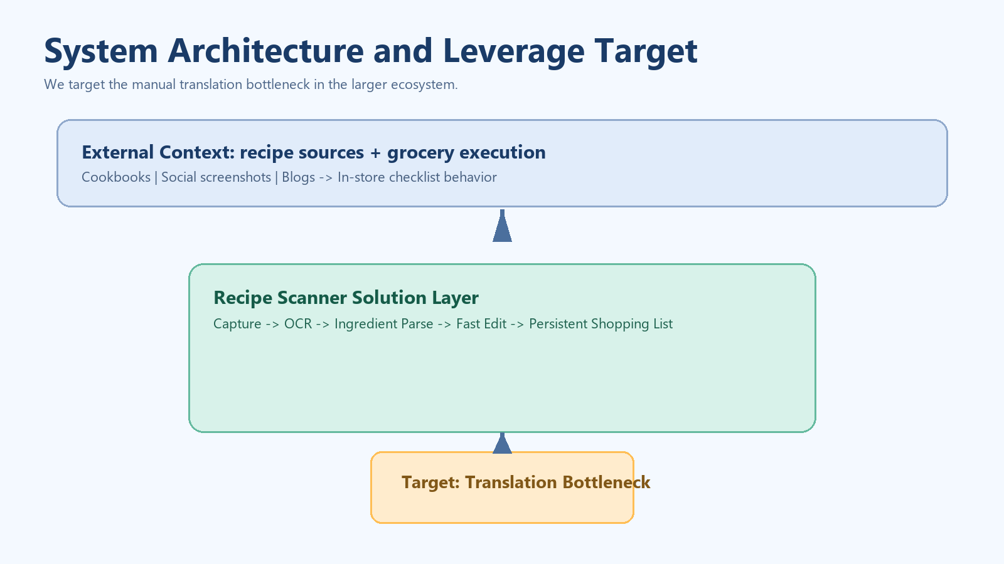
System Architecture and Leverage Points
Where we intervene in the larger system
Speaker B | 1:05
Leverage Points
• LP1 OCR quality
• LP2 Parser precision
• LP3 Edit speed
• LP4 Checklist persistence
• Target: translation bottleneck
Recipe Scanner Midterm | https://github.com/patrickpetty23/recipe-app
8

Slide 9
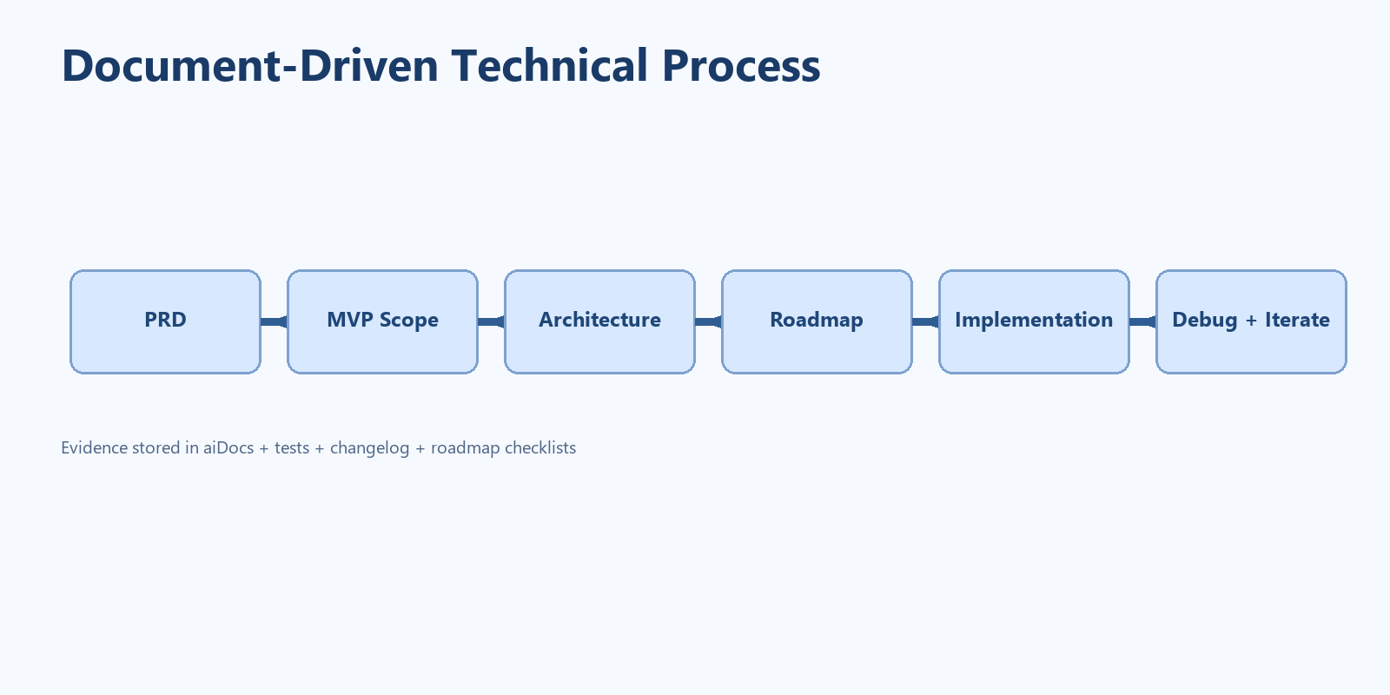
Technical Process Evidence
Built phase-by-phase, not one-shot
Speaker C | 1:00
Process Signals Casey Cares About
Artifacts
• Roadmap checklists completed by phase
• Docs updated as implementation evolved
• Core logic split for testability
• PRD, MVP, architecture, roadmap, changelog
• Rubric map + artifact index
• Evidence docs linked to decisions
Recipe Scanner Midterm | https://github.com/patrickpetty23/recipe-app
9

Slide 10
AI Infrastructure and Debugging Discipline
What technical leaders evaluate
Speaker C | 0:55
Infrastructure
Structured Logs
• AI docs structure (`aiDocs/`) and MCP checklist
• Secret-safe `.gitignore` and reproducible scripts
• Cross-platform constraints documented
• Shared `RecipeCore` for parser + fixtures
{"event":"ocr_low_confidence","confidence":"0.66"} {"event":"ocr_completed","ingredient_count":"17"}
Test-Log-Fix
• Reproduce -> inspect log -> patch -> rerun fixtures
• `scripts/run-cli-tests.ps1` + JSON fixtures
Recipe Scanner Midterm | https://github.com/patrickpetty23/recipe-app
10

Slide 11
Success/Failure Plan and Decision Gates
Business-governed execution
Speaker A | 0:55
Success Indicators
Failure Triggers + Pivots
• Median list creation remains <30s
• Field accuracy remains >=90%
• Weekly reuse intent >=50%
• Correction count trend decreases
• If speed edge disappears, narrow use case
• If trust remains low, shift to semi-manual assist
• If retention fails, pause expansion and re-scope
• Current top risk: social screenshot noise
Recipe Scanner Midterm | https://github.com/patrickpetty23/recipe-app
11

Slide 12
30-Day Plan Before Final
Focused execution, no scope creep
Speaker A | 0:50
Milestones
Week 1
Screenshot-noise parser hardening + fixture expansion
Week 2
Additional target-user sessions (student + ELS heavy)
Week 3
Measure correction trends and weekly reuse intent
Week 4
Demo polish + final decision checkpoint
Recipe Scanner Midterm | https://github.com/patrickpetty23/recipe-app
12

Slide 13
Final Ask to Leadership
Greenlight continuation with constrained scope
Speaker A | 0:40
We have evidence of customer value, a tested hypothesis, and disciplined technical process. We are asking for approval to continue on the current narrow strategy.
Requested Decision
• 1) Keep scope centered on translation bottleneck
• 2) Prioritize screenshot-noise reduction over feature expansion
• 3) Re-evaluate with retention and correction metrics at final milestone
Recipe Scanner Midterm | https://github.com/patrickpetty23/recipe-app
13

Slide 14
Appendix: Required Artifact Submission
Everything requested in rubric is in-repo
Backup
Artifact Checklist
• GitHub repository link: https://github.com/patrickpetty23/recipe-app
• Deep customer analysis
• Founding hypothesis
• 3 real customer conversation documents
• 1 falsification test report
• 1 2x2 differentiation grid
• System architecture with leverage points and target layer
• Technical process evidence, logging/debugging, and roadmap progression
Recipe Scanner Midterm | https://github.com/patrickpetty23/recipe-app
14

Slide 15
Reference Map
Where reviewers can verify every claim
Backup
Key Files
• presentation/MIDTERM_ARTIFACTS.md
• aiDocs/customer-deep-analysis.md
• aiDocs/founding-hypothesis.md
• aiDocs/falsification-test.md
• aiDocs/differentiation-2x2.md
• aiDocs/system-architecture-leverage.md
• aiDocs/evidence/customer-conversation-u1.md / u2.md / u3.md
• aiDocs/debugging.md and scripts/run-cli-tests.ps1
Recipe Scanner Midterm | https://github.com/patrickpetty23/recipe-app
15

