Slide 1
SESSION 6
Stakeholder Mapping
Design Thinking for MBAs
Monday, February 9, 2026 | Instructor: Patrick Ray

Slide 2
Who Is Affected by This Problem?
With your team, identify 3-4 stakeholders affected by your problem scenario.
Include at least one extreme user: someone who experiences this problem 10x more intensely than average, or who has found creative workarounds.
For each stakeholder, document:
1. Who are they? (Be specific: "frontline nurses," not "healthcare workers")
2. What do they optimize for?
3. What constraints do they face?
~20 minutes

Slide 3
Stakeholder Mapping
Element | Prompt
Who | Specific role or identity (not generic)
Optimizes for | What are they trying to maximize?
Constraints | What limits their options?
Top concerns | What do they care about most? (2-3)
Tensions | Where might their interests conflict with others?
Helpful Hint: If everyone on your list wants the same thing, that’s a clue you might need to reapproach.

Slide 4
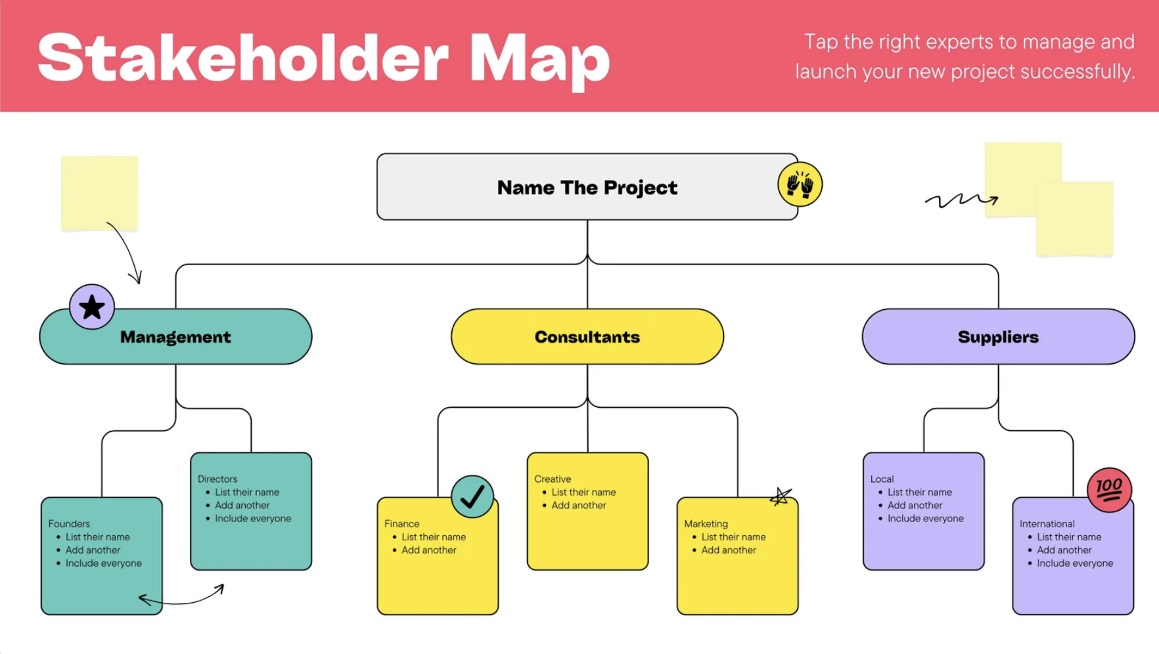
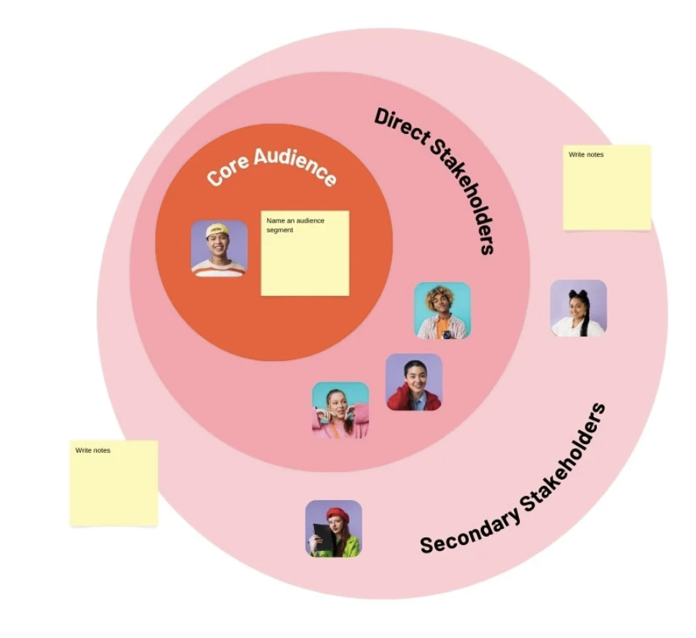
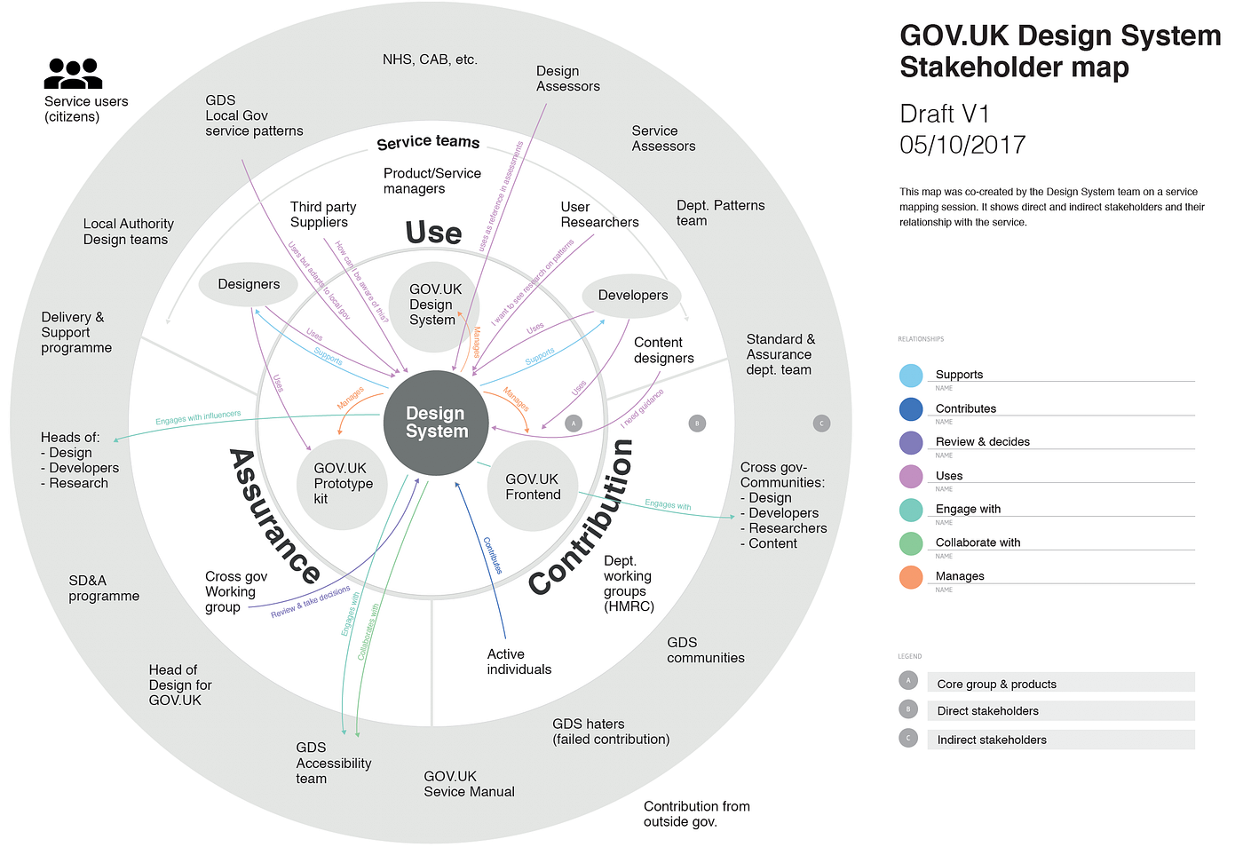
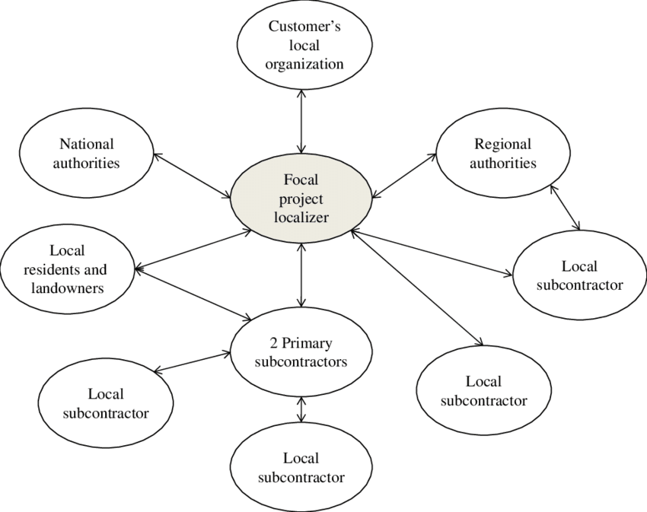
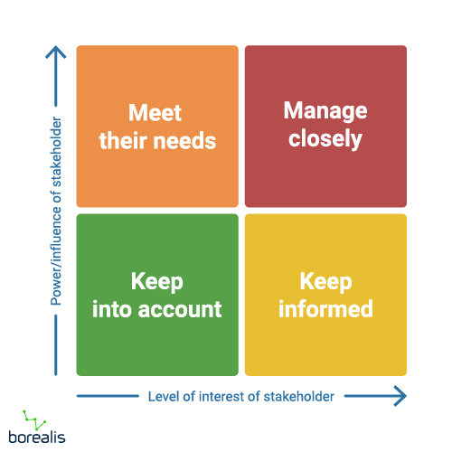
Visual Examples:

Slide 5
Go Deeper
Choose your 2-3 most critical stakeholders and explore:
1. What are their top 2-3 concerns?
2. What do they care about most?
3. What would they sacrifice to get what they want?
4. Where do their concerns intersect with other stakeholders?
5. What are some cause/effect relationships between stakeholders?
Look for tensions. If solving for one stakeholder creates a problem for another, you're on to something.
~ 20 minutes

Slide 6
What Did You Find?
Name one stakeholder your team almost forgot. Why were they easy to overlook?
Where do stakeholder concerns conflict?
Which stakeholders are hardest to access?

Slide 7


From Observation to Conversation
In Project 1, you practiced pure observation. Shadowing, TETHER. Your job was to watch, not ask.
In Project 2, you add a new tool: the empathy interview.
Observation
Interviews
Shows you what people do
Help you understand why: motivations, constraints, frustrations
Helpful hint: These two skills complement each other, so don’t be afraid to use both!

Slide 8

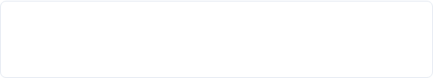
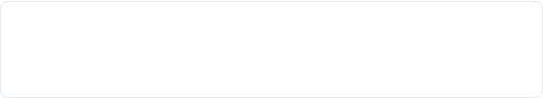
Design Tapas Menu
1. Trader Joe's (10 min)
2. 30 Circles (10 min)
Practice spotting needs from observation
Rapid ideation and reframing
3. John Venn (5 min)
4. Story of Your Name (5 min)
Where design thinking begins
Community building through storytelling
5. Why? Interview (10 min)
6. 3 Things (5 min)
Practicing deep listening
High-energy icebreaker
7. 2 Truths 1 Lie (5 minutes)
7. TaDa! (10 minutes)
Just For Fun!
Learn From Others, Experiment Rapidly

Slide 9
Activity: The "Why?" Interview
Round 1 (2 min each)
Interview about a topic (e.g., morning routine) using ONLY body language and nodding. No words. Interviewer can ask only the initial question.
Round 2 (2 min each)
Same topic. Now you can ask "Why?"

Slide 10
Reflection: The "Why?" Interview
How did that feel? What was challenging?

Slide 11
Empathy Interview Principles
1
Listen more than you talk.
Your job is to understand their world, not explain yours.
2
Follow curiosity.
When something surprises you, go deeper: "Tell me more about that."
3
Ask for stories, not opinions.
"Tell me about a time when..." beats "What do you think about..."
4
Embrace silence.
After they answer, wait. They'll often fill the silence with something more interesting.
5
No leading questions.
"How do you experience X?" not "What's frustrating about X?"

Slide 12
What's Next
Wednesday (Session 7): Problem Framing + Reframing
Research expectation: Each team member conducts 1-2 research activities (observations, interviews, or both) before Session 8 (Feb 16)
Canvas: Project 2 Research Guide will be posted with more interview guidance
"When you present your problem definition, we'll ask: 'What did you learn from talking to people?'"
Reminder: Find the Duct Tape.
Each week, identify and document one workaround or improvised fix in your notebook.
See you Wednesday!

