Slide 1
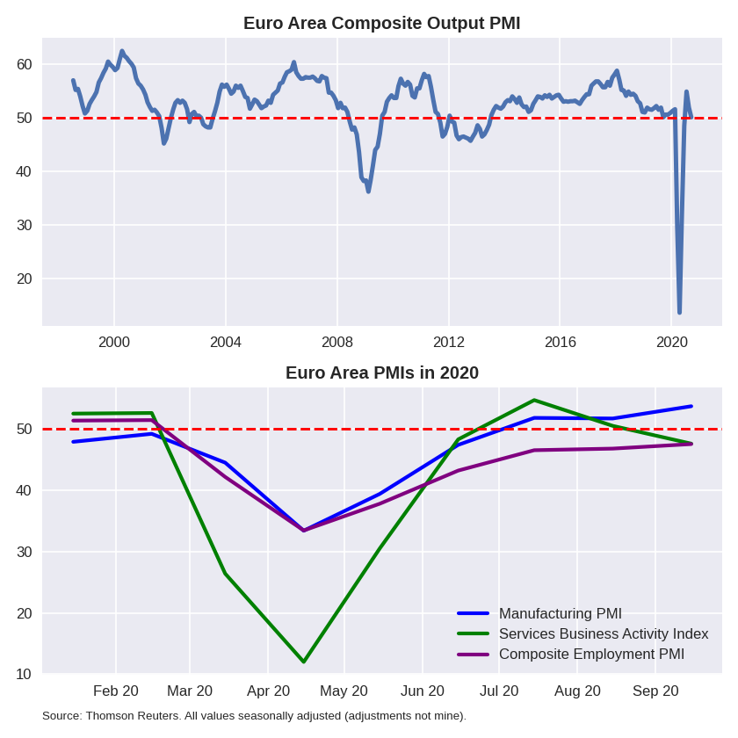
9 |  | August | Flash September
1 | EU Composite Output PMI | 51.9 | 50.1
2 | EU Manufacturing PMI | 51.7 | 53.7
3 | EU Services Business Activity Index | 50.5 | 47.6
4 | EU Manufacturing – New Orders | 55.41 | 57.08
5 | EU Services – New Business | 49.84 | 47.75
6 | EU Composite Employment PMI | 46.79 | 47.53
7 | Germany Composite Output PMI | 54.4 | 53.7
8 | France Composite Output PMI | 51.6 | 48.5

