Slide 1
Bootcamp
Machine Learning

Slide 2
Review

Slide 3
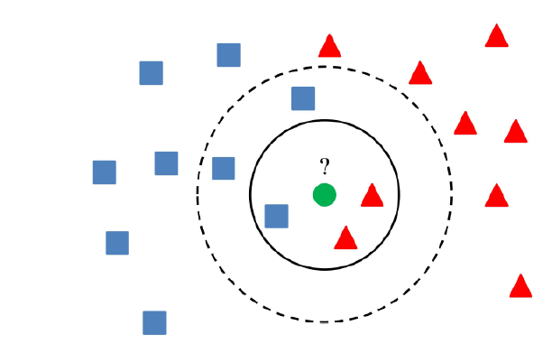

Slide 4
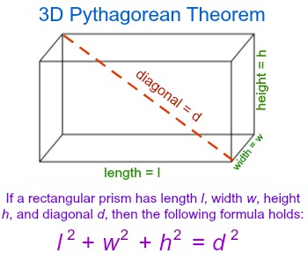

Slide 5
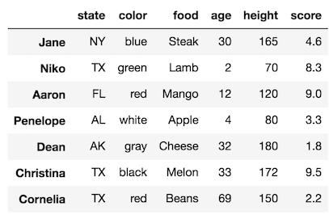
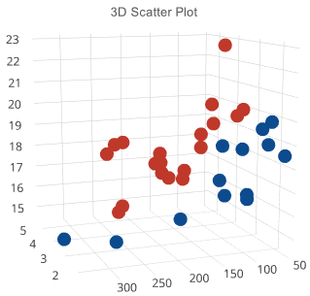

Slide 6
?

Slide 7

Setting the Table
Feature Matrix, Target Vector
Training Set, Test Set

Slide 8
Setting the Table
Feature Matrix, Target Vector
Training Set, Test Set

Slide 9
Feature Matrix, Target Vector
X = df.drop(columns=['price'])
y = df['price']

Slide 10
Training Set, Test Set
X_train, X_test, y_train, y_test = = train_test_split(X, y)

Slide 11
Training Set, Test Set
X_train, X_test, y_train, y_test = = train_test_split(X, y)

Slide 12
Fitting Model
model = KNeighborsClassifier()
model.fit(X_train, y_train)

Slide 13
Evaluating
Classifiers

Slide 14
Cannot use Regression metrics
Outputs are classes, not numbers
“Amount of error” is a bad fit

Slide 15
Accuracy
% of samples correctly classified
Does not tell you WHERE error is

Slide 16
Confusion Matrix
Grid comparing predicted VS actual
Shows where your errors lie
Correction classification on diagonal

Slide 17
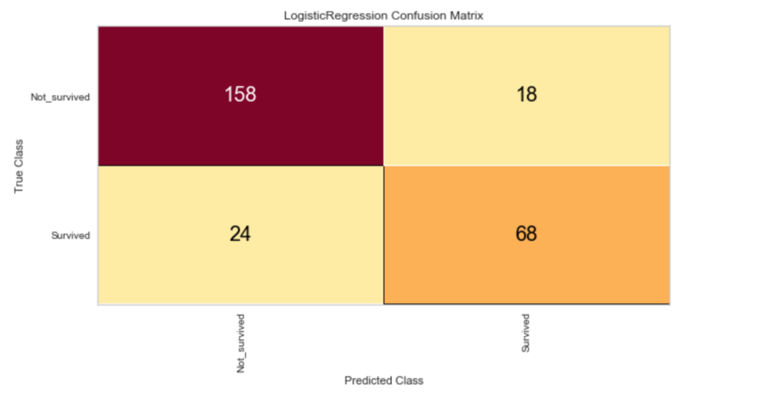

Slide 18
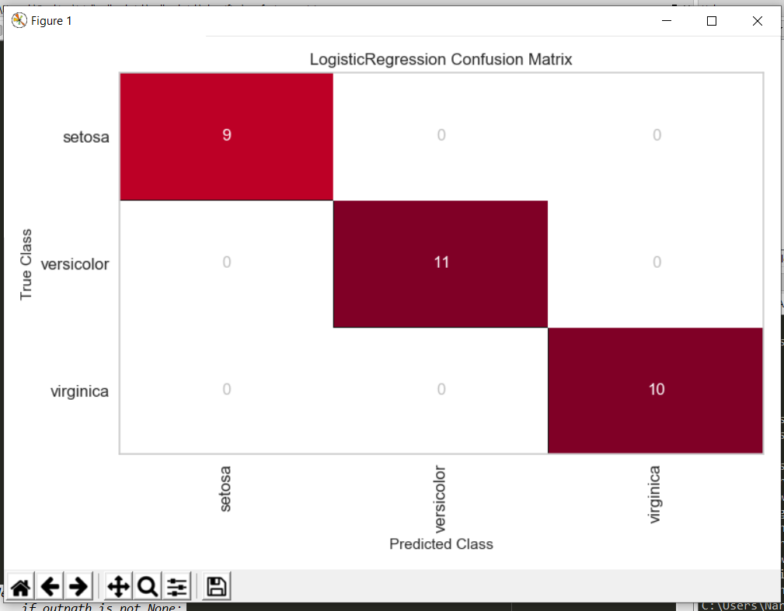
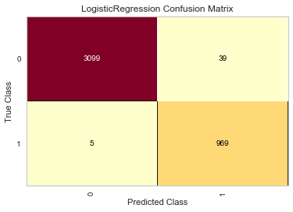
Confusion Matrix

Slide 19
Sensitivity
Success rate on samples that SHOULD be positive
True Positive / False Negative + True Positive

Slide 20
Class prediction Error
Derived from the confusion matrix
Sometimes easier to interpret

Slide 21
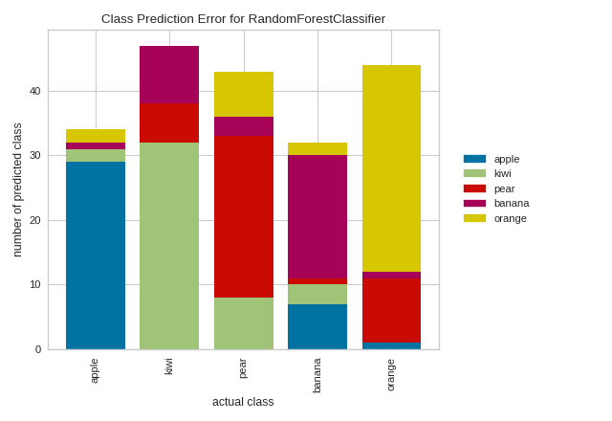

Slide 22
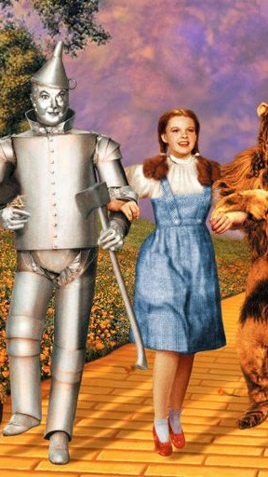
Yellowbrick
Introducing

Slide 23
Yellowbrick
Diagnostic visualizations! Automatic!
Built to integrate with scikit-learn

Slide 24
Example
cm = ConfusionMatrix(model)
cm.fit(X_train, y_train)
cm.score(X_test, y_test)
cm.finalize()

Slide 25
Exercises

Slide 26
Handling
Missing Data

Slide 27
Finding Nulls
df[“age”].isnull()

Slide 28
Finding Nulls
df.isnull().sum()

Slide 29
Finding Nulls
df.isnull().mean()

Slide 30
Three types of situations
A few nulls (<5%)
Significant # of nulls
Mostly nulls

Slide 31
A Few Nulls
No significant impact
Drop them

Slide 32
Significant Nulls
Try to repair
Fill with average value

Slide 33
mostly nulls
To start, leave them out
Likely not very helpful

Slide 34
Exercises

Slide 35
Feature Engineering

Slide 36
The Problem
Distance relies on subtraction
We can’t subtract categorical data :(

Slide 37
Simple Encoding Doesn’t work
What if we re-label each category as 0,1, 2, .. etc?
Model thinks we’re adding more and more of same thing!

Slide 38
One-hot encoding
Creates a 1-or-0 column for each unique value in categorical
Per row, only one of the new columns will have a 1, hence 1-hot

Slide 39
How the math works:
y = … + 3xn + ..

Slide 40
How the math works:
y = … + 3(1) + ..

Slide 41
How the math works:
y = … + 3(0) + ..

Slide 42
How the math works:
y = … + 3(0) + ..
Adds a fixed amount, or doesn’t!

Slide 43
One-hot encoding
Creates a 1-or-0 column for each unique value in categorical
Per row, only one of the new columns will be positive, hence “one-hot”

Slide 44
What does the one-hot encoded version look like?

Slide 45
NY | TX | AL | AK
1 | 0 | 0 | 0
0 | 1 | 0 | 0
0 | 0 | 0 | 1
0 | 0 | 1 | 0

Slide 46
How the math works:
y = … + 3(1) + ..
Each state has a coefficient

Slide 47
sklearn Pipelines
Transform data en route to your model
Can chain multiple transformations together

Slide 48
sklearn Pipelines
Transform data on way to model
We can’t subtract categorical data :(

Slide 49
Pipelines
encode = OneHotEncoder()
make_pipeline(encode, model)

Slide 50
Columns based on unique values
encode.fit(X)

Slide 51
Columns based on unique values
encode.fit(X)
Finds All the categories

Slide 52
Map rows into new encoding
encode.transform(X)

Slide 53
Map rows into new encoding
encode.transform(X)
Creates column
for each category

Slide 54
Exercises

