Slide 1
Bootcamp
Machine Learning

Slide 2
Bayes Theorem

Slide 3
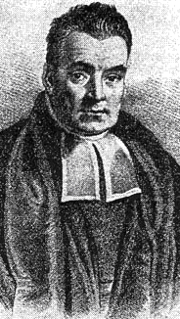
Thomas Bayes
Presbyterian Minister in 1700s England
Bayes’ Theorem found in his notes after death
Not much else known!

Slide 4

Bayes’ Theorem
How to evaluate evidence using probability theory

Slide 5
Probability
P(A) = % of cases where A is true
What “cases” refers to is different in each situation

Slide 6
Conditional Probability
P(A|D) = % of cases where A is true, assuming D is true

Slide 7
Question
I learn: 40% of coffee spills on planes happen during bad weather
If there’s bad weather, should I not get on the plane?

Slide 8
Question
P(θ) = spilled coffee = 0.01
P(D) = bad weather = 0.3
P(D|θ) = 0.4

Slide 9
Bayes’ Theorem
How to find P(θ|D) given P(D|θ)

Slide 10

P(θ)

Slide 11
P(D)
P(θ)
P(θ&D)

Slide 12
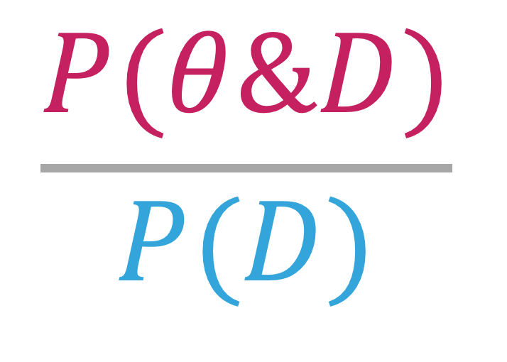
What fraction of D is also θ?
P(θ|D)
=
$$\frac{P(θ\&D)}{P(D)}$$
Note this fraction is relative to P(D)
Notes:
P(θ|D) is the posterior

Slide 13
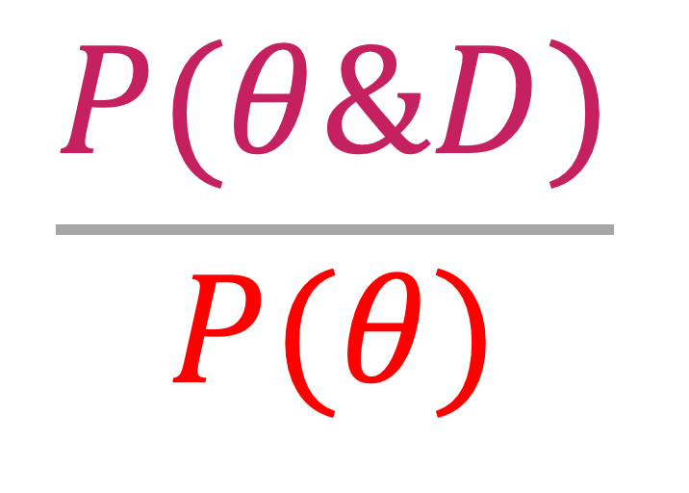
What fraction of θ is also D?
P(D|θ)
=
$$\frac{P(θ\&D)}{P(θ)}$$
Note this fraction is relative to P(θ)
Notes:
P(D|θ) is the liklihood

Slide 14
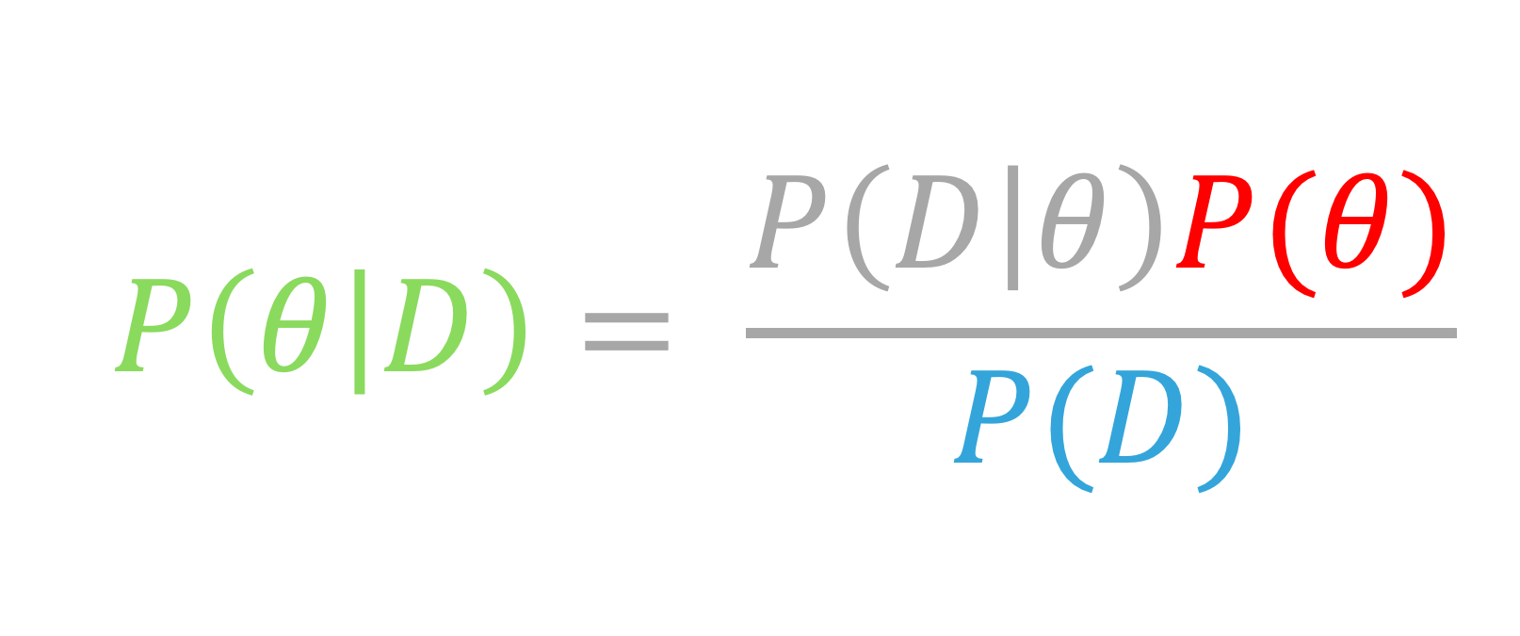
P(θ & D) = P(D|θ)P(θ)
$$P\left(θ | D\right)= \frac{P\left(D | θ\right)P(θ)}{P(D)}$$
P(θ & D) = P(θ|D)P(D)

Slide 15
Exercises

Slide 16
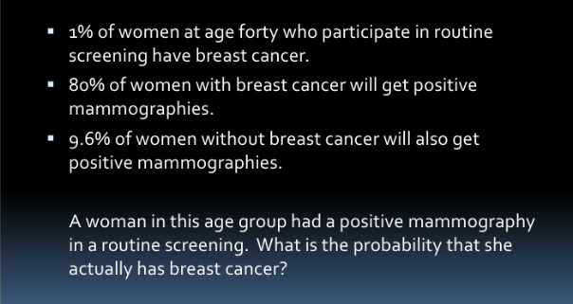

Slide 17
P(BC|+test) = P(+test|BC)P(BC) / P(+test)

Slide 18
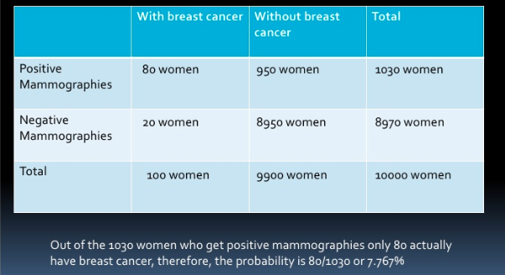

Slide 19
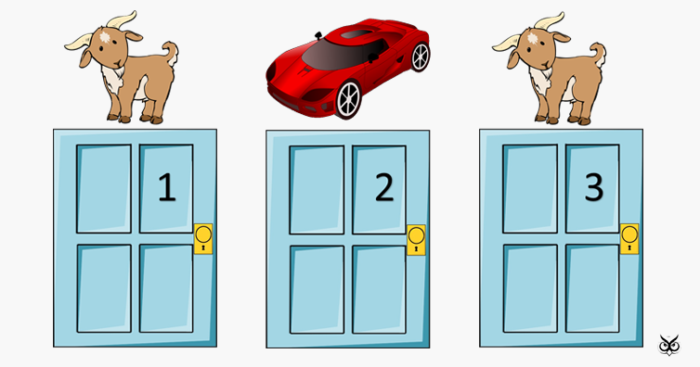

Slide 20
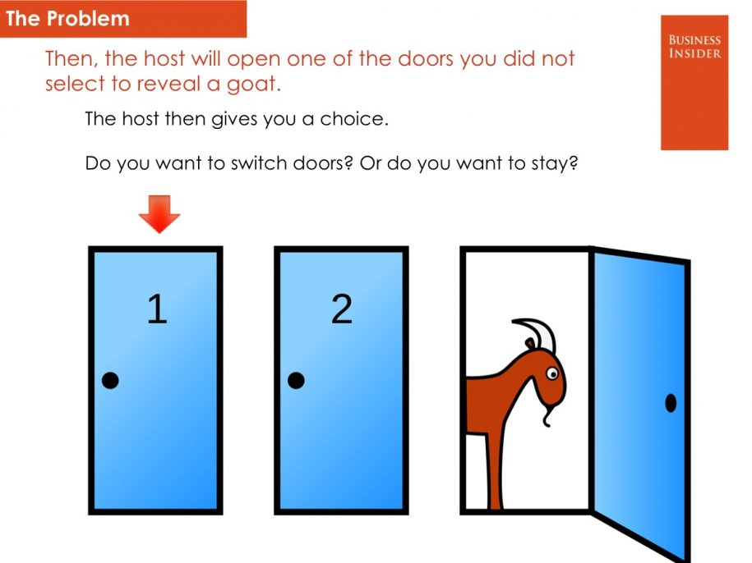

Slide 21
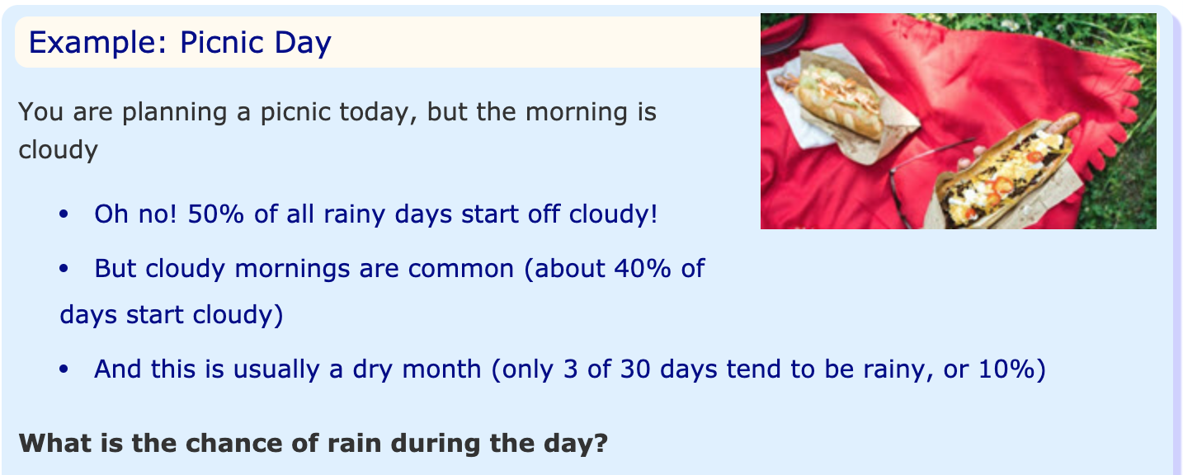

Slide 22
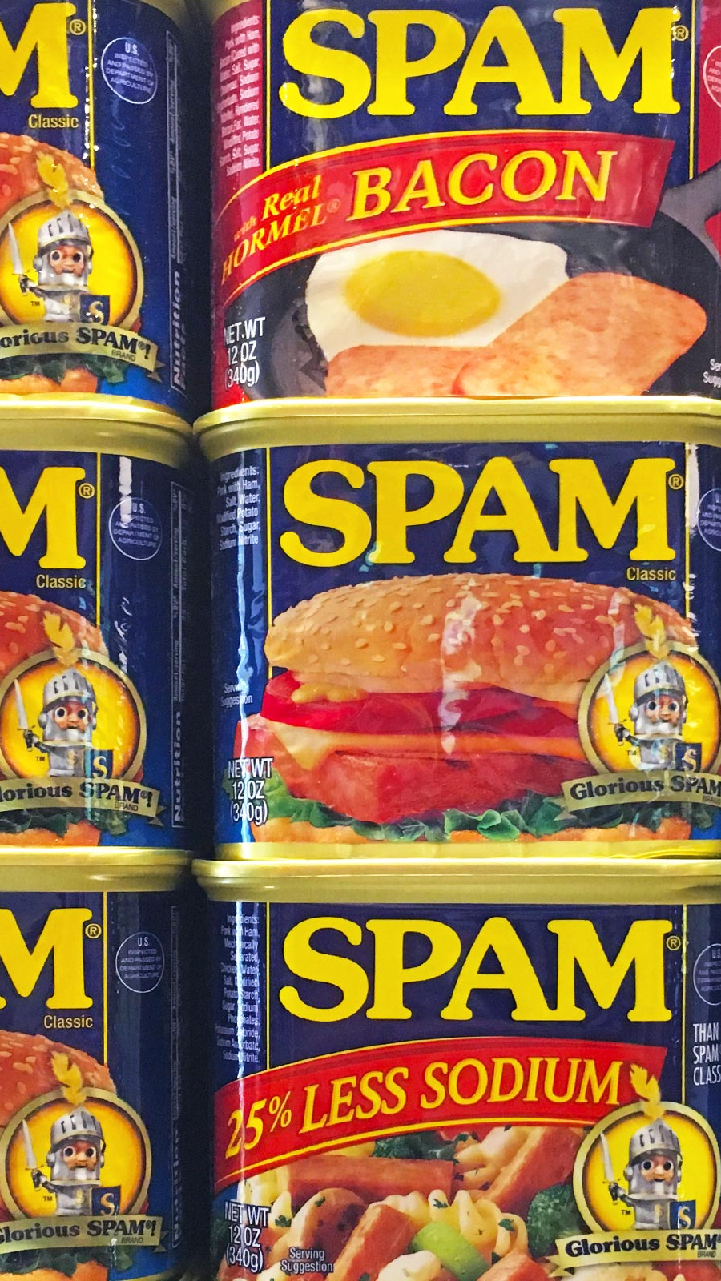
Detecting Spam

Slide 23
“Naive” Bayes Assumption
Assume features are independent
Can multiply probabilities of all features together

Slide 24
P(heads|fair ) • P(heads|fair)…

Slide 25
1/2 • 1/2 • 1/2 • 1/2 = 0.0625

Slide 26
P(heads | unfair) • P(heads | unfair)…

Slide 27
0.9 • 0.9 • 0.9 • 0.9 = 0.6561

Slide 28
Catching an unfair coin
Ten times more likely it’s unfair!
Confidence grows with more flips

Slide 29
Catching spam
Is email more likely generated by HAM or SPAM?
Frequency of words assuming HAM vs SPAM
approach known as “bag of words”

Slide 30
Vectorizing
Each vocab word is a feature
An e-mail is represented as a tally of words

Slide 31
P(SPAM)
P(“pills”)

Slide 32

Bayes’ Theorem
$$P\left(SPAM \right|"pills") = \frac{P(SPAM \& \text{"}\text{pills}\text{"})}{P(\text{"}\text{pills}")}$$

Slide 33
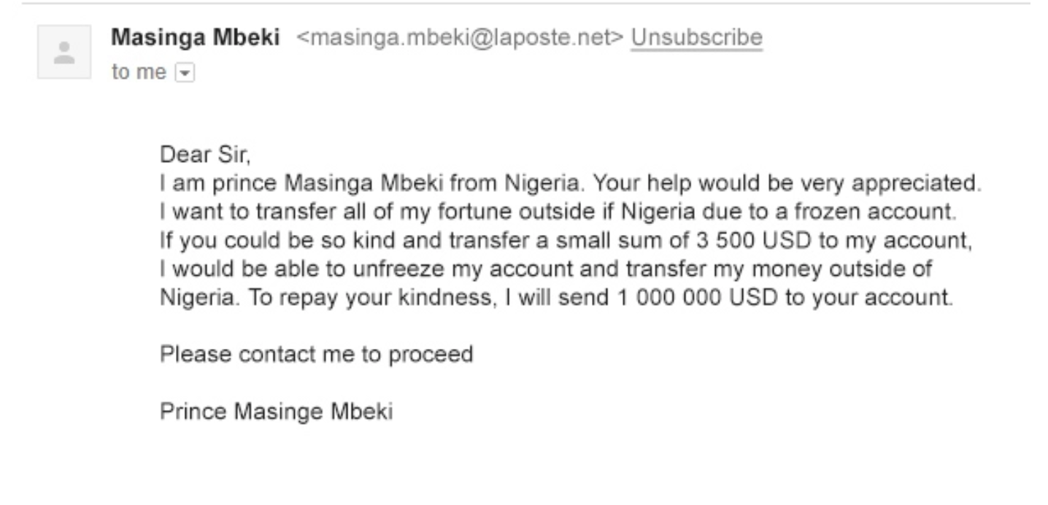

Slide 34
P(“prince” | SPAM) • P(“Nigeria” | SPAM) • …

Slide 35
Exercises

Slide 36

Creating a Bot

Slide 37
Generating tweets
Our classifiers work “in reverse” as well!
Choose words with historic frequency

Slide 38
Random.choice()
Choose randomly from any collection
Parameter “weights” controls frequency
Parameter “k” controls how many

Slide 39
Tweepy
Library that wraps around the Twitter API
Your account needs approval to use the Twitter API

Slide 40
Exercises

