Slide 1
Bootcamp
Machine Learning

Slide 2
Bayes Theorem

Slide 3
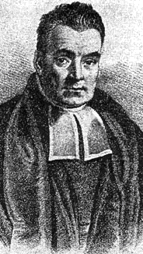
Thomas Bayes
Presbyterian Minister in 1700s England
Bayes’ Theorem found in his notes after death
Not much else known!

Slide 4

Bayes’ Theorem
How to evaluate evidence using probability theory

Slide 5
Probability
P(A) = % of cases where A is true
What “cases” refers to is different in each situation

Slide 6
Conditional Probability
P(A|B) = % of cases where A is true, assuming B is true

Slide 7
Question
I learn: 40% of plane crashes happen during bad weather
If there’s bad weather, should I not get on the plane?

Slide 8
Question
P(A) = airplane crash = 0.1
P(B) = bad weather = 0.2
P(B|A) = 0.4

Slide 9
Bayes’ Theorem
How to find P(A|B) given P(B|A)

Slide 10
P(A)

Slide 11
P(B)
P(A)

Slide 12
P(A&B)

Slide 13
P(A|B)

Slide 14
What fraction of B is also A?
P(A|B)

Slide 15
What fraction of B is also A?
P(A|B)
(Note: Relative to size of B!)

Slide 16
P(B|A)
What fraction of A is also B?

Slide 17
P(A & B)

Slide 18
P(A & B) = P(B|A)P(A)

Slide 19
P(A|B) = P(B|A)P(A) / P(B)
P(A)
P(B)

Slide 20
P(A|B) = P(B|A)P(A) / P(B)

Slide 21
P(A|B) = P(B|A)P(A) / P(B)

Slide 22
Bayes’ Theorem
P(A|B) = P(A&B) / P(B)

Slide 23
Bayes’ Theorem
P(A|B) = P(B|A)P(A) / P(B)

Slide 24
P(A&B)
P(B)

Slide 25
Exercises

Slide 26
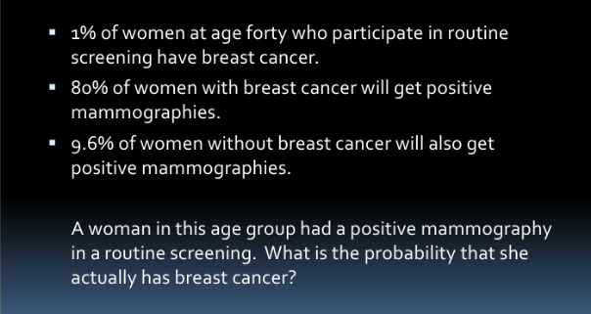

Slide 27
P(BC|+test) = P(+test|BC)P(BC) / P(+test)

Slide 28
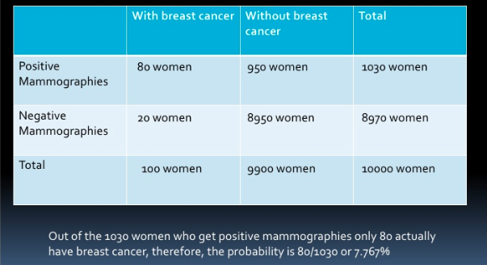

Slide 29
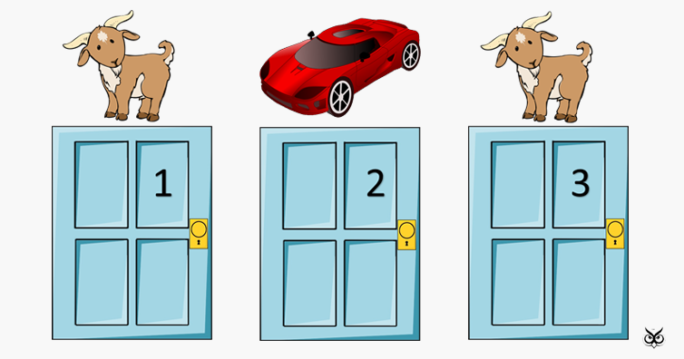

Slide 30
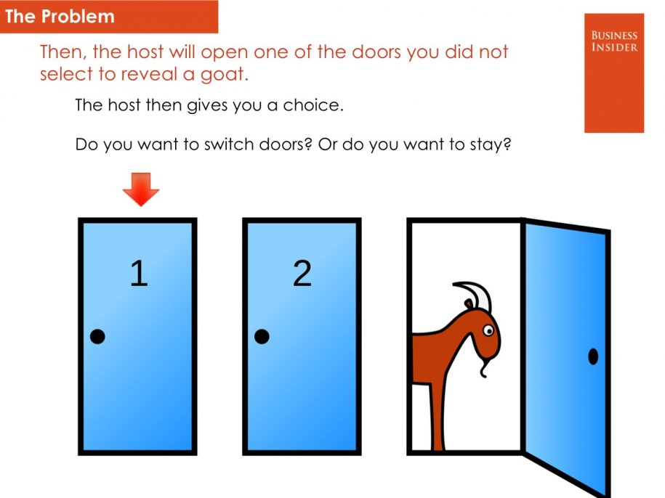

Slide 31
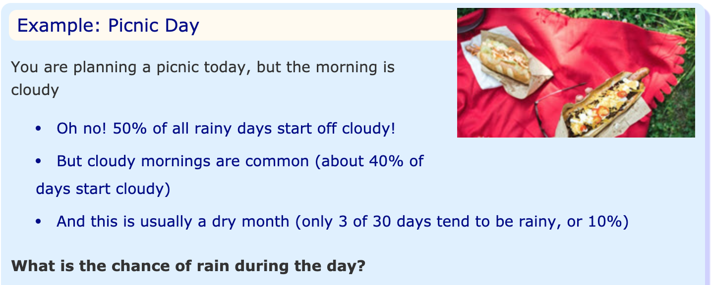

Slide 32
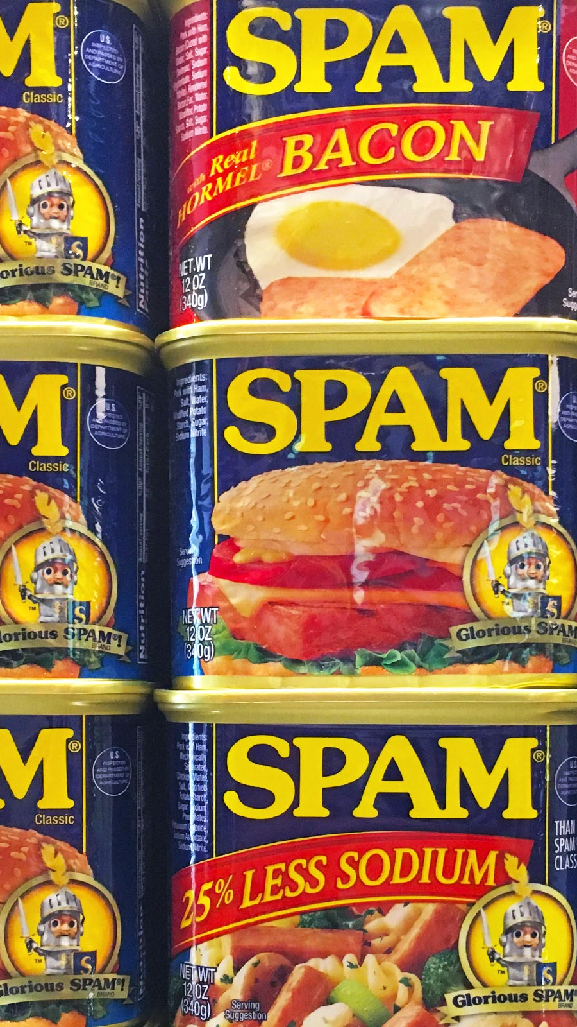
Detecting Spam

Slide 33
Catching an unfair coin
One fair coin (50% heads, 50% tails)
One unfair coin (90% heads, 10% tails)

Slide 34
P(unfair)
P(heads)

Slide 35
P(unfair|heads)
= P(heads|unfair)P(unfair) / P(heads)

Slide 36
P(unfair|heads)
= P(heads|unfair)P(unfair) / P(heads)

Slide 37
P(unfair|heads)
= P(heads|unfair)P(unfair) / P(heads)

Slide 38
“Naive” Assumption
Assume features are independent
Can multiply probabilities of all features together

Slide 39
P(fair|heads) • P(fair|heads)…

Slide 40
1/2 • 1/2 • 1/2 • 1/2 = 0.0625

Slide 41
P(unfair|heads) • P(unfair|heads)…

Slide 42
0.9 • 0.9 • 0.9 • 0.9 = 0.6561

Slide 43
Catching an unfair coin
Ten times more likely it’s unfair!
Confidence grows with more flips

Slide 44
Catching spam
Is email more likely generated by HAM or SPAM?
Frequency of words assuming HAM vs SPAM
approach known as “bag of words”

Slide 45
Vectorizing
Each vocab word is a feature
An e-mail is represented as a tally of words

Slide 46
P(SPAM)
P(“pills”)

Slide 47
Bayes’ Theorem
P(SPAM|”pills”) = P(SPAM&”pills”)/P(“pills”)

Slide 48
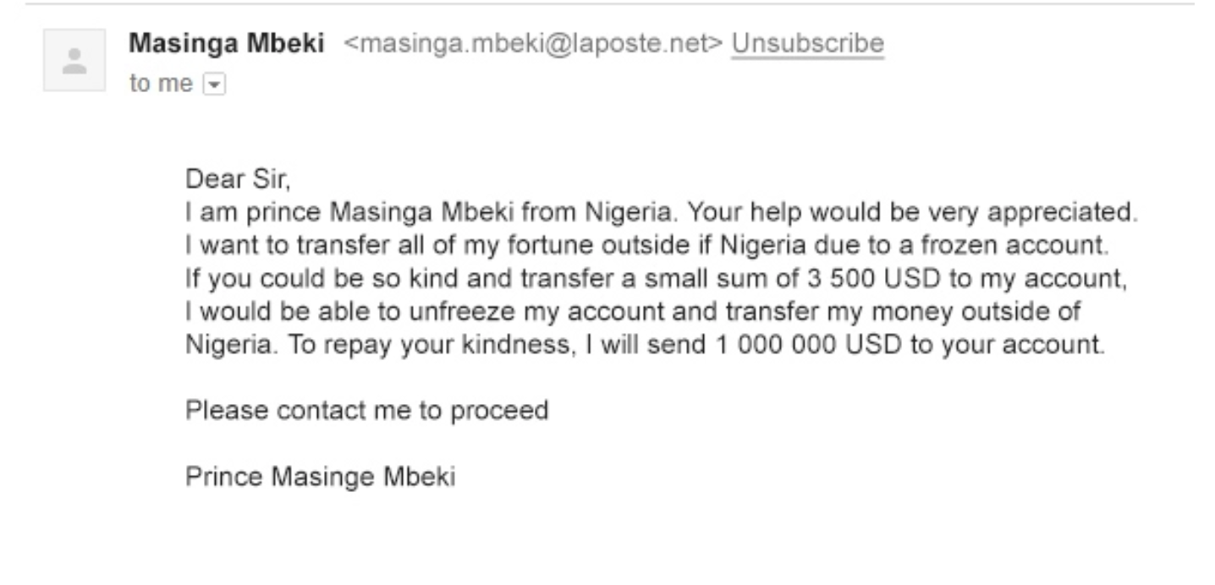

Slide 49
P(SPAM|”prince”) • P(SPAM|”nigeria”) • …

Slide 50
Exercises

Slide 51

Creating a Bot

Slide 52
Generating tweets
Our classifiers work “in reverse” as well!
Choose words with historic frequency

Slide 53
Random.choice()
Choose randomly from any collection
Parameter “weights” controls frequency
Parameter “k” controls how many

Slide 54
Tweepy
Library that wraps around the Twitter API
Your account needs approval to use the Twitter API

Slide 55
Exercises

