Slide 1
Machine Learning
Bootcamp

Slide 2
Logistic Regression

Slide 3

Logistic Regression
Modify output of linear model to be a probability
Used for classification, despite name

Slide 4
Problems with Probability
Positive values only
Must fit between 0 and 1

Slide 5
Solution: Output something easier
Output something more line-friendly
Translate back to probability later

Slide 6
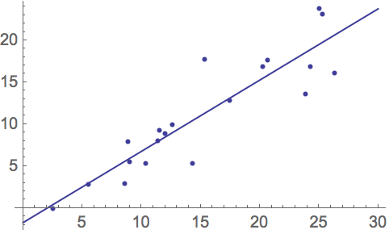

Slide 7
Fix #1: Odds
Ratio of two probabilities
e.g. P(Win) = 0.8, P(Lose) =0.2
Odds of winning = 0.8/0.2 = 4
Odds of losing = 0.2/0.8 = 0.25

Slide 8
Odds
In the case where the probability of winning is at least 50%...
Range from 0 to infinity

Slide 9
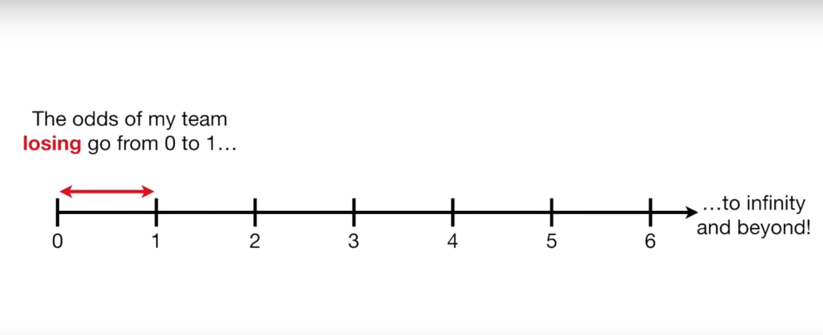
Odds
In the case where the probability of winning is at least 50%...
Only valid between 0 and 1

Slide 10
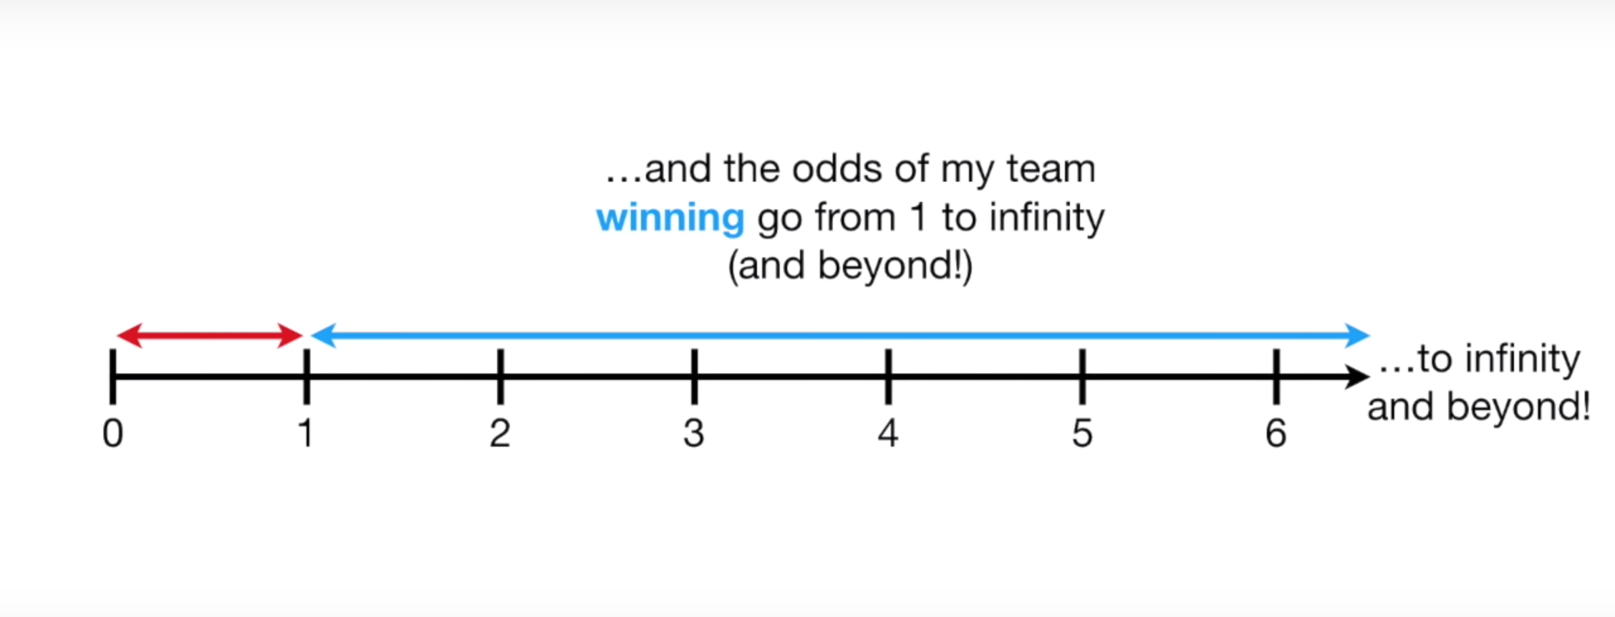
Odds
In the case where the probability of winning is at least 50%...
Only valid between 0 and 1

Slide 11
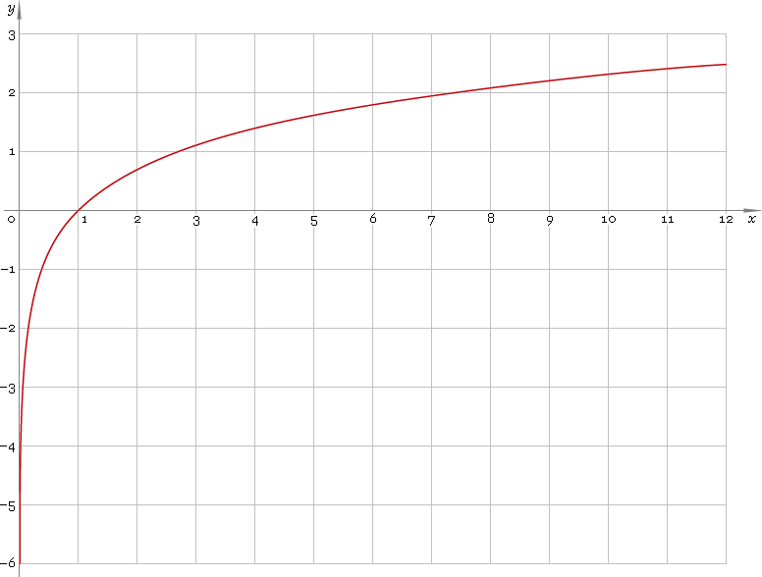
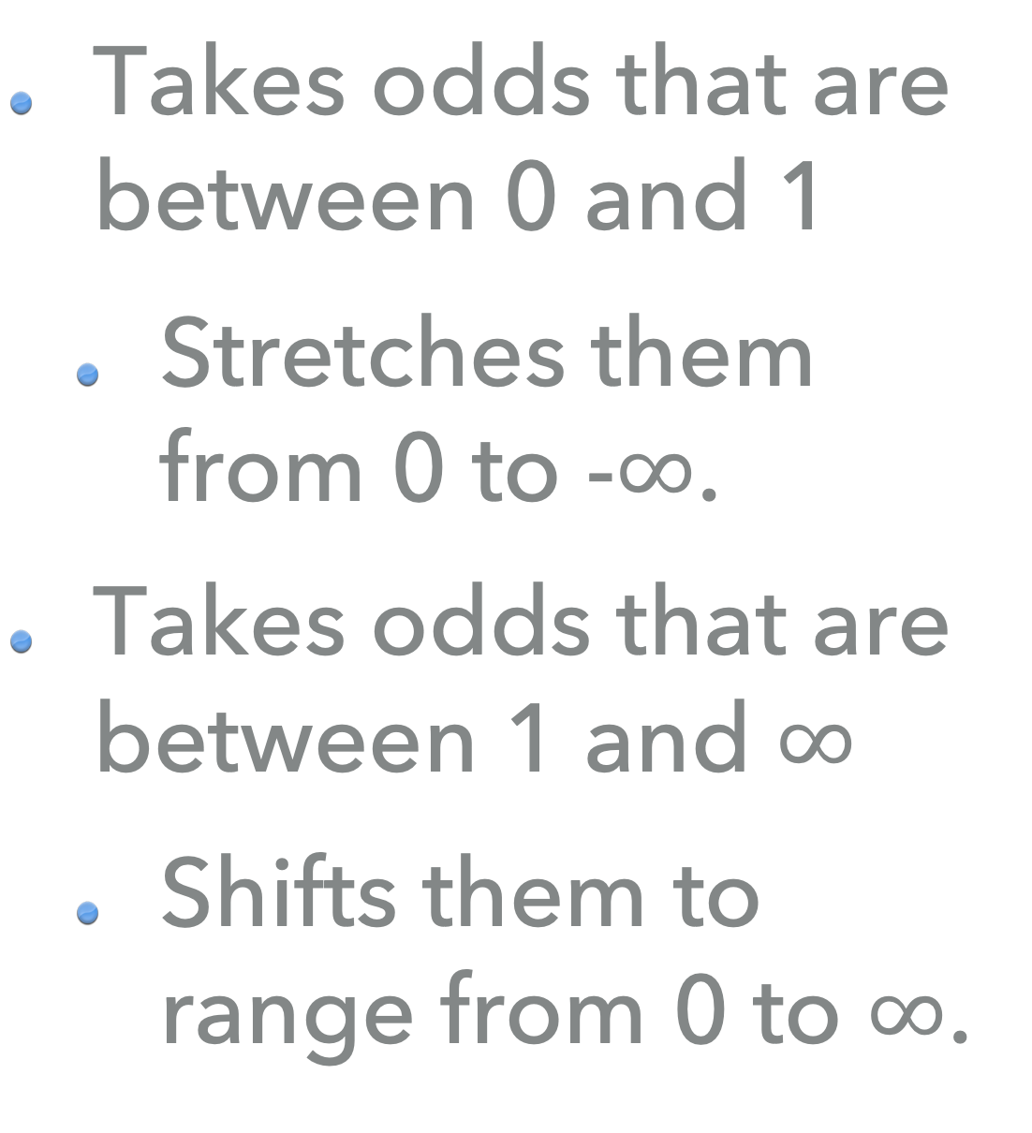
Fix #2: Log()
Takes odds that are between 0 and 1
Stretches them from 0 to -$∞$.
Takes odds that are between 1 and $∞$
Shifts them to range from 0 to $∞$.

Slide 12
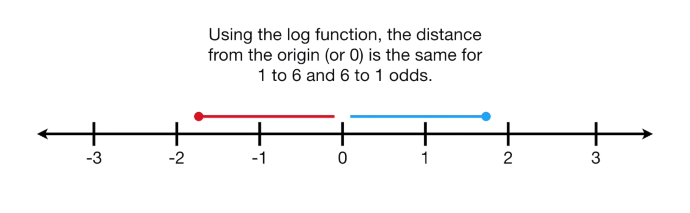
Fix #2: Log()

Slide 13
Fix #2: Log()
Win = log(4) = 1.39
Lose = log(0.25) = -1.39

Slide 14
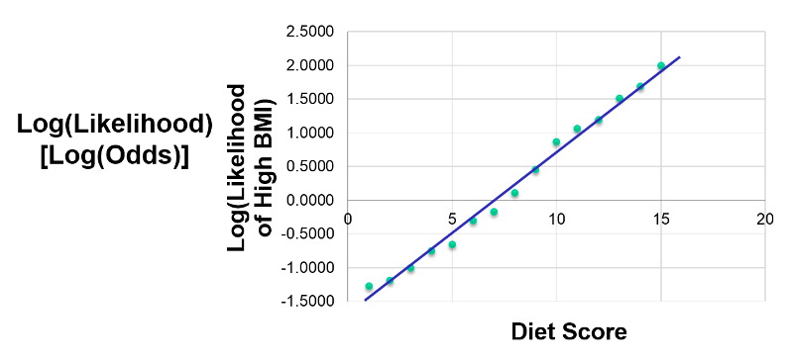

Slide 15
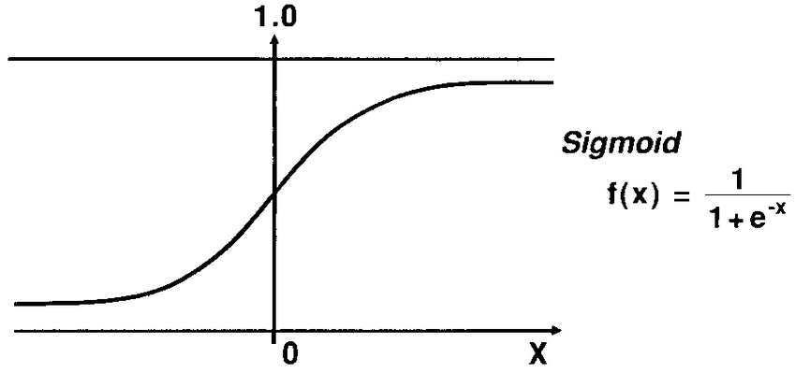
Sigmoid function
Translates log-odds back to probability

Slide 16
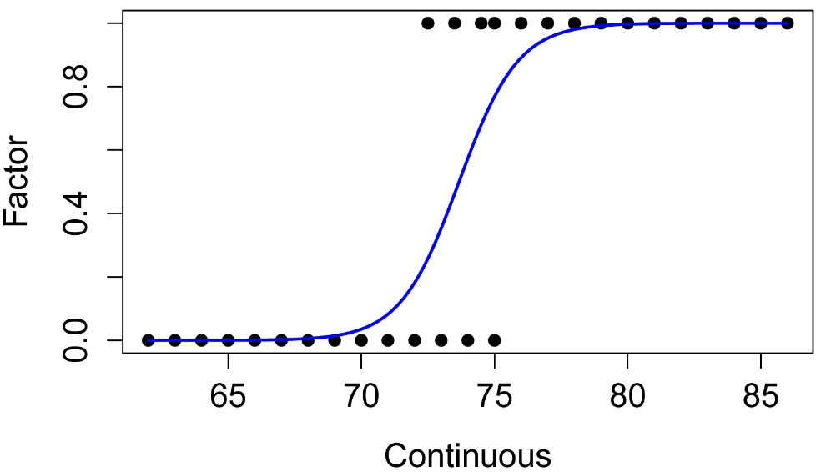
Maximum Likelihood

Slide 17
Logistic Regression
Output is probability
Probability -> classification using a discrimination threshold
Default threshold: 0.5

Slide 18
Discrimination Threshold

Slide 19
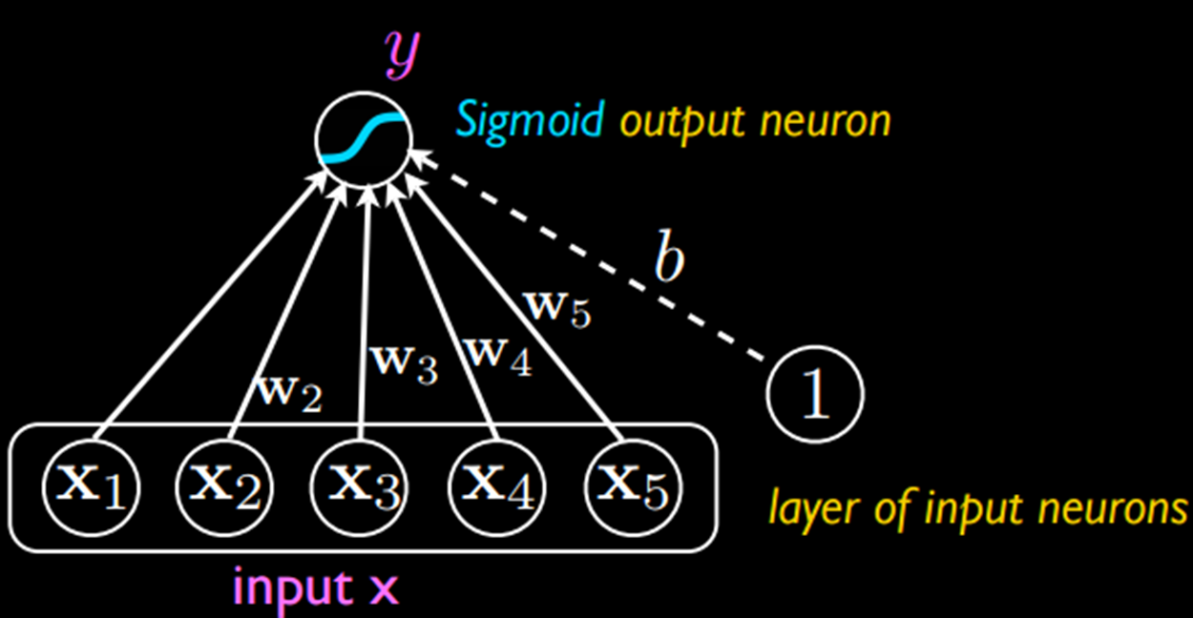
Deep Learning / neural networks
Machine learning models
Treat each of the neurons as a logistic regression classifier
Example:
x1: Is the object orange?
x2: Is the object shaped like a cat?
x3: Is the object chasing a mouse?

Slide 20
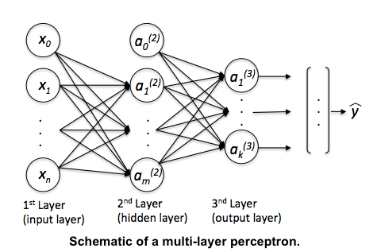

Slide 21
Exercises

Slide 22
ROC Curve
Short for “Receiver operating characteristic”
Shows effect of changing probability threshold

Slide 23
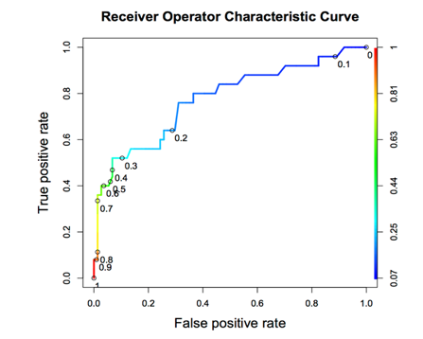
Notes:
True positive rate / sensitivity / recall: the proportion of actual positives that are correctly identified as such
-Out of all the positive samples, what proportion did you *correctly* identify?
False positive rate = (1 – specificity):
-Out of all the negative samples, what proportion did we *fail* to identify as such?
(Specificity is like a recall but for the negative class; what portion of the negative class did we catch / capture?)
The y axis is a success rate.
The x axis is a failure rate.

Slide 24
ROC Curve
Tradeoff between True Positive Rate and False Positive Rate
Neutral on class? Choose closest point to top-left corner.

Slide 25
Area Under the curve
Total AUC is a measure of classifier power
1.0 is perfect, 0.5 is as bad as random chance

Slide 26
Notes:
True positive rate / sensitivity / recall: the proportion of actual positives that are correctly identified as such
-Out of all the positive samples, what proportion did you *correctly* identify?
False positive rate = (1 – specificity):
-Out of all the negative samples, what proportion did we *fail* to identify as such?
(Specificity is like a recall but for the negative class; what portion of the negative class did we catch / capture?)
The y axis is a success rate.
The x axis is a failure rate.

Slide 27
RoC and class balance
X-axis is sized relative to NEGATIVE class
Y-axis is sized relative to POSITIVE class

Slide 28
Notes:
True positive rate / sensitivity / recall: the proportion of actual positives that are correctly identified as such
-Out of all the positive samples, what proportion did you *correctly* identify?
False positive rate = (1 – specificity):
-Out of all the negative samples, what proportion did we *fail* to identify as such?
(Specificity is like a recall but for the negative class; what portion of the negative class did we catch / capture?)
The y axis is a success rate.
The x axis is a failure rate.

Slide 29
Precision-Recall Curve
Both axes are sized relative to POSITIVE class
Shows how % correct of POSITIVE guesses goes down as threshold lowers

Slide 30
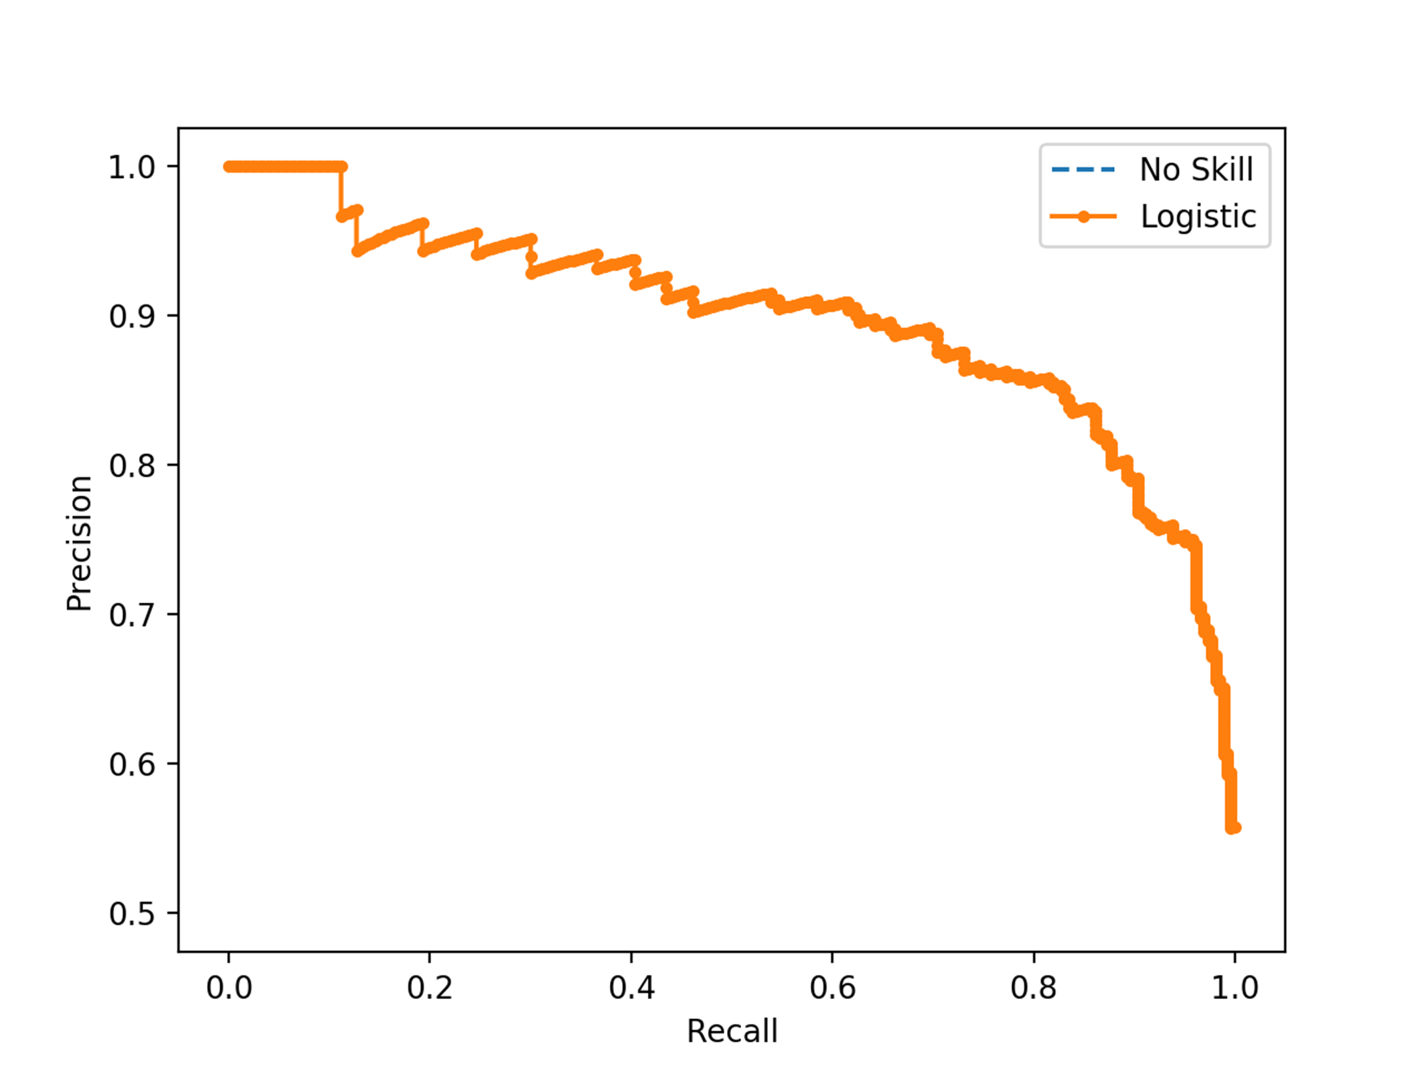
SUCCESS RATE WITH POSITIVE GUESSES
TRUE POSITIVE RATE
Notes:
Precision / positive predictive value: true positives / (true positives + false positives)
Recall / sensitivity / true positive rate: the proportion of actual positives that are correctly identified as such
-Out of all the positive samples, what proportion did you correctly identify?

Slide 31
Exercises

Slide 32
Imbalanced classes

Slide 33
problem #1
Randomly selecting rows USUALLY yields the correct class proportions
However, when positive cases are sparse, LOTS of variance

Slide 34
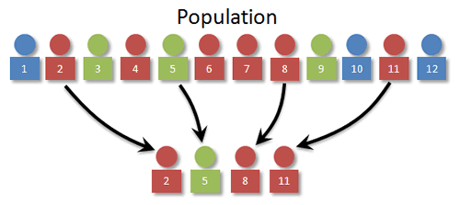

Slide 35
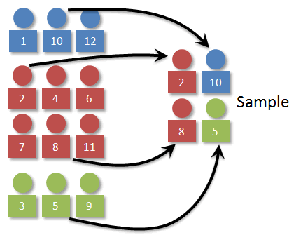

Slide 36
Problem #2
Often have WAY more negative samples than positive
High “accuracy” if you always guess negative!

Slide 37

Transactions
Fraudulent

Slide 38
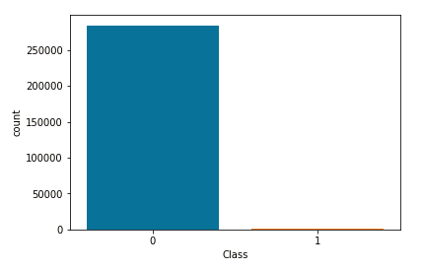

Slide 39
Sensitivity
TP / (TP + FN)
Focuses only on performance on TRUE samples

Slide 40
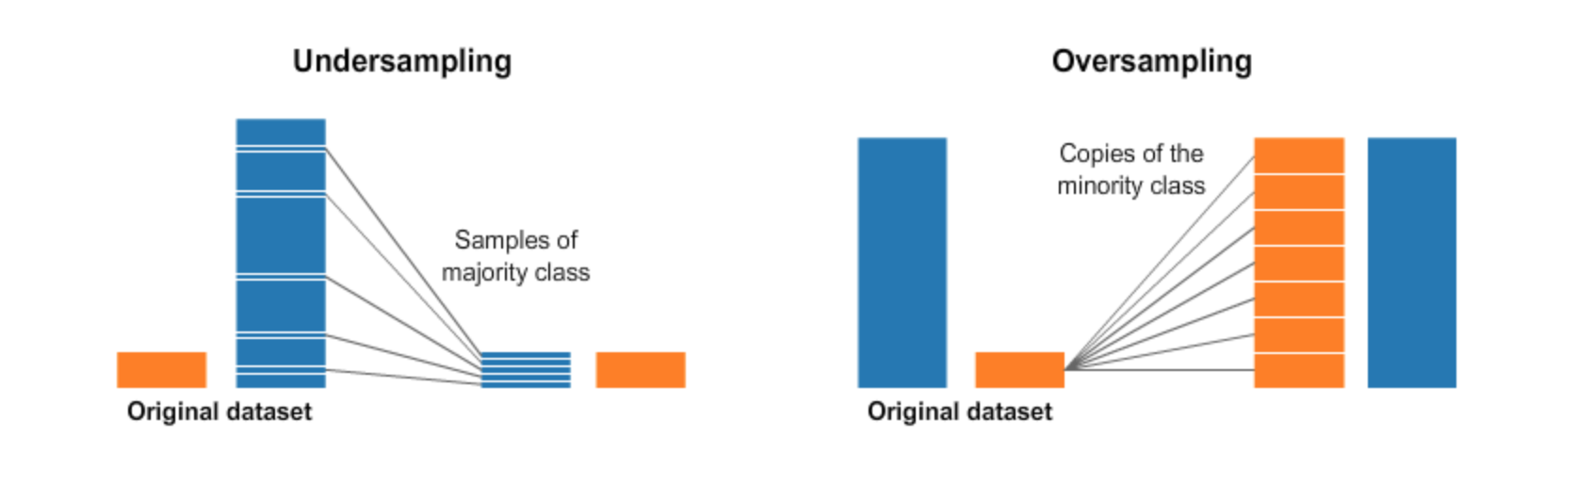

Slide 41
Oversampling
Often have WAY more negative samples than positive
High “accuracy” if you always guess negative!

Slide 43
Undersampling
Avoid — loses data!
Used when size is expensive, eg. Big Data or data that has to be cleaned manually

Slide 44
Imbalance-learn
Fix imbalance in Pipeline
Need to import make_pipeline() from imbalance-learn instead

Slide 45
Random Oversampler
Adds random duplicates
from imblearn.over_sampling import RandomOverSampler

