Slide 1
Machine Learning
Bootcamp

Slide 2
Logistic Regression

Slide 3
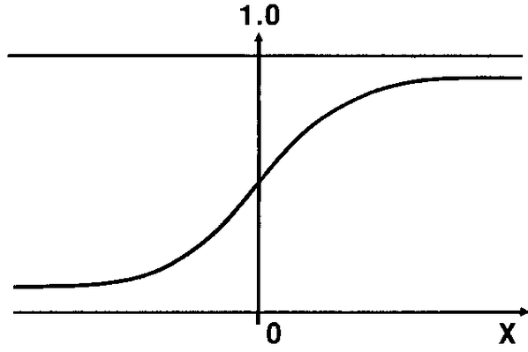
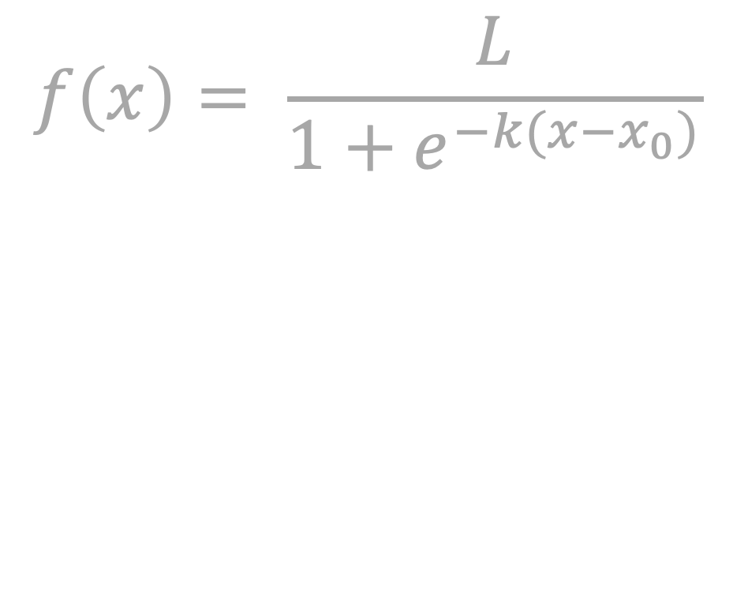
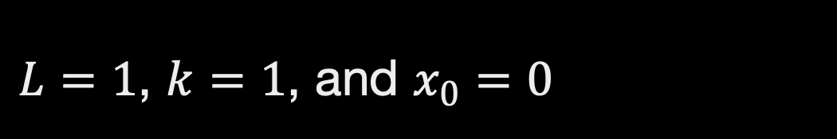
Assume Probability can be modeled with a logistic curve
$$f\left(x\right)= \frac{L}{1+e^{−k(x−x_{0})}}$$
$L=1$, $k=1$, and $x_{0}=0$

Slide 4

Logistic Regression
Try different parameters for a line
Modify output of that linear model to be a logistic curve
Used for classification, despite name

Slide 5
First Step: How to go back and forth between Logistic curve and a line?
Assume the line represents the log odds!

Slide 6
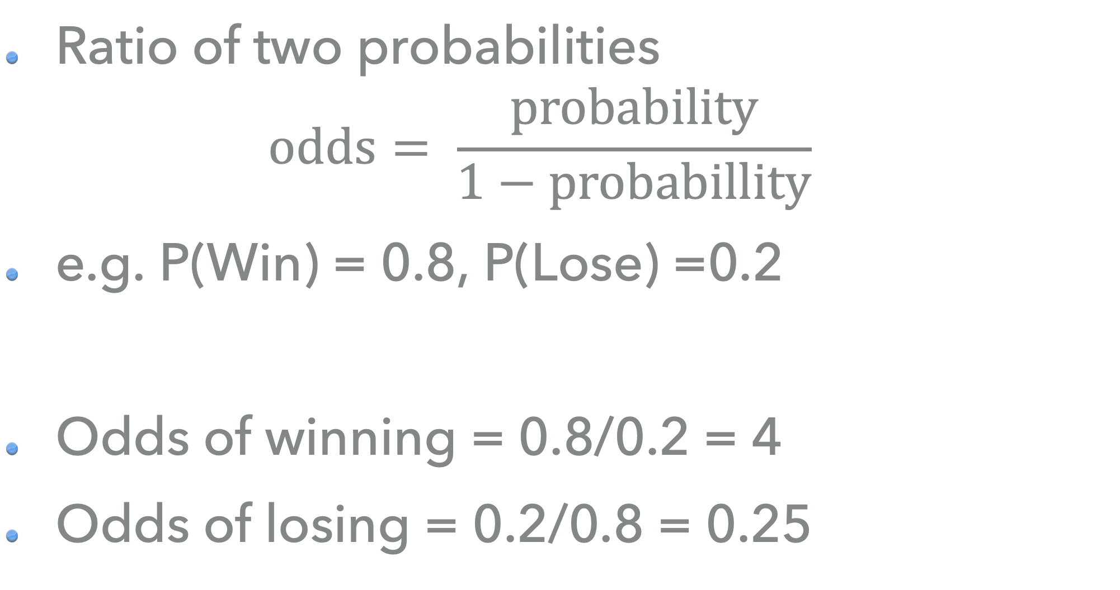
Odds
Ratio of two probabilities
$$odds= \frac{probability}{1−probabillity}$$
e.g. P(Win) = 0.8, P(Lose) =0.2
Odds of winning = 0.8/0.2 = 4
Odds of losing = 0.2/0.8 = 0.25

Slide 7


So… Will assuming the line is the log odds work?
If $p= \frac{1}{1+e^{−k(x−x_{0})}}$,
is $log\left(\frac{probability}{1−probabillity}\right)$ linear?
$$p=\frac{1}{1+e^{−ℓ}}=\frac{e^{ℓ}}{e^{ℓ}+1}$$

Slide 8

So… Will assuming the line is the log odds work?
If $p= \frac{1}{1+e^{−k(x−x_{0})}}$,
is $log\left(\frac{probability}{1−probabillity}\right)$ linear?
$$p=\frac{1}{1+e^{−ℓ}}=\frac{e^{ℓ}}{e^{ℓ}+1}$$
$$p\left(1+e^{ℓ}\right)=e^{ℓ}$$

Slide 9

So… Will assuming the line is the log odds work?
If $p= \frac{1}{1+e^{−k(x−x_{0})}}$,
is $log\left(\frac{probability}{1−probabillity}\right)$ linear?
$$p=\frac{1}{1+e^{−ℓ}}=\frac{e^{ℓ}}{e^{ℓ}+1}$$
$$p\left(1+e^{ℓ}\right)=e^{ℓ}$$
$$p+pe^{ℓ}=e^{ℓ}$$

Slide 10
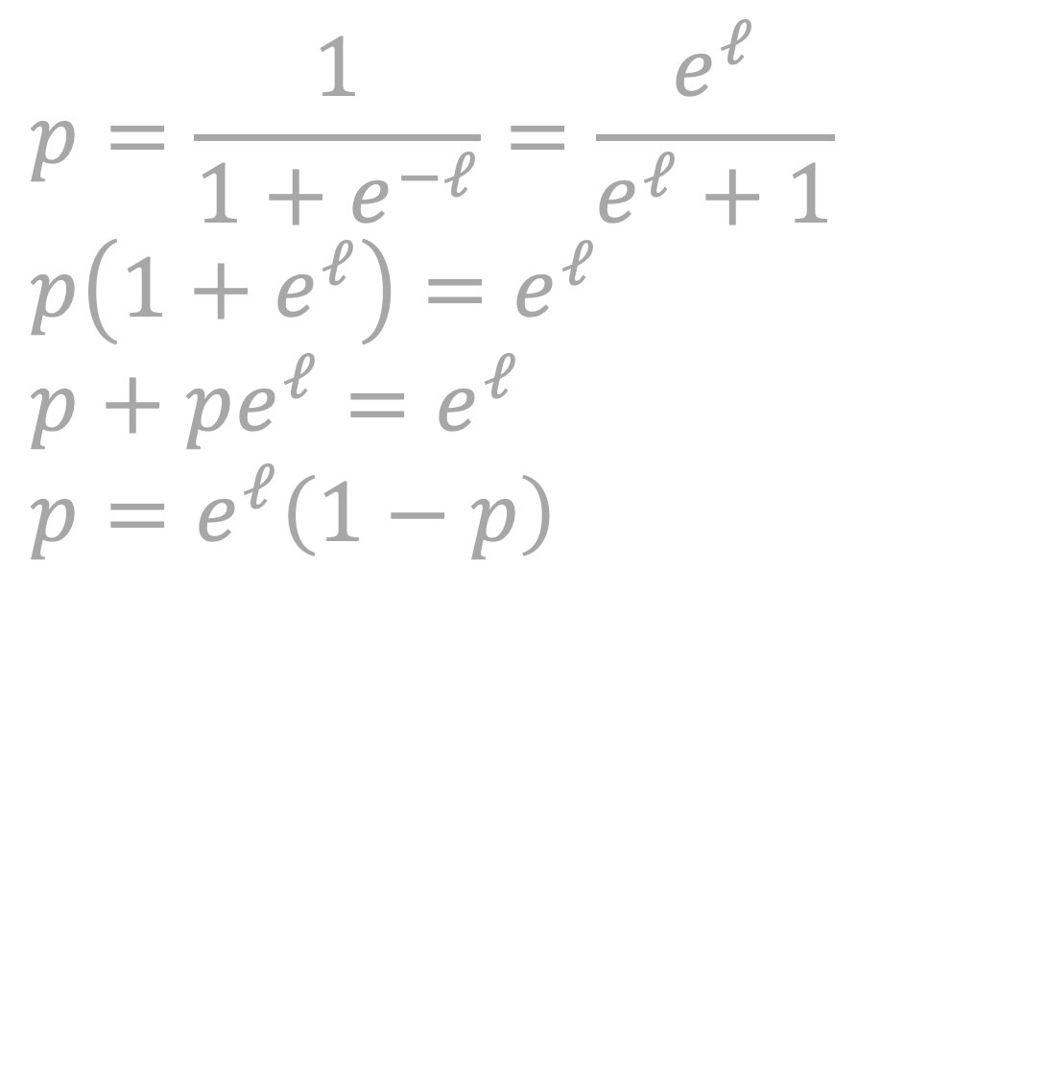
So… Will assuming the line is the log odds work?
If $p= \frac{1}{1+e^{−k(x−x_{0})}}$,
is $log\left(\frac{probability}{1−probabillity}\right)$ linear?
$$p=\frac{1}{1+e^{−ℓ}}=\frac{e^{ℓ}}{e^{ℓ}+1}$$
$$p\left(1+e^{ℓ}\right)=e^{ℓ}$$
$$p+pe^{ℓ}=e^{ℓ}$$
$$p=e^{ℓ}\left(1−p\right)$$

Slide 11
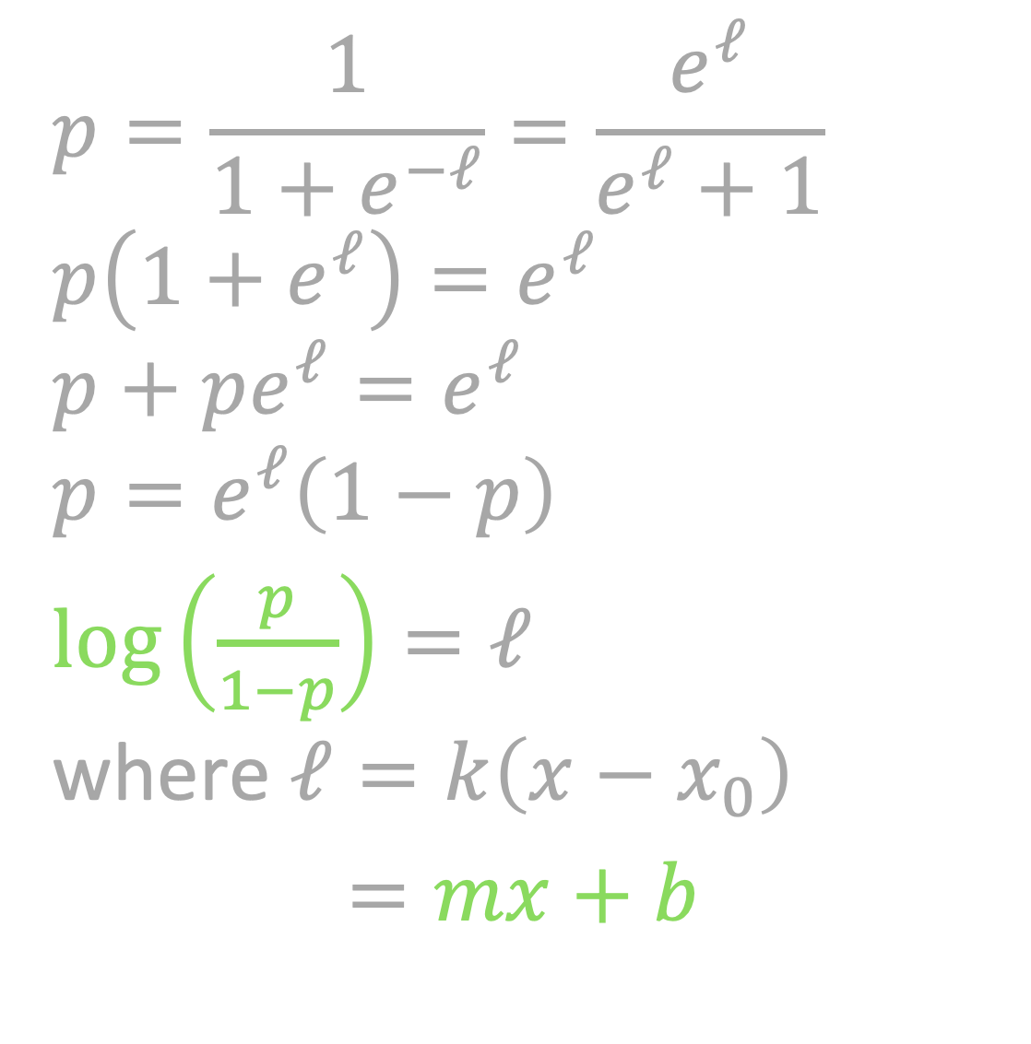
So… Will assuming the line is the log odds work?
If $p= \frac{1}{1+e^{−k(x−x_{0})}}$,
is $log\left(\frac{probability}{1−probabillity}\right)$ linear?
$$p=\frac{1}{1+e^{−ℓ}}=\frac{e^{ℓ}}{e^{ℓ}+1}$$
$$p\left(1+e^{ℓ}\right)=e^{ℓ}$$
$$p+pe^{ℓ}=e^{ℓ}$$
$$p=e^{ℓ}\left(1−p\right)$$
$log\left(\frac{p}{1−p}\right)=ℓ$ where $ℓ=k\left(x−x_{0}\right)$
$=mx+b$

Slide 12
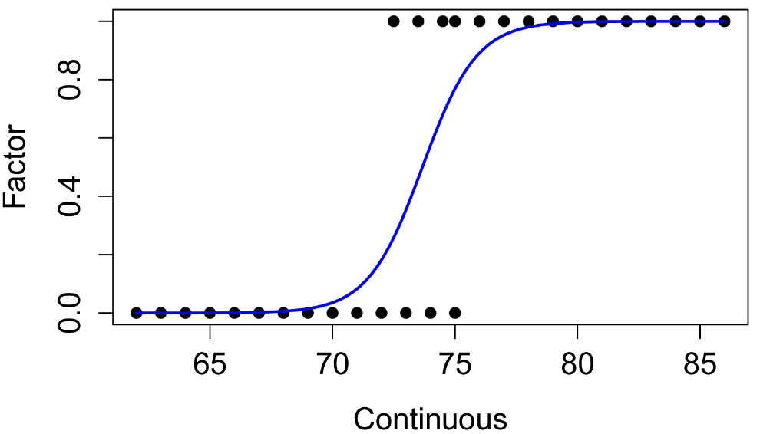

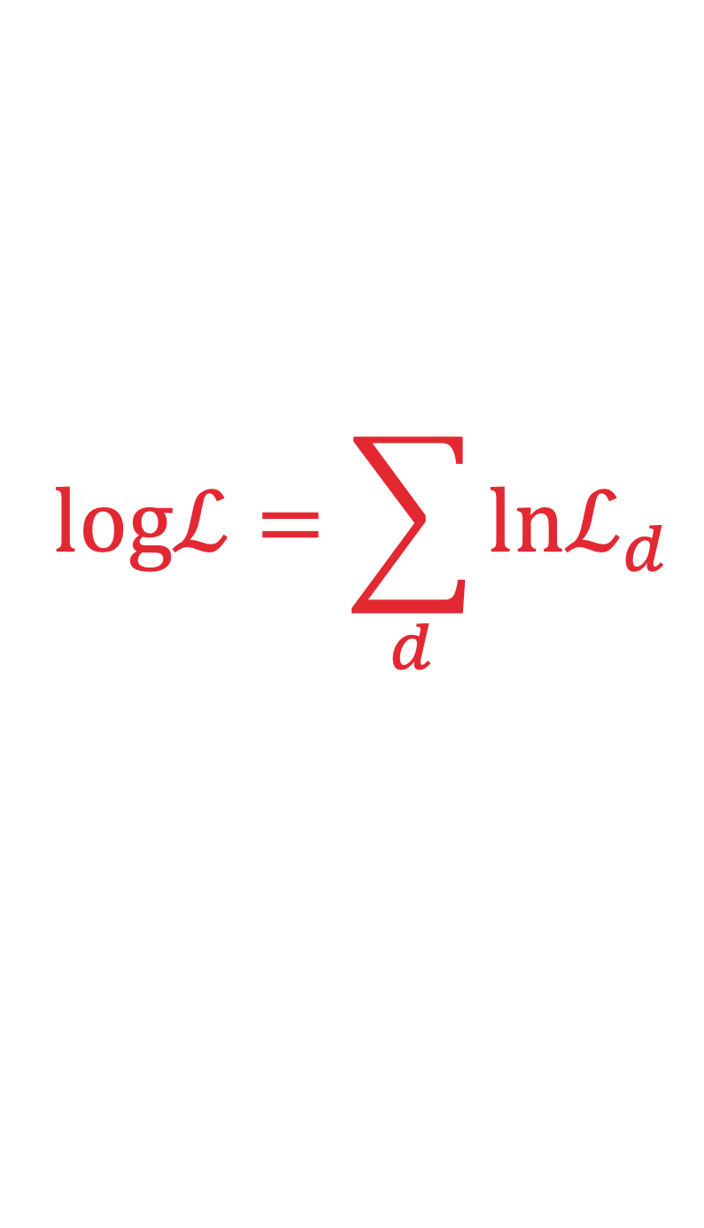

Maximum Likelihood
$$ℒ_{i}$$
Probability of a heart attack
$$logℒ=\sum_{d}{lnℒ_{d}}$$
$${1−ℒ}_{j}$$
Age

Slide 13
Logistic Regression
Output is probability
Probability -> classification using a discrimination threshold
Default threshold: 0.5

Slide 14
Discrimination Threshold

Slide 15
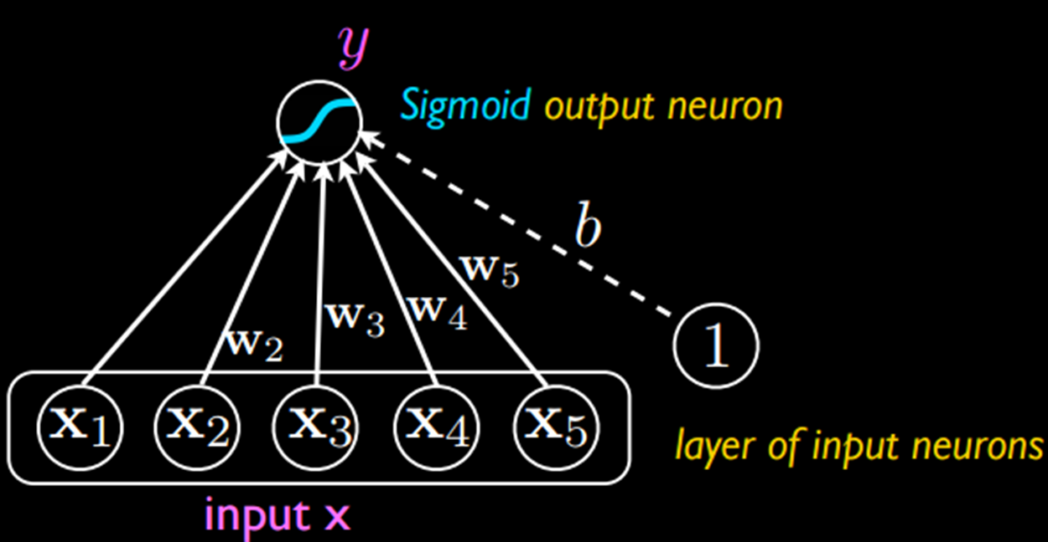
Deep Learning / neural networks
Machine learning models
Treat each of the neurons as a logistic regression classifier
Example:
x1: Is the object orange?
x2: Is the object shaped like a cat?
x3: Is the object chasing a mouse?

Slide 16
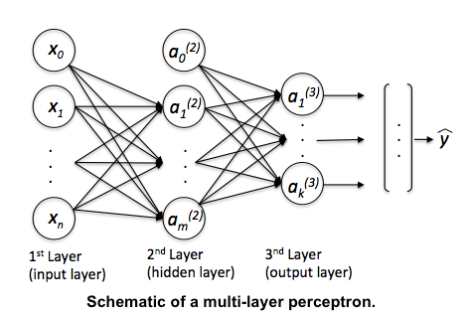

Slide 17
Exercises

Slide 18
ROC Curve
Short for “Receiver operating characteristic”
Shows effect of changing probability threshold

Slide 19
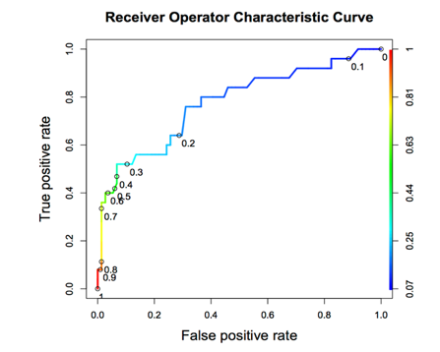
Notes:
True positive rate / sensitivity / recall: the proportion of actual positives that are correctly identified as such
-Out of all the positive samples, what proportion did you *correctly* identify?
False positive rate = (1 – specificity):
-Out of all the negative samples, what proportion did we *fail* to identify as such?
(Specificity is like a recall but for the negative class; what portion of the negative class did we catch / capture?)
The y axis is a success rate.
The x axis is a failure rate.

Slide 20
ROC Curve
Tradeoff between True Positive Rate and False Positive Rate
Neutral on class? Choose closest point to top-left corner.

Slide 21
Area Under the curve
Total AUC is a measure of classifier power
1.0 is perfect, 0.5 is as bad as random chance

Slide 22
Notes:
True positive rate / sensitivity / recall: the proportion of actual positives that are correctly identified as such
-Out of all the positive samples, what proportion did you *correctly* identify?
False positive rate = (1 – specificity):
-Out of all the negative samples, what proportion did we *fail* to identify as such?
(Specificity is like a recall but for the negative class; what portion of the negative class did we catch / capture?)
The y axis is a success rate.
The x axis is a failure rate.

Slide 23
RoC and class balance
X-axis is sized relative to NEGATIVE class
Y-axis is sized relative to POSITIVE class

Slide 24
Notes:
True positive rate / sensitivity / recall: the proportion of actual positives that are correctly identified as such
-Out of all the positive samples, what proportion did you *correctly* identify?
False positive rate = (1 – specificity):
-Out of all the negative samples, what proportion did we *fail* to identify as such?
(Specificity is like a recall but for the negative class; what portion of the negative class did we catch / capture?)
The y axis is a success rate.
The x axis is a failure rate.

Slide 25
Precision-Recall Curve
Both axes are sized relative to POSITIVE class
Shows how % correct of POSITIVE guesses goes down as threshold lowers

Slide 26
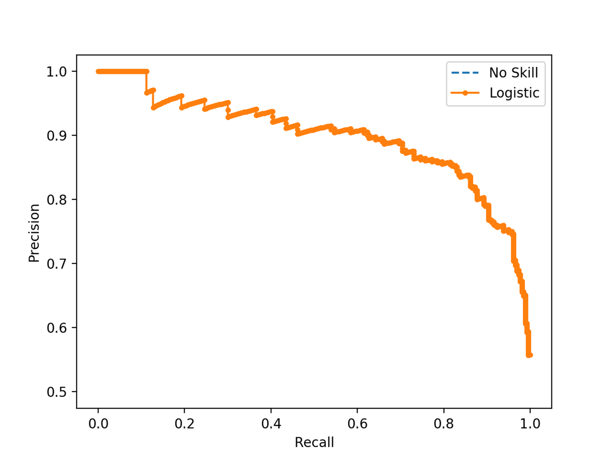
SUCCESS RATE WITH POSITIVE GUESSES
TRUE POSITIVE RATE
Notes:
Precision / positive predictive value: true positives / (true positives + false positives)
Recall / sensitivity / true positive rate: the proportion of actual positives that are correctly identified as such
-Out of all the positive samples, what proportion did you correctly identify?

Slide 27
Exercises

Slide 28
Imbalanced classes

Slide 29
problem #1
Randomly selecting rows USUALLY yields the correct class proportions
However, when positive cases are sparse, LOTS of variance

Slide 30
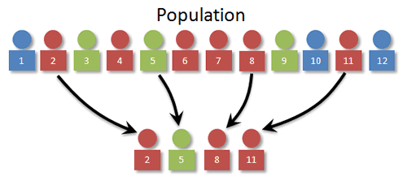

Slide 31
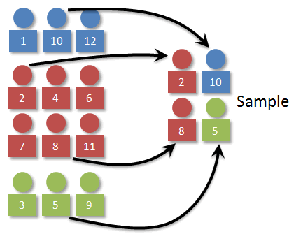

Slide 32
Problem #2
Often have WAY more negative samples than positive
High “accuracy” if you always guess negative!

Slide 33

Transactions
Fraudulent

Slide 34
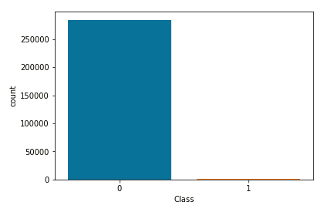

Slide 35
Sensitivity
TP / (TP + FN)
Focuses only on performance on TRUE samples

Slide 36
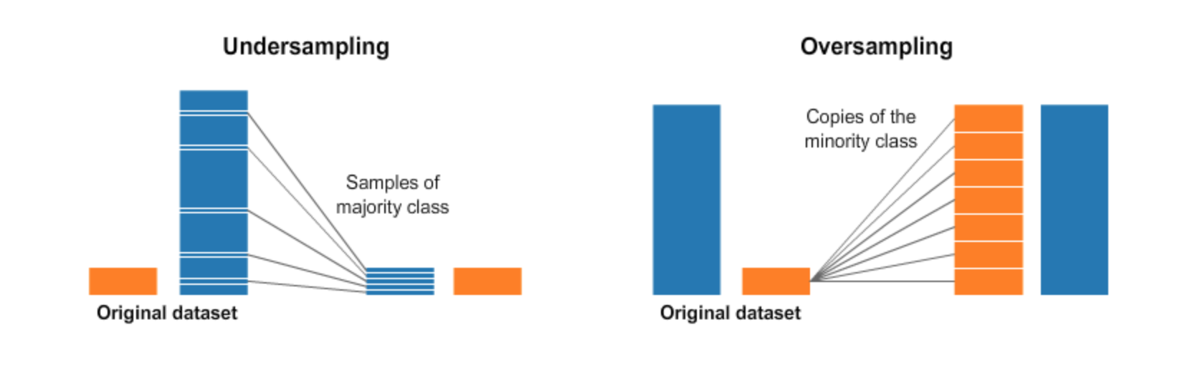

Slide 37
Oversampling
Often have WAY more negative samples than positive
High “accuracy” if you always guess negative!

Slide 39
Undersampling
Avoid — loses data!
Used when size is expensive, eg. Big Data or data that has to be cleaned manually

Slide 40
Imbalance-learn
Fix imbalance in Pipeline
Need to import make_pipeline() from imbalance-learn instead

Slide 41
Random Oversampler
Adds random duplicates
from imblearn.over_sampling import RandomOverSampler

