Slide 1
Bootcamp
Machine Learning

Slide 2
Regression &
Parametric Models

Slide 3
Linear Regression

Slide 4
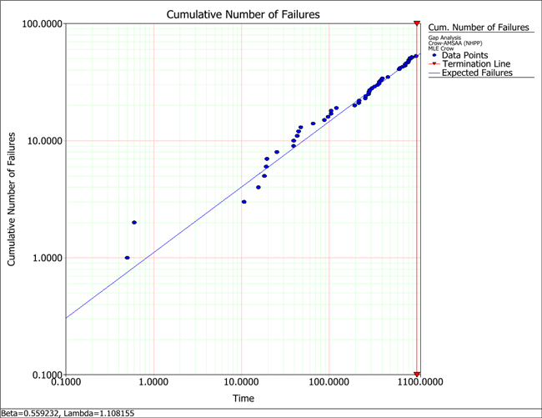

Slide 5

Parametric Models
Model constrained by formula
Parameters of formula learned from data

Slide 6
Linear Regression
y = 2x0 + 3x1 + … + 1

Slide 7
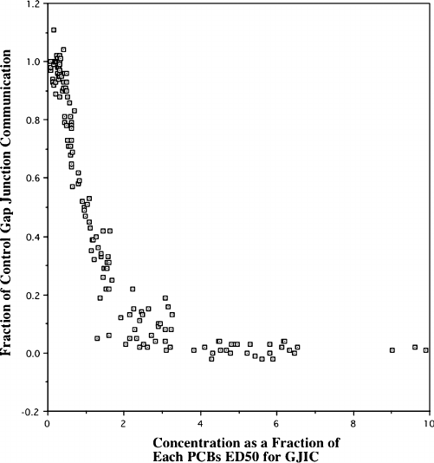

Slide 8
Training a Model
model = LinearRegression()
model.fit(X_train,y_train)

Slide 9
Using a Model
y_predicted = model.predict(X_test)

Slide 10
Evaluating a Model
model.score(X_test, y_test)

Slide 11
R2 Score
How much error does your model have vs “just guess the mean”?
1.0 is a perfect model, 0.0 is exactly as bad as “just guess the mean”

Slide 12
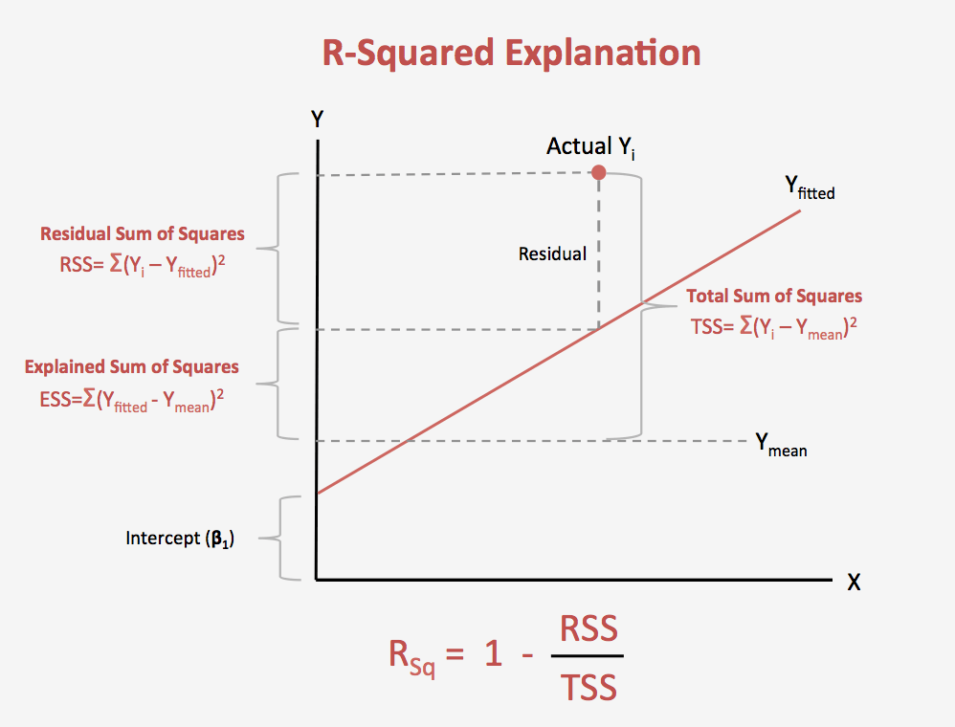
Text

Slide 13
Mean absolute error
from sklearn.metrics \
import mean_absolute_error
mean_absolute_error(y_predicted, y_test)

Slide 14
Exercises

Slide 15
Regularization

Slide 16
regularization
Fix what “best-fit” means
Add penalty for complex models

Slide 17
Ridge Regression (L2)
sum(model.coef_**2)
Low-signal features will have smaller and smaller coefficients

Slide 18
Lasso Regression (L1)
sum(abs(model.coef_))
Low-signal features will end up with coefficients of 0

Slide 19
Alpha parameter
Changes how heavily we weight regularization
Can test different values with validation curve!

Slide 20
Learning curve
Scores model as size of data increases
Convergence means more data won’t help

Slide 21
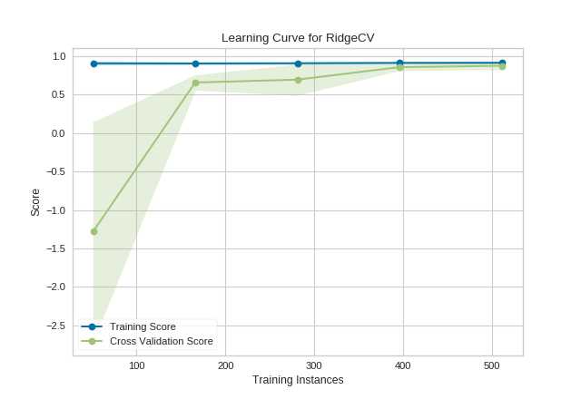

Slide 22
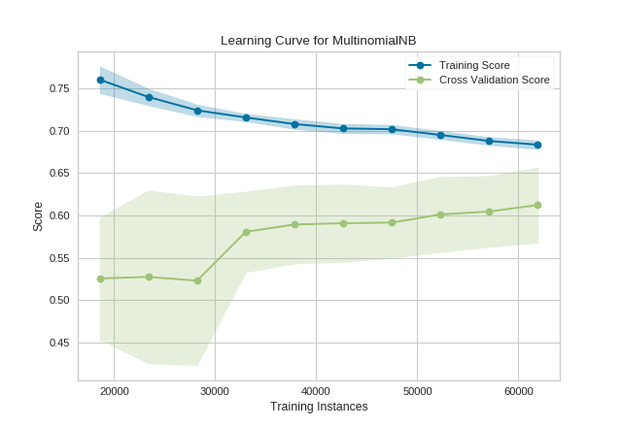

Slide 23
Exercises

Slide 24
Bias-Variance Tradeoff

Slide 25
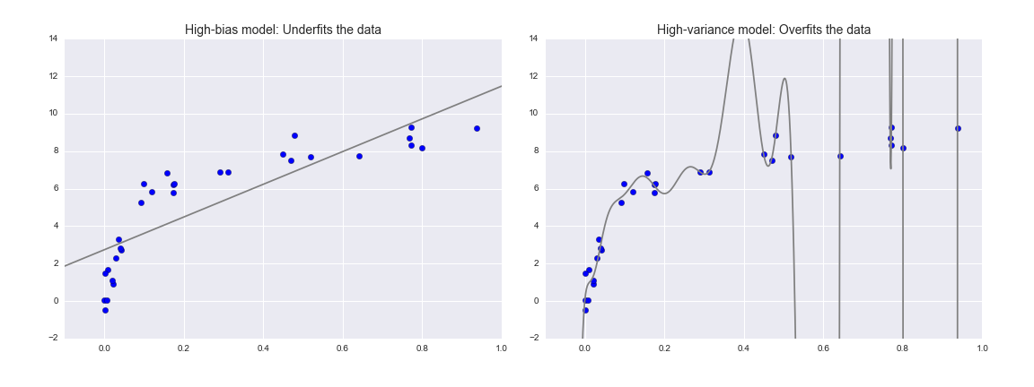

Slide 27
Overfitting
Model fits training set
Complex models overfit data

Slide 28
Polynomial Regression
Feature engineering: data is modified, not the model
New column is the square of the original column (or cube, etc)

Slide 29
Linear Regression
y = 2x0 + 3x1 + … + 1

Slide 30
Polynomial Regression
y = 2x0 + 3x1 + … + 1
+ 1x0² + 2x1² + …

Slide 31
Polynomial Regression
y = 2x0 + 3x1 + … + 1
+ 1x0² + 2x1² + …
+ 3x0³ + 1x1³ + …

Slide 32
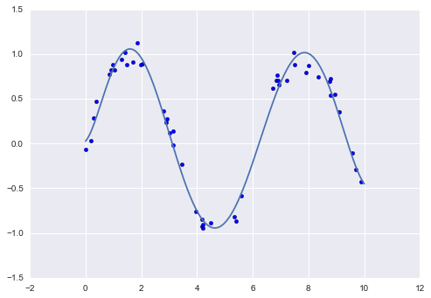

Slide 33
Downsides
Features matrix grows FAST!
Complex models overfit data

Slide 34
Validation curve
See result of changing hyperparameter
Look for sweet spot

Slide 35
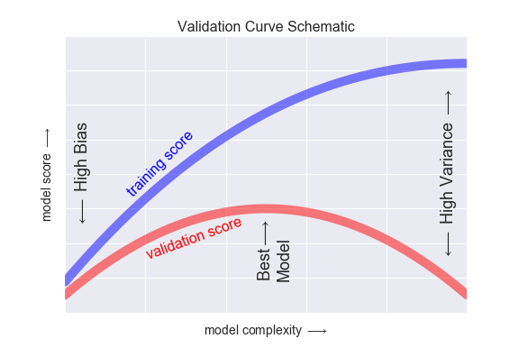

Slide 36
Exercises

