Slide 1
Bootcamp
Machine Learning

Slide 2
Review

Slide 3
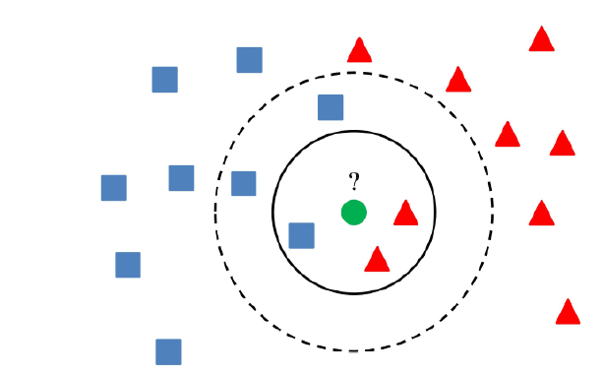

Slide 4
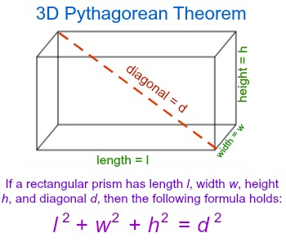

Slide 5
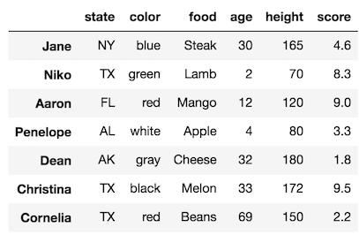
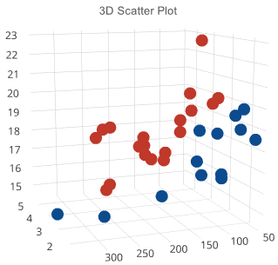

Slide 6
?

Slide 7

Setting the Table
Feature Matrix, Target Vector
Training Set, Test Set

Slide 8
Setting the Table
Feature Matrix, Target Vector
Training Set, Test Set

Slide 9
Feature Matrix, Target Vector
X = df.drop(columns=['price'])
y = df['price']

Slide 10
Training Set, Test Set
X_train, X_test, y_train, y_test = train_test_split(X, y)

Slide 11
Fitting Model
model = KNeighborsClassifier()
model.fit(X_train, y_train)

Slide 12
Evaluating
Classifiers

Slide 13
Cannot use Regression metrics for evaluation
Outputs are classes, not numbers
“Amount of error” is a bad fit

Slide 14
Accuracy
% of samples correctly classified
Does not tell you WHERE error is

Slide 15
Confusion Matrix
Grid comparing predicted VS actual
Shows where your errors lie
Correction classification on diagonal

Slide 16
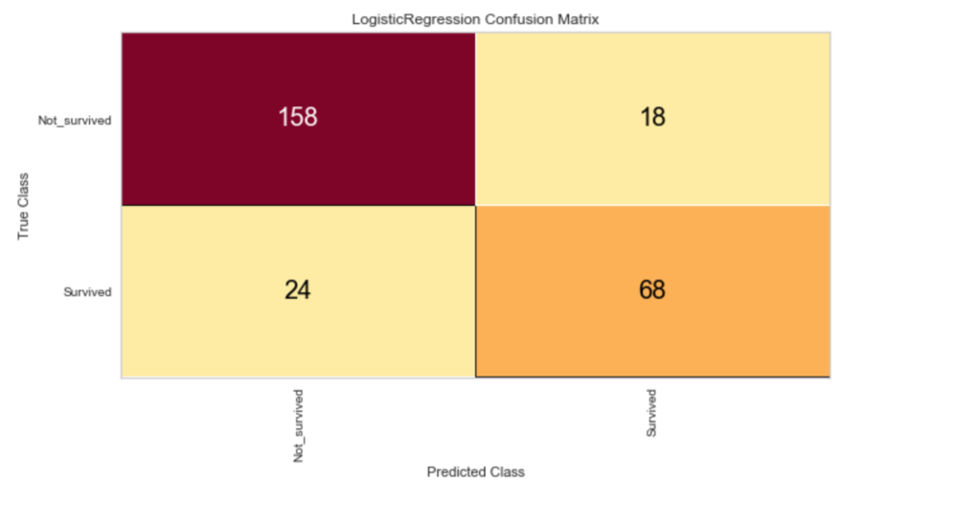

Slide 17
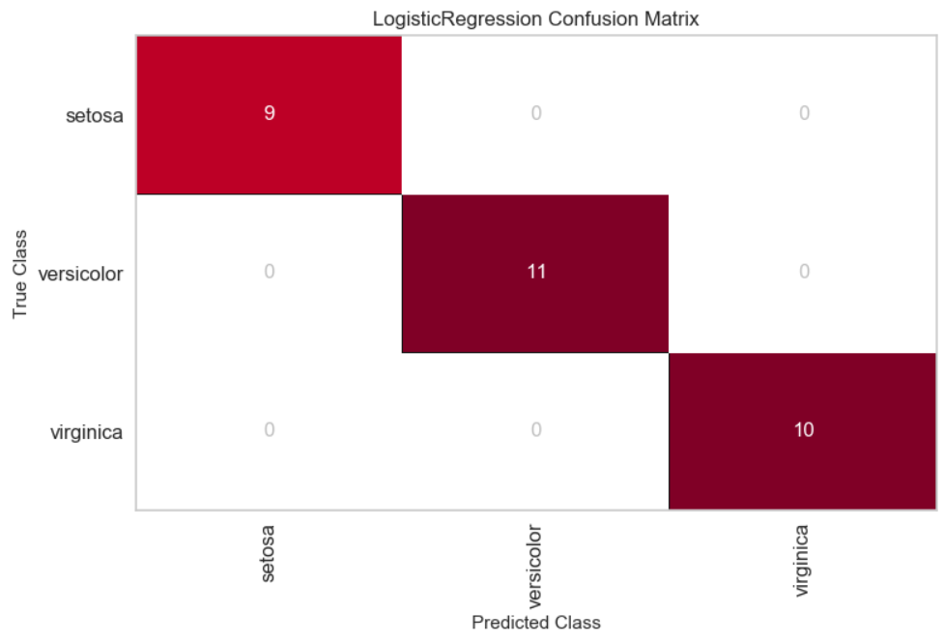
A Perfect Model

Slide 18
Sensitivity
Success rate on samples that SHOULD be positive
True Positive / (False Negative + True Positive)

Slide 19
Class prediction Error
Derived from the confusion matrix
Sometimes easier to interpret

Slide 20
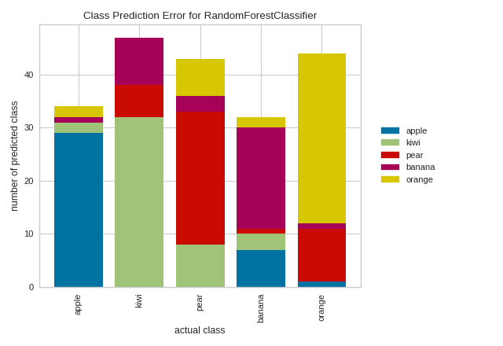

Slide 21
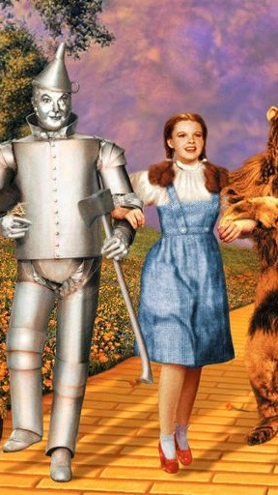
Yellowbrick
Introducing

Slide 22
Yellowbrick
Diagnostic visualizations! Automatic!
Built to integrate with scikit-learn

Slide 23
Example
cm = ConfusionMatrix(model)
cm.fit(X_train, y_train)
cm.score(X_test, y_test)
cm.finalize()

Slide 24
Exercises

Slide 25
Handling
Missing Data

Slide 26
Finding Nulls
df[“age”].isnull()
A Boolean mask for null ages

Slide 27
Finding Nulls
df.isnull().sum()
Find the number of nulls in each column

Slide 28
Finding Nulls
df.isnull().mean()
Percentage of values that are null in each column

Slide 29
Three types of situations
A few nulls (<5%)
Significant # of nulls
Mostly nulls

Slide 30
A Few Nulls
No significant impact
Drop them

Slide 31
Significant Nulls
Try to repair
Fill with average value

Slide 32
mostly nulls
To start, leave them out
Likely not very helpful

Slide 33
Exercises

Slide 34
Feature Engineering

Slide 35
The Problem
Distance relies on subtraction
We can’t subtract categorical data :(

Slide 36
Simple Encoding Doesn’t work
What if we re-label child as 0, man as 1, woman as 2?
Incorrect implications for those categories
Implies woman is 200% further from a child than a man

Slide 37
One-hot encoding
Creates a 1-or-0 column for each unique value in categorical
Per row, only one of the new columns will have a 1, hence “one-hot”

Slide 38
What does the one-hot encoded version look like?

Slide 39
Pitfalls
One-Hot Encoding
NY | TX | AL | AK
1 | 0 | 0 | 0
0 | 1 | 0 | 0
0 | 0 | 0 | 1
0 | 0 | 1 | 0
Imagine having 50 new columns, one for each U.S. state
Model will suffer with much more than 10 one-hot encoded columns

Slide 40
sklearn Pipelines
Transform data en route to your model
Because we can’t do arithmetic on categorical data)
Similar to how we wrapped our model in Yellowbrick
Can chain multiple transformations together

Slide 41
Pipelines
from sklearn.preprocessing import OneHotEncoder
from sklearn.pipeline import make_pipeline
encode = OneHotEncoder()
p_model = make_pipeline(encode, model)
p_model.fit(X_train, y_train)

Slide 42
1: Columns based on unique values
What make_pipeline() is doing in the background
encode.fit(X)
Finds All the categories

Slide 43
2: Map rows into new encoding
What make_pipeline() is doing in the background
encode.transform(X)
Creates column
for each category

Slide 44
Exercises

