Slide 1
Bootcamp
Machine Learning

Slide 2
Regression &
Parametric Models

Slide 3
Linear Regression

Slide 4
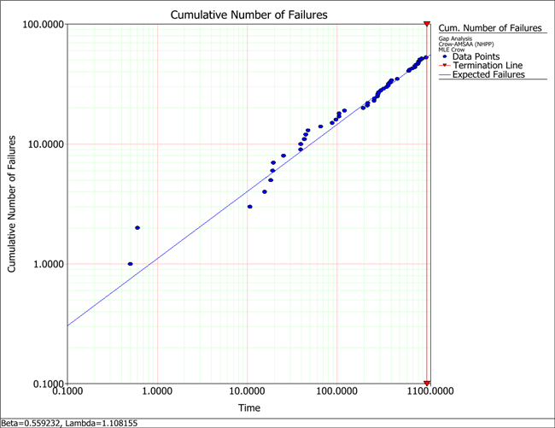

Slide 5

Parametric Models
Model constrained by formula
Parameters of formula learned from data

Slide 6
Linear Regression
y = 2x0 + 3x1 + … + 1

Slide 7
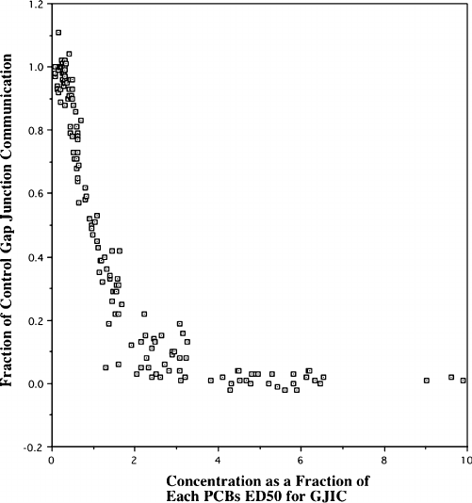

Slide 8
Training a Model
model = LinearRegression()
model.fit(X_train,y_train)

Slide 9
Using a Model
y_predicted = model.predict(X_test)

Slide 10
Evaluating a Model
model.score(X_test, y_test)

Slide 11
R² Score
How much error your model has vs. “just guess the mean”
Proportion of variance that is explained by your model
Range of R²:
1.0 is a perfect model
0.0 is exactly as bad as “just guess the mean”
Can be infinitely bad (approaching negative infinity)
In a single-variable model, R² is equal to the correlation between the data and the predictions.

Slide 12
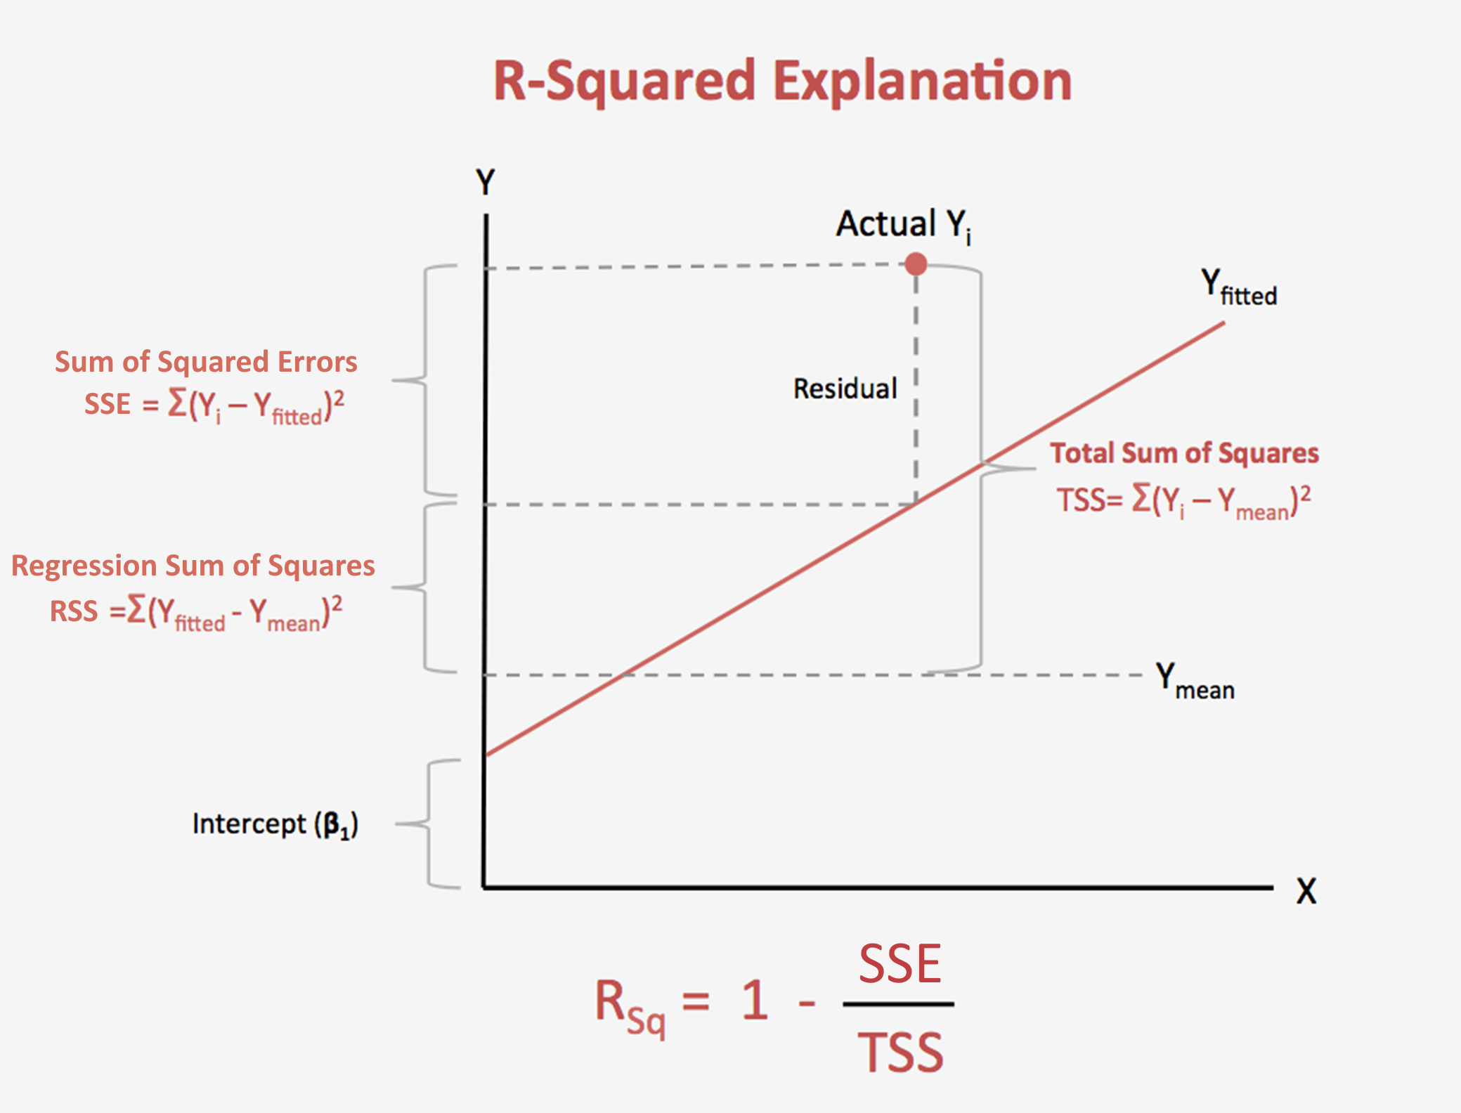

Slide 13
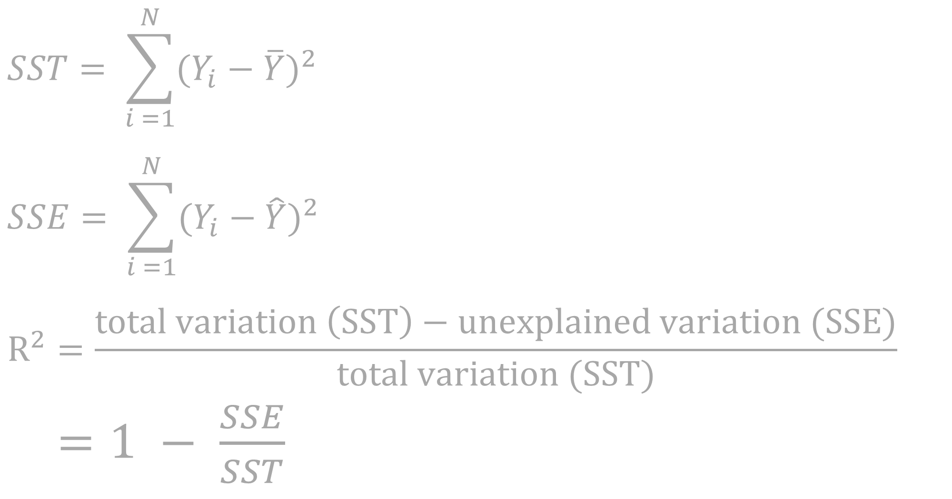
R² score
$$SST= \sum_{i =1}^{N}{{(Y_{i}−\overline{Y})}^{2}}$$
$$SSE= \sum_{i =1}^{N}{{(Y_{i}−\hat{Y})}^{2}}$$
$$R^{2}=\frac{total variation \left(SST\right)−unexplained variation (SSE)}{total variation (SST)}$$
$=1 − \frac{SSE}{SST}$

Slide 14
Mean absolute error
from sklearn.metrics \
import mean_absolute_error
mean_absolute_error(y_predicted, y_test)

Slide 15
Exercises

Slide 16
Regularization

Slide 17
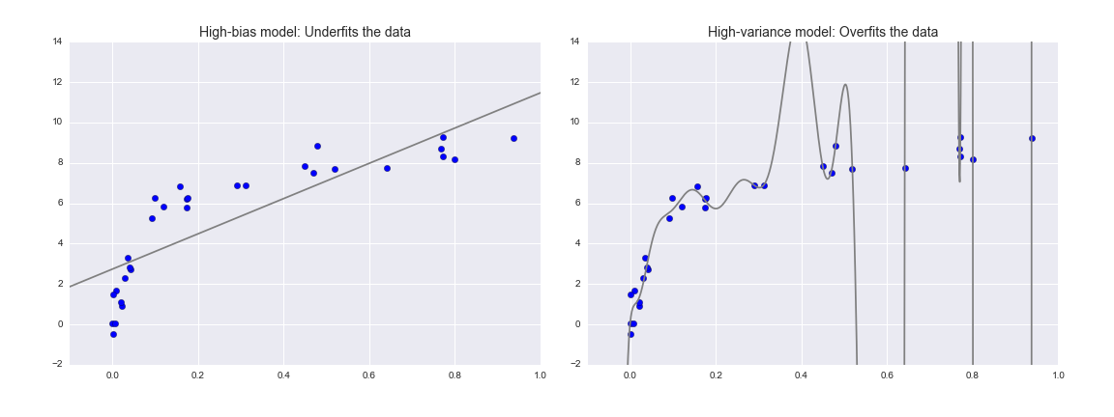

Slide 19
Overfitting
Model fits training set
Complex models overfit data
Training set performance >> test set performance

Slide 20
regularization
Fix what “best-fit” means
So far it’s meant the sum of squared errors is minimized
Add penalty for complex models

Slide 21
Ridge Regression (L2)
Minimize [ SSE + sum(model.coef_**2) ]
Larger coefficients: penalized more
Smaller coefficients: penalized less
Low-signal features will have smaller and smaller coefficients

Slide 22
Lasso Regression (L1)
Minimize [ SSE + sum(abs(model.coef_)) ]
Larger coefficients: penalized more
Smaller coefficients: penalized less
Low-signal features will end up with coefficients of 0

Slide 23
Which one to use?
Ridge Regression
Many features that each make a small legitimate contribution
Lasso Regression
Too many features. A lot of them are noise.

Slide 24
Alpha parameter
Changes how heavily we weight regularization
Can test different values with validation curve!

Slide 25
Learning curve
Scores model as size of data increases
Convergence means more data won’t help

Slide 26
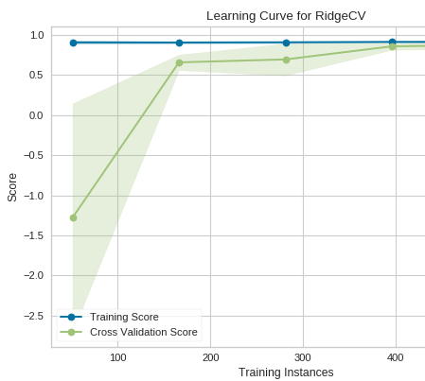
A Good Learning Curve
Learning Curve
Training Score
How well the model performs on the training set
Cross Validation Score
How well the model performs on the test set

Slide 27
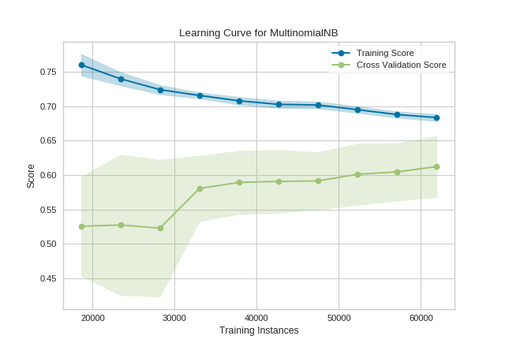
An odd learning curve
Notes:
Overfitting: cross validation score would be way worse than the training score

Slide 28
Exercises

Slide 29
Bias-Variance Tradeoff

Slide 32
Polynomial Regression
Feature engineering: data is modified, not the model
New column is the square of the original column (or cube, etc)

Slide 33
Linear Regression
y = 2x0 + 3x1 + … + 1

Slide 34
Polynomial Regression
y = 2x0 + 3x1 + … + 1
+ 1x0² + 2x1² + …
+ 3x0³ + 1x1³ + …

Slide 35
When to use Polynomial Regression
When the model is UNDERFIT

Slide 36
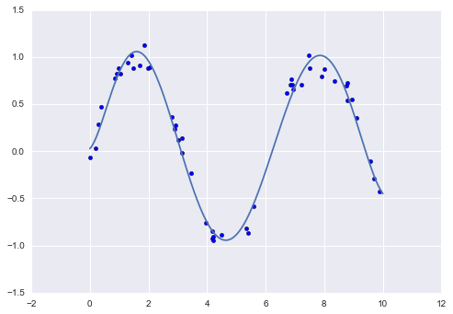

Slide 37
Downsides
Features matrix grows FAST!
Complex models overfit data

Slide 38
Validation curve
See result of changing hyperparameter
Look for sweet spot

Slide 39
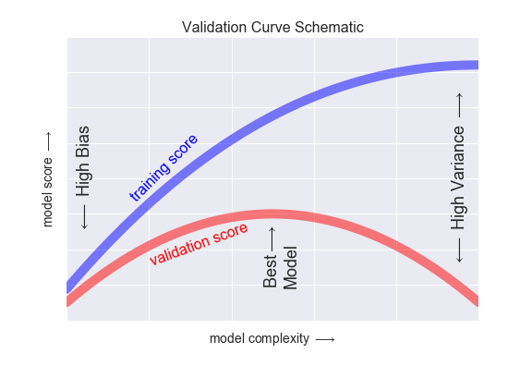

Slide 40
Exercises

