Slide 1
Machine Learning
Bootcamp

Slide 2
Logistic Regression

Slide 3

Logistic Regression
Modify output of linear model to be a probability
Used for classification, despite name

Slide 4
Problems with Probability
Positive values only
Must fit between 0 and 1

Slide 5
Solution: Output something easier
Output something more line-friendly
Translate back to probability later

Slide 6
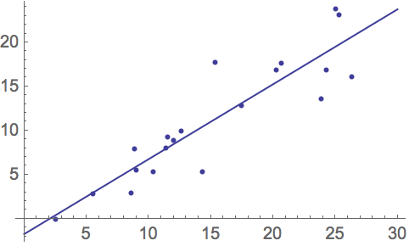

Slide 7
Fix #1: Odds
Ratio of two probabilities
e.g. P(Win) = 0.8, P(Lose) =0.2
Odds of winning = 0.8/0.2 = 4
Odds of losing = 0.2/0.8 = 0.25

Slide 8
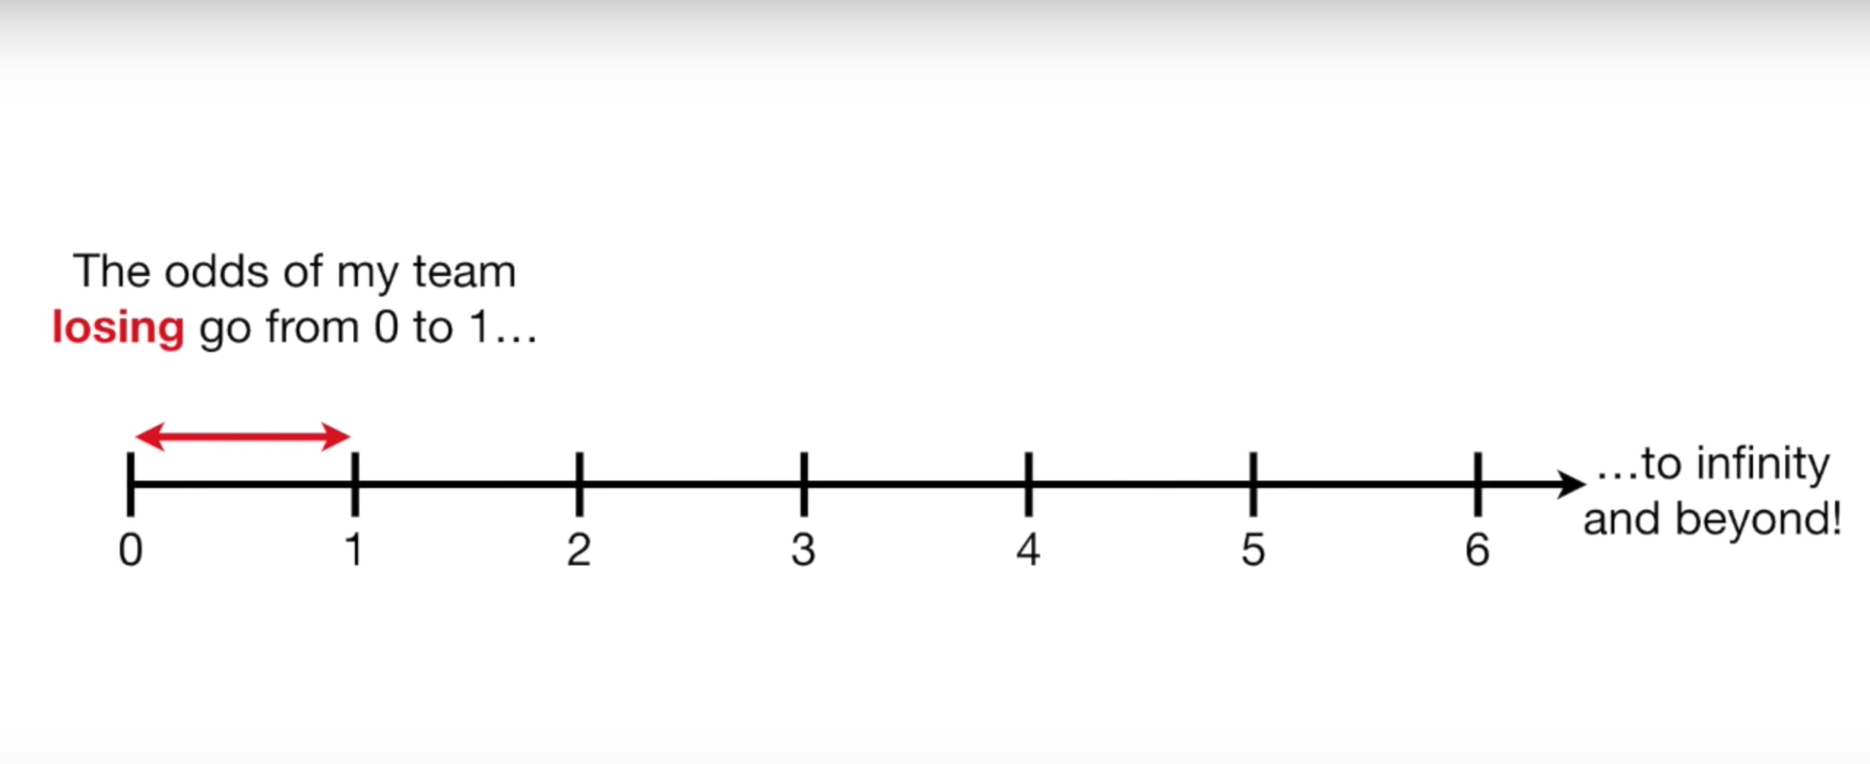
Odds
Only valid between 0 and 1

Slide 9
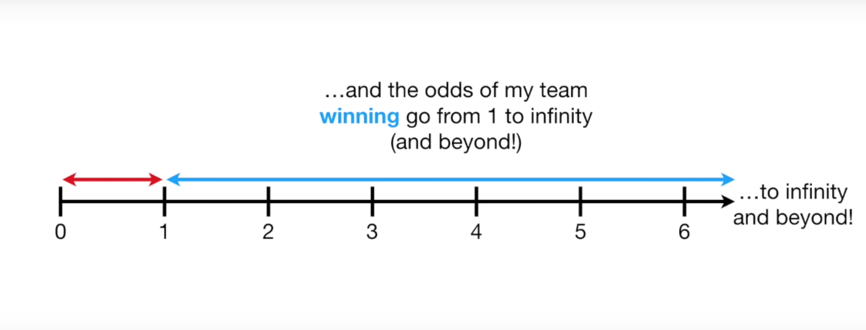
Odds
Only valid between 0 and 1

Slide 10
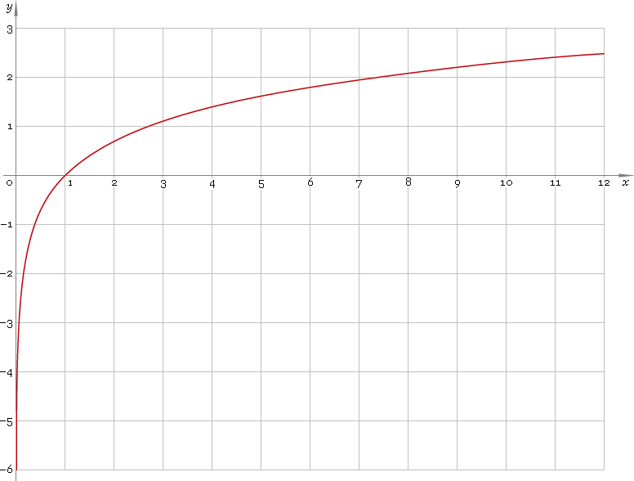
Fix #2: Log()
Evens out scale between 0-1 and rest

Slide 11
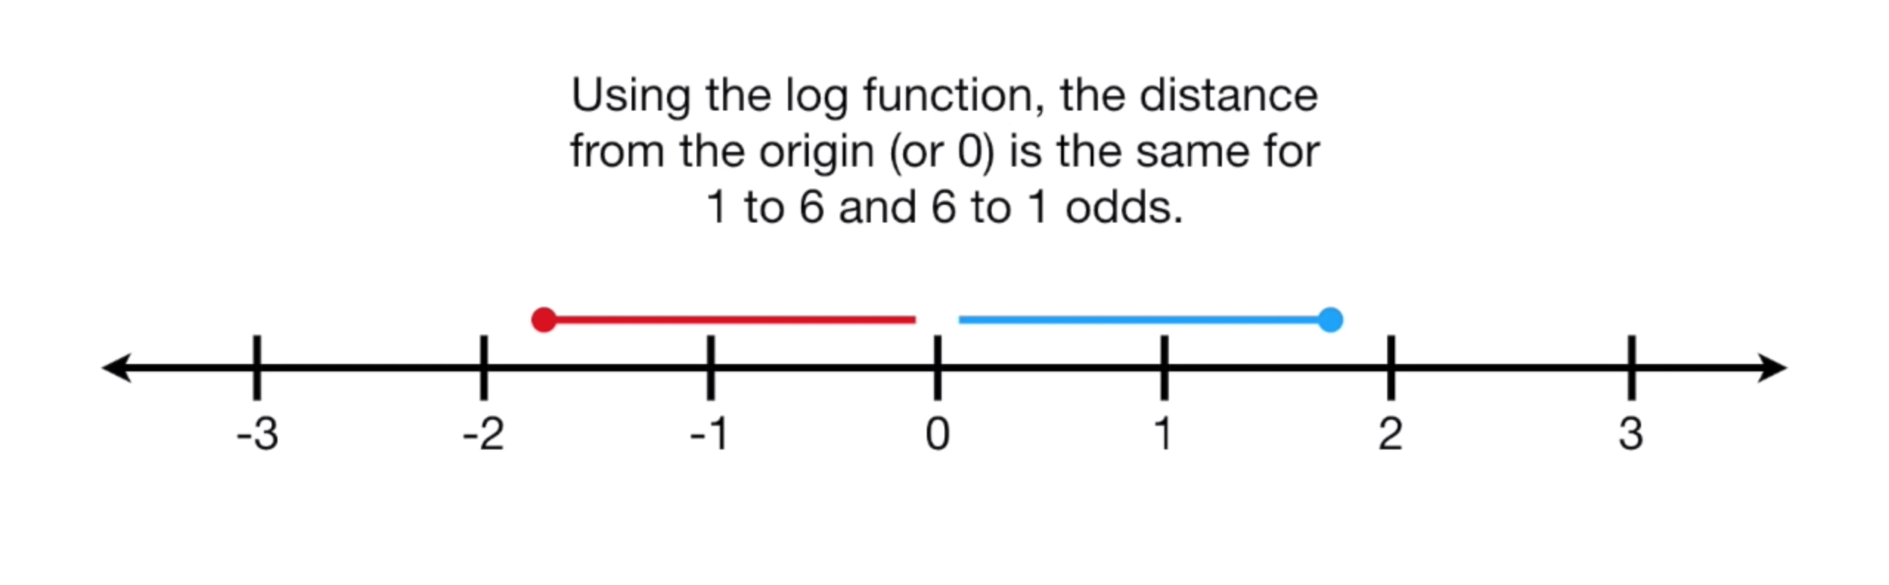
Log-Odds

Slide 12
Fix #2: Log()
Win = log(4) = 1.39
Lose = log(0.25) = -1.39

Slide 13
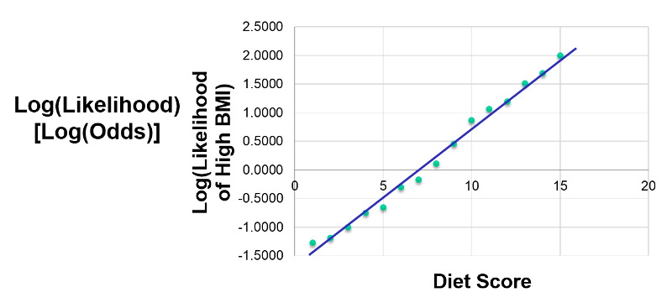

Slide 14
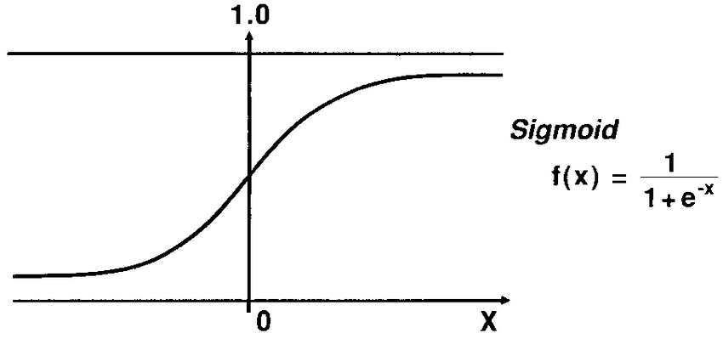
Sigmoid function
Translates log-odds back to probability

Slide 15
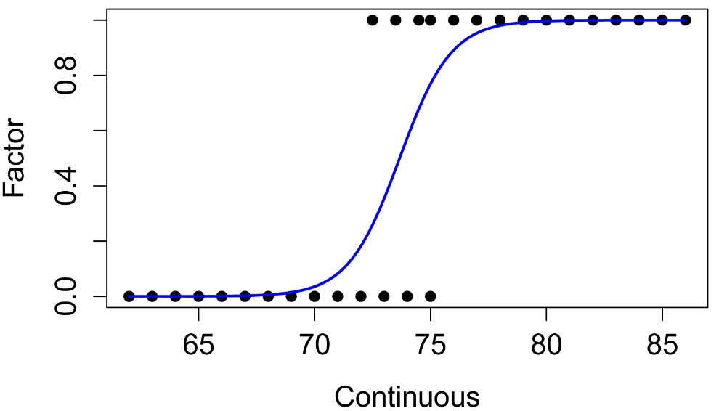
Maximum Likelihood

Slide 16
Logistic Regression
Output is probability
Probability -> classification using a discrimination threshold
Default threshold: 0.5

Slide 17
Discrimination Threshold

Slide 18
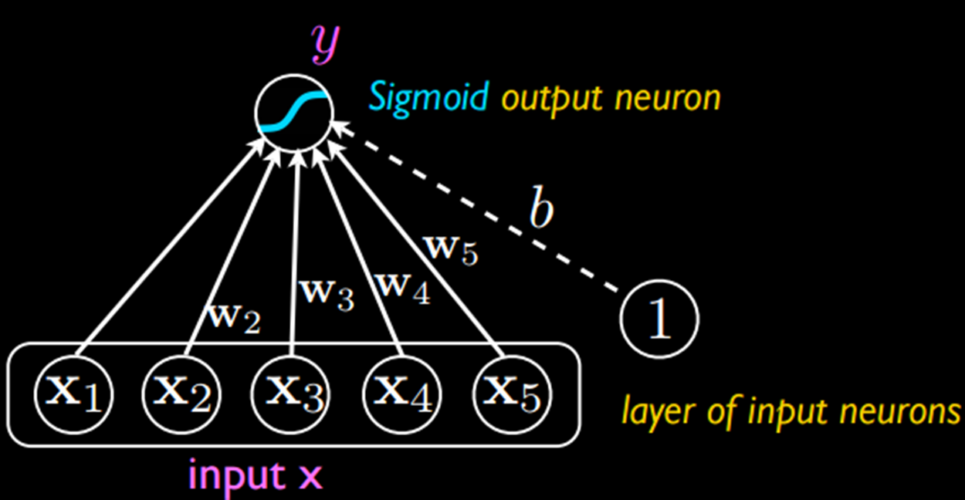
Deep Learning / neural networks
Machine learning models
Treat each of the neurons as a logistic regression classifier
Example:
x1: Is the object orange?
x2: Is the object shaped like a cat?
x3: Is the object chasing a mouse?

Slide 19
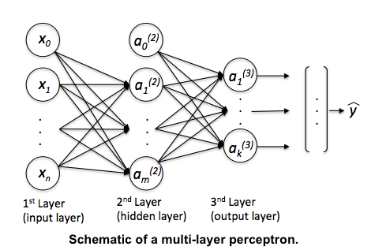

Slide 20
Exercises

Slide 21
ROC Curve
Short for “Receiver operating characteristic”
Shows effect of changing probability threshold

Slide 22
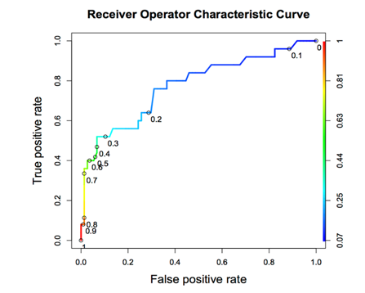
Notes:
True positive rate / sensitivity / recall: the proportion of actual positives that are correctly identified as such
-Out of all the true positives, what proportion did you correctly identify?
False positive rate:
-Out of all the true negatives, what proportion did fail to identify as such?

Slide 23
ROC Curve
Tradeoff between True Positive Rate and False Positive Rate
Neutral on class? Choose closest point to top-left corner.

Slide 24
Area Under the curve
Total AUC is a measure of classifier power
1.0 is perfect, 0.5 is as bad as random chance

Slide 25
Notes:
True positive rate / sensitivity / recall: the proportion of actual positives that are correctly identified as such
-Out of all the true positives, what proportion did you correctly identify?
False positive rate:
-Out of all the true negatives, what proportion did fail to identify as such?

Slide 26
RoC and class balance
X-axis is sized relative to POSITIVE class
Y-axis is sized relative to NEGATIVE class

Slide 27
Notes:
True positive rate / sensitivity / recall: the proportion of actual positives that are correctly identified as such
-Out of all the true positives, what proportion did you correctly identify?
False positive rate:
-Out of all the true negatives, what proportion did fail to identify as such?

Slide 28
Precision-Recall Curve
Both axes are sized relative to POSITIVE class
Shows how % correct of POSITIVE guesses goes down as threshold lowers

Slide 29
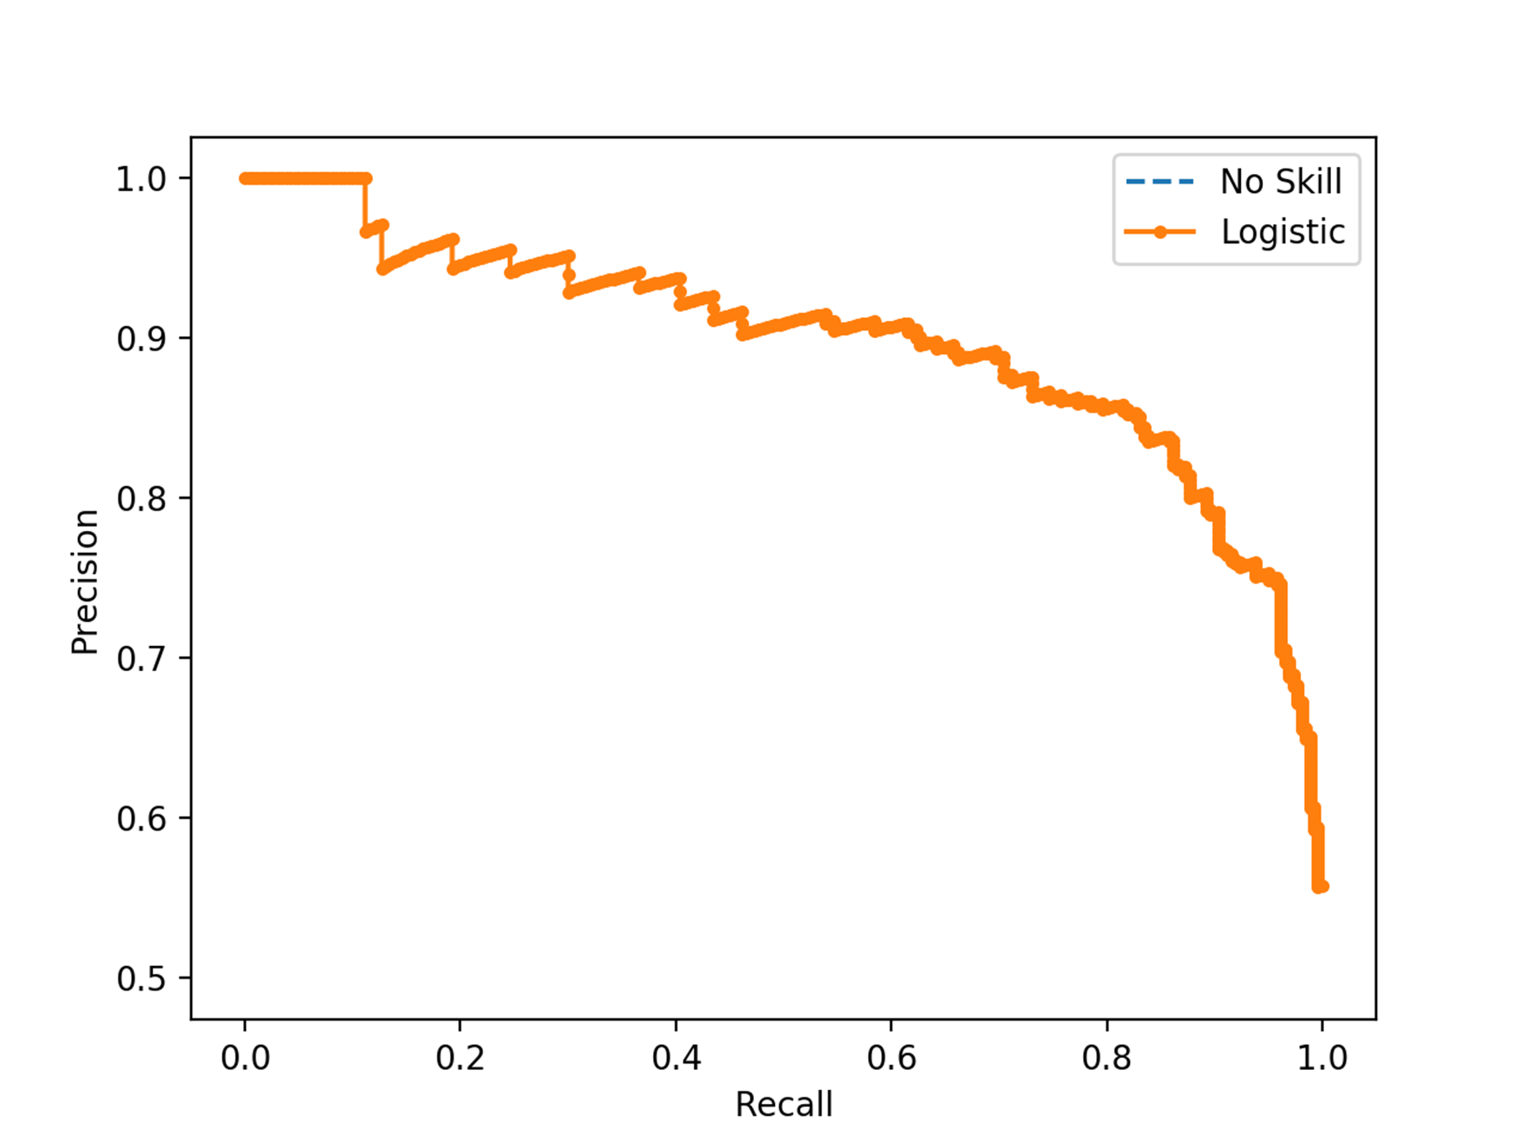
SUCCESS RATE WITH POSITIVE GUESSES
TRUE POSITIVE RATE
Notes:
Precision / positive predictive value: true positives / (true positives + false positives)
Recall / sensitivity / true positive rate: the proportion of actual positives that are correctly identified as such
-Out of all the true positives, what proportion did you correctly identify?

Slide 30
Exercises

Slide 31
Imbalanced classes

Slide 32
problem #1
Randomly selecting rows USUALLY class proportions
However, when positive cases are sparse, LOTS of variance

Slide 33
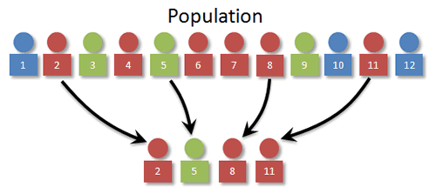

Slide 34
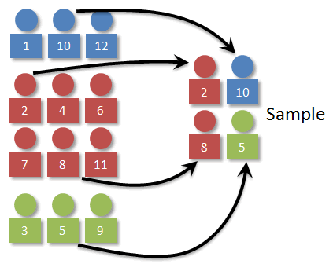

Slide 35
Problem #2
Often have WAY more negative samples than positive
High “accuracy” if you always guess negative!

Slide 36

Transactions
Fraudulent

Slide 37
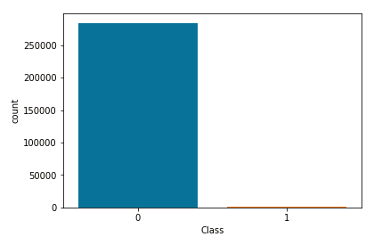

Slide 38
Sensitivity
TP / (TP + FN)
Focuses only on performance on TRUE samples

Slide 39
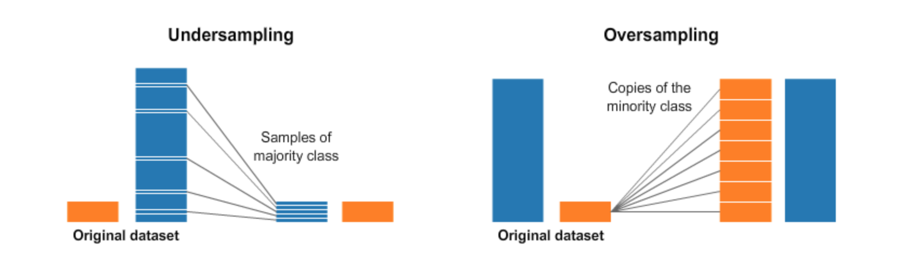

Slide 40
Oversampling
Often have WAY more negative samples than positive
High “accuracy” if you always guess negative!

Slide 42
Undersampling
Avoid — loses data!
Used when size is expensive, eg. Big Data or data that has to be cleaned manually

Slide 43
Imbalance-learn
Fix imbalance in Pipeline
Need to import make_pipeline() from imbalance-learn instead

Slide 44
Random Oversampler
Adds random duplicates
from imblearn.over_sampling import RandomOverSampler

