Slide 1
Bootcamp
Machine Learning

Slide 2
Decision Trees

Slide 3

Interpreting
Decision tree

Slide 4
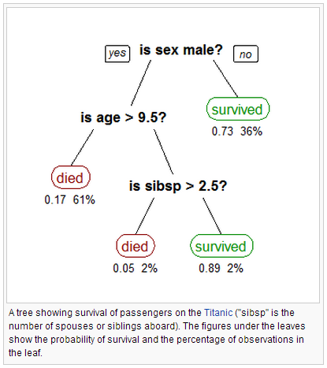

Slide 5

Building
Decision tree
Notes:
Yes/no questions
Ask the questions that eliminate the most possibilities

Slide 6
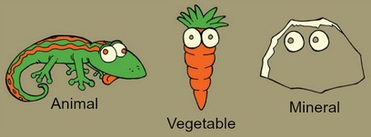

Slide 7
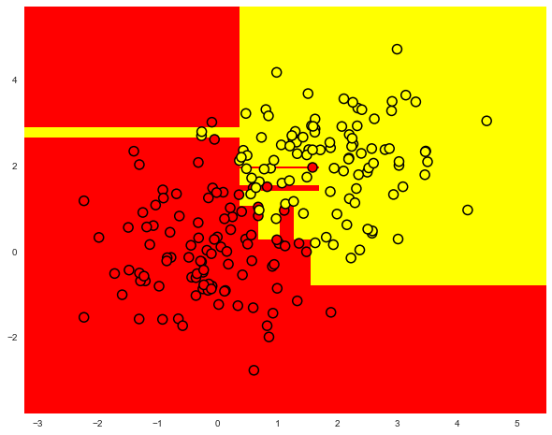
Feature B
Feature A

Slide 8
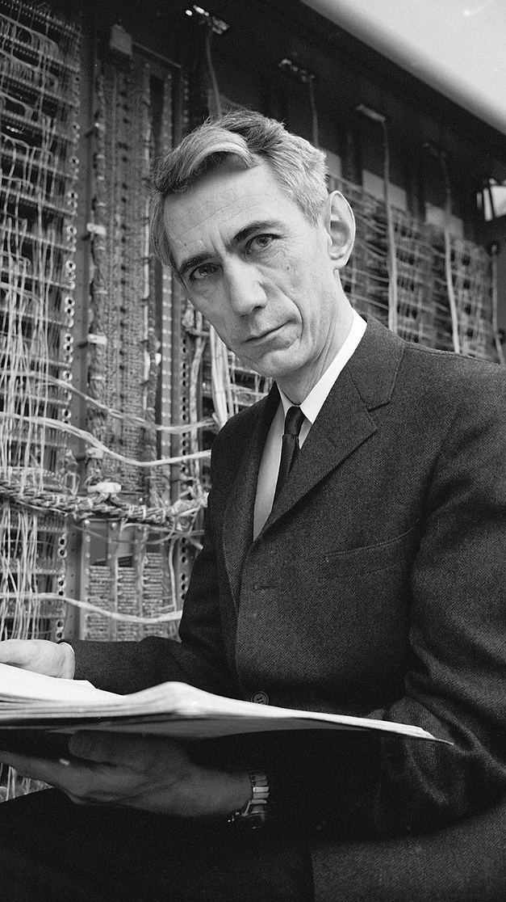
Claude Shannon

Slide 9
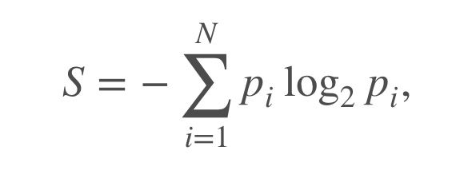

Shannon Entropy
Measure of how many possible states a a system can be in
Features that reduce entropy are good to split on in decision trees

Slide 10
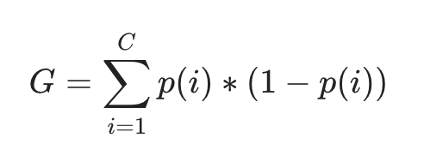
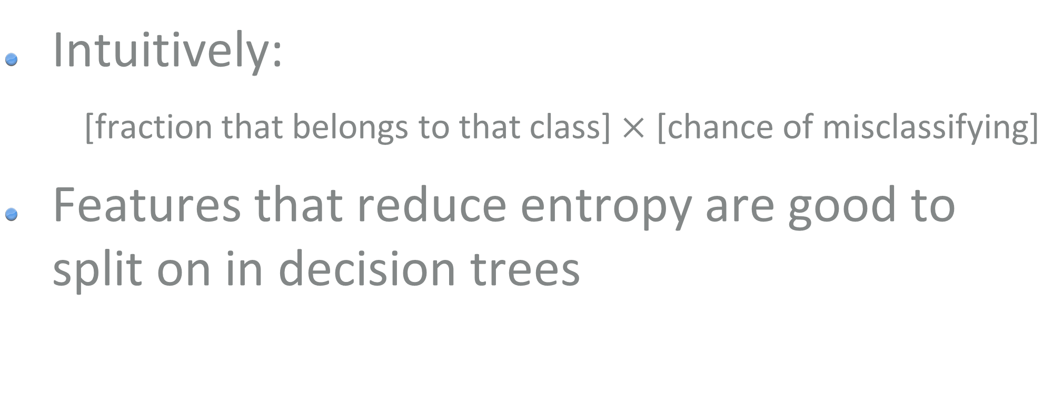
Gini Index/Impurity
Intuitively:
[fraction that belongs to that class] $×$ [chance of misclassifying]
Features that reduce entropy are good to split on in decision trees

Slide 11
Building a Decision tree
Evaluate Gini impurity of every possible split in data
Repeat process within each subset
Not guaranteed to be optimal!

Slide 12
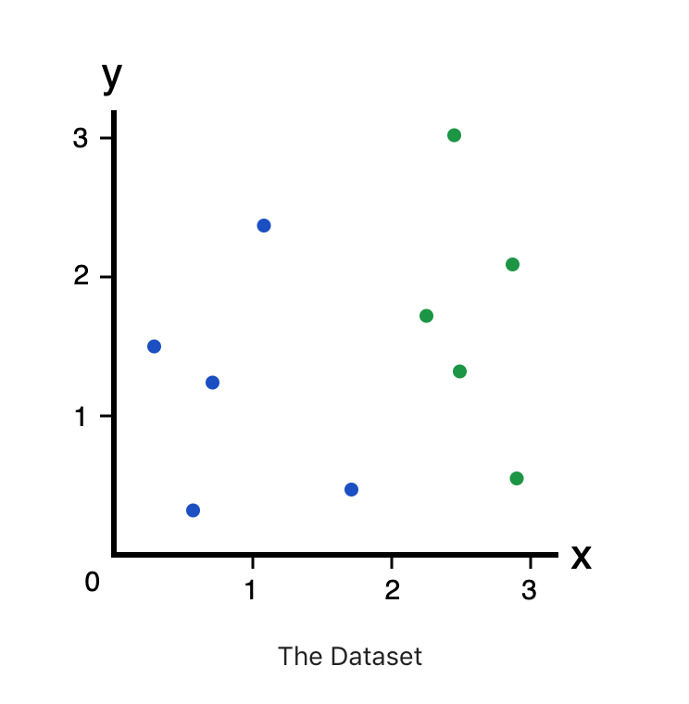

Slide 13
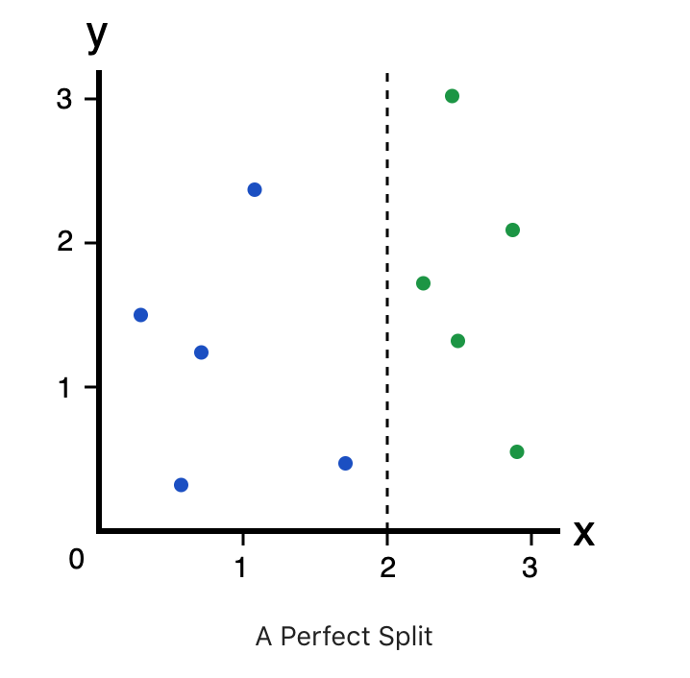

Slide 14
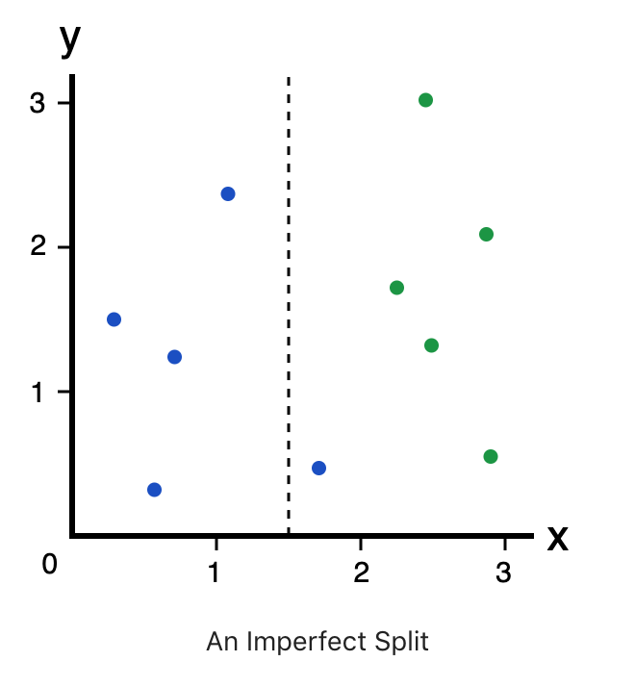

Slide 15
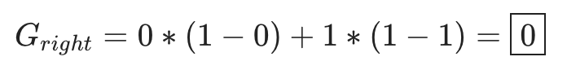

Slide 17
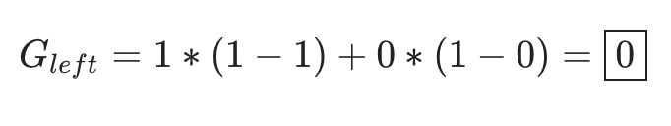

Slide 19
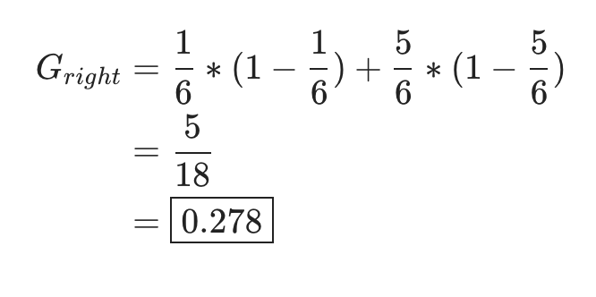

Slide 22
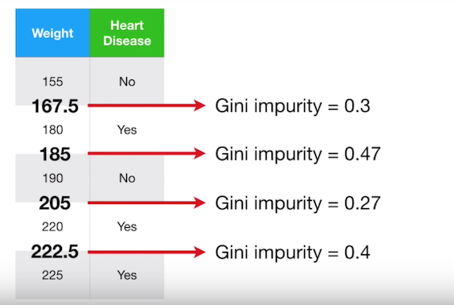

Slide 23
Pros of Decision Trees
Transparent, interpretable by humans
Inputs can be categorical or numeric
Can do regression or classification

Slide 24
Cons of Decision Trees
High variance. Unstable even with small changes in training set.
Optimal tree is often impossible to calculate

Slide 25
Ensemble Methods

Slide 26
Ensemble methods
Combining multiple models
Akin to “Wisdom of the Crowds”
Models can focus on different parts of the data

Slide 27
Bagging
Short for bootstrap aggregating
Models are trained on random subsets of the data

Slide 28
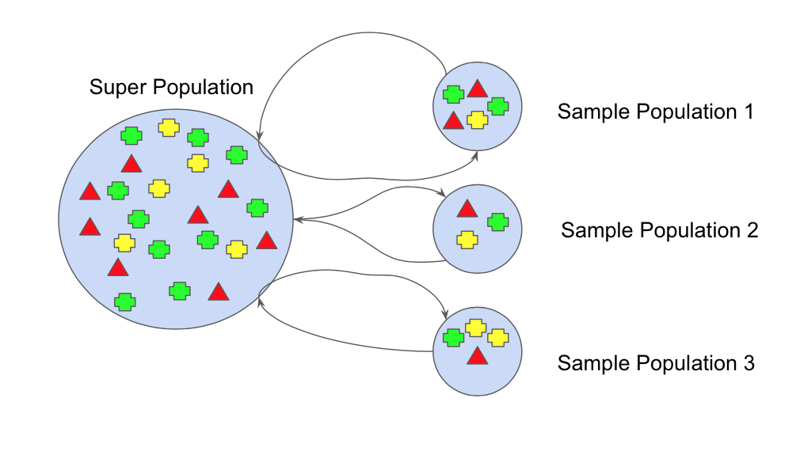

Slide 29
Bagging: Final Step
Classification: Majority vote
Regression: Average the outputs

Slide 30
Random Forest
Train a multitude of decision trees
Each tree uses a random subset of samples
Each SPLIT uses a random subset of features

Slide 31

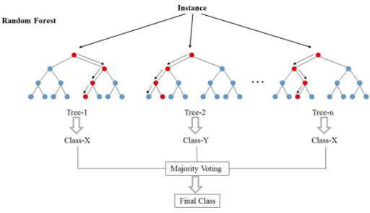

Slide 32
Random features
Some features will be predictive
Predictive features will end up being used by many models, and affecting final output

Slide 33
Exercises

Slide 34
Recap

Slide 35
Distance-Based Techniques

Slide 36
Distance-Based ML
K-Nearest Neighbors
Linear Regression
Polynomial Regression
Logistic Regression

Slide 37
Benefits
Easy to understand and interpret
Parametric distance-based models perform well with a small amount of data
Tend not to overfit

Slide 38
Drawbacks
Numerical inputs only
More dimensions? More problems

Slide 39
Probability-Based Techniques

Slide 40
probability Based
Naive Bayes

Slide 41
Benefits
Handles high-dimensional data well
Fast in both training and prediction

Slide 42
Drawbacks
Classification tasks only
Sensitive to slight differences in data, eg “starbucks” vs “Starbuck”

Slide 43
Tree-Based Techniques

Slide 44
Tree Based
Decision tree
Random forest

Slide 45
Benefits
Easy to understand and interpret
Does not require much data cleaning
Can fit unusual patterns
Automatic feature selection

Slide 46
Drawbacks
In sklearn, numerical inputs only
To avoid overfitting, you lose interpretability
Good baseline, but hard to fine-tune

Slide 47
Parametric
Models

Slide 48
Parametric Models
Linear Regression
Polynomial Regression
Logistic Regression
Naive Bayes

Slide 49
Benefits
Require much less data
If underlying assumptions are accurate, generally performs better

Slide 50
Drawbacks
Will underfit if assumptions aren’t accurate
Past a point, will basically ignore more data
Cannot fit mathematically unusual patterns

Slide 51
Non-parametric
Models

Slide 52
Non-parametric
K-Nearest Neighbors
Decision Trees
Random Forest

Slide 53
Benefits
No assumptions about probability distribution or functional form
Can fit very irregular patterns

Slide 54
Drawbacks
Low bias means it’s easy to overfit
Requires much more data to be accurate
“Model” keeps the entire dataset!

Slide 55
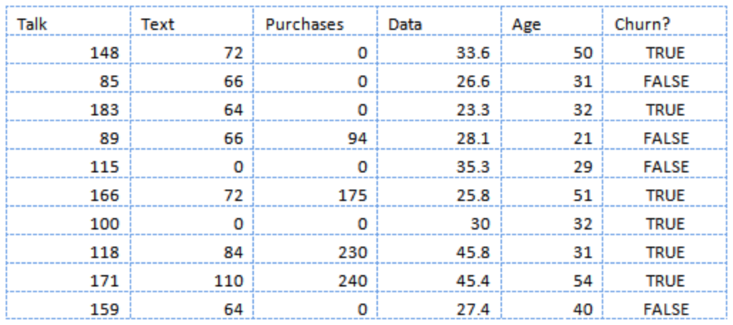
Notes:
(Decision trees)
Random forest
Logistical regression
Naïve Bayes
KNN

Slide 56
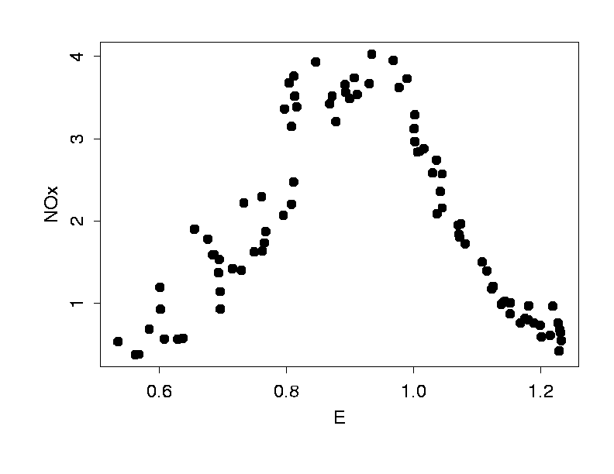
Text

Slide 57
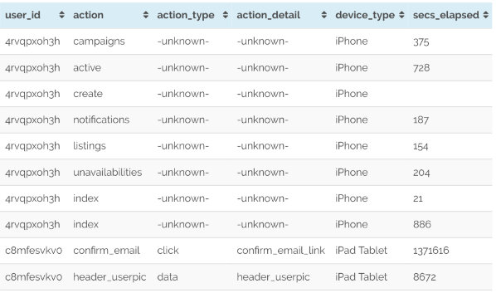
Text

Slide 58
