Slide 1
Bootcamp
Machine Learning

Slide 2
Logistic Regression

Slide 3

Logistic Regression
Modify output of linear model to be a probability
Used for classification, despite name

Slide 4
Problems with Probability
Positive values only
Must fit between 0 and 1

Slide 5
Solution: Output something easier
Output something more line-friendly
Translate back to probability later

Slide 6
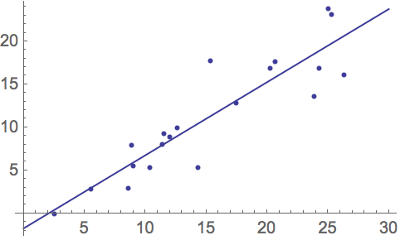

Slide 7
Fix #1: Odds
Ratio of two probabilities
e.g. P(Win) = 0.8, P(Lose) =0.2
Odds of winning = 0.8/0.2 = 4
Odds of losing = 0.2/0.8 = 0.25

Slide 8
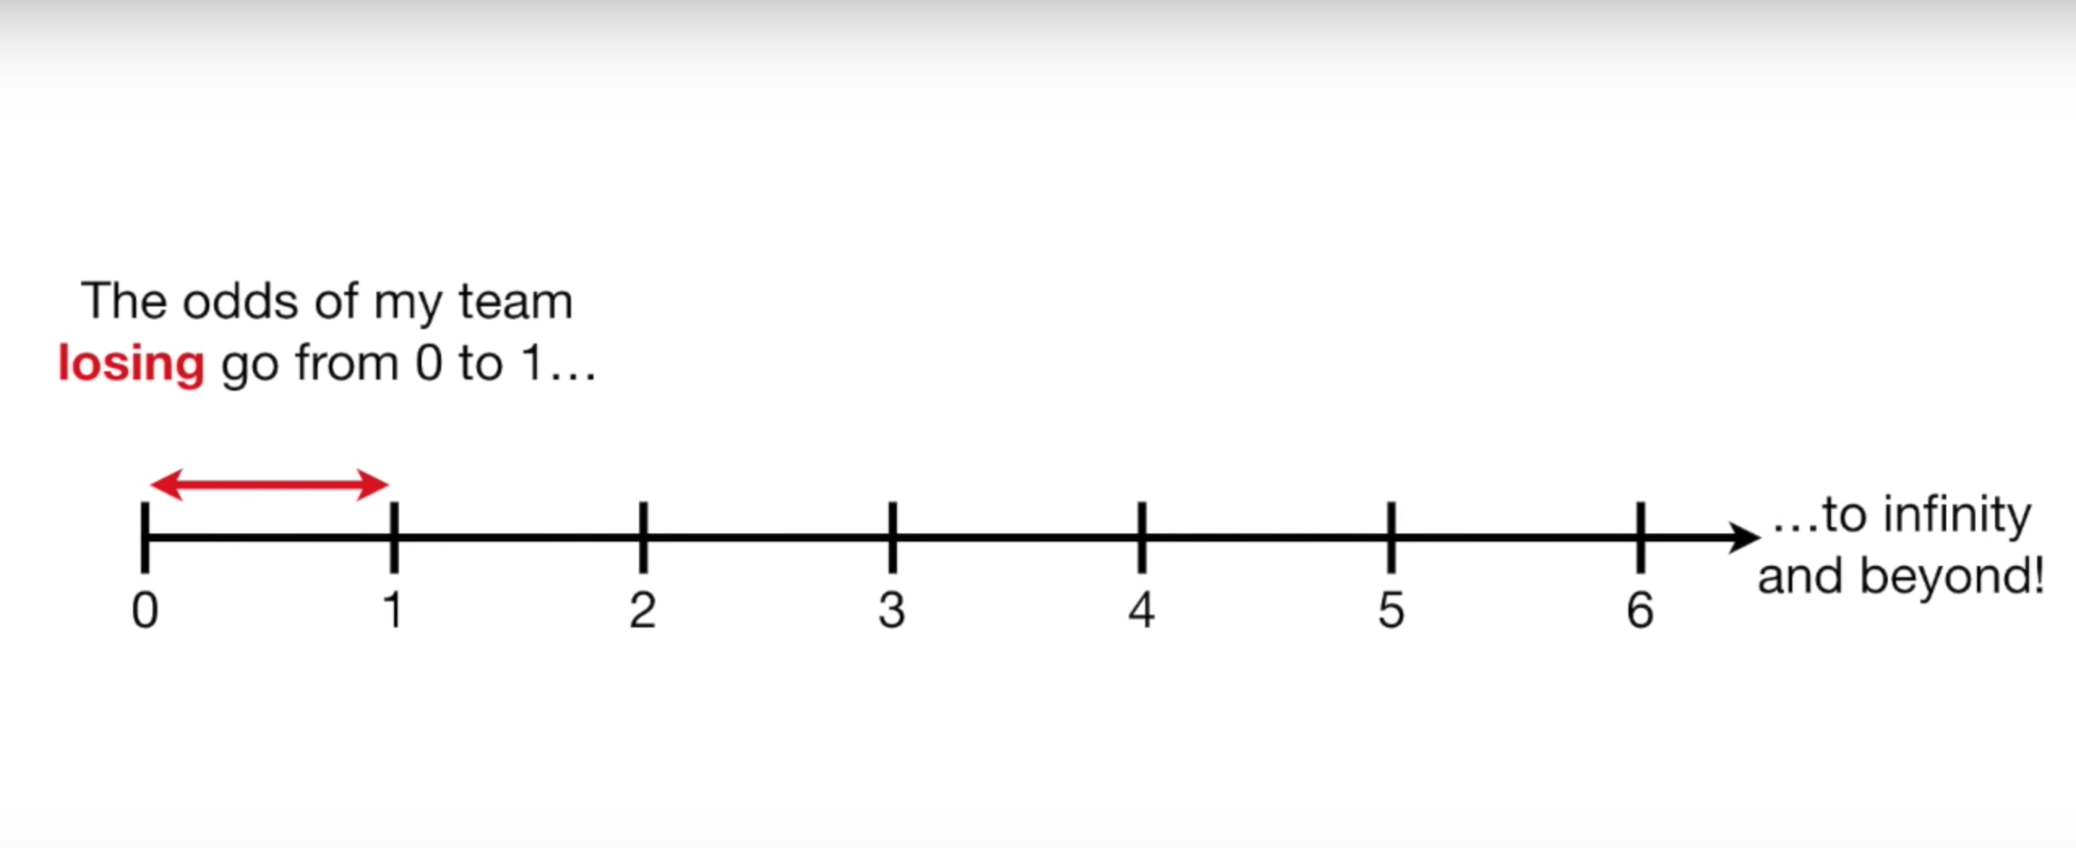
Odds
Only valid between 0 and 1

Slide 9
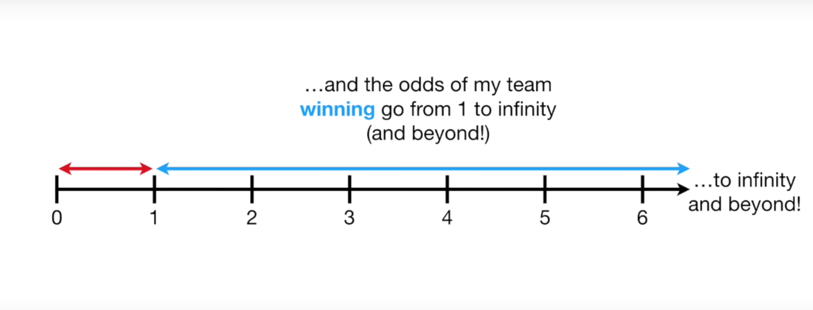
Odds
Only valid between 0 and 1

Slide 10
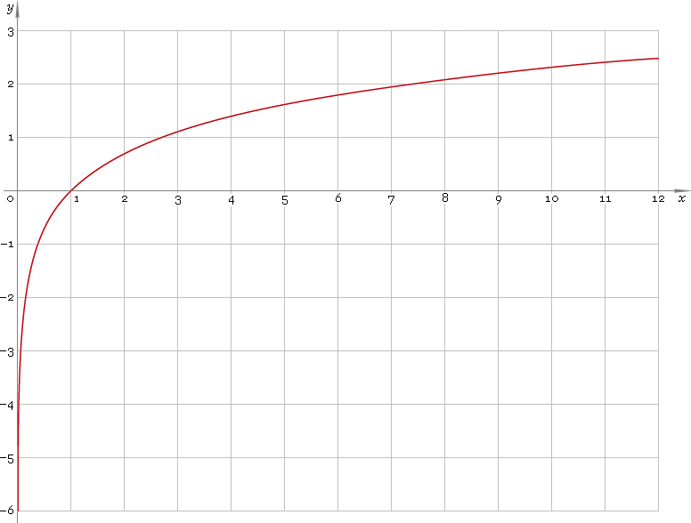
Fix #2: Log()
Evens out scale between 0-1 and rest

Slide 11
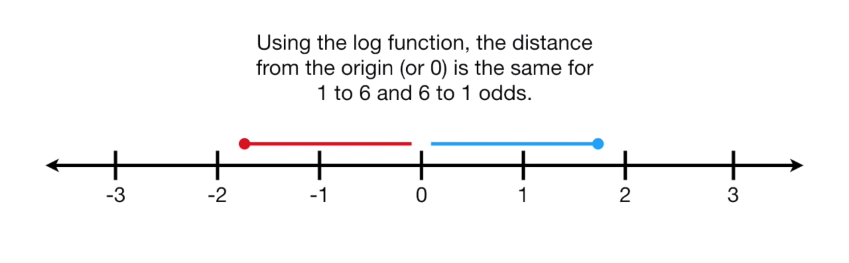
Log-Odds

Slide 12
Fix #2: Log()
Win = log(4) = 1.39
Lose = log(0.25) = -1.39

Slide 13
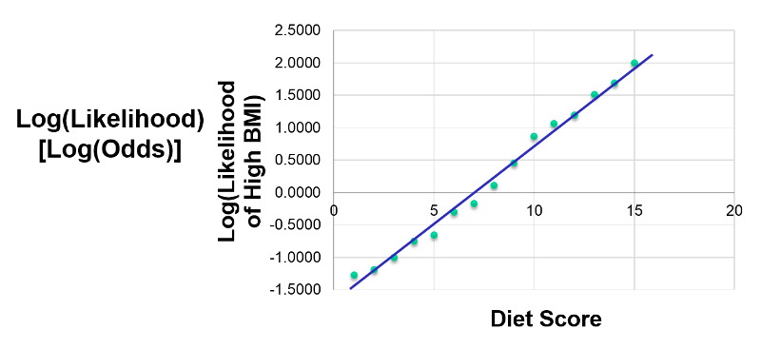

Slide 14
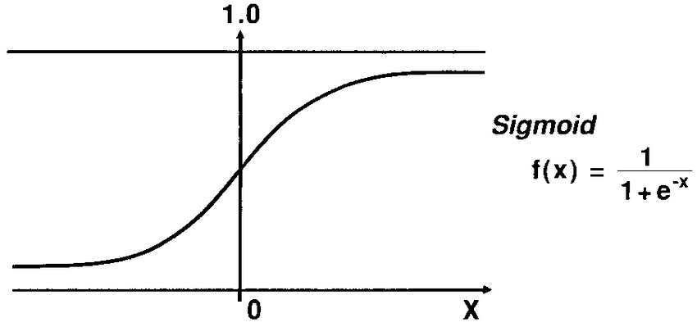
Sigmoid function
Translates log-odds back to probability

Slide 15
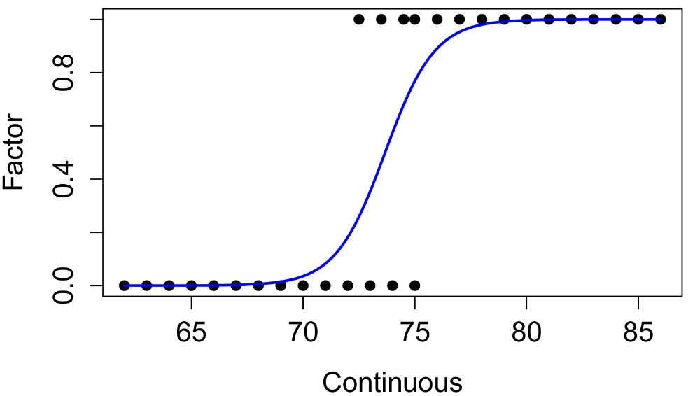

Slide 16
Logistic Regression
Output is probability
Probability -> classification using a discrimination threshold
Default threshold: 0.5

Slide 18
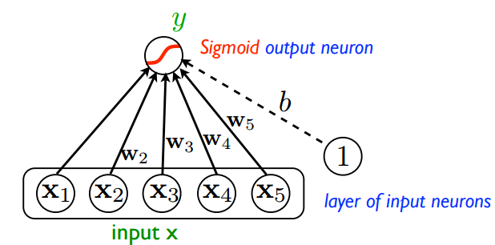

Slide 19
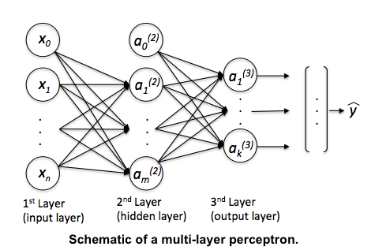

Slide 20
Exercises

Slide 21
ROC Curve
Short for “Receiver operating characteristic”
Shows effect of changing probability threshold

Slide 22
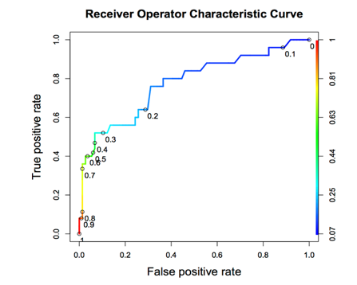

Slide 23
ROC Curve
Tradeoff between True Positive Rate and False Positive Rate
Neutral on class? Choose closest point to top-left corner.

Slide 24
Area Under the curve
Total AUC is a measure of classifier power
1.0 is perfect, 0.5 is as bad as random chance

Slide 26
RoC and class balance
X-axis is sized relative to POSITIVE class
Y-axis is sized relative to NEGATIVE class

Slide 28
Precision-Recall Curve
Both axes are sized relative to POSITIVE class
Shows how % correct of POSITIVE guesses goes down as threshold lowers

Slide 29
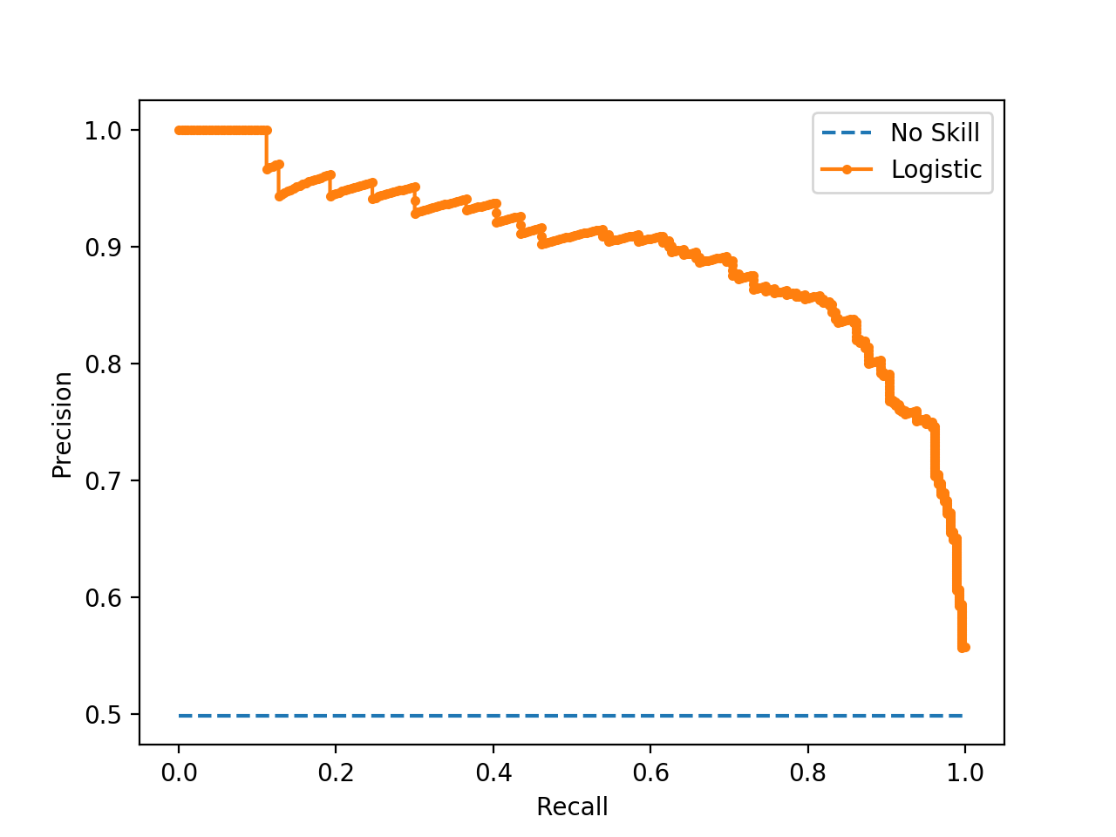

Slide 30
SUCCESS RATE WITH POSITIVE GUESSES
TRUE POSITIVE RATE

Slide 31
Exercises

Slide 32
Imbalanced classes

Slide 33
problem #1
Randomly selecting rows USUALLY class proportions
However, when positive cases are sparse, LOTS of variance

Slide 34
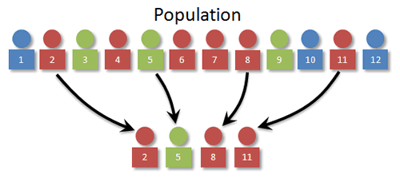

Slide 35
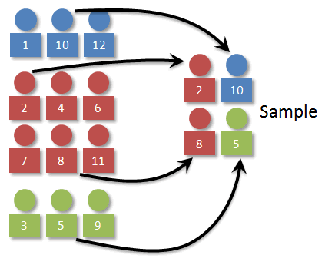

Slide 36
Problem #2
Often have WAY more negative samples than positive
High “accuracy” if you always guess negative!

Slide 37

Transactions
Fraudulent

Slide 38
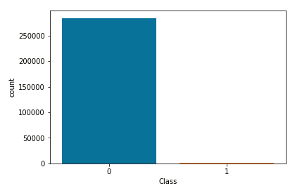

Slide 39
Sensitivity
TP / TP + FN
Focuses only on performance on TRUE samples

Slide 40
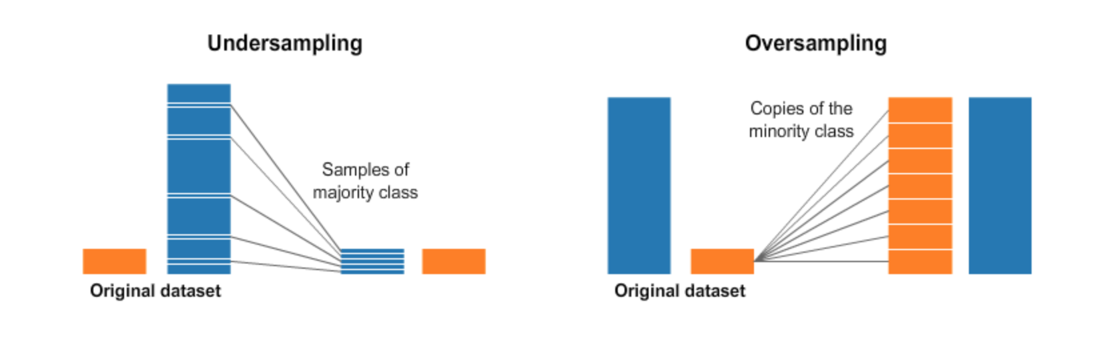

Slide 41
Oversampling
Often have WAY more negative samples than positive
High “accuracy” if you always guess negative!

Slide 43
Undersampling
Avoid — loses data!
Used when size is expensive, eg. Big Data or data that has to be cleaned manually

Slide 44
Imbalance-learn
Fix imbalance in Pipeline
Need to import make_pipeline() from imbalance-learn instead

Slide 45
Random Oversampler
Adds random duplicates
from imblearn.over_sampling import RandomOverSampler

