Slide 1
Bootcamp
Python for Data Science

Slide 2

Sci-Kit Learn
All-in-one machine learning package
Built on Numpy and matplotlib

Slide 3

Text

Slide 4
Imported as sklearn
import sklearn

Slide 5
Imported as sklearn
from sklearn.linear_model \
import LinearRegression

Slide 6
Linear Regression

Slide 7
Code is not the hard part
model = LinearRegression()
model.fit(Xs, ys)

Slide 8
Code is not the hard part
model.predict(Xs)
target estimate

Slide 9
Linear Regression
Outputs line of best fit
“Best fit” is a function of error

Slide 10
single-variable
y = 2x + 1
coefficient AKA slope

Slide 11
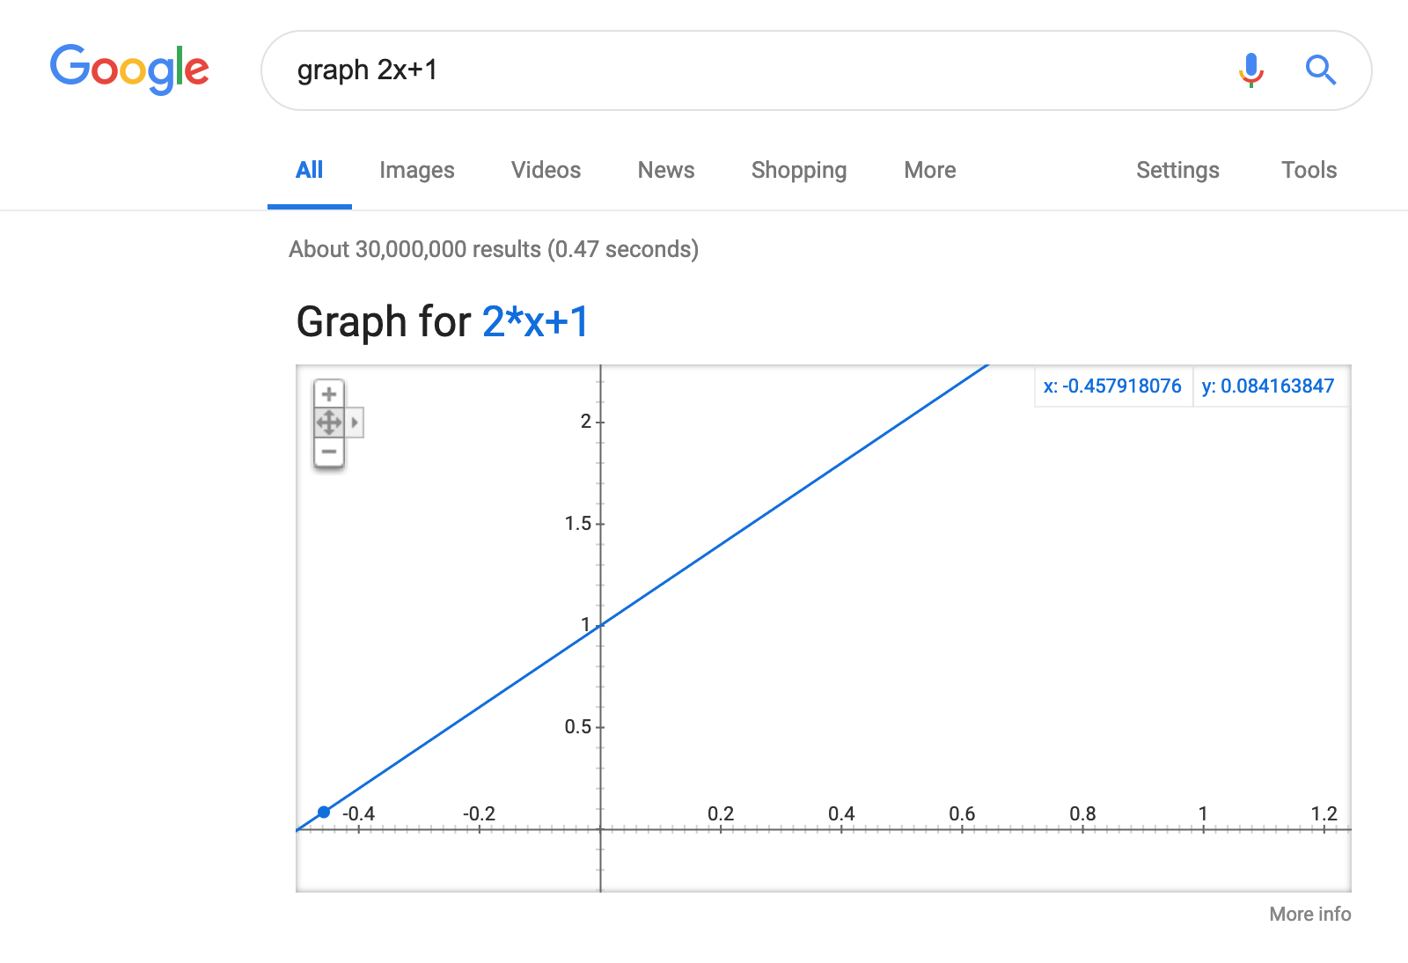
Text

Slide 12
single-variable
y = 2x + 1
1 —> 3
2 —> 5
3 —> 7

Slide 13
Python Equivalent
model = LinearRegression()
model.coef_ = np.array([2.0])
model.intercept_ = 1.0

Slide 14
Ndarray.reshape
Syntax:
ndarray.reshape(rows, columns)
>>> Xs = np.array([1,2,3])
>>> Xs = Xs.reshape(3,1)
>>> print(Xs)
array([[1],
[2],
[3]])

Slide 15
Ndarray.reshape
You can also specify one and leave the other up to Python with -1.
>>> Xs = np.array([1,2,3])
>>> Xs = Xs.reshape(-1,1)
>>> print(Xs)
array([[1],
[2],
[3]])

Slide 16
single-variable
>>> Xs = np.array([1,2,3]).reshape(-1,1)
>>> y = model.predict(Xs)
>>> print(y)
[3,5,7]

Slide 17
single-variable Linear models
No magic!
2 dials: coefficient and intercept

Slide 18
Overlaying graphs
fig = plt.figure()
ax = fig.add_subplot(1,1,1)
ax.plot(df[‘avg_num_rooms’],
predicted_price)
df.plot(‘avg_num_rooms’,
‘median_price,
kind=‘scatter’, ax = ax)
plt.show()

Slide 19
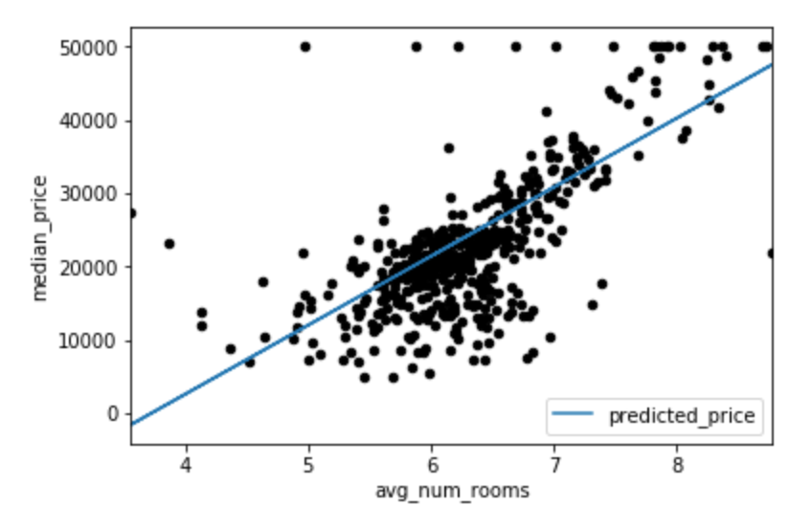

Slide 20
Exercises

Slide 21
Why Least squares?
Math is much simpler
Maximum likelihood estimator, when data is normal

Slide 22
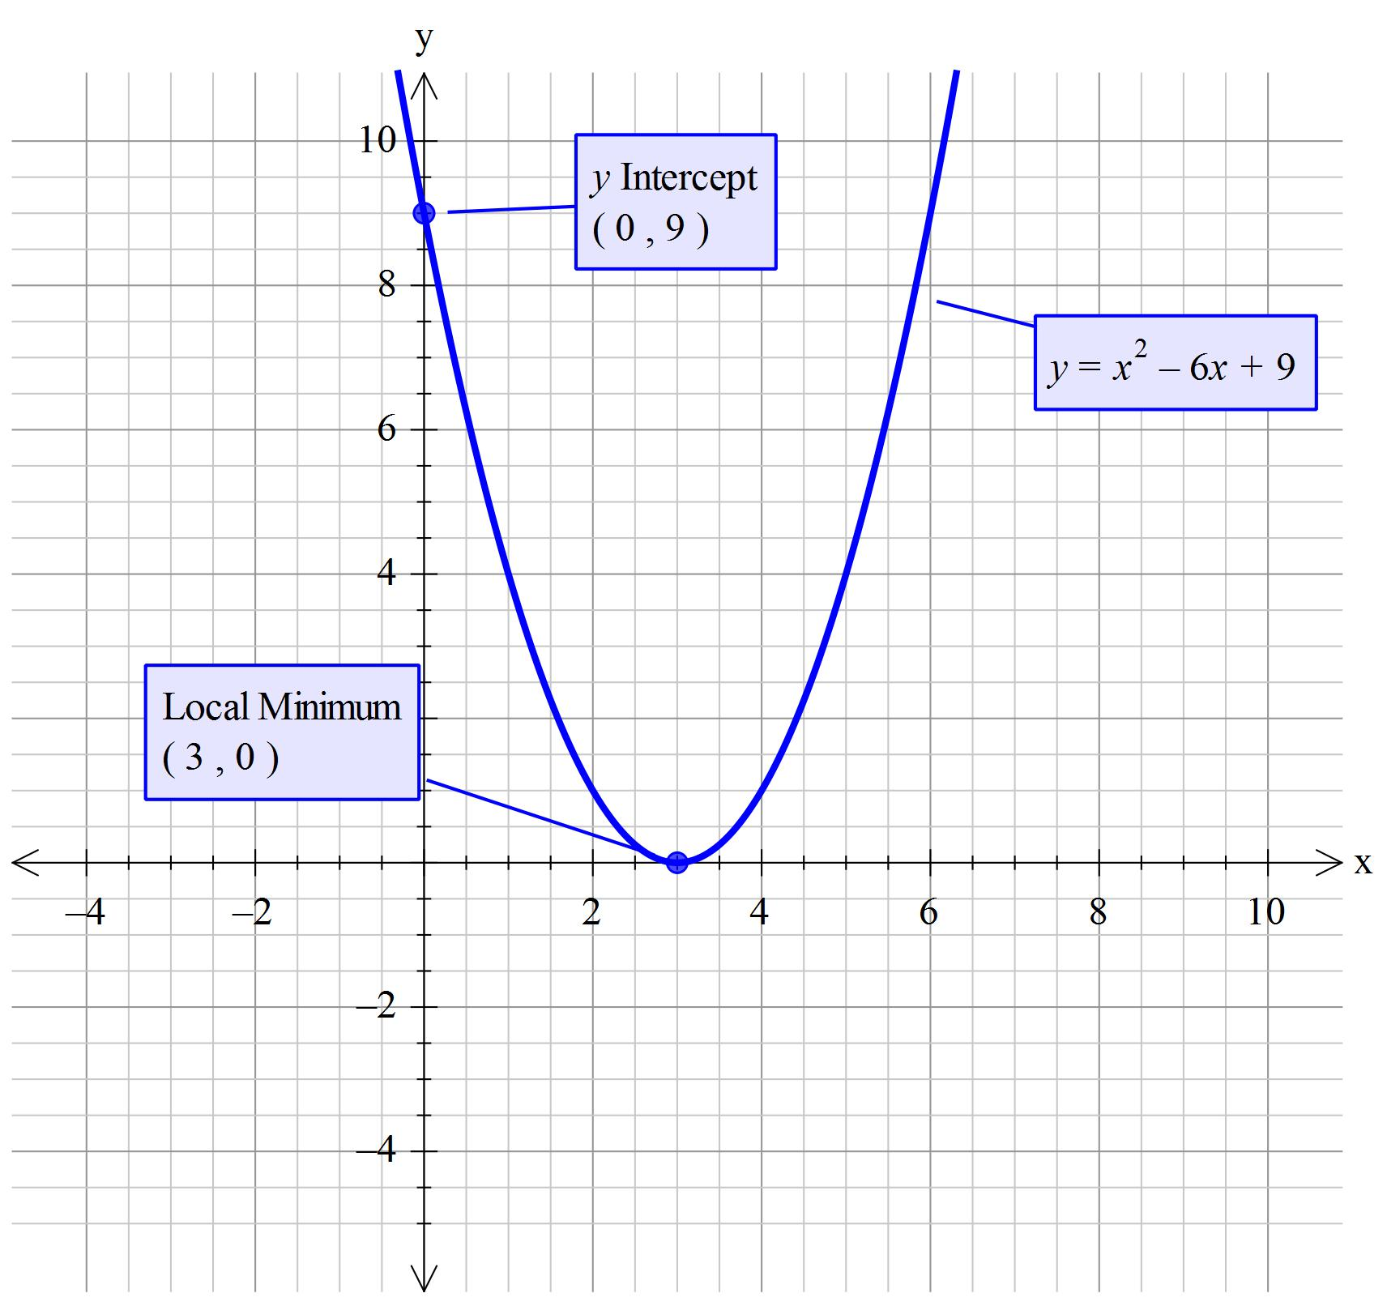
Text

Slide 23
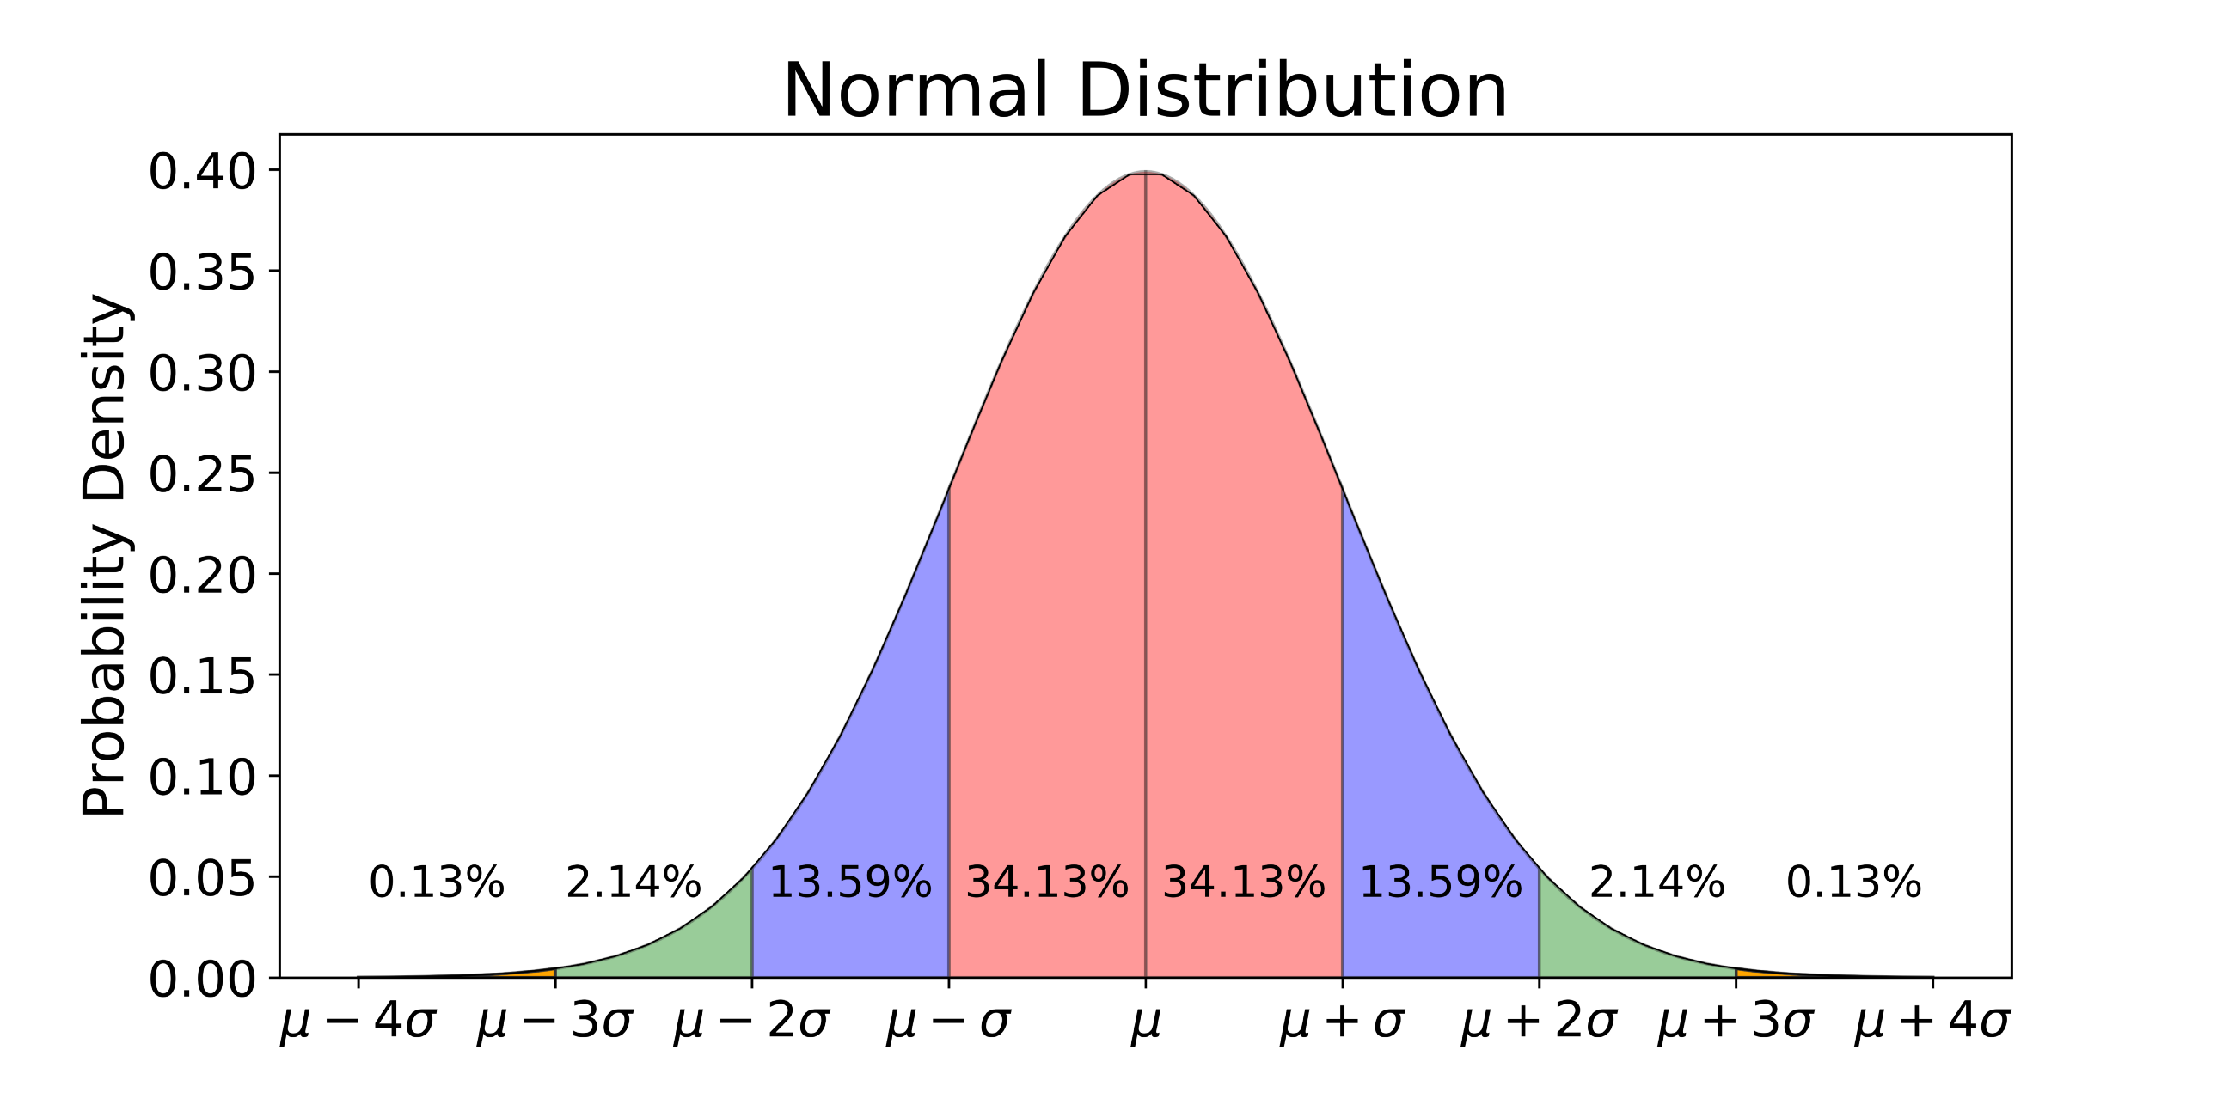

Slide 24
Multi-variable
y = 2x0 + 3x1 + 1

Slide 25
Mean Squared Error
Squared error just like least squares, but average instead of total
Scale is relative to your data!

Slide 26
R² Score
Compares model’s error to deviations from the average
Proportion of variance that is explained by your model
Goes from 1 (perfect) to negative infinity
In a single-variable model, R² is equal to the correlation between the data and the predictions.

Slide 27
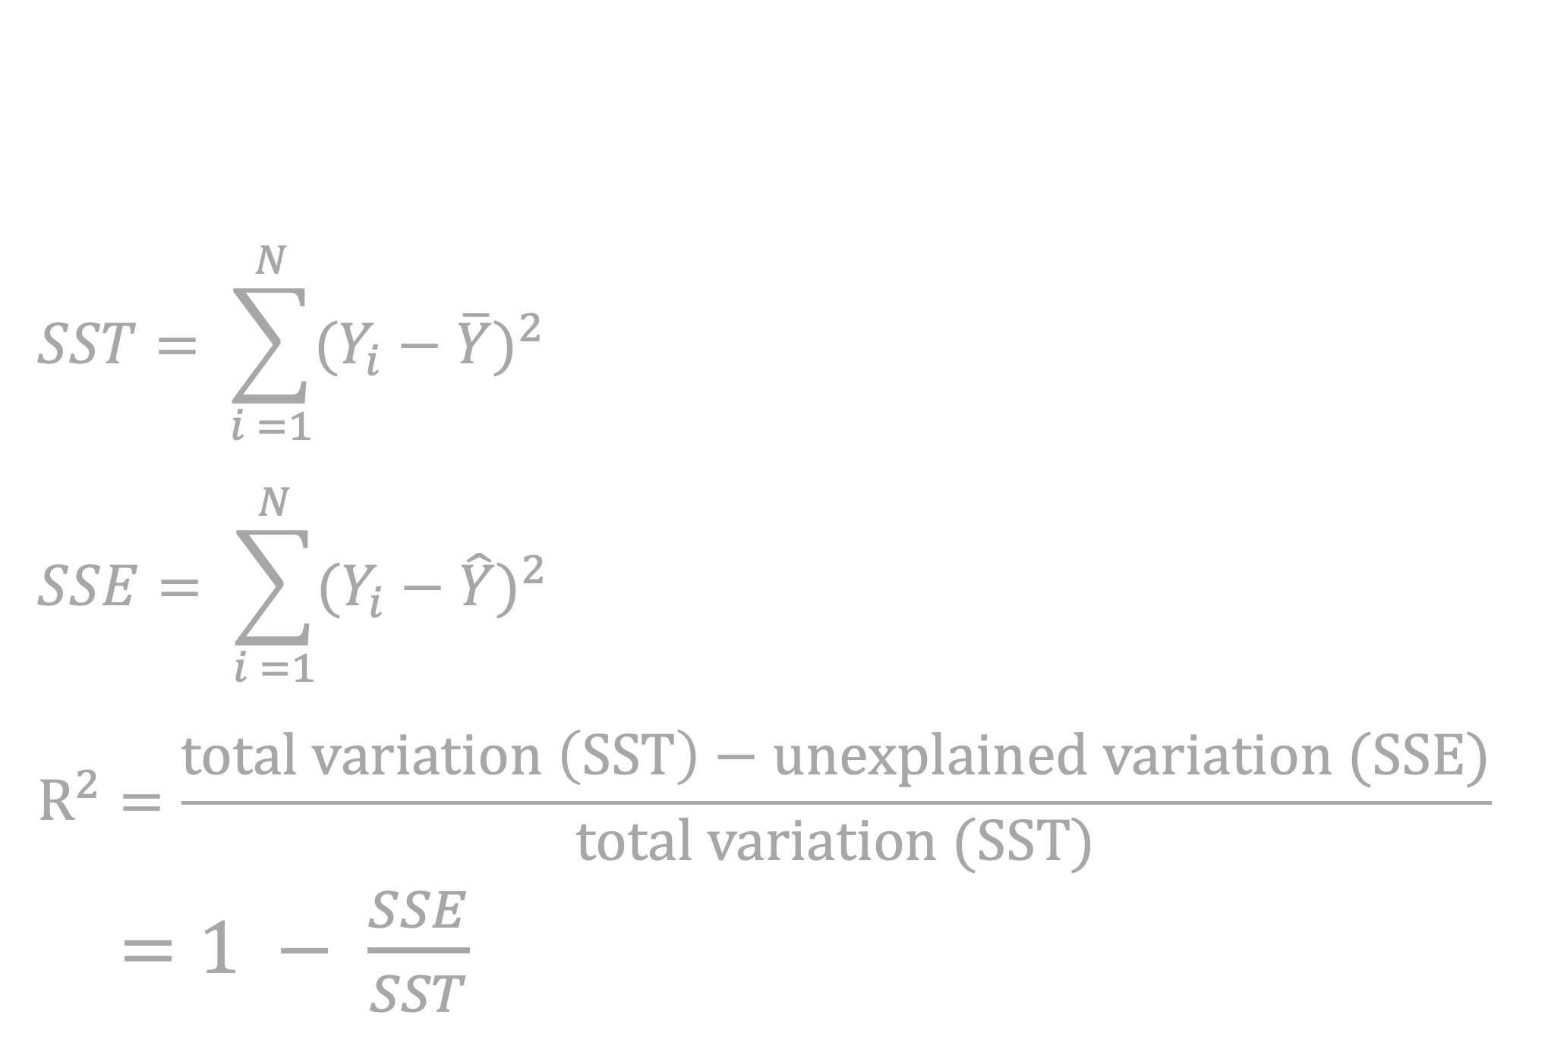
R² score
$$SST= \sum_{i =1}^{N}{{(Y_{i}−\overline{Y})}^{2}}$$
$$SSE= \sum_{i =1}^{N}{{(Y_{i}−\hat{Y})}^{2}}$$
$$R^{2}=\frac{total variation \left(SST\right)−unexplained variation (SSE)}{total variation (SST)}$$
$=1 − \frac{SSE}{SST}$

Slide 28
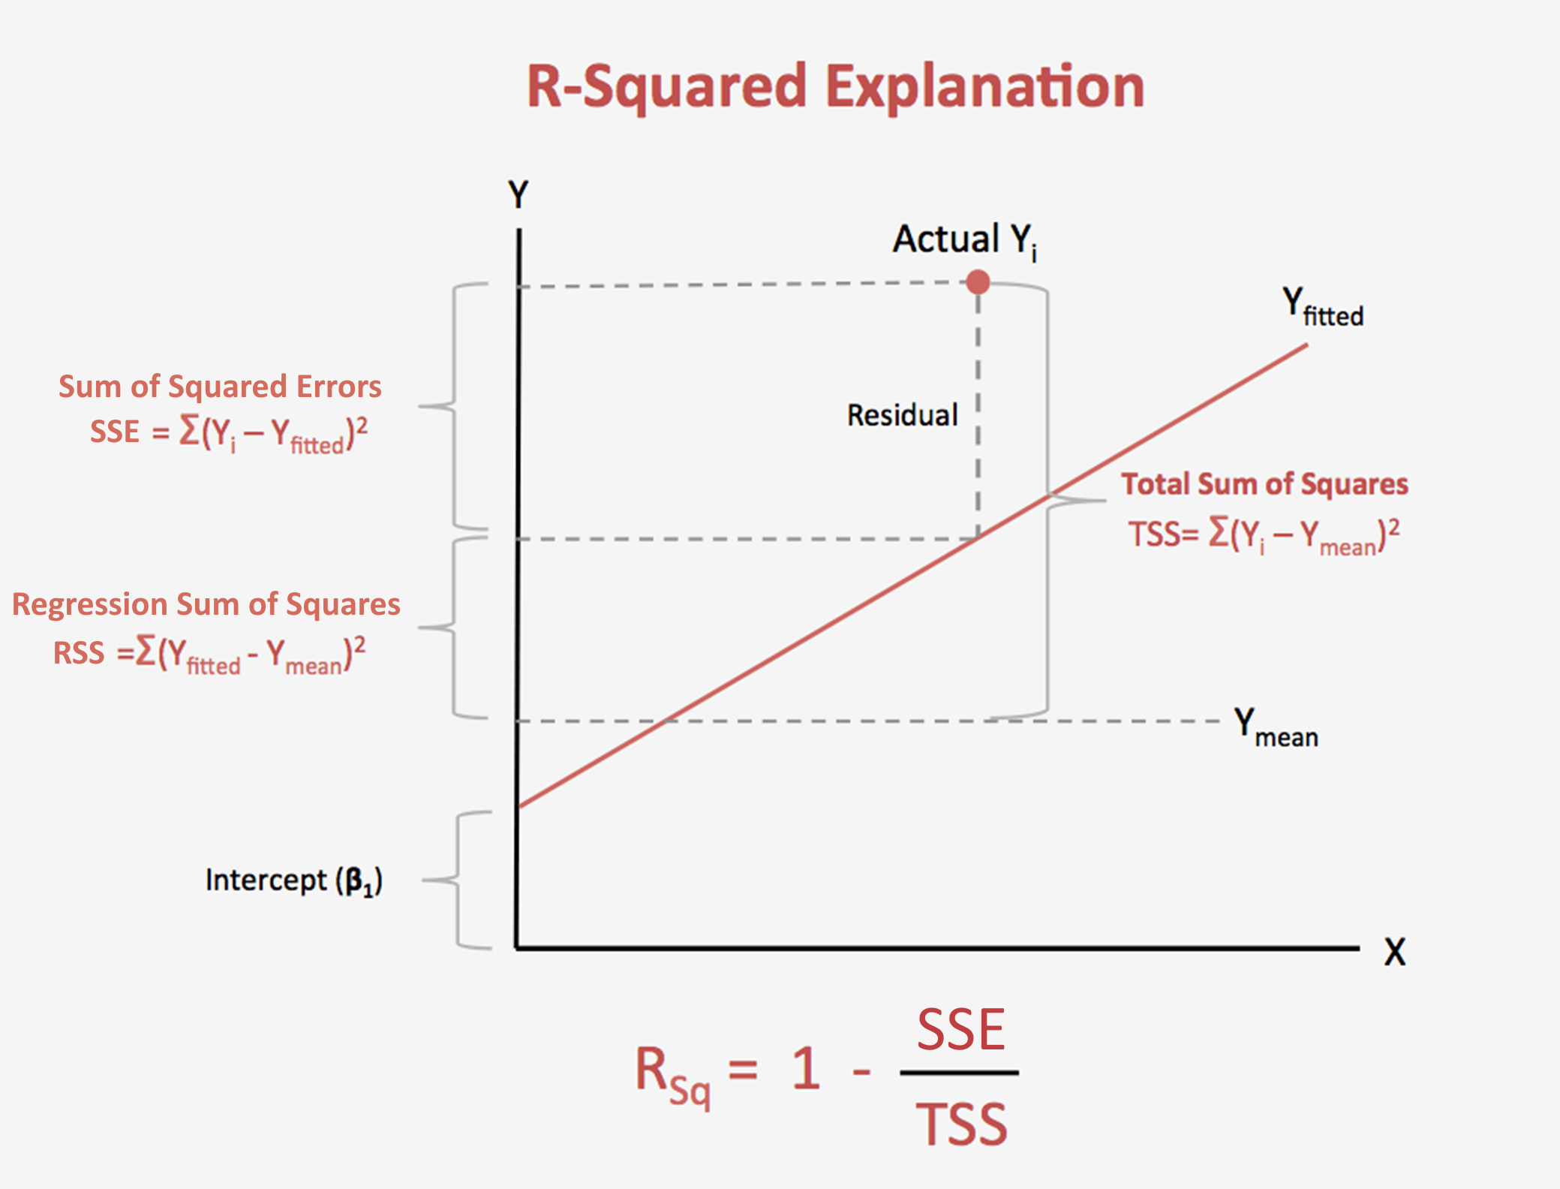

Slide 29
R² Score
Adding data will always “improve” R² score even if the data is irrelevant
Only add data with significant R² boost

Slide 30
Interpreting Linear models
model.coef_
[-1.840,4.24, …, -9.96])

Slide 31
Exercises

