Slide 1
Bootcamp
Python for Data Science

Slide 2
Importing time series data
pd.read_csv(‘path.csv',
parse_dates=[‘Date'],
index_col='Date')

Slide 3

Partial string indexing
Pandas translates string to date
Order is: Year - Month - Day

Slide 4
Partial string indexing
df.loc[‘2017’]

Slide 5
Partial string indexing
df.loc[‘2017-02’]

Slide 6
Partial string indexing
df.loc[‘2017-02-01’]

Slide 7
Basic Statistics
df.describe()

Slide 8
.Describe()
Finds all numeric columns
Gives max, min, var, std, etc

Slide 9
Correlation
df.corr()

Slide 10
Correlation

Slide 11
Plotting
df.plot()

Slide 12
Matplotlib
Intro to Data Visualization with

Slide 13
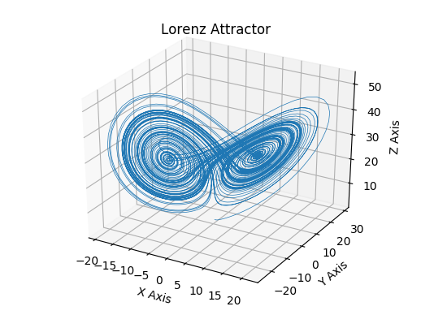

Slide 14
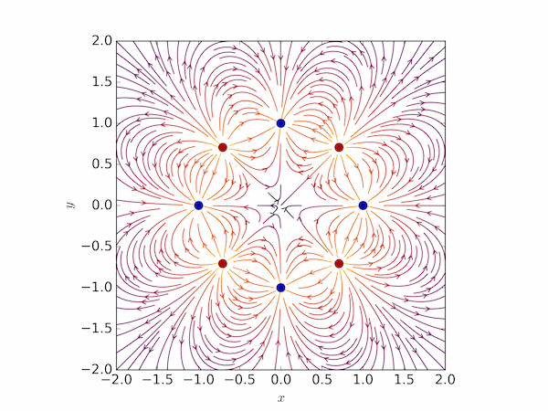

Slide 15
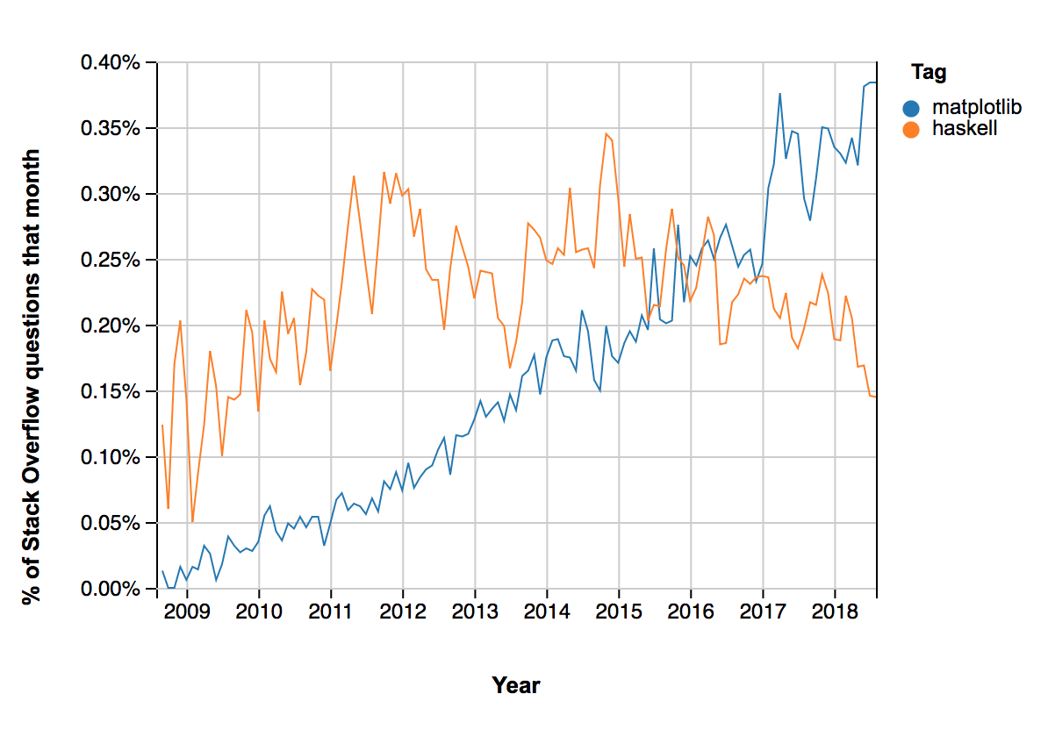

Slide 16
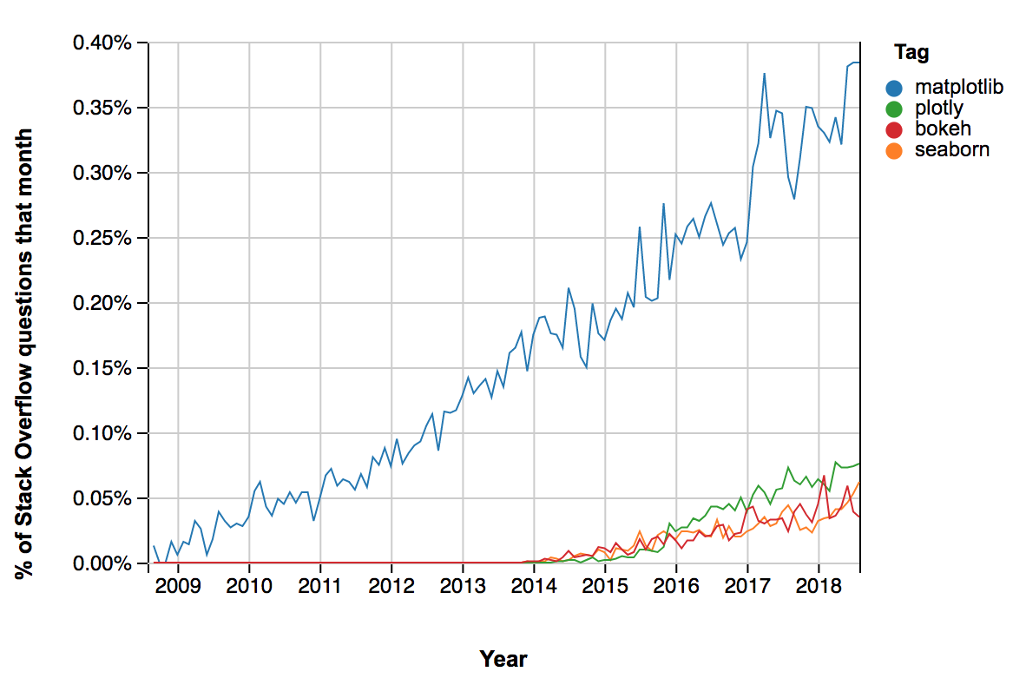

Slide 17
Goal for Today’s lesson

Slide 18

Graphs
Bar charts
Scatter plots
Histograms

Slide 19
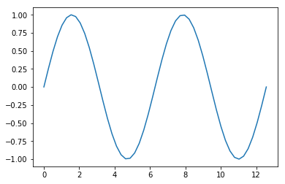
Possibly the simplest thing in python
>>> from matplotlib import pyplot as plt
>>> theta = np.linspace(0., 4.*np.pi, 50)
>>> plt.plot(theta, np.sin(theta))
>>> plt.show()

Slide 20
Syntax
plt.plot( x_data, y_data, format)
USEFUL KEYWORD ARGUMENT: label
plt.plot(x_data,
y_data,
format,
label=‘text you want in the legend’)

Slide 21
Format String
The format string is two characters
First: color
Second: marker/line
e.g.: ‘r-’ is a red line.

Slide 22
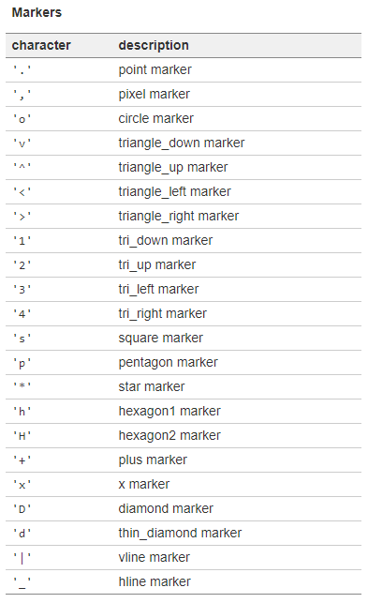
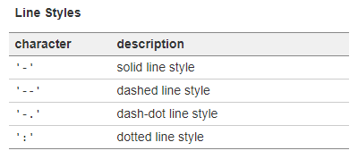
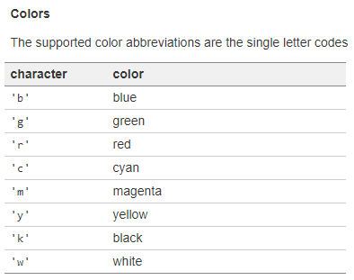
Format characters

Slide 23
Useful pyplot methods
plt.xlabel(‘x axis label’, fontsize=14)
plt.ylabel(‘y axis label’, fontsize=14)
plt.xticks(rotation=45, ha=‘left’)
plt.yticks(rotation=45, ha=‘left’)
plt.title(‘Plot Title’, fontsize=20)
plt.grid()
plt.legend(fontsize=14)

Slide 24
Exercises

Slide 25
A Little more complicated
fig = plt.figure(figsize=(width,
height))
ax = fig.add_subplot(grid_rows,
grid_columns,
subplot_position)
ax.plot(x_data, y_data)
plt.show()

Slide 26
Subplots
fig = plt.figure(figsize=(width,
height))
ax1 = fig.add_subplot(2,1,1)
ax1.plot(x1_data, y1_data)
ax2 = fig.add_subplot(2,1,2)
ax2.plot(x2_data, y2_data)
plt.show()

Slide 27
Making sense of the subplot grid
Example: grid_rows = 2, grid_columns = 2
Position 1
Position 2
Position 3
Position 4

Slide 28
Useful axis methods
ax.set_xlabel(‘x-axis label’)
ax.legend(fontsize=14)
ax.tick_params(axis=‘x’, rotation=45)
ax.set_yscale(‘log’)
ax.set_xscale(‘linear’)
ax.set_title(‘Plot Title’, fontsize=20)
ax.legend(fontsize=14)
fig.suptitle(‘Figure Super Title’, fontsize=20, y=0.92)
fig.subplots_adjust(wspace=0., hspace=0.)

Slide 29
Gridspec
Allows you to size subplots like slices
fig = plt.figure()
gs = fig.add_gridspec(rows, columns)
ax1 = fig.add_subplot(gs[row1_slices,
col1_slices])
ax2 = fig.add_subplot(gs[row2_slices,
col2_slices])

Slide 30
Example: 5-to-1
fig = plt.figure()
gs = fig.add_gridspec(6, 1)
ax1 = fig.add_subplot(gs[0:6, 1])
ax1.plot(xs1, ys1)
ax2 = fig.add_subplot(gs[6, 1])
ax2.plot(xs2, ys2)
plt.show()

Slide 31
Other plot types
Bar Plot
plt.bar(xs, ys, width=0.8)
Histogram Plot
plt.hist(data,
bins=Nbins_or_list_of_bins,
rwidth=visual_bar_width,
weights=list_of_weights_for_data)

Slide 32
Exercises

