Slide 1
Bootcamp
Python for Data Science

Slide 2

Linear Regression
Outputs line of best fit
“Best fit” minimizes squared error

Slide 3
Imported as sklearn
from sklearn.linear_model \
import LinearRegression

Slide 4
single-variable Linear models
No magic!
2 dials: coefficient and intercept

Slide 5
single-variable
y = 2x + 1
1 —> 3
2 —> 5
3 —> 7

Slide 6
Python Equivalent
model = LinearRegression()
model.coef_ = np.array([2.0])
model.intercept_ = 1.0

Slide 7
single-variable
y = model.predict(x)
1 —> 3
2 —> 5
3 —> 7

Slide 8
Training a Model
model = LinearRegression()
columns = [‘crime_rate’]
model.fit(df[columns],df[‘median_price])

Slide 9
Using a Model
model.predict(df[columns])

Slide 10
Exercises

Slide 11
Multi-variable
y = 2x0 + 3x1 + 1

Slide 12
Multi-variable
y = 2x0 + 3x1 + 1
1,4 —> 15
2,3 —> 14

Slide 13
Training a Model
model = LinearRegression()
columns = [‘crime_rate’, ‘tax_rate’]
model.fit(df[columns],df[‘median_price])

Slide 14
Using a Model
model.predict(df[columns])

Slide 15
Interpreting Linear models
model.coef_
[-1.840,4.24, …, -9.96])

Slide 16
Problem with interpreting coefficients:
Independent variables are not centered on zero
Independent variables’ magnitudes are on differences scales from each other

Slide 17
Solution: Normalize!
Centered data around zero
Scale all columns between 0-1

Slide 18
Normalizing your data
LinearRegression(normalize=True)

Slide 19
Problem WITH Sum of Squared Errors (SSE)
It can be huge!

Slide 20
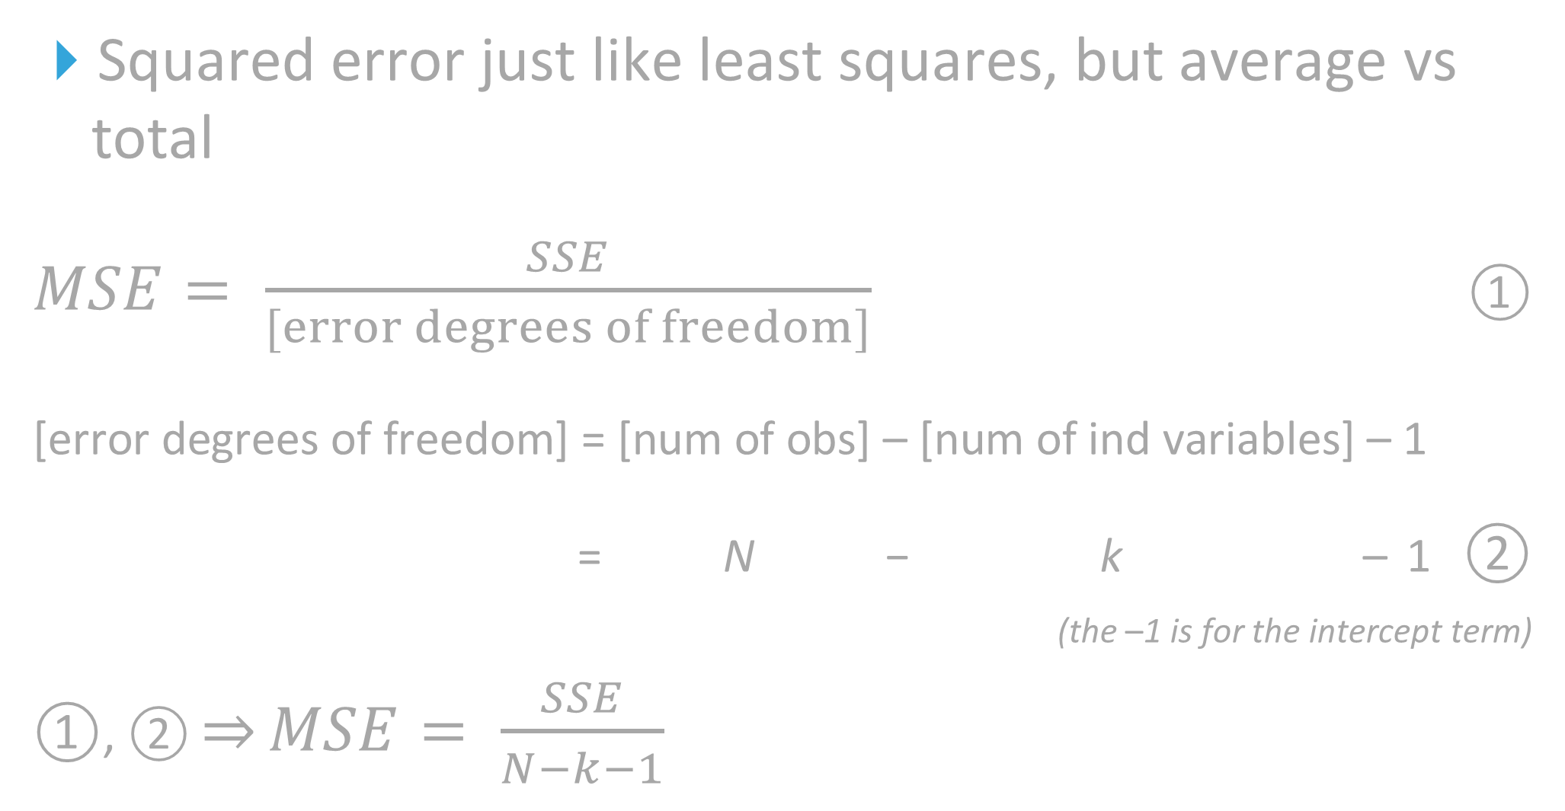
Mean Squared Error (MSE): Solution?
Squared error just like least squares, but average vs total
$MSE= \frac{SSE}{[error degrees of freedom]}$ ①
[error degrees of freedom] = [num of obs] – [num of ind variables] – 1
= N − k – 1 ②
(the –1 is for the intercept term)
①, ② ⇒ $MSE= \frac{SSE}{N−k−1}$

Slide 21
Problem with using MEAN squared error (MSE) to evaluate a model:
It changes depending on the scale of the data.
E.g. A model for predicting home prices would have a larger MSE vs. a model for predicting CO₂ particles per million in the air.
Is there a standardized way to evaluate model strength?

Slide 22
SOLUTION: R² Score!
Percentage of the total variation in the dependent variable explained by the independent variables
I.e. how much error your model has vs. “just guess the mean”
Goes from 1 (perfect) to negative infinity
0 is just as good as guessing the mean
In single-variable regression, R² is equal to the squared correlation between the dependent and independent variables

Slide 23
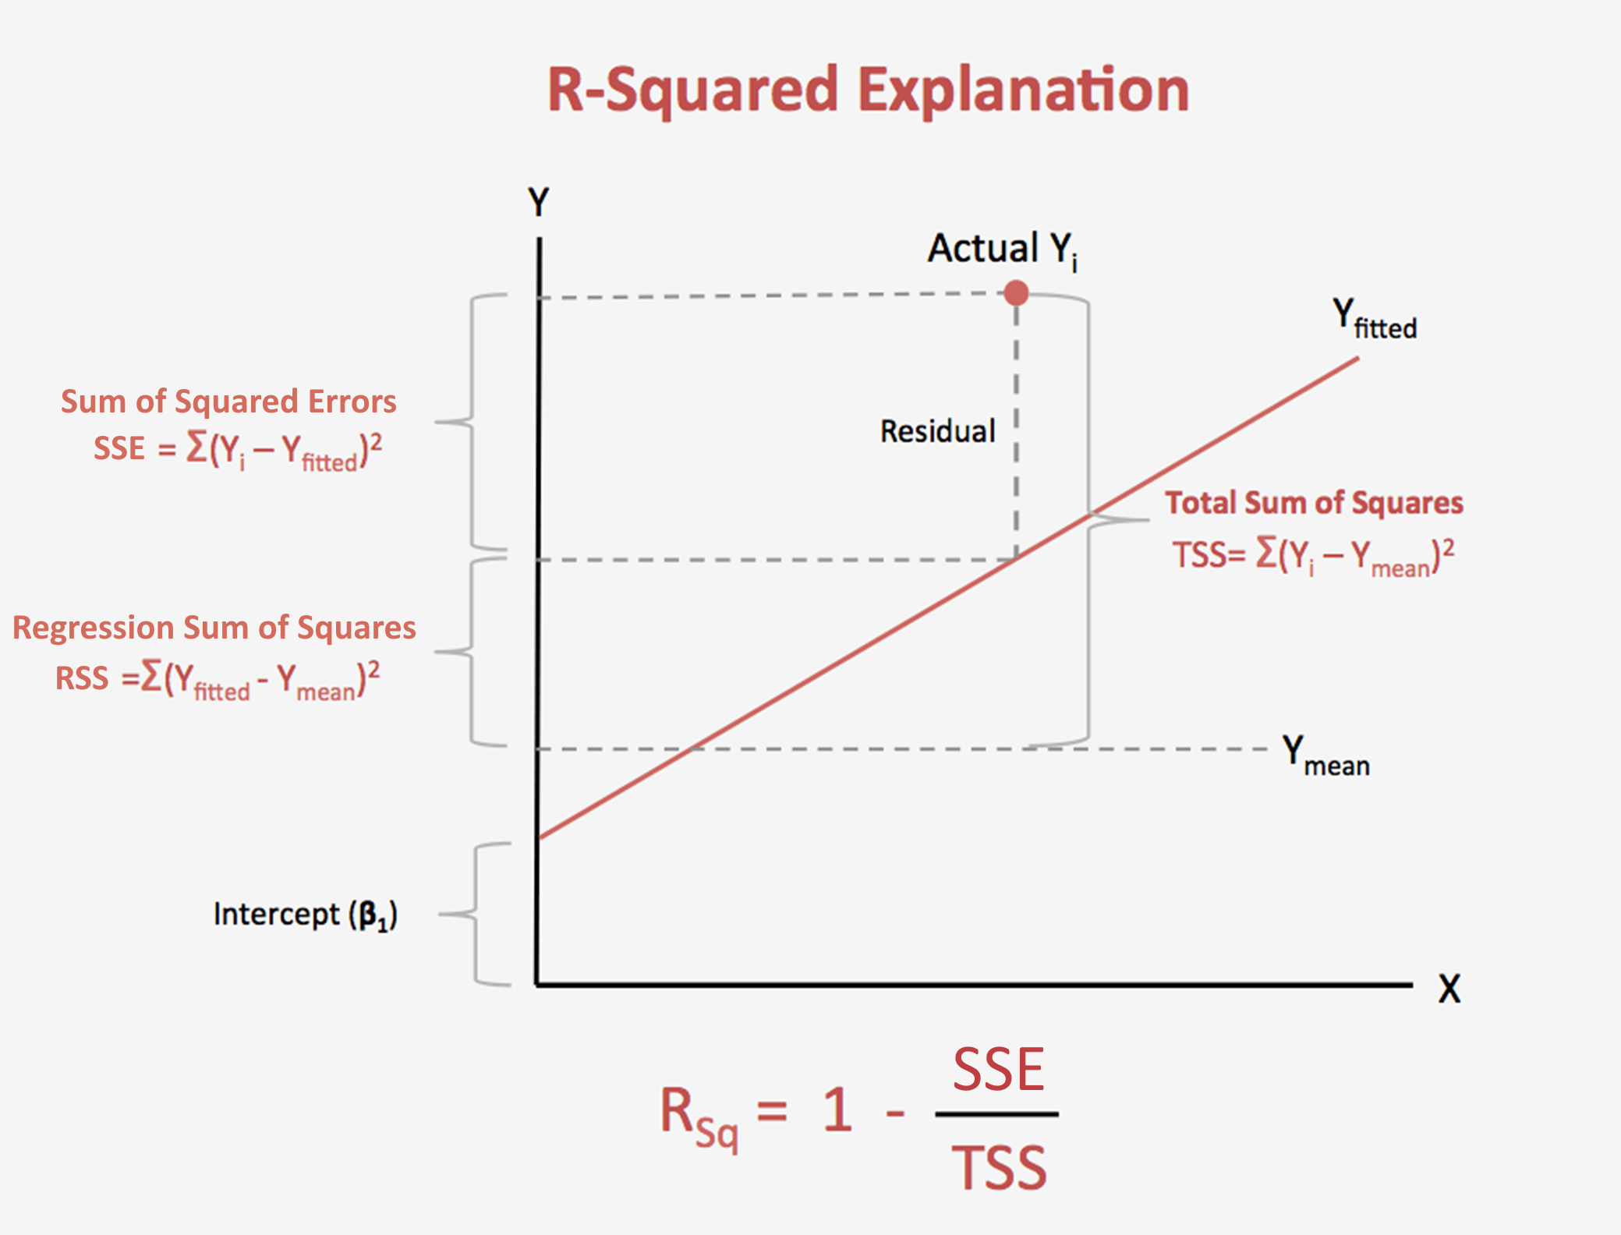

Slide 24

R² score (coefficient of determination)
$$SST= \sum_{i =1}^{N}{{(Y_{i}−\overline{Y})}^{2}}$$
$$SSE= \sum_{i =1}^{N}{{(Y_{i}−\hat{Y})}^{2}}$$
$$R^{2}=\frac{total variation \left(SST\right)−unexplained variation (SSE)}{total variation (SST)}$$
$=1 − \frac{SSE}{SST}$

Slide 25
Exercises

Slide 26
Linear model assumptions
Linear relationship
Independence
Normality
Equal Variance

Slide 27
Testing methods
Quick and qualitative
Protects against major errors

Slide 28
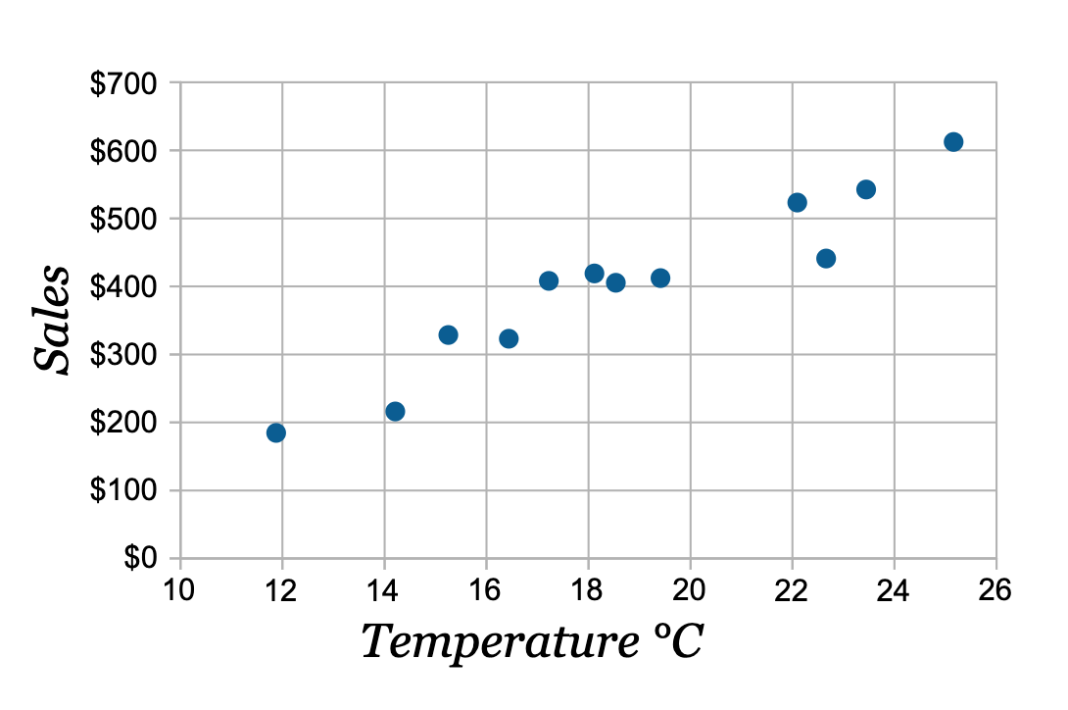
Linear relationship
Can check with a scatter plot

Slide 29
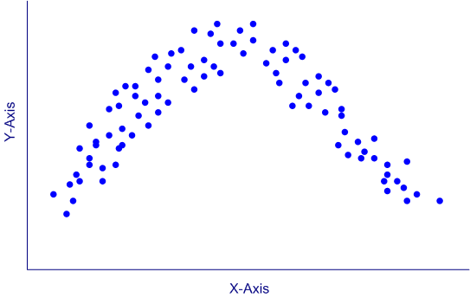
Linear relationship
Can check with a scatter plot

Slide 30
Linear model assumptions
Linear relationship
Independence
Normality
Equal Variance

Slide 31
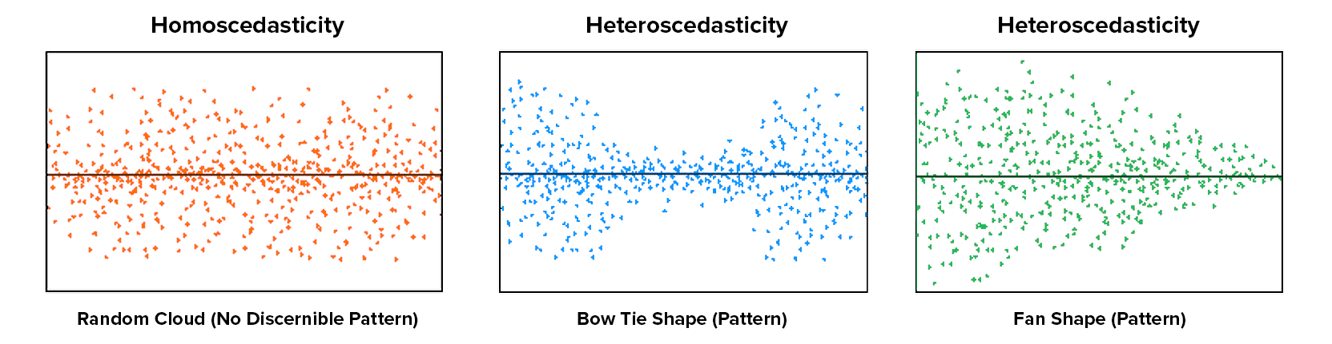
Equal Variance
Can check with a scatter plot

Slide 32
equal Variance
Can check with a scatter plot

Slide 33
equal Variance
Can check with a scatter plot

Slide 34
Linear model assumptions
Linear relationship
Independence
Normality
Equal Variance

Slide 35
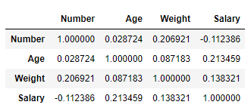
Independence
Check the correlation matrix df.corr()

Slide 36
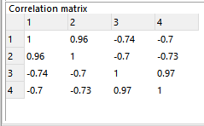
Independence
Check the correlation matrix df.corr()

Slide 37
Linear model assumptions
Linear relationship
Independence
Normality
Equal Variance

Slide 38
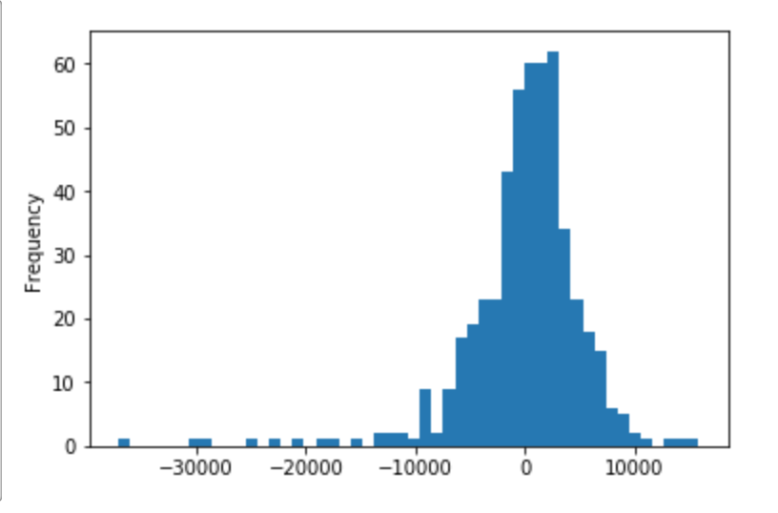
Normality of errors
Can check with a histogram

Slide 39
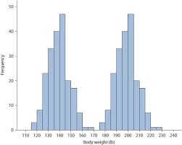
Normality of errors
Can check with a histogram

Slide 40
Linear model assumptions
Linear relationship
Independence
Normality
Equal Variance

Slide 41
Exercises

