Slide 1
Bootcamp
Python for Data Science

Slide 2
Patrick Staudt, CFA
Developing Python scripts for astrophysics research since 2017
VBA since 2011
A stint of C++ in 2008
Ph.D. student, Physics, UC Irvine, 2026
B.S., Astrophysics, Rutgers, January 2020
B.S., Management, UConn, May 2010

Slide 3
Why Python?

Slide 4
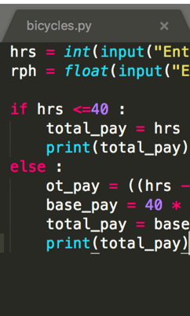
Code
Short, Readable

Slide 5

Community
broad Open-Source

Slide 6
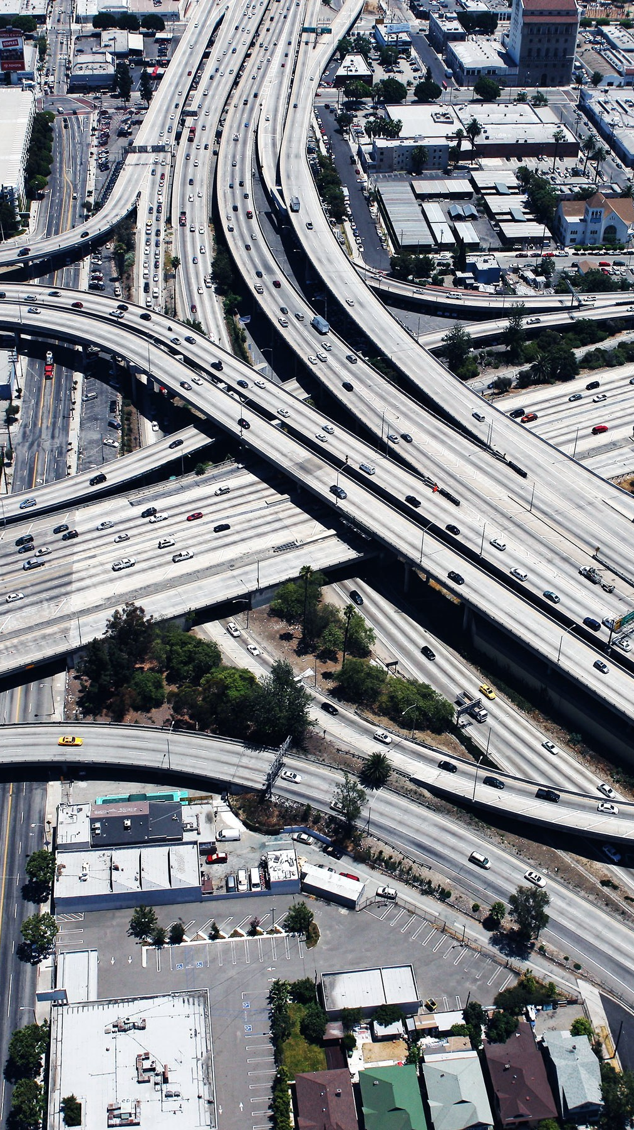
Infrastructure
Modern Software

Slide 7
Class format

Slide 8
Class format

Slide 9
Class format
10 minutes for lesson & demo
20 minutes for exercise
Pause to review & ask questions
Rinse and repeat

Slide 10
FUNDAMENTALS

Slide 11
How to think about Python
You are giving orders to your computer
Each order is called a “statement”

Slide 12
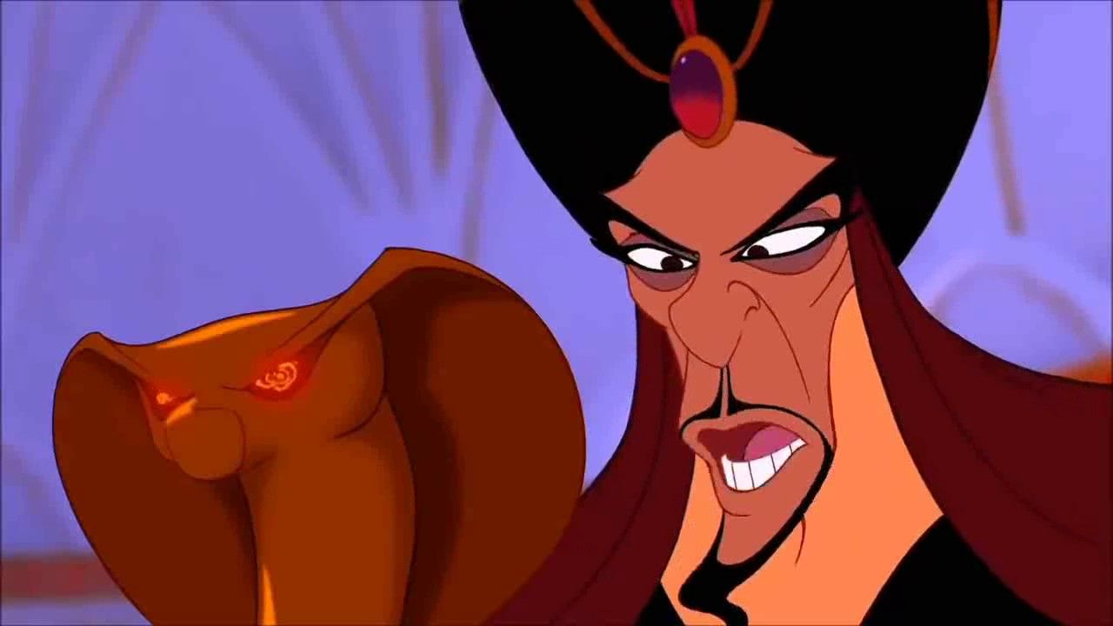
You
Python

Slide 13
ASSIgnment Statement
English:
remember “fav_number” means 3
arbitrary label

Slide 14
ASSIgnment Statement
fav_number = 3
value
variable

Slide 15
Rules for Variables
Must start with a letter or underscore
Cannot start with a number
Only letters, numbers and underscores allowed
Variable names are case-sensitive

Slide 16
Variables
my_number

Slide 17
Variables
my_number

Slide 18
Variables
my_number
3amigos

Slide 19
Variables
my_number
3amigos

Slide 20
Variables
my_number
3amigos
left-handed

Slide 21
Variables
my_number
3amigos
left-handed

Slide 22
Expressions vs. Statements

Slide 23
ExpressionS
An expression is part of a statement
Noun without a verb

Slide 24
Expression Examples
Variables (like fav_number)
>>> fav_number
3
Values (like 3)
>>> 3
3

Slide 25

Python thinks like your calculator
If you enter 7 + 9, this is still an expression.
Equivalent to 16.

Slide 26

Expression Vs Statement
Equal to a single value: expression

Slide 27
Expression Vs Statement
Equal to a single value: expression
Executing an order: statement
Important to know when you’re giving an order vs noun
Expression
len(“string”)
Statement
l = len(“string”)

Slide 28
Old Friends
Integers (called “int”)
Decimals (called “float”)

Slide 29
Old Friends
Addition (+)
Multiplication (*)
Division (/)
Exponents (**)

Slide 30
A New Friend
Modulo (%)
Finds the remainder

Slide 31
Concepts covered so Far
Statement
Expression
Variable
Int, Float

Slide 32
Exercises

Slide 33
New Data Type: String
Text wrapped in quotes
Only meaningful to humans

Slide 34
String Example
greeting = “hello world!”

Slide 35
String Example
greeting = “hello world!”
value

Slide 36
Indexing Syntax
PYTHON IS ZERO INDEXED! NEVER FORGET THIS.
English:
get the first letter in my_string

Slide 37
Indexing Syntax
my_string[0]

Slide 38
Indexing Syntax
English translation:
get the seventh letter in my_string

Slide 39
Indexing Syntax
my_string[6]

Slide 40
Indexing Syntax
English:
get the last letter in my_string

Slide 41
Indexing Syntax
my_string[-1]

Slide 42
Slice Syntax
English:
get the third to the twelfth elements of my_string

Slide 43
SLICE Syntax
my_string[start : stop_exclusive]
01234567890123456
>>> my_string = ‘this is my string’
>>> print(my_string[3:12])
s is my s
345678901
not included!

Slide 44
Slice Syntax
English:
get all the letters up to the third

Slide 45
SLICE Syntax
>>> my_string[:3]
same thing as
>>> my_string[0:3]

Slide 46
Slice Syntax
English:
grab from the second element through until the end

Slide 47
SLICE Syntax
my_string[2:]

Slide 48
Slice: step
[start_index:end_index:step]

Slide 49
Slice: step
my_list[::2]
even # items in list

Slide 50
Slice: step
my_list[1::2]
odd # items in list

Slide 51
Slice: step
my_list[::-1]
reverse list

Slide 52
Exercises

Slide 53
Values: What kinds ARE THERE?
Int
Float
String

Slide 54
Mixing data types
1 + 7.0 = 8.0

Slide 55
Mixing data types
1 + 7.0 = 8.0
1.0 + “7.0” = error

Slide 56
Mixing data types
1 + 7.0 = 8
1.0 + int(“7.0”) = 8.0

Slide 57
F-Strings
Text with variables injected
Normal string but with an “f” before the quotes

Slide 58
F-strings
my_name = “rob”

Slide 59
F-strings
f“Hello, {my_name}!”

Slide 60
F-strings
f“Hello, {my_name}!”
“Hello, Rob”

Slide 61
Function
Performs an action
Action in example: cast to integer

Slide 62
Anatomy of a function call
int(“7.0”)
function
input (aka argument)

Slide 63
Function vs method
Same: performs an “action” with input
Different: where input comes from

Slide 64
method Example
>>> “Rob”.replace(“R”,“B”)
‘Bob’
method on string

Slide 65
Function vs method
Input between parentheses
int(“123”)
“Rob”.replace(“R”,“B”)

Slide 66
Function vs method
Input between parentheses
int(“123”)
Main input before dot
“Rob”.replace(“R”,“B”)

Slide 67
Casting between Data types
int()
float()
str()

Slide 68
Concepts covered so Far
Function
Method
Casting

Slide 69
Exercises

Slide 70
Evaluations
https://www.careercenters.com/evaluations/new

