Slide 1
Bootcamp
Python for Data Science

Slide 2

For-Loops
Repeats a chunk of code
Hands in different item each time

Slide 3
For-loops
pets = [“dog”, “cat”, “fish”]
for pet in pets:
print(pet)

Slide 4
For-loops
pets = [“dog”, “cat”, “fish”]
for pet in pets:
print(pet)

Slide 5
For-loops
pets = [“dog”, “cat”, “fish”]
for pet in pets:
if pet == “dog”:
print(“Man’s best friend!”)
else:
print(“whatever”)

Slide 6
Range function
Generates range of numbers
Parameters match slice syntax

Slide 7
Range function
range(3)

Slide 8
Range function
range(3)
0, 1, 2

Slide 9
Range function
range(1,4)

Slide 10
Range function
range(1,4)
1, 2, 3

Slide 11
Range function
range(3,0,-1)
3, 2, 1

Slide 12
Range is Not A List
Returns a “lazy” list
Numbers are generated one-by-one to save memory

Slide 13
Convert Range to list
list(range(3))
[0, 1, 2]

Slide 14
For-Loops
Repeats a chunk of code
Hands in different item each time

Slide 15
Exercises

Slide 16
Values: what kinds are there?
data types: int, float, string, bool
lists of the above

Slide 17
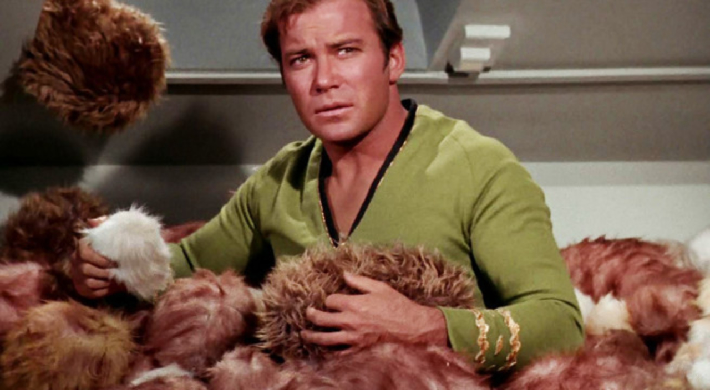
Trouble with Lists
Hard to manage lots of data

Slide 18
Trouble with Lists
Was it my_list[8] or my_list[9]?
Hard to manage lots of data

Slide 19


Slide 20
Dictionary
Store data under a label (“key”)
Fetch value later by key

Slide 21
Dictionary
d = { “name”: “Rob” }

Slide 22
Dictionary
d = {“name”: “Rob”,
“hair”: “brown”}

Slide 23
Dictionary
d[“hair”]
“brown”

Slide 24
Dictionary
d[“hair”] = “blonde”

Slide 25
Dictionary Keys
What happens if we loop through a dictionary?
>>> for x in d:
... print(x)
name
hair
The loop iterates through the keys.

Slide 26
Dictionary Keys
You can also use d.keys()
>>> print(d.keys())
dict_keys([‘name’, ‘hair’])

Slide 27
Dictionary Values
Performing an action with each dictionary value
>>> for x in d.values():
... print(x)
Rob
blonde

Slide 28
Dictionary item sets
d.items()
>>> print(d.items())
dict_items([(‘name’, ‘Rob’), (‘hair’, ‘blonde’)])

Slide 29
Dictionary Item sets
Performing an action with each key, value pair
>>> for x, y in d.items():
... print(‘key: ’ + x)
... print(‘value: ’ + y)
... print(‘’)
key: name
value: Rob
key: hair
value: blonde

Slide 30
Exercises

Slide 31
Using APIS

Slide 32
API
Application Programming Interface
website for programs — no visuals

Slide 33
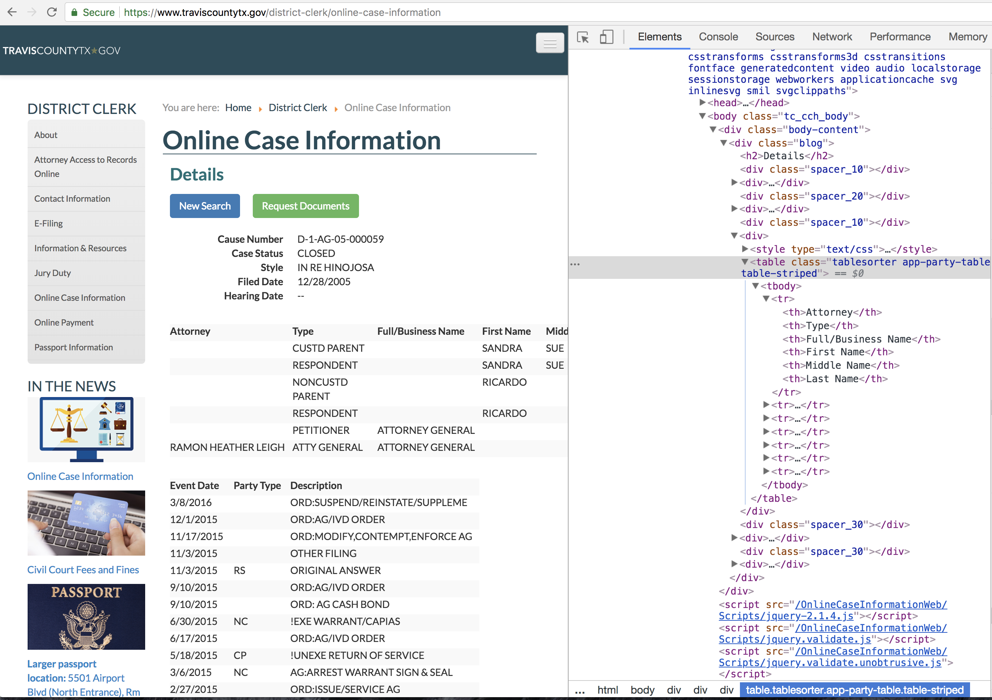

Slide 34

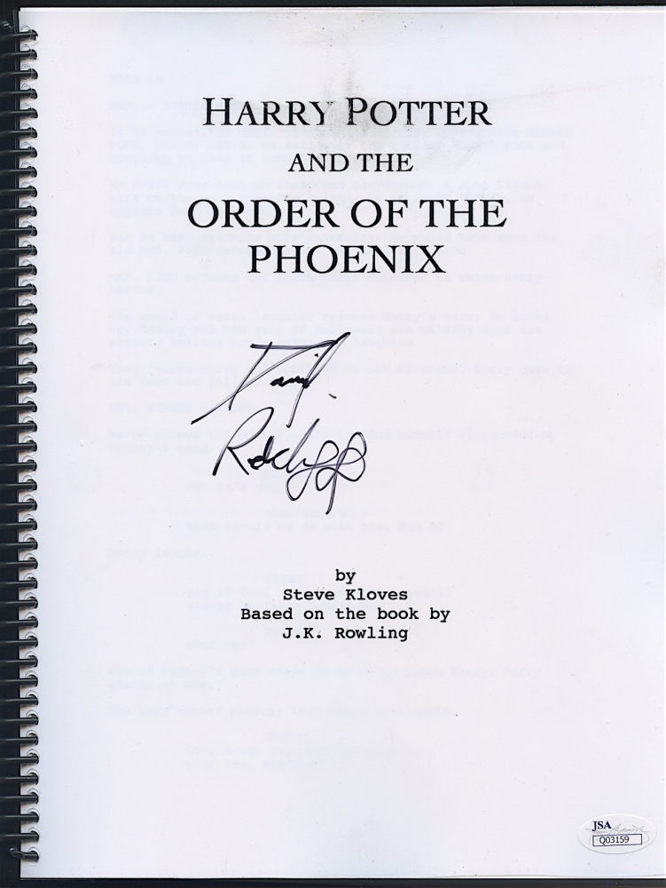
HTML

Slide 35

No thanks

Slide 36
Json (Javascript object notation)
Simple format for sending data
Turns into a Python dictionary!

Slide 37
Json
{
"name": “John Smith",
"address": {
"street": "21 2nd Street",
"city": "New York” }
}

Slide 38
API
Going to use IEXTrading.com
No account/password needed!

Slide 39
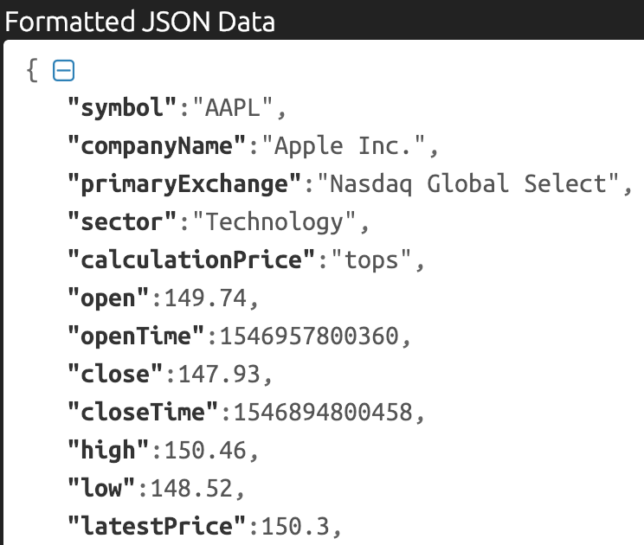

Slide 40
HTTP (Hypertext Transfer Protocol)
Each request has a verb like GET or POST
Data returned in body of response

Slide 41
Requests Package
Makes HTTP requests simple

Slide 42
Using Requests
import requests
url = “https://api.kanye.rest/"
response = requests.get(url)
response.text

Slide 43
Using Requests
import requests
url = “https://api.kanye.rest/"
response = requests.get(url)
response.text
body of response

Slide 44
Using Requests
data = response.json()

Slide 45
Using Requests
data = response.json()
{“date":"2019-03-05",
“high":176,
"low":174.54,
"volume":19737419}

Slide 46
Concepts covered so Far
API
JSON
Requests
HTTP/HTTPS

Slide 47

Classes and Objects

Slide 48
Class vs object
class is a “blueprint” with empty slots
object is one occurrence, slots filled

Slide 49
Why do we need classes?
Like dictionary with guaranteed keys
Can create methods

Slide 50
Using a Class
rob = Person(“Rob”)
rob.name
>>> “Rob”

Slide 51
Using a Class
rob = Person(“Rob”)
rob.say_name()
>>> “Hi I’m Rob”

Slide 52
Why do we need classes?
Store data and methods together
Can make code more intuitive

Slide 53
Class
class Person():
def __init__(self, name):
self.name = name

Slide 54
Class
class Person():
def __init__(self, name):
self.name = name

Slide 55
Class
class Person():
def __init__(self, name):
self.name = name

Slide 56
What is “self”??
Class is the cookie-cutter, self is the cookie
First argument in any method

Slide 57
Class
class Person():
def __init__(self, name):
self.name = name

Slide 58
Class
constructor
class Person():
def __init__(self, name):
self.name = name

Slide 59
Class
*magic*
class Person():
def __init__(self, name):
self.name = name

Slide 60
Class
instance
class Person():
def __init__(self, name):
self.name = name

Slide 61
Class
*magic*
class Person():
def __init__(self, name):
self.name = name

Slide 62
Class
class Person():
def __init__(self, name):
self.name = name

Slide 63
Class
class Person():
def __init__(self, name):
self.name = name
attribute

Slide 64
Class
class Person():
def __init__(self, name):
self.name = name
self[“name”] = name

Slide 65
Class
class Person():
…
def say_name(self):
print(self.name)

Slide 66
Class
rob = Person(“Rob”)
rob.name
>>> “Rob”

Slide 67
Class
rob = Person(“Rob”)
rob.name
>>> “Rob”
attribute

Slide 68
Class
rob = Person(“Rob”)
rob.say_name()
>>> “Rob”

Slide 69
Class
rob = Person(“Rob”)
rob.say_name()
>>> “Rob”
method

Slide 70
Exercises

Slide 71
Concepts covered so Far
For-loops
Dictionary
Class

Slide 72
Dictionary
my_dict = {“name”: “Rob”,
“hair”: “brown”}

Slide 73
Dictionary
my_dict[“hair”] = “blonde”

Slide 74
Dictionary
my_dict[“hair”]

Slide 75
Dictionary
my_dict[“hair”]
“brown”

Slide 76
Dictionary
for key in my_dict:
print(f“look at this {key}!”)

Slide 77
Dictionary
for key, value in my_dict.items():
print(f“look at this {key}!”)
print(f“look at this {value}”)

Slide 78
Class
class Person():
def __init__(self, name):
self.name = name

Slide 79
Class
rob = Person(“Rob”)
rob.name

Slide 80
Class
rob = Person(“Rob”)
rob.name
“Rob”

