Slide 1
Bootcamp
Python for Data Science

Slide 2
open Source tools

Slide 3
Flexible is slow

Slide 4

Nothing comes for free
List & dictionary hold any value
Also grow to any length
Numbers have no fixed size

Slide 5
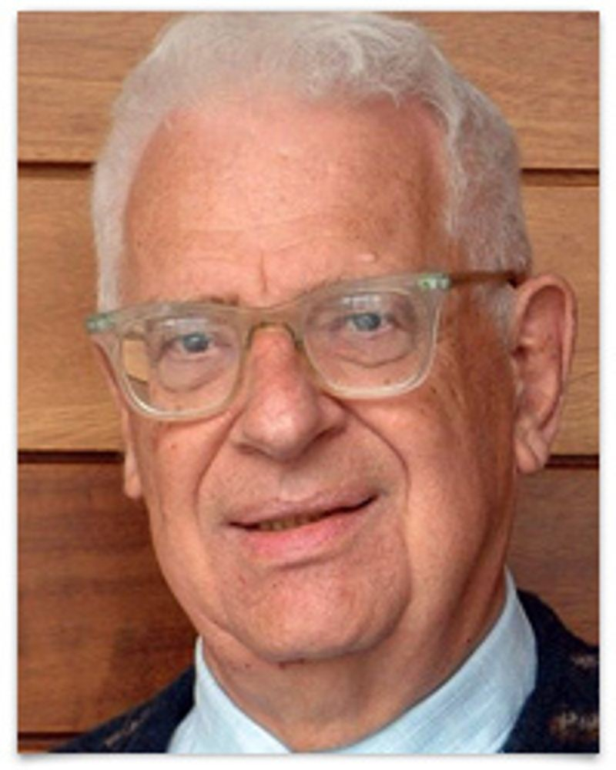
Every problem in computer science can be solved by another layer of indirection
- David Wheeler

Slide 6
Packages
Code designed for re-use
Must be installed before use

Slide 7
First Package: Numpy
Short for “numerical python”
Has array that is faster for math

Slide 8
importing numpy
import numpy as np
alias

Slide 9
NDarray
short for “n-dimensional array”
one dimension will be enough

Slide 10
creating an array
np.array([1, 2, 3])

Slide 11
Element-wise addition
np.array([1, 2]) + np.array([1, 2])
array([2, 4])

Slide 12
broaDcasting
np.array([1, 2]) + 2
array([3, 4])

Slide 13
broaDcasting
np.array([1, 2]) * 3
array([3, 9])

Slide 14
Exercises

Slide 15
Slices: View vs Copy
Slice on list creates a new copy
Slice on array creates a “view”

Slide 16
Slice as view
original = np.array([1, 2, 3])
new_one = original[1:]
new_one[0] = 0
original: [1, 0, 3]

Slide 17
solution
original = np.array([1, 2, 3])
new_one = original[1:].copy()
new_one[0] = 0
original: [1, 2, 3]

Slide 18
Concepts covered so Far
Ufunc
Element-wise operations
Broadcasting
View vs Copy

Slide 19
Exercises

Slide 20
Boolean ufuncs
take arrays as input/output

Slide 21
Boolean ufunc
np.equal (==)
np.less (<)
np.greater (>)

Slide 22
Element-wise
np.array([1, 2]) == np.array([1, 2])
array([True, True])

Slide 23
broaDcasting
np.array([1, 2]) < 2
array([True, False])

Slide 24
broaDcasting
np.array([1, 2, 3]) == 3
array([False, False, True])

Slide 25
Boolean INdexing
my_array = np.array([1, 2, 3])
my_array[[False, False, True]]
array([3])

Slide 26
Boolean INdexing
my_array = np.array([1, 2, 3])
my_array[[False, False, True]]
boolean mask

Slide 27
Boolean INdexing
my_array = np.array([1, 2, 3])
my_array[my_array > 2]
boolean mask

Slide 28
Boolean INdexing
my_array = np.array([1, 2, 3])
my_array[my_array > 2]
array([3])

Slide 29
Boolean INdexing
ones = (my_array == 1)
evens = (my_array % 2 == 0)

Slide 30
Boolean INdexing
my_array[ones | evens]
works like “or”

Slide 31
Boolean INdexing
my_array[ones & evens]
works like “and”

Slide 32
Concepts covered so Far
Element-wise Boolean operations
Broadcasting Boolean operations
Boolean mask

Slide 33
Exercises

