Slide 1
Bootcamp
Python for Data Science

Slide 2
Pandas

Slide 3

Pandas
Short for “panel data”
DataFrame concept from R

Slide 4
importing Pandas
import pandas as pd

Slide 5
Dataframe
Similar to a spreadsheet
Columns are Numpy arrays with special index

Slide 6
creating a Dataframe
df = pd.read_csv(“path_to_file”)

Slide 7
Looking at top rows
new_df.head()

Slide 8
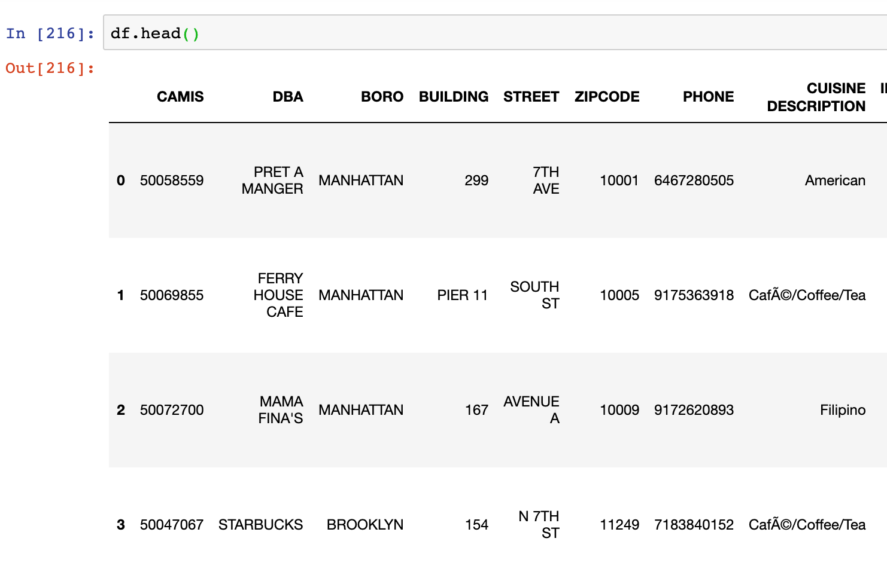
Text

Slide 9
Column AKA “Series”
Column values are Numpy arrays
Fancy index on top

Slide 10
Why?
Meaningful indices (cf. dictionary)
Auto-alignment

Slide 11

Trouble with Lists
Was it my_list[8] or my_list[9]?
Hard to manage lots of data

Slide 12
Series
Numpy array with fancy index
Can still use Boolean indexing!

Slide 13
Boolean indexing
df[df[“SCORE”] > 30]

Slide 14
Boolean indexing
df[(df[“ROI”]>30) & (df[“ROI”]<9)]

Slide 15
Boolean indexing
more_30 = df[“ROI”]>30
less_9 = df[“ROI”]<9
df[more_30 & less_9]

Slide 16
Counting Unique values
new_df[‘first_name’].value_counts()

Slide 17
Counting Unique values
new_df[‘first_name’].value_counts()
“John”: 352
“Chris”: 280
“Tom”: 264

Slide 18
Concepts covered so Far
Pandas
DataFrames
dtype
.head()
Boolean indexing

Slide 19
Exercises

Slide 20

Working with Columns

Slide 21
Checking Data Type
new_df.dtypes

Slide 22
Specifying Data Types
pd.read_csv(“path_to_file”,
dtype={“ZIPCODE”: str})

Slide 23
Using Numpy functions
new_df[‘SCORE’].mean()

Slide 24
Creating a New Column
Similar to new dictionary key
Can use Numpy functions

Slide 25
Creating a new Column
df[‘profit’] =
df[‘revenue’] - df[‘expenses’]

Slide 26
Dataframe from columns
df[[‘revenue’, ‘profit’]]

Slide 27
Sorting by a column
df.sort_values(“revenue”)

Slide 28
Sorting in descending order
df.sort_values(“revenue”,
ascending=False)

Slide 29
Concepts covered so Far
dtypes
Create and select columns
Sorting

Slide 30
Exercises

Slide 31

Cleaning Data

Slide 32
String ufuncs
All under .str dataframe attribute
Explore and clean raw data

Slide 33
.contains()
Find duplicates with a wide net
Case sensitive

Slide 34
.startswith() and .endsWith()
similar to .contains()
useful with addresses, structured text

Slide 35
.loc[index, column] = ?
Use to overwrite values
Standardize spellings, etc

Slide 36
NaN ufuncs
NaN is a missing value
Drop, replace or ignore

Slide 37
Finding Nans
df['GRADE'].notnull()

Slide 38
Filling Nans
df['GRADE'].fillna('NOT RATED')

Slide 39
Saving a Dataframe
df.to_csv(“path_to_file”)

Slide 40
Exercises

