Slide 1
Bootcamp
Python for Data Science

Slide 2
Importing time series data
pd.read_csv(‘path.csv',
parse_dates=[‘Date'],
index_col='Date')

Slide 3
Dataframe from dicts
pd.DataFrame.from_dict(dict_list)
Dicts must all have same keys!

Slide 4

Partial string indexing
Pandas translates string to date
Order is: Year - Month - Day

Slide 5
Partial string indexing
df[‘2017’]

Slide 6
Partial string indexing
df[‘2017-02’]

Slide 7
Partial string indexing
df[‘2017-02-01’]

Slide 8
Basic Statistics
df.describe()

Slide 9
.Describe()
Finds all numeric columns
Gives max, min, var, std, etc

Slide 10
Correlation
df.corr()

Slide 11
Correlation

Slide 12
Plotting
df.plot()

Slide 13
Matplotlib
Intro to Data Visualization with

Slide 14
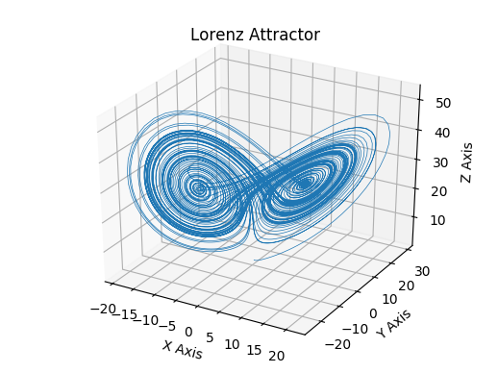

Slide 15
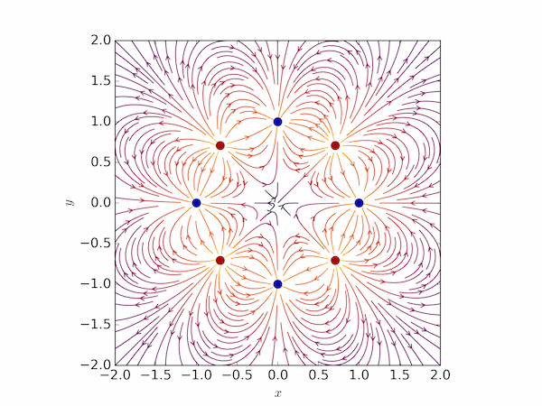

Slide 16
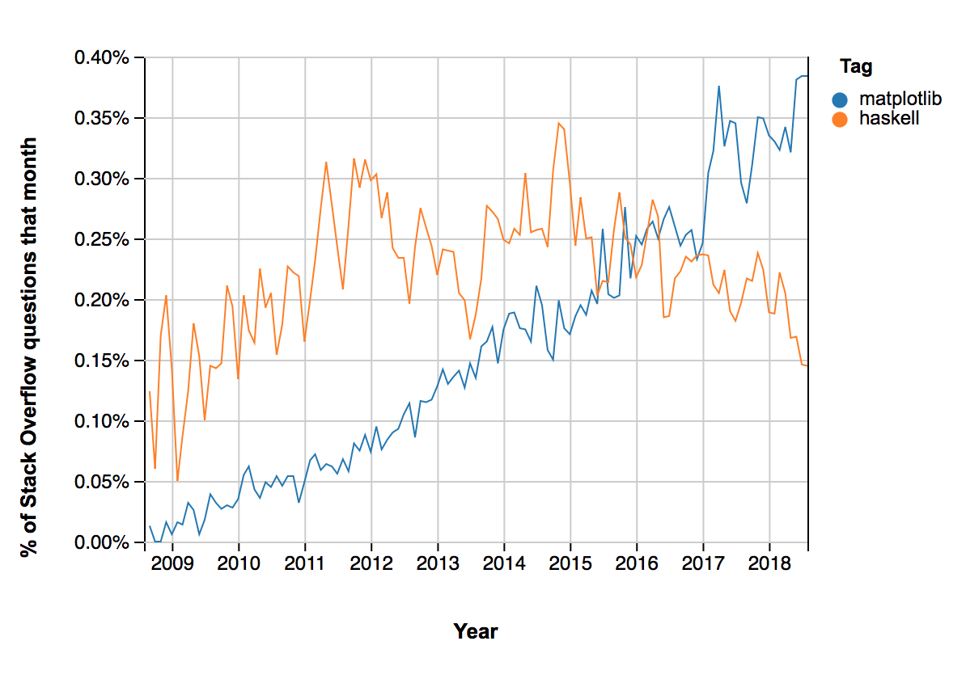

Slide 17
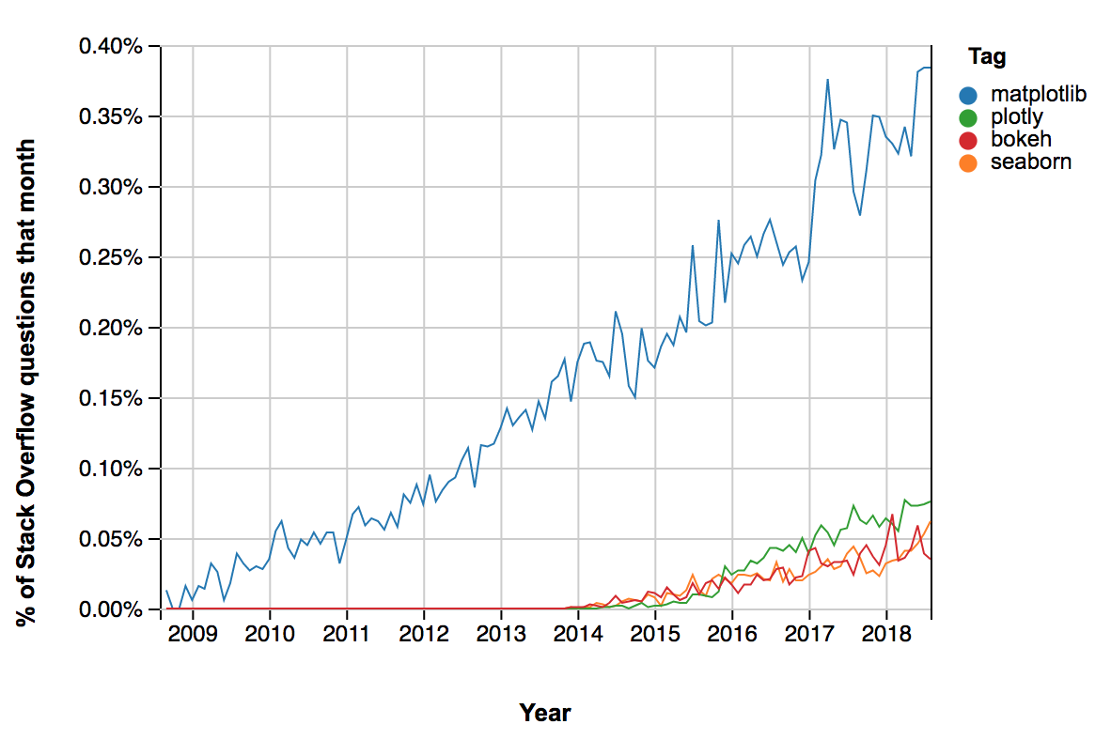

Slide 18
Goal for Today’s lesson

Slide 19

Graphs
Bar charts
Scatter plots
Histograms

Slide 20
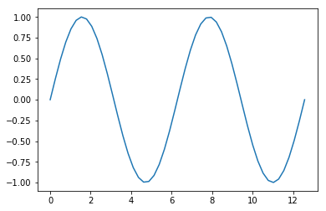
Possibly the simplest thing in python
>>> from matplotlib import pyplot as plt
>>> theta = np.linspace(0., 4.*np.pi, 50)
>>> plt.plot(theta, np.sin(theta))
>>> plt.show()

Slide 21
Syntax
plt.plot( x_data, y_data, format)
USEFUL KEYWORD ARGUMENT: label
plt.plot(x_data,
y_data,
format,
label=‘text you want in the legend’)

Slide 22
Format String
The format string is two characters
First: color
Second: marker/line
e.g.: ‘r-’ is a red line.

Slide 23
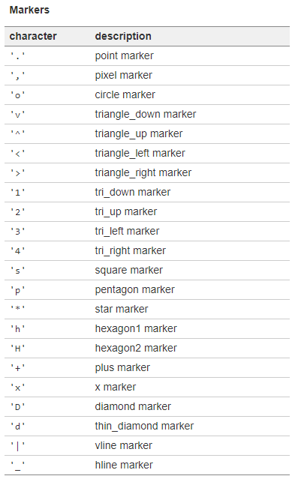
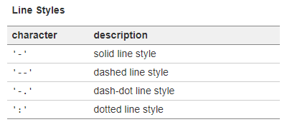
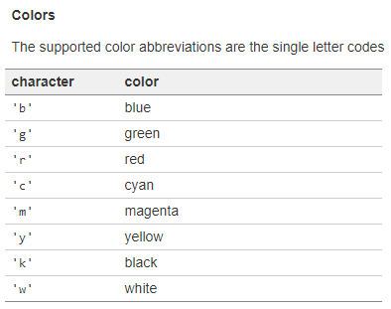
Format characters

Slide 24
Useful pyplot methods
plt.xlabel(‘x axis label’, fontsize=14)
plt.ylabel(‘y axis label’, fontsize=14)
plt.xticks(rotation=45, ha=‘left’)
plt.yticks(rotation=45, ha=‘left’)
plt.title(‘Plot Title’, fontsize=20)
plt.grid()
plt.legend(fontsize=14)

Slide 25
Exercises

Slide 26
A Little more complicated
fig = plt.figure(figsize=(width,
height))
ax = fig.add_subplot(grid_rows,
grid_columns,
subplot_position)
ax.plot(x_data, y_data)
plt.show()

Slide 27
Subplots
fig = plt.figure(figsize=(width,
height))
ax1 = fig.add_subplot(2,1,1)
ax1.plot(x1_data, y1_data)
ax2 = fig.add_subplot(2,1,2)
ax2.plot(x2_data, y2_data)
plt.show()

Slide 28
Making sense of the subplot grid
Example: grid_rows = 2, grid_columns = 2
Position 1
Position 2
Position 3
Position 4

Slide 29
Useful axis methods
ax.set_xlabel(‘x-axis label’)
ax.legend(fontsize=14)
ax.tick_params(axis=‘x’, rotation=45)
ax.set_yscale(‘log’)
ax.set_xscale(‘linear’)
ax.set_title(‘Plot Title’, fontsize=20)
ax.legend(fontsize=14)
fig.suptitle(‘Figure Super Title’, fontsize=20, y=0.92)
fig.subplots_adjust(wspace=0., hspace=0.)

Slide 30
Gridspec
Allows you to size subplots like slices
fig = plt.figure()
gs = fig.add_gridspec(rows, columns)
ax1 = fig.add_subplot(gs[row1_slices,
col1_slices])
ax2 = fig.add_subplot(gs[row2_slices,
col2_slices])

Slide 31
Example: 5-to-1
fig = plt.figure()
gs = fig.add_gridspec(6, 1)
ax1 = fig.add_subplot(gs[0:6, 1])
ax1.plot(xs1, ys1)
ax2 = fig.add_subplot(gs[6, 1])
ax2.plot(xs2, ys2)
plt.show()

Slide 32
Other plot types
Bar Plot
plt.bar(xs, ys, width=0.8)
Histogram Plot
plt.hist(data,
bins=Nbins_or_list_of_bins,
rwidth=visual_bar_width,
weights=list_of_weights_for_data)

Slide 33
Exercises

