Slide 1
Python Level II

Slide 2
Patrick Staudt, CFA
Developing Python scripts for astrophysics research since 2017
VBA since 2011
A stint of C++ in 2008
Ph.D. student, Physics, UC Irvine, 2026
B.S., Astrophysics, Rutgers, January 2020
B.S., Management, UConn, May 2010

Slide 3
Review

Slide 4

Lists and slicing

Slide 5
Fetching from an index
my_list[0]

Slide 6
Fetching from an index
my_list[0]
“first element”

Slide 7
Assigning to an index
my_list[0] = “new thing”

Slide 8
Append
my_list.append(“new thing”)
_______

Slide 9
Slice: step
[start_index:end_index:step]

Slide 10
Slice: step
my_list[::-1]
reverse list

Slide 11
Split
“id, name, date”.split(“,”)
[“id”, “name”, “date”]

Slide 12
Functions and methods

Slide 13
Function vs method
Input between parentheses
print(“Rob”)
Main input before dot
“Rob”.replace(“R”,“B”)

Slide 14
Defining A Function
def double(my_name):
answer = my_name + my_name
return answer

Slide 15
Defining A Function
def double(my_name):
answer = my_name + my_name
return answer
arbitrary label for input

Slide 16
Calling A Function
double(“Rob”)

Slide 17
Defining A Function
def double(“Rob”):
answer = “Rob” + “Rob”
return answer

Slide 18
Exercises

Slide 19
Booleans

Slide 20
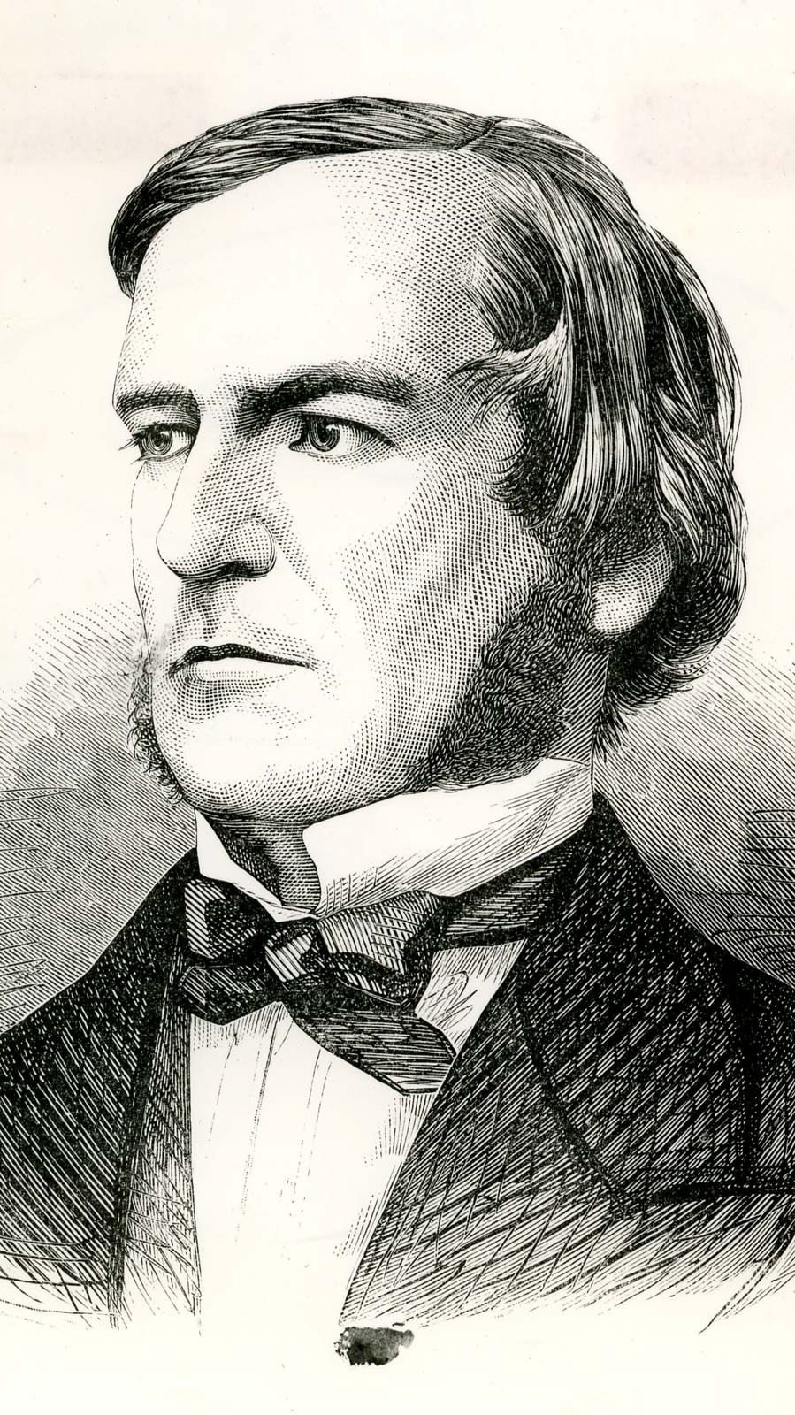
“universal laws of thought which are …mathematical as to their form”
-George Boole

Slide 21
‘Types’ we’ve covered:
Int
Float
String
Booleans

Slide 22
Equals
“this str” == “that str”

Slide 23
Booleans
100 > 0
“this str” == “that str”

Slide 24
Booleans
100 > 0
“this str” == “that str”
True
False

Slide 25
Boolean Operators?
True + False
True * False
True / True

Slide 26
Boolean Operators?
True + False
True * False
True / True

Slide 27
Boolean Operators
or
and
not

Slide 28
Boolean Operators
True or False
True and False
not True

Slide 29
Boolean Operators
True or False
True and False
not True
True

Slide 30
Boolean Operators
True or False
True and False
not True
True
False

Slide 31
Boolean Operators
True or False
True and False
not True
True
False
False

Slide 32
Casting between Data types
int()
float()
str()
bool()

Slide 33
Concepts covered so Far
Boolean values (True/False)
Boolean operators (or, and, not)
Casting using bool()

Slide 34
Exercises

Slide 35
Concepts covered so Far
Boolean values (True/False)
Boolean operators (or, and, not)
Casting between data types

Slide 36
What’s missing?

Slide 37
Flow Diagram
Start
Finish

Slide 38


Slide 39

Conditional Statements
Directs route taken by program
Hinges on Boolean expressions

Slide 40
Examples of conditions
my_name == “Rob”
age > 21
name in list_of_guests

Slide 41
if Statement
if condition_is_true:
print(“extra code runs!”)

Slide 42
Flow Diagram
Extra!
Yes
Start
If
No
Finish

Slide 43
if-Else Statement
if condition_is_true:
print(“path #1 runs”)
else:
print(“path #2 runs”)

Slide 44
Flow Diagram
Path 1
Yes
Start
If
Finish
No
Path 2

Slide 45
if-elif-Else Statement
if condition_is_true:
print(“path #1 runs”)
elif second_condition_is_true:
print(“path #2 runs”)
else:
print(“path #3 runs”)

Slide 46
Exercises

