Slide 1
Unification of Temporary Storage in the NodeKernel Architecture
Patrick Stuedi, Animesh Trivedi, Jonas Pfefferle, Ana Klimovic,
Adrian Schuepbach, Bernard Metzler
Notes:
Ok, last talk of today, which is going to be on efficient management of temporary data in data processing workloads.

Slide 2
Temporary/Intermediate Data
Output data
Broadcast
Shuffle
Input data
Map
Reduce
HDFS,
S3
HDFS,
S3
Map-reduce job
Notes:
Let’s start by talking about temporary data a bit first.
Frameworks like Spark, Flink, Haddop deal with various forms of temporary data, and with temporary data we mean data that has a limited lifetime.

Slide 3
Temporary/Intermediate Data
Broadcast
Output data
Shuffle
Input data
Map
Reduce
HDFS,
S3
HDFS,
S3
Map-reduce job
Notes:
One example is broadcast or shuffle data in a Spark job, or cached RDDs in Spark, or any similar data set in other frameworks.
We say broadcast and shuffle data are examples of intra-job temporary data because their lifetime is bound the the lifetime of the job.

Slide 4
Temporary/Intermediate Data
Broadcast
Intermediate data
Output data
Shuffle
Input data
Map
Reduce
HDFS,
S3
HDFS,
S3
HDFS,
S3
Map-reduce job
ML training
Notes:
There is also inter-job temporary data, like intermediate results shared between jobs in more complex workflows.

Slide 5
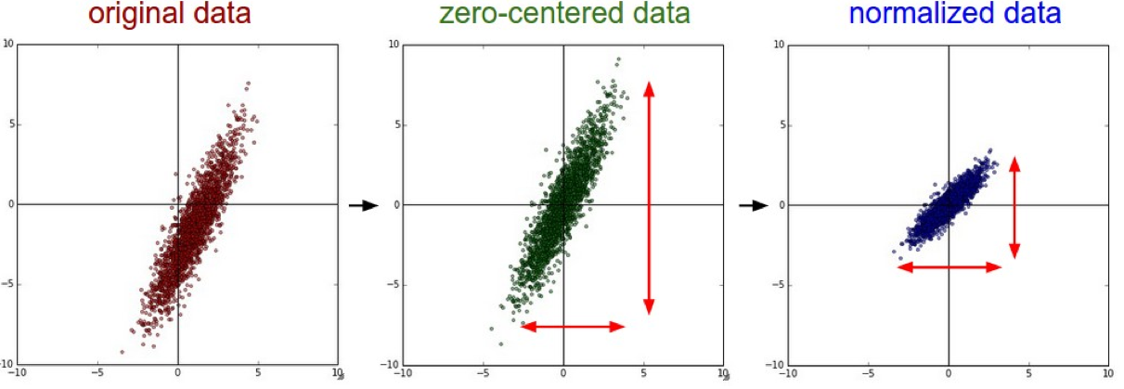
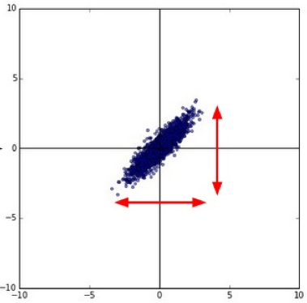
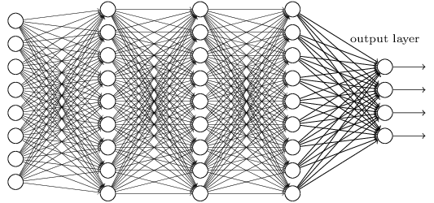
Temporary/Intermediate Data
ML pre-processing
(Spark job)
normalized
images
ML training
(Tensorflow job)
Output data
Input data
HDFS,
S3
HDFS,
S3
HDFS,
S3
Map-reduce job
ML training
Notes:
Think about a machine learning workflow where the training phase is operating on a pre-processed data set that has been computed using map-reduce job.
Just like shuffle or broadcast data, the pre-processed data typically has a limited lifetime bound to the duration of the job or the workflow in this case.

Slide 6
Temporary/Intermediate Data
97 out of 100 TPC-DS
queries includes at least
“order by”, “group by” or “join”
50% of all jobs at FB
have at least 1 shuffle
[Riffle/Eurosys’18]
ML Worflow
[Apache Airflow,
MLFlow, etc.]
HDFS,
S3
HDFS,
S3
HDFS,
S3
Map-reduce job
ML training
Temporary data is an important class of data for data processing workloads
Notes:
Turns out that temporary data is in fact an important class of data for many workloads.
For instance, 97 out of 100 TPC-DS queries when run on Spark include at a shuffle or a broadcast phase.
Riffle, a recent paper from FB on optimizing shuffle I/O reports that 50% of all jobs at FB have at least one shuffle phase.
Similarly, many ML workloads consist of multiple jobs, sharing intermediate results between jobs, and different frameworks have been proposed to manage these types of multi-job workflows.

Slide 7

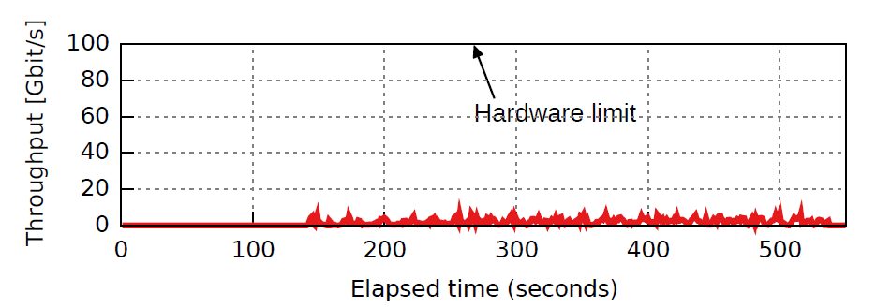
Shortcomings of Temporary Data Storage
Inefficient:
  Difficult to leverage modern networking and storage hardware (e.g., 100 Gb/s Ethernet, NVMe Flash, etc.)
Inflexible:
  emporary data management hard-wired with data processing framework
  Difficult to change deployment (e.g., disaggregation, tiered storage, etc.)
Notes:
So what’s the problem with temporary data, or how temporary data is managed.
The first issue is related to performance. Turns out it’s really difficult to leverage fast networking and storage hardware.
This figure shows the network bandwidth in Spark Terasort run on a 100G network with all data completely in DRAM.
Terasort is actually one of the most I/O intensive workloads because all the input data has to be shuffled over the network, so would be fantastic if we could make good of the available 100G network bandwidth. Unfortunately, though, the bandwidth never goes above 5-10 Gb/s.

Slide 8
Shortcomings of Temporary Data Storage
Inefficient:
  Difficult to leverage modern networking and storage hardware (e.g., 100 Gb/s Ethernet, NVMe Flash, etc.)
Inflexible:
  emporary data management hard-wired with data processing framework
  Difficult to change deployment (e.g., disaggregation, tiered storage, etc.)
Ousterhout/NSDI’16
Trivedi/HotCloud’16
Notes:
This is shuffle, but similar performance issues can be observed for other types of temporary data and there are several papers documenting these issues.

Slide 9
Shortcomings of Temporary Data Storage
Inefficient:
  Difficult to leverage modern networking and storage hardware (e.g., 100 Gb/s Ethernet, NVMe Flash, etc.)
Inflexible:
  Temporary data management hard-wired with data processing framework
  Difficult to change deployment (e.g., disaggregation, tiered storage, etc.)
Notes:
Now assume you want to address these performance issues. It’s going to be really painful because temporary data management is often tightly integrated with the compute framework, so you would have to go and re-work the shuffle module, the broadcast module, the way RDD caching is implemented etc. And by the time those modules run efficiently on 100G, you find out that you’re shuffle operation is not making effective use of flash. Or maybe you want to support storage disaggregation, so now you again have took at each module. And even if do you, you’ve only look at one framework, but your workflow may spawn multiple frameworks.

Slide 10
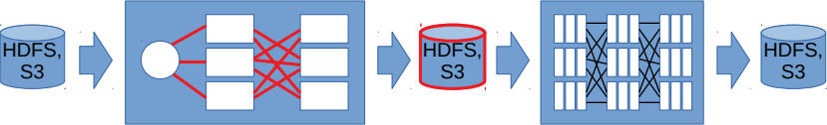
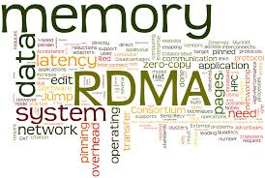
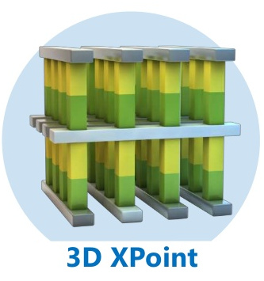
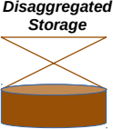

Instead of this...
Broadcast
Intermediate data
Output data
Shuffle
Input data
Map
Reduce
Can’t implement
every operation
for all the different
hardware and
deployment
options
Notes:
So clearly, we don’t want to modify all the different modules and frameworks each time we want to support a new hardware or a new deployment mode.

Slide 11
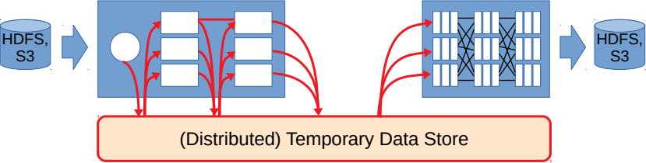

...better do this
Broadcast
Intermediate data
Output data
Shuffle
Input data
Map
Reduce
Implement hardware
support once and
support different
operations and
frameworks
Notes:
In this work, we argue that a more flexible approach is to logically separate data processing from temporary data management.
Instead of exchanging temporary data directly between tasks, which is what current implementations do, data sharing should be implemented as storage operations on an external distributed data store.
By doing so, supporting new hardware or new deployment modes becomes much easier. If the data store can operate well on a 100G network, the shuffle operation will also perform well. If the data store operates well in a disaggregated environment, your shuffle and broadcast will also be capable of doing so.

Slide 12
How should the temporary data store look?
Can we use an existing storage platform, e.g., KV store, FS, etc.?
Notes:
So now obiously the next question is how should that temporary data store look like?
Can use existing storage platforms like distributed KV stores or distributed file systems?

Slide 13
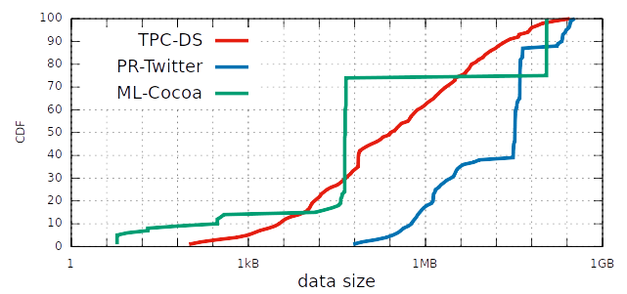
Temporary data distribution
Wide range of data sets (per task)
Notes:
We set out to better understand the requirements for temporary data storage by looking at the size distribution of temporary data for different workloads. This figure shows, for a Spark deployment, the amount of shuffle and broadcast data generated per task for a TPC-DS SQL benchmark, PageRank on the Twitter Graph and Machine Learning using the Cocoa Framework.

Slide 14
Temporary data distribution
KV-Store regime:
RAMCloud,
ccKVS, etc.
Wide range of data sets (per task)
Notes:
The observation is that the data sizes are ranging from a few bytes to almost 1GB per task.
What does that mean in terms of data storage?
Over the last years the research community has produced high-performance storage systems covering both ends of the spectrum.
RAMCloud, Pilaf, etc, are RDMA-based KV stores providing low-latency access for small data sets, so covering the left end of this spectrum very well.

Slide 15
Temporary data distribution
KV-Store regime:
RAMCloud,
ccKVS, etc.
Filesystem regime:
Octopus,
Gassyfs, etc.
Wide range of data sets (per task)
Notes:
Octopus is high-performance file systems for non-volatile memory, also RDMA based, providing high-bandwidth access to large data sets, covering the right end of the spectrum.

Slide 16
Temporary data distribution
KV-Store regime:
RAMCloud,
ccKVS, etc.
Filesystem regime:
Octopus,
Gassyfs, etc.
?
Wide range of data sets (per task)
Notes:
But turns out that finding a storage platform that covers the full spectrum of data sizes, offering high-performance data access for any size, is much harder.
We found that the existing storage platforms either do not support arbitrary data sizes or are not able to perform well across the full spectrum.
Often the limitations are by design. For instance, a single key/value pair in distributed KV store is always stored on one server, limiting access bandwidth for large KV pairs. On the other hand, filesystems often cannot match the latencies of KV stores due to additional metadata overhead.

Slide 17
Temporary Data Storage Requirements
Perform well for wide range of data sizes
  A few KB to many GBs per storage object
Support large data volumes
  Can’t keep all data in memory all the time
Provide convenient abstractions for storing temporary
  Key-value, File, what else?
Scalability
Fault-tolerance, Durability
  Temporary data is short-lived, can we use coarse grained recovery?
Notes:
So the need to perform well on a wide range of data sizes put us on new ground and actually was the starting point where we said ok let’s build something new.
And we if do, what other requirements do we have.

Slide 18
Temporary Data Storage Requirements
Perform well for wide range of data sizes
  A few KB to many GBs per storage object
Support large data volumes
  Can’t keep all data in memory all the time
Provide convenient abstractions for storing temporary
  Key-value, File, what else?
Scalability
Fault-tolerance, Durability
  Temporary data is short-lived, can we use coarse grained recovery?
Notes:
Well, we need to be able to support large volumes of data. For instance, in some cases the amount of shuffle data can be as big as the input data. A purely memory based storage system is not going to be cost effective in such a case.

Slide 19
Temporary Data Storage Requirements
Perform well for wide range of data sizes
  A few KB to many GBs per storage object
Support large data volumes
  Can’t keep all data in memory all the time
Provide convenient abstractions for storing temporary
  Key-value, File, what else?
Scalability
Fault-tolerance, Durability
  Temporary data is short-lived, can we use coarse grained recovery?
Notes:
We also want to think about what right the abstraction is to support different types of temporary data. For instance, a KV interface might be a good match for accessing broadcast objects in Spark. A stream based file interface might be the right abstraction for accessing cached input data. On the other hand, neither the FS or the KV abstraction might be a good match when reading and writing shuffle which consists of both random writes and sequential reads.

Slide 20
Temporary Data Storage Requirements
Perform well for wide range of data sizes
  A few KB to many GBs per storage object
Support large data volumes
  Can’t keep all data in memory all the time
Provide convenient abstractions for storing temporary
  Key-value, File, what else?
Scalability
Fault-tolerance, Durability
  Temporary data is short-lived, can we use coarse grained recovery?
Notes:
We also need scalability, means we want the system to be able to scale out

Slide 21
Temporary Data Storage Requirements
Perform well for wide range of data sizes
  A few KB to many GBs per storage object
Support large data volumes
  Can’t keep all data in memory all the time
Provide convenient abstractions for storing temporary
  Key-value, File, what else?
Scalability
Fault-tolerance, Durability
  Temporary data is short-lived, can we use coarse grained recovery?
Notes:
There are also requirements that require less attention in temporary storage system, like fault tolerance or durability.
The lifetime of temporary data is often short, and data processing frameworks have fault-tolerance baked in, so maybe replicating each data item 3 times is an overkill.
That doesn’t mean we don’t need fault tolerance. In it’s a question of the likelyhood of loosing data, and the overhead fault-tolerance adds vs the cost of re-computing the data.

Slide 22
NodeKernel
Distributed storage architecture for temporary data
Fusion of filesystem and key-value semantics
Designed for high-performance hardware
Notes:
So based on these requirements, we designed NodeKernel, a new distributed storage architecture for temporary data.
At a high level NodeKernel is fusing filesystem and keyvalue semantics into a single store, so it’s giving you the best of both worlds, low latency for small data sets, and high bandwidth for large data sets.
NodeKernel is designed explicitely with modern hardware in mind, some of the design decisions in NodeKernel are directly influenced by performance characteristics of fast networking and storage hardware.

Slide 23
NodeKernel: Data Model
/
CreateNode()
LookupNode()
RemoveNode()
RenameNode()
config
shuffle
param1
param2
part1
part2
map1
map2
map1
map2
/cache
/key1
/cache
/key2
/shuffle
/part1
/map1
/shuffle
/part1
/map2
/shuffle
/part2
/map1
/shuffle
/part2
/map2
Notes:
NodeKernel exposes ar hierarchical namespace of nodes. Application can create, lookup, rename and delete nodes in the hierarchy.
The hierarchnical namespace applications to conveniently organize different types of temporary data, or to logically separate data from different jobs.

Slide 24
NodeKernel: Data Model
/
CreateNode()
LookupNode()
RemoveNode()
RenameNode()
Node {
AppendData()
UpdateData()
ReadData()
}
config
shuffle
param1
param2
part1
part2
map1
map2
map1
map2
/cache
/key1
/cache
/key2
/shuffle
/part1
/map1
/shuffle
/part1
/map2
/shuffle
/part2
/map1
/shuffle
/part2
/map2
Notes:
In contrast to let’s say a file system where data is entirely stored in files, in NodeKernel every node in the tree can have some data attached to it.
The NodeKernel defines a type “Node” that supports operations to append data to a node, to read data from a node, or to update already written data with new data.

Slide 25
NodeKernel: Node Types
/
Directory : Node {
Enumerate()
}
File : Node {
Read()
Append()
}
config
shuffle
param1
param2
part1
part2
map1
map2
map1
map2
/cache
/key1
/cache
/key2
/shuffle
/part1
/map1
/shuffle
/part1
/map2
/shuffle
/part2
/map1
/shuffle
/part2
/map2
Notes:
NodeKernel defines several specific node types. Those are extension of then basic node type and offer additional functionality tailored to different types of temporary data.
Like for instance, there are directory and file node types offering file system like semantics. That is, a directory node has an operation to enumerate all of its children.
Directory and files are convenient abstractions to cache input data.

Slide 26
NodeKernel: Node Types
/
Table : Node {
Put()
Get()
}
KeyValue : Node {
Append()
Read();
}
config
shuffle
param1
param2
part1
part2
map1
map2
map1
map2
/cache
/key1
/cache
/key2
/shuffle
/part1
/map1
/shuffle
/part1
/map2
/shuffle
/part2
/map1
/shuffle
/part2
/map2
Notes:
There are Table and KeyValue nodes types. A table has Put/Get operations to add a new KeyValue node to the table, or to atomically replace an already existing KeyValue node.
Table and keyValue types are a convenient abstraction for caching data that needs regular updates.

Slide 27
NodeKernel: Node Types
/
Bag : Node {
readSubtree()
}
File : Node {
Read()
Append()
}
config
shuffle
param1
param2
part1
part2
map1
map2
map1
map2
/cache
/key1
/cache
/key2
/shuffle
/part1
/map1
/shuffle
/part1
/map2
/shuffle
/part2
/map1
/shuffle
/part2
/map2
Notes:
And then there is bag node type operating in concert with the file node type. A bag is basically a flat directory of files, but with an additional operation to read all the data of the files as if the bag was one large file.
The bag abstraction is convenient for shuffle operations as it allows each partition in a shuffle operation to be modelled as a bag. We get to that later.

Slide 28
NodeKernel: System Architecture
Application
View
/
foo
bar
Clients
Datacenter
Network
e.g., all
storage servers
with NVMe
Flash
Storage
Class 1
Storage
Class 2
Storage
Class N
Notes:
So let’s take a look at how data is actually stored in NodeKernel.
NodeKernel’s architecture is actually very similar to the architecture of a distributed file system like hdfs or gfs. Data is chopped up in blocks, and the blocks are distributed over storage servers.
One difference in NodeKernel is that storage servers are logically grouped into storage classes. The simplest way to think about a storage class is, as all storage servers storing blocks of a certain type. So you might have a storage class for DRAM and storage class for flash or disk.

Slide 29
NodeKernel: System Architecture
Application
View
/
foo
bar
Clients
Datacenter
Network
tree
structure,
tiering policy,
block mapping
e.g., all
storage servers
with NVMe
Flash
Metadata
Plane
Storage
Class 1
Storage
Class 2
Storage
Class N
Notes:
Which storage class to use for a particular node, how to distributed the blocks across the storage servers, etc., those are all decisions made by the meta servers.

Slide 30
NodeKernel: System Architecture
hierarchical
Tiering:
fill higher
performing tiers
first
Application
View
/
foo
bar
Clients
Datacenter
Network
tree
structure,
tiering policy,
block mapping
e.g., all
storage servers
with NVMe
Flash
Metadata
Plane
Storage
Class 1
Storage
Class 2
Storage
Class N
Notes:
Metadata servers maintain a list of all free blocks in the cluster. And when applications append data to a node, the metadata server has to pick a block from the free list and allocate it to the node.
NodeKernel advocates an allocation policy we call horizontal tiering, that is, the metadata server will always try to allocate a block on the fastest available storage class. So it will only allocate blocks on a flash storage server if there are no free DRAM blocks on any server in the cluster. That also means that a data set attached to a node may contain blocks from different storage classes.

Slide 31
NodeKernel: System Architecture
hierarchical
Tiering:
fill higher
performing tiers
first
Application
View
/
hash
partitioned
storage
namespace
foo
bar
Clients
Datacenter
Network
tree
structure,
tiering policy,
block mapping
e.g., all
storage servers
with NVMe
Flash
Metadata
Plane
Storage
Class 1
Storage
Class 2
Storage
Class N
Notes:
The metadata servers also maintain the basic tree structure of the storage hierarchy.
You may have observed that the meta data plane consists of multiple meta data server. This is because we partition the storage namespace across several servers to scalability reasons. Partitoining is done at the first level in the storage hierarchy, so each metadata server is responsible for exactly one top level subtree.

Slide 32
NodeKernel: System Architecture
hierarchical
Tiering:
fill higher
performing tiers
first
Application
View
/
Append()
Update()
Read()
hash
partitioned
storage
namespace
foo
bar
Clients
metadata access
Datacenter
Network
tree
structure,
tiering policy,
block mapping
data access
e.g., all
storage servers
with NVMe
Flash
Metadata
Plane
Storage
Class 1
Storage
Class 2
Storage
Class N
Notes:
Given this architecture consisting of a data plane and a metadata plane, every operation to append read or update data of a node involves two operations, one interaction with the between the client and the metadata server telling the client which storage server storage that particular block, and then another interaction with the data node to actually read or write the block.

Slide 33
Example: KeyValue PUT
Metadata
Servers
Storage
Servers
client
buffer
KV
Server
Client
Client
create
create()
data write
PUT
getblock
append()
DRAM block
ack
ack
close
close()
NodeKernel
Traditional KVS
Notes:
The full message flow is illustrated in this figure for the example of appending data to a KeyValue node.

Slide 34
Example: KeyValue PUT
Metadata
Servers
Storage
Servers
client
buffer
KV
Server
Client
Client
create
create()
data write
PUT
getblock
tiering
decision,
load
balancing
append()
DRAM block
ack
ack
close
close()
NodeKernel
Traditional KVS
Separating metadata from data adds flexibility
but requires low-latency metadata operations
Notes:
A clear advantage of NodeKernel’s architecture is that by separating the metadata from data plane, we gain flexibility. For every block the metadata server can find the most suitable storage server in the cluster in terms of storage media, loadbalancing etc.

Slide 35
Example: KeyValue PUT
Metadata
Servers
Storage
Servers
client
buffer
KV
Server
Client
Client
create
create()
data write
PUT
getblock
tiering
decision,
load
balancing
append()
DRAM block
ack
ack
close
close()
NodeKernel
Traditional KVS
Separating metadata from data adds flexibility
but requires low- but requires low-latency metadata operationslatency metadata operations
Notes:
As a downside, however, we also need an extra roundtrip, two extra roundtrips as we need to communicate the final size of the data to the mdata server after writing.
That is two roundtrips more than a key value put operation in a traditional distributed key value store.
The key underlying assumption in NodeKernel, however, is that with current and future low-latency network fabrics, such a metadata roundtrip can be implemented at a latency overhead of only a few microseconds.

Slide 36
Apache Crail
Implementation of the NodeKernel architecture
Low-latency RDMA-based RPC between client and metadata servers
Two storage classes:
  Flash accessed via NVM-over-Fabrics
  DRAM accessed via RDMA
Open source: crail.apache.org
Notes:
Crail is our implementation of the NodeKernel architecture. It uses low-latency RDMA based RPC between the client and the metadata server to minimize the overhead of metadata operation to a few microseconds.
Crail comes with three storage classes. Flash access via NVMe-over fabrics, DRAM accessed via RDMA, and DRAM accessed via TCP.
Crail is a current apache incubator project and its code is open source.

Slide 37
Evaluation
16 node cluster, machine hardware:
  100 Gb/s RDMA RoCE
  256 GB DRAM
  Intel Optane NVMe SSD
Evaluation questions:
  Any size: how well is Crail performing for different object sizes?
  Modern hardware: are we able to accelerate workloads?
  Flexibility: what benefits we get by decoupling data processing and temporary data storage?
  Abstractions: Are KeyValue, File and Bag abstractions helpful?

Slide 38
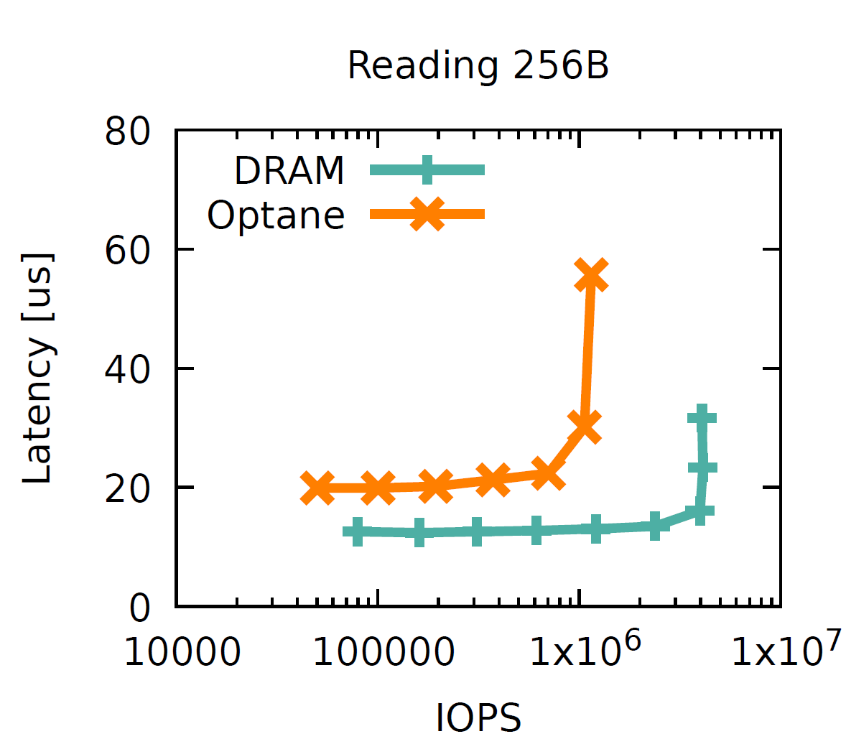
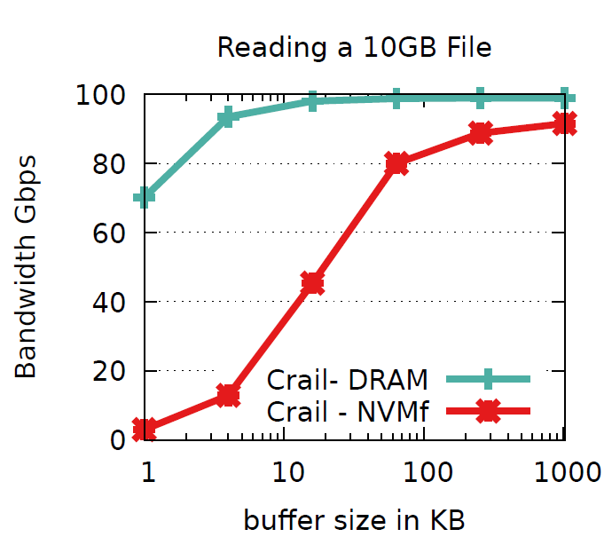
Small and Large Data Sets
KeyValue GET (256B)
File read (10GB)
Crail serves small and large data sets close to the hardware limit
(latency RDMA: 3us, latency Optane 15us, bandwidth RDMA: 100 Gb/s)
Notes:
One of the main requirements we discussed in the beginning is the ability to perform well on a wide range of data sizes.
This slide shows on the left, the performance of Crail for KeyValue GET operations on small 256B data sets, and on the right, the performance for reading a large 10GB file.
In both cases Crail’s performance is very close the hardware limits.

Slide 39

Spark Shuffle using Crail::Bag
local
files
network
transfers
compute
cluster
map
tasks
reduce
tasks
Notes:
So with the basic performance looking good for both small and large data sets, let’s see if NodeKernel’s abstractions are helpful to implement higher-level operations and whether we can accelerate those operation.
We use data shuffling in Spark as an example.

Slide 40
Spark Shuffle using Crail::Bag
append
2
1
sequential
read
compute
cluster
Crail
File
map
tasks
reduce
tasks
Crail
Bag

Slide 41
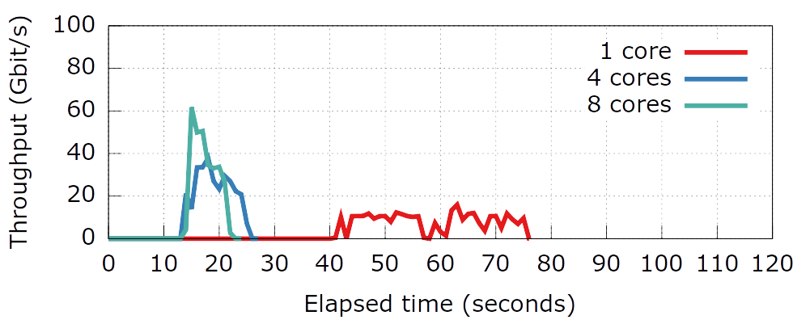
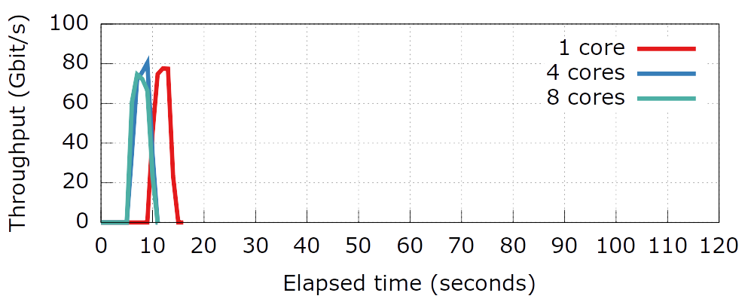
Spark GroupBy (80M keys, 4K)
Spark/
Vanilla
Spark/
Crail
2x
2.5x
5x
Spark shuffling via Crail on a single core is 2x faster
than vanilla Spark on 8 cores per executor (8 executors)

Slide 42
Flexible Deployment
Data processing job
HDFS,
S3
HDFS,
S3
configuration
Disaggregation,
Flash/DRAM ratio,
RDMA, TCP,
NVM-of-Fabrics,
etc.
Crail

Slide 43
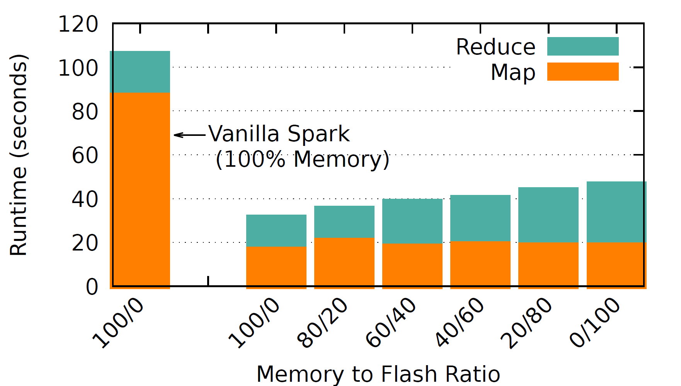
DRAM / Flash Ratio
200GB Sorting
Flexible deployment: Crail permits trading performance for cost

Slide 44
Conclusions
Sharing temporary efficiently in data processing workloads is challenging
  Inefficient in deployments with modern hardware
  Inflexible: difficult to use storage tiering, disaggregation, etc.
NodeKernel: distributed storage architecture for temporary data storage
  Fusion of Filesystem and Key-Value semantics in single storage namespace
Apache Crail: Implementation of NodeKernel for RDMA and NVMf
  Accelerates temporary data storage on modern hardware
  Enable flexible deployment: storage tiering, disaggregation, etc.

Slide 45
Open Source
Crail:
https://github.com/apache/incubator-crail
Crail shuffler:
https://github.com/zrlio/crail-spark-io
YCSB benchmark:
https://github.com/brianfrankcooper/YCSB
(includes Crail)

Slide 46
Backup

Slide 47
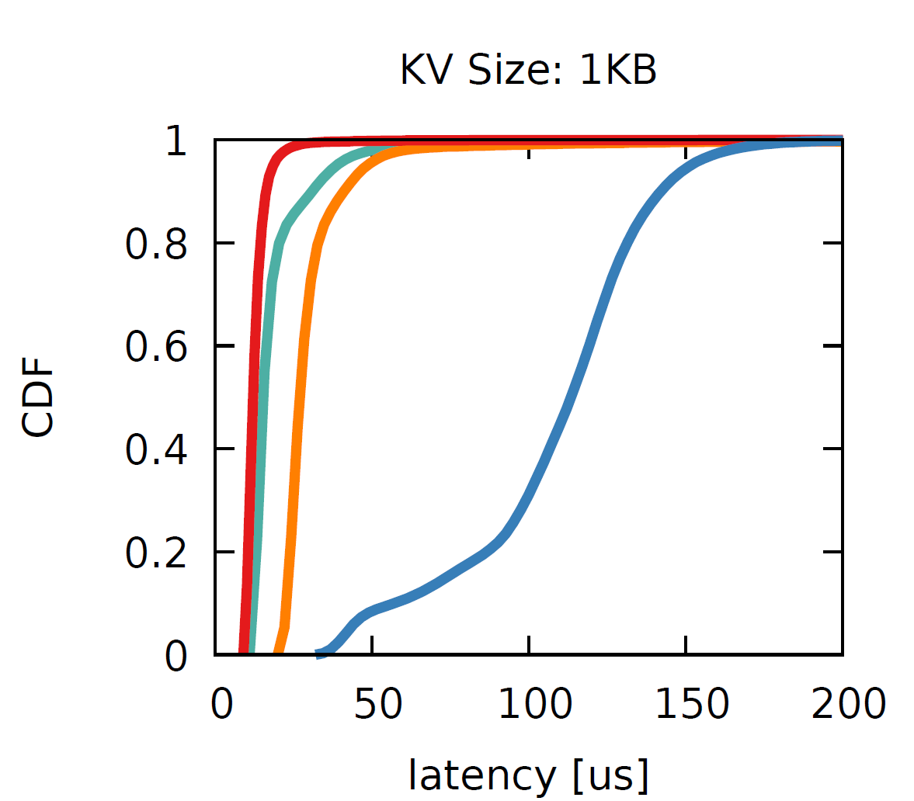
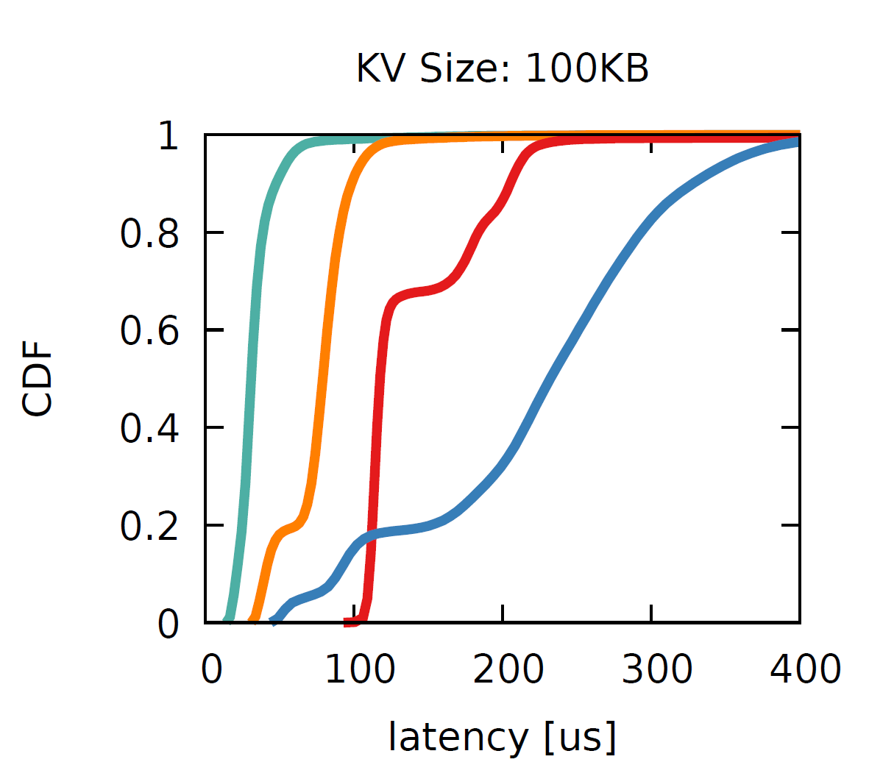
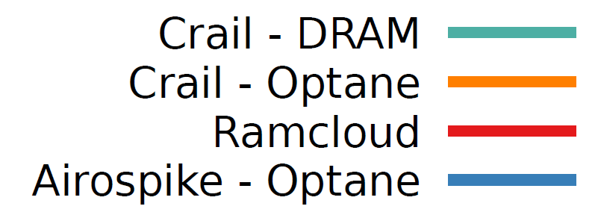
YCSB Benchmark: GET Latency
1KB KV pairs: ~12us (DRAM) and 30us (NVMe)
100KB KV pairs: ~30us (DRAM) and 40us (NVMe)

Slide 48
Persistence & Fault Tolerance
Data plane
  No replication
  Graceful handling of faulty or crashed storage servers
  (signaled at client during read/write ops)
Meta data plane
  Persist metadata state using operation logging
  Shutdown and replay log to re-create state
Pluggable log device
  Current log is on local FS
  Could be a distributed log: maintain a hot standby metadata server
Metadata
server
Metadata
server
RPC
clients
log
operation
replay
log
log interface
log
mplementation

Slide 49
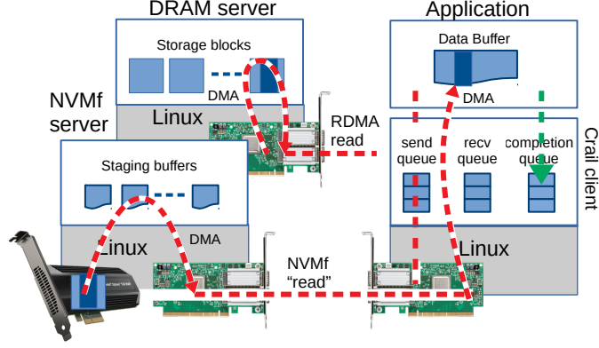
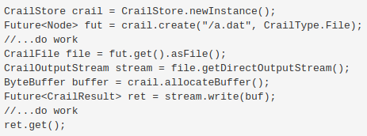
Crail Data Plane

Slide 50
Crail Data Plane
1
1
asynchronous
API

Slide 51
Crail Data Plane
zero copy
data movement
1
1
asynchronous
API

Slide 52
Crail Data Plane
zero copy
data movement
direct
data placement
1
1
asynchronous
API

Slide 53
Crail Data Plane
transfer only
data requested
zero copy
data movement
direct
data placement
1
1
asynchronous
API

Slide 54
Crail Data Plane
transfer only
data requested
zero copy
data movement
direct
data placement
1
2
1
2
asynchronous
API
synchronous
call

Slide 55
Example: KeyValue Node
Metadata
Servers
Storage
Servers
client
buffer
KV
Server
Client
Client
overwrites
existing
KV node
create
create()
data write
PUT
getblock
append()
DRAM block
ack
ack
close
close()
NodeKernel
Traditional KVS
Notes:
The client will first communicate with the metadata server to create a new keyvalue node at a given location in the storage hierarchy. The metadata will create a new node, replacing any old node with the same name if it exists.
The metadata server will then allocate a block just as discussed before and return information about the block, which includes the storage server that stores the block, back to the client.
During the append operation the client interacts with the storage server to write the block over the network.
Important here is that, depending on the type of block, that is DRAM or Flash, the client may use a different protocol. For intsance, in Crail, our implementation of the NodeKernel architecture, DRAM is access via RDMA whereas Flash is accessed via NVMe-over-Fabrics.

Slide 56
Example: KeyValue Node
Metadata
Servers
Storage
Servers
client
buffer
KV
Server
Client
Client
overwrites
existing
KV node
create
create()
data write
PUT
getblock
append()
DRAM block
ack
ack
close
access protocol
depends on
block type
close()
NodeKernel
Traditional KVS

Slide 57
Slide Material

Slide 58
Temporary Data Storage Requirements
Perform well for wide range of data sizes
  A few KB to many GBs per storage object
Support large data volumes
  Can’t keep all data in memory all the time
Provide convenient abstractions for storing temporary
  Key-value, File, what else?
Scalability
Fault-tolerance, Durability
  Temporary data is short-lived (seconds to minutes)
Notes:
We also need scalability, means we want the system to be able to scale out

Slide 59
Temporary/Intermediate Data
ML pre-processing
(Spark job)
normalized
images
ML training
(Tensorflow job)
Output data
Input data
HDFS,
S3
HDFS,
S3
HDFS,
S3
Map-reduce job
ML training
Temporary data is an important class of data for data processing workloads
Notes:
Managing temporary data efficiently is key to the performance of data processing workloads.
There have been several research
For instance, about 50% of all Spark jobs at FB have a shuffle phase. Similarly, many ML workloads are actually workflows consisting of multiple jobs.

Slide 60
BagNode
Table
Node
KeyValue
Node
Directory
Node
FileNode
Application interface
Metadata Lookup
Datacener
Network
Data
Read/Write
Clients
hashing
Metadata
Plane
Storage
Class 1
Storage
Class 2
Storage
Class N

Slide 61
Metadata Lookup
Datacener
Network
Data
Read/Write
Clients
hashing
Metadata
Plane
Storage
Class 1
Storage
Class 2
Storage
Class N

Slide 62
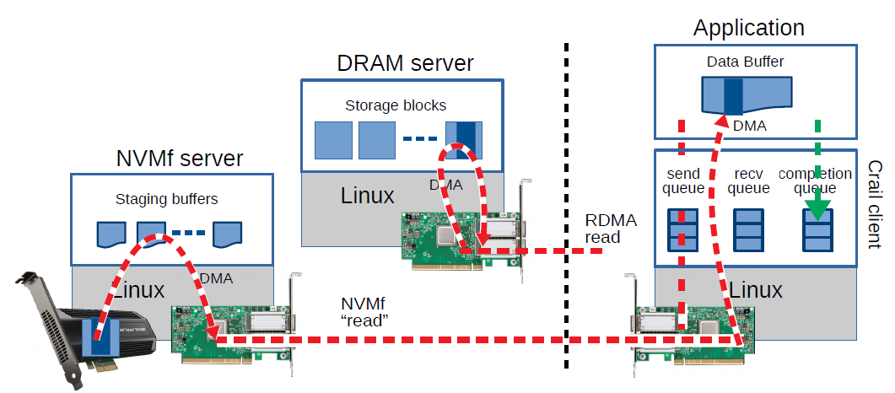
Apache Crail
Implementation of the NodeKernel architecture
  RDMA-based RPC for communication between client and metadata servers
  Two storage classes
    DRAM/RDMA
    Flash/NVMf
Java-based

Slide 63
Disaggregated
Storage

Slide 64
Disaggregated
Storage

Slide 65
System Architecture
/
foo
bar
Datacenter
Network
tree
structure,
tiering policy,
block mapping
e.g., all
storage servers
with NVMe
Flash
Metadata
Plane
Storage
Class 1
Storage
Class 2
Storage
Class N

Slide 66
NodeKernel: Data Model
/
Directory : Node {
Enumerate()
}
File : Node {
Read()
Append()
}
Bag : Node {
readSubtree()
}
Table : Node {
Put()
Get()
}
config
cache
shuffle
/config
key1
key2
part1
part2
map1
map2
map1
map2
/cache
/key1
/cache
/key2
/shuffle
/part1
/map1
/shuffle
/part1
/map2
/shuffle
/part2
/map1
/shuffle
/part2
/map2

Slide 67
NodeKernel: Data Model
/
CreateNode()
LookupNode()
RemoveNode()
RenameNode()
Node {
AppendData()
UpdateData()
ReadData()
}
cache
shuffle
key1
key2
part1
part2
map1
map2
map1
map2
/cache
/key1
/cache
/key2
/shuffle
/part1
/map1
/shuffle
/part1
/map2
/shuffle
/part2
/map1
/shuffle
/part2
/map2

Slide 68
Dir
“/”
list
Table
Dir
“/tab1”
list
“/dir1”
list
KV
KV
KV
File
File
value
value
value
data
data
“/tab1/key1”
“/tab1/key2”
“/tab1/keyn”
“/dir1/file1”
“/dir1/file2”

Slide 69
Node Types
/
Directory : Node {
Enumerate()
}
File : Node {
Read()
Append()
}
Bag : Node {
readSubtree()
}
Table : Node {
Put()
Get()
}
cache
shuffle
key1
key2
part1
part2
map1
map2
map1
map2
/cache
/key1
/cache
/key2
/shuffle
/part1
/map1
/shuffle
/part1
/map2
/shuffle
/part2
/map1
/shuffle
/part2
/map2

Slide 70
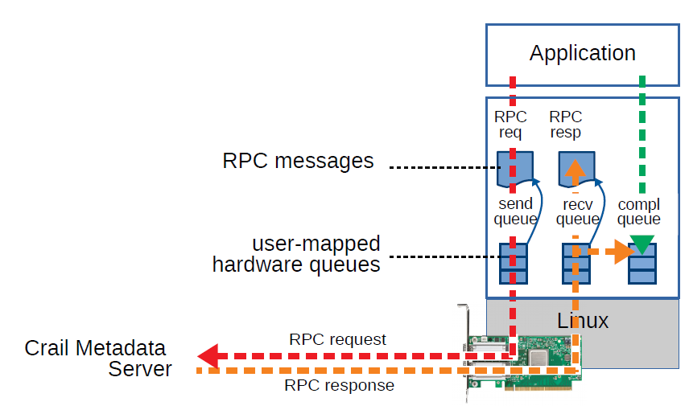

User-Level I/O: Metadata
1
2
1
2
Crail
client
library

Slide 71
User-Level I/O: Metadata
1
2
1
2
No threads
No context switches
Crail
client
library

Slide 72

User-Level I/O: Data
1
2
1
2

Slide 73
User-Level I/O: Data
zero-copy,
transfer only
data that is
requested
Application
1
2
1
2

Slide 74
BagNode
Table
Node
KeyValue
Node
Directory
Node
FileNode
Application interface
Metadata Lookup
Datacener
Network
Data
Read/Write
Clients
hashing
Metadata
Plane
Storage
Class 1
Storage
Class 2
Storage
Class N

Slide 75
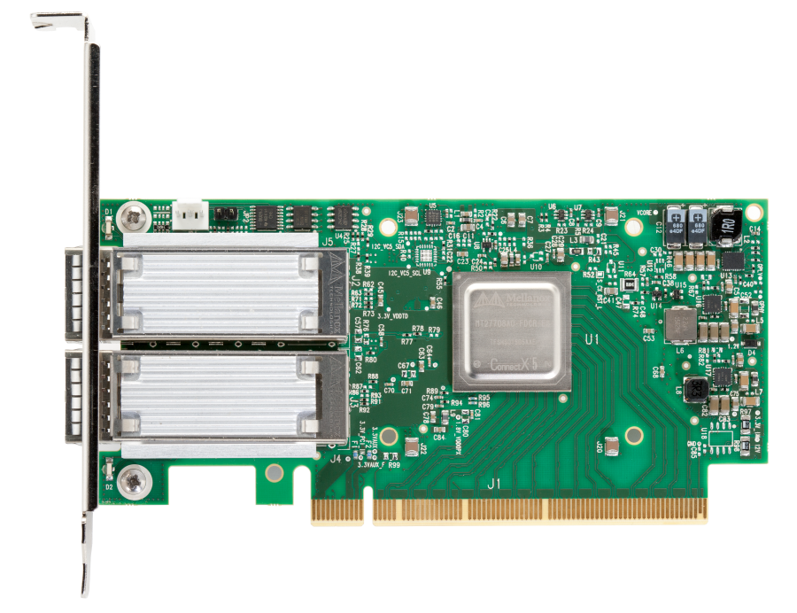
Application
RPC
req
RPC
resp
RPC messages
send
queue
recv
queue
compl
queue
user-mapped
hardware queues
Linux
Crail Metadata
Server
RPC request
RPC response

Slide 76

DRAM server
Application
Storage blocks
Data Buffer
NVMf
server
DMA
DMA
Linux
RDMA
read
send
queue
recv
queue
completion
queue
Staging buffers
Crail client
Linux
Linux
DMA
NVMf
“read”

Slide 77
User-Level I/O: Data
Application
DRAM server
Data Buffer
Storage blocks
DMA
NVMf server
Linux
send
queue
recv
queue
completion
queue
DMA
Staging buffers
Crail client
RDMA
read
Linux
Linux
DMA
NVMf
“read”

Slide 78
Instead of this...
Broadcast
Intermediate data
Output data
Shuffle
Input data
Map
Reduce
HDFS,
S3
HDFS,
S3
HDFS,
S3
Map-reduce job
ML training

Slide 79
...better do this
Broadcast
Intermediate data
Output data
Shuffle
Input data
Map
Reduce
HDFS,
S3
HDFS,
S3
(Distributed) Temporary Data Store

Slide 80
HDFS,
S3
HDFS,
S3
HDFS,
S3

Slide 81
HDFS,
S3
HDFS,
S3
(Distributed) Temporary Data Store

Slide 82
Input
Cores
Map
Reduce
Output
Net
Ser
Sort
Net
Ser
Sort
Net
Ser
Sort

Slide 83
Cores
Map
Crail
Reduce
Task
File
Directory
Sorted key range

Slide 84
append
1
parallel
read
2
map
tasks
Crail
File
Crail
MultiFile
reduce
tasks

