Slide 1
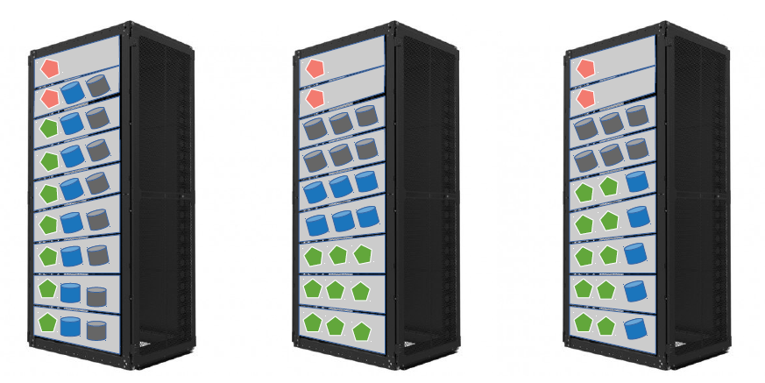
Crail Store: Deployment Modes
Metadata server
Flash storage server
DRAM storage server
Application compute
compute/storage
co-located
compute/storage
disaggregated
flash storage
disaggregation

Slide 2
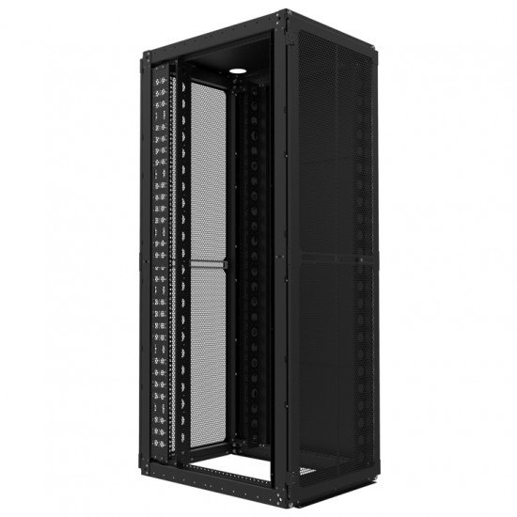
Metadata server
Disaggregated flash tier (class 2)
Local flash tier (class 1)
DRAM storage tier (class 0)
Application compute

Slide 4
Disaggregated flash tier
Local flash tier
DRAM storage tier

Slide 5
time
W-A W-B W-C W-D W-E D-A D-B W-F
Disaggregated flash tier
Local flash tier
DRAM storage tier

Slide 6
time
t0 t1 t10 t11 t12 t13 t14 t15
W-A W-B W-C W-D W-E D-A D-B W-F
Disaggregated flash tier
Local flash tier
DRAM storage tier

Slide 7
Disaggregated flash tier
Local flash tier
time
DRAM storage tier
W-A W-B W-C W-D W-E D-A D-B W-F

Slide 9
storage
demand
disaggregated
flash tier
local
flash tier
local
DRAM tier

Slide 10
capacity
demand
disaggregated
flash tier
local
flash tier
local
DRAM tier

