Slide 1
mapper₀
mapper₀
reducer₀
reducer₀
mapper₁
mapper₁
mapper₂
reducer₁
mapper₂
reducer₁

Slide 2

Cores
Map
tasks
Crail
Reduce
tasks
CrailFile
CrailMultiFile
Sorted partition

Slide 3
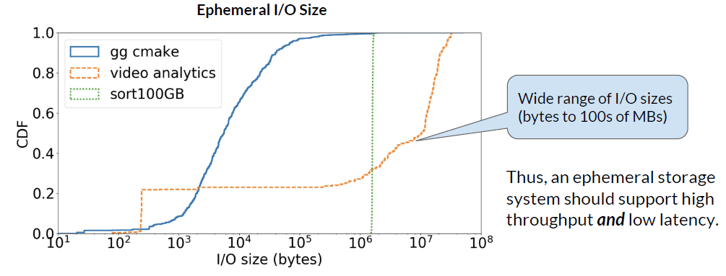
Requirements for
Ephemeral Storage
1
High performance for a wide range of object sizes
  Exploit massive parallelism with large number of serverless tasks

Slide 4
Spark Serverless: What’s missing?
SparkContext
Worker
Worker
Worker
Executor
Executor
Executor
Task
Task
Task
In-memory
cache
(MemStore)
Filesystem

Slide 5
Spark Serverless: What’s missing?
SparkContext
loosing
Intermediate
data/state!
Scale-down
event
Worker
Worker
Worker
Executor
Executor
Executor
Task
Task
Task
In-memory
cache
(MemStore)
Filesystem

Slide 6
Disaggregation of Ephemeral Data
SparkContext
Worker
Worker
Worker
Executor
Executor
Executor
Task
Task
Task
Network
Fabric
DRAM tier
Disaggregated
Storage
Flash tier

Slide 7
Disaggregation of Ephemeral Data
SparkContext
Scale-down
event
Data/state
available
when
executor
disappears
Worker
Worker
Worker
Executor
Executor
Executor
Task
Task
Task
Network
Fabric
DRAM tier
Disaggregated
Storage
Flash tier

