Slide 1
Phone master v.2
Peicheng Su
Weiyu liu

Slide 2
New features
Forget Password
Slide show
Search bar
Item detail
Shopping cart shows how many items you have.
Delete unwanted items from shopping cart

Slide 3

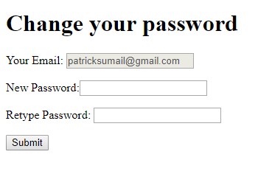
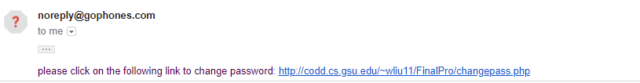
Forget password

Slide 4
Core-change password
$subject = 'Changing Password'; $content = "please click on the following link to change password: http://codd.cs.gsu.edu/~wliu11/FinalPro/changepass.php"; $headers = 'From: noreply@goPhones.com'; mail($email,$subject,$content,$headers);

Slide 5
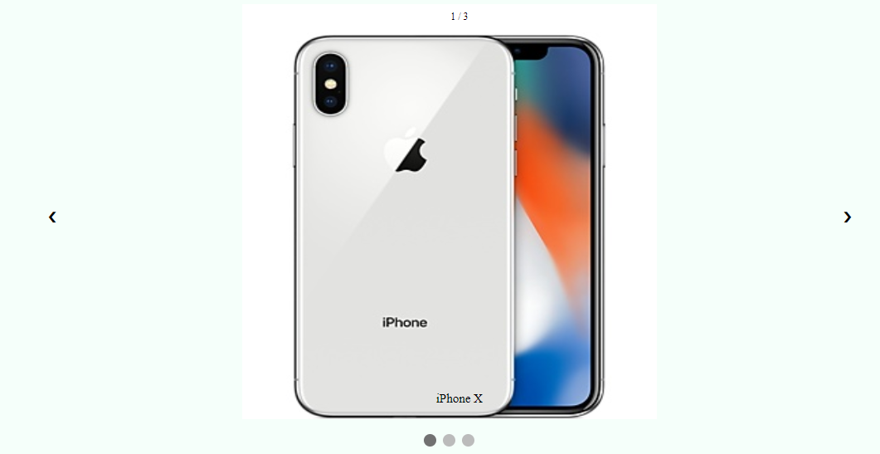
Slide show
When clicking next button/ previous button, it passes index+1/-1 parameter to plusSlide(index) function. In the plusSlide() function, it sets corresponding html tag display to block.

Slide 6
Search bar
Event: onKeyUp
Method: String.search
CSS: if matches, set display to block else, set display to none

Slide 7
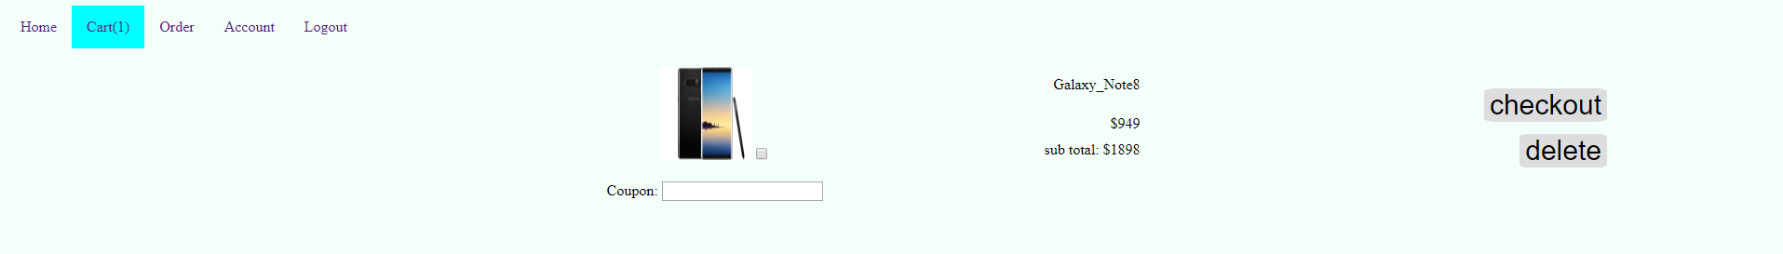
Shopping cart
Implemented by Ajax:
cartNum.php calculates the number of items in the shopping cart
cart.php send request to cartNum.php get the number of items
Delete:
Simple delete query from database, then refresh the page.

Slide 8
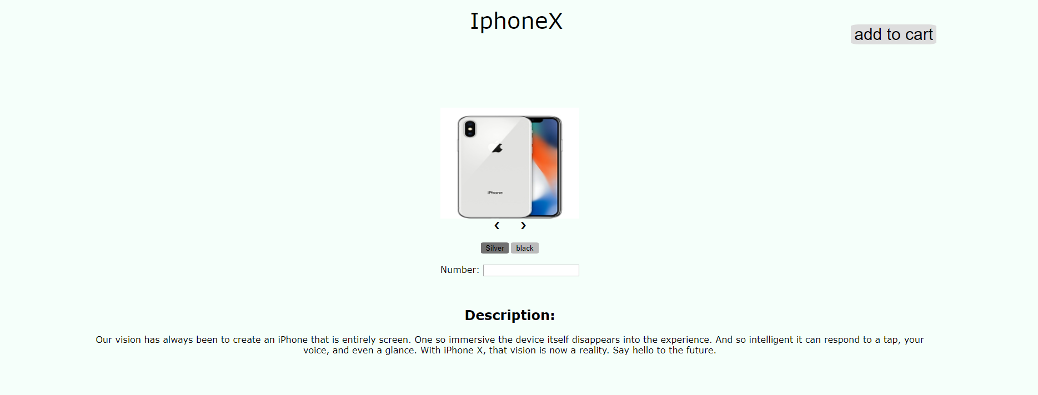
Item detail

Slide 9
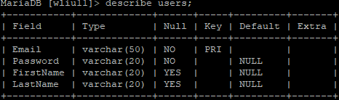
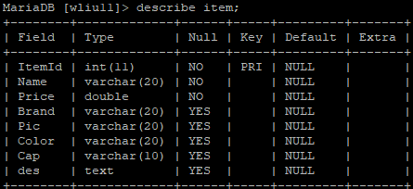
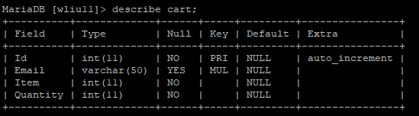
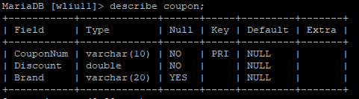
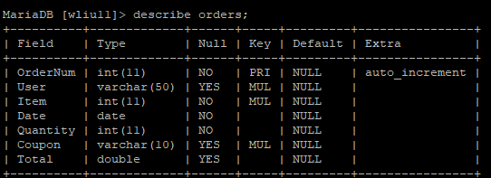
database

Slide 10
demo
http://codd.cs.gsu.edu/~wliu11/FinalPro/Home.php

