Slide 1
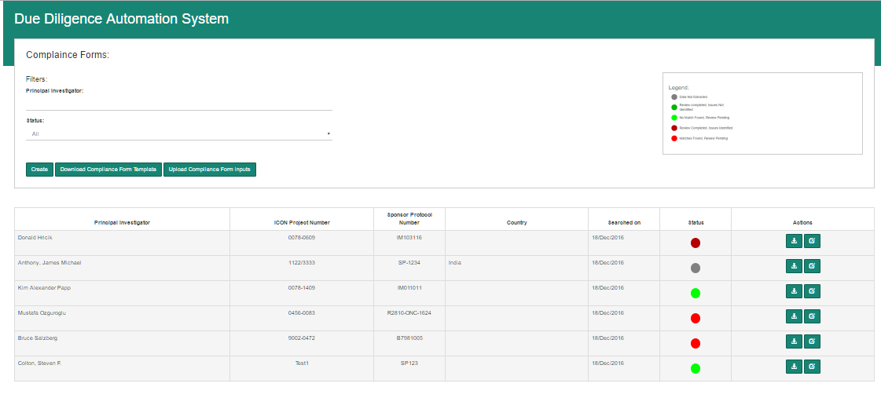
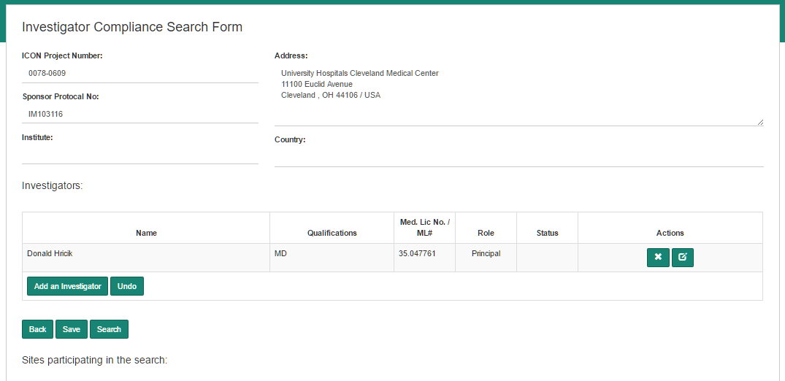
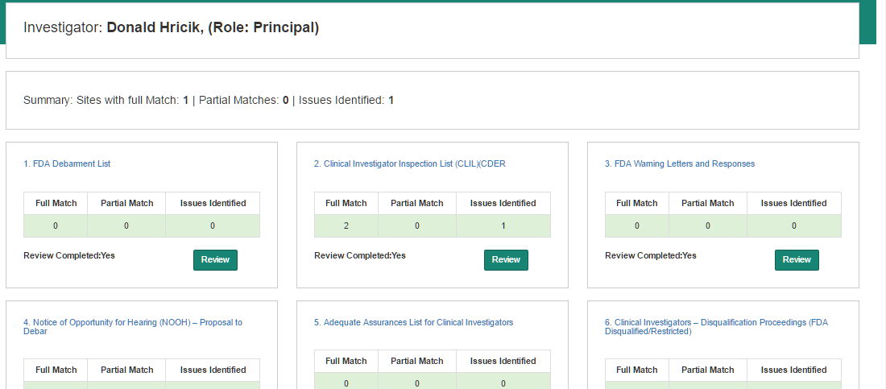

Slide 3
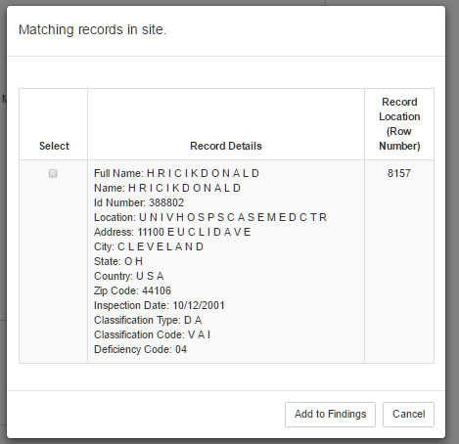
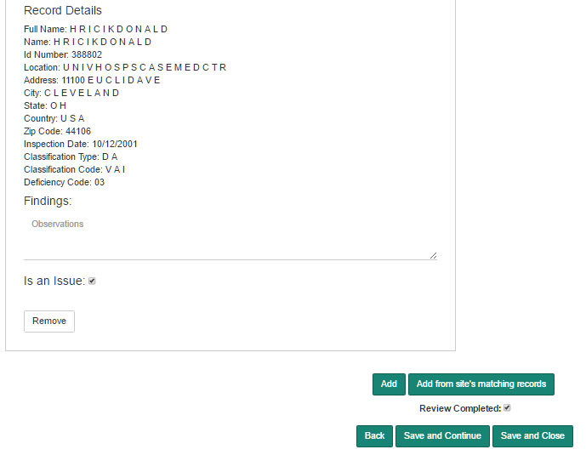
Recording Findings / Observations

Slide 4
Adding Findings (Observations):
Use ‘Add’ button to record observations.
Use ‘Add from site’s matching records’ to add and then record observations
The Findings will appear in the Compliance form under section ‘Findings’
Identify if this observation is ‘Is an Issue’. If one or more findings are marked as ‘Is an Issue’ then ‘Issues Identified’ is flagged for that site.
Check ‘Review Completed’ check box if the recording of findings is completed for this site
‘Save and Close’ to return to the previous screen.

Slide 5
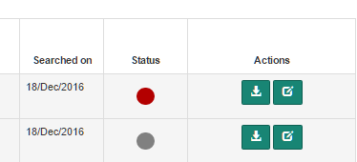
Open a Compliance Form for editing
Generate and download a Compliance Form (MS Word document)

Slide 6
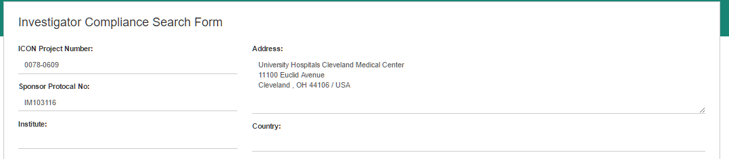

Slide 7
