Slide 1
Advertisement Detection Using Convolutional Neural Networks
Patrick von Platen
Esin Koyuncu
Esra Akan
20.07.2018

Slide 2
Introduction
Task
Classifying images from soccer videos, deciding which images contain advertisement and which do not
Finding the location of the advertisement in the image
Requirements
Soccer videos given by supervisor
A network model for image classification:
VGG16, built by Visual Geometry Group, scored first place on the image localization task and second place on the image classification task in the Image Net Challenge in 2014

Slide 3

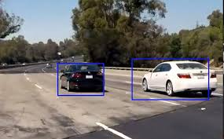
Pipeline of the Project
Preprocessing
VGG16
Images
Labels
Training
Model
Trained Weights
Evaluation
Advertisment Locating
Classified Images

Slide 4
Preprocessing
Convert 3 videos into ~1000 images
Label images manually! ☹
Downsample images by a factor of 2
Shuffle image data and labels
Split into train and test sets (90/10 %)

Slide 5
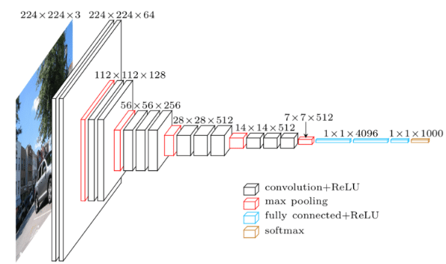
Model
Original VGG16 architecture
The layers after the last max pooling layer are changed to detect the advertisement
One class needed as output
New layers:
Flatten (Fully-connected, no activation)
Dense (Fully-connected, ReLu activation, size 1000)
Output: (1 output node, sigmoid activation ~ 2 output nodes with softmax activation)

Slide 6
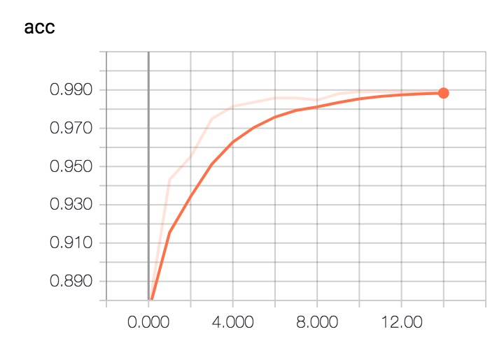
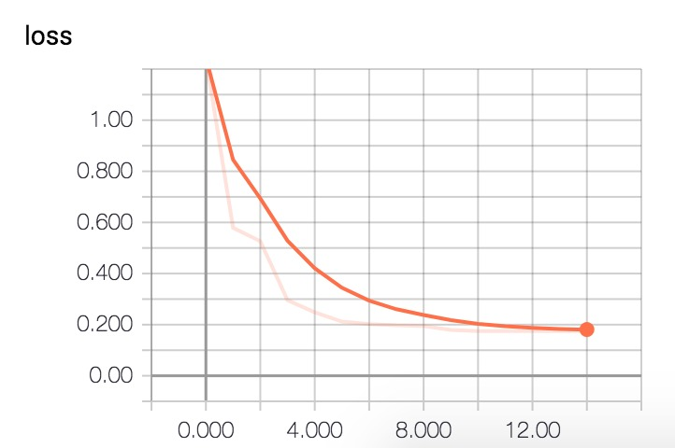
Training
Training parameters
Cross entropy loss function
Learning rate: 0.0001
Number of epochs: 15
Batch-size: 20
Data
Input data: (288, 384,3) dimensional image as numpy array
Label: (1) dimensional integer being 0 or 1

Slide 7
Evaluation
Input
Trained weights
Model
~100 images
Labels
Output
Classification of images
Accuracy

Slide 8
Locating the Advertisement
Output of last convolution layer contains spatial information of the image → Assumption:
High activation of output nodes of convolutional layer correspond to advertisement
Location of advertisement can be traced back
Trace back network
Multiply outputs and weights of both flatten and last dense layer
Look for largest contributions
Mark them on a mask of dimension (9x12)
Print mask on image of dimension (288x384)

Slide 9
Challenges
Labeling of images: How to decide whether image contains advertisement or not?
Problems with random access memory (RAM): Downscaling of images
Training had to be done on cluster due to ~50 million trainable parameters
Slow feedback loop when debugging due to high complexity of calculations
Locating of advertisement does not work → Possible reasons:
Wrong method
Bad labelling
Backtracking was done over two layers having non-linear activation functions → Not possible

