Slide 1
The Advance Directive Ontology (ADO)
A computable representation of end-of-life care preferences in advanced heart failure
Patrick Walsh • Darren Chan
Stanford University
Clinical
scenario
OWL 2
ontology
Actionable
output
Notes:
NARRATIVE: Act I — frame the talk.
SAY: Patrick Walsh & Darren Chan. ADO = computable EOL preferences in advanced HF. Not a legal AD.
TRANSITION: "Start at the 2 a.m. crisis."
[~25s]

Slide 2
CLINICAL PROBLEM
The workflow has documents, orders, and gaps
End-of-life preferences often move through three different instruments. The loss happens in the middle: conditional patient wishes become coarse checkboxes or bedside orders.
Low resolution
Disease blind
No reasoning
Advance directive
values + wishes
POLST
portable orders
Code status
bedside action
Acute crisis
what do we do?
Example wish lost in translation
“I would accept a ventilator temporarily if the cause is reversible, but never indefinitely.”
A checkbox can record “ventilator: yes/no,” but not the conditional structure.
Advance Directive Ontology (ADO) | BMDS 210 / CS 270
2
Notes:
NARRATIVE: Act I — three instruments, translation loss.
SAY: AD → POLST → code status. Conditional wishes → coarse boxes. Low resolution + disease blindness.
TRANSITION: "HF is where that hurts most."
[~45s]

Slide 3
WHY THIS CLINICAL SCOPE
Advanced heart failure makes the gap visible
Heart failure is unpredictable, device-dependent, and frequently revisited in emergency/ICU settings—exactly where preference interpretation becomes time pressured.
CPR /
resuscitation
Dialysis
Advanced HF
Mechanical
ventilation
Vasopressor /
inotrope escalation
ICD + device
management
Generic AD templates rarely mention ICD deactivation, LVAD/device decisions, or inotrope escalation.
Advance Directive Ontology (ADO) | BMDS 210 / CS 270
3
Notes:
NARRATIVE: Act I — why HF scope.
SAY: Five decision points. ICD/LVAD/inotropes missing from generic templates.
TRANSITION: "Smallest object that preserves patient logic?"
[~35s]

Slide 4
APPROACH
Core idea: turn patient language into computable preference objects
ADO preserves the original text, but gives a reasoner the structured facts it needs to decide whether a preference actually applies.
Intervention
vasopressor withdrawal
PreferenceStatement
“Do not continue vasopressors
if there is no improvement after 72 hours.”
ActivationCondition
no improvement; 72h
Strength
strong / conditional
Why preserve original language?
Negated?
no
It lets the system be auditable and lets clinicians see the patient’s words behind the inference.
OriginalText
verbatim quote
Advance Directive Ontology (ADO) | BMDS 210 / CS 270
4
Notes:
NARRATIVE: Act II — PreferenceStatement.
SAY: Intervention + activation + strength + negation + verbatim. Walk 72h vasopressor example.
TRANSITION: "How much structure we built."
[~45s]

Slide 5
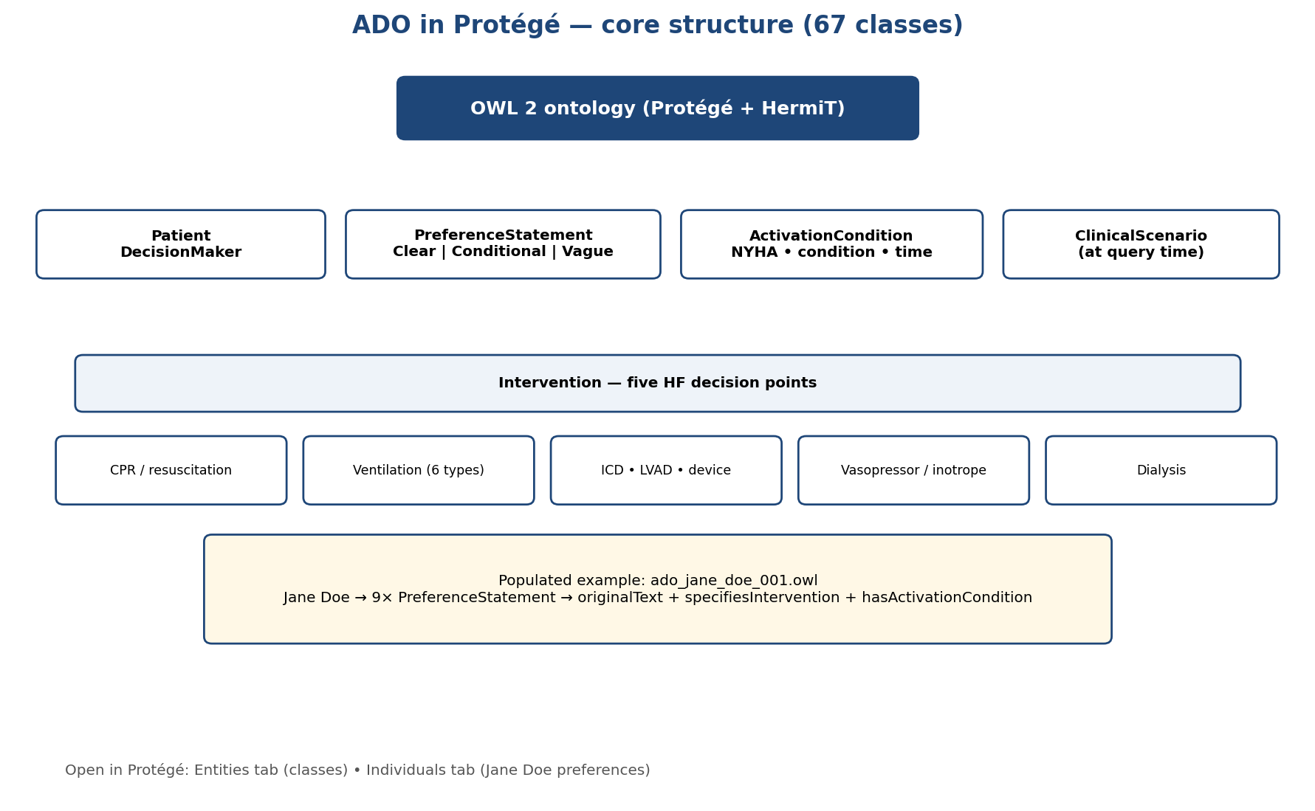
ONTOLOGY SCOPE
What ADO models
67
22
21
Five decision points are expanded into intervention subclasses at a clinically meaningful level of granularity.
classes
properties
intervention subclasses
CPR / resuscitation
CPR • defibrillation • transcutaneous pacing
Ventilation
temporary vs. indefinite • invasive vs. non-invasive • withdrawal
Device management
ICD deactivation • shock therapy • LVAD • pacemaker
Escalation
vasopressor/inotrope escalation and withdrawal
Dialysis
acute • chronic • withdrawal
Grounding: clinical concepts are mapped to standard terminologies such as SNOMED CT.
Advance Directive Ontology (ADO) | BMDS 210 / CS 270
5
Notes:
NARRATIVE: Act II — ontology credibility.
SAY: 67 classes, 22 properties, 21 interventions. POINT AT hierarchy figure.
OPTIONAL LIVE: Protégé — ado_jane_doe_001.owl
TRANSITION: "Know when NOT to answer."
[~35s]

Slide 6
OUTPUT SEMANTICS
The reasoner is designed to be honest, not overconfident
Instead of forcing a binary answer, ADO returns one of four outputs that tell a clinician how much the directive actually says.
Clear match
No coverage
conditions met; unambiguous
directive is silent for this scenario
Clinical
scenario
Partial match
Vague match
some conditions uncertain/unmet; defer
imprecise language surfaced
This is the safety feature: uncertainty becomes visible rather than hidden behind a confident answer.
Advance Directive Ontology (ADO) | BMDS 210 / CS 270
6
Notes:
NARRATIVE: Act II — four honest outputs.
SAY: Clear / Partial / No coverage / Vague. Can't say "I don't know" = safety failure.
TRANSITION: "Pipeline wiring."
[~40s]

Slide 7
SYSTEM IMPLEMENTATION
End-to-end architecture
LLMs are used only at the boundary. The ontology remains the auditable source of truth, and the deterministic reasoner produces the clinical output.
Structured form
or free text
Closed-world
LLM extraction
Validated JSON
preferences
OWL ontology
+ individuals
Scenario-based
reasoner
ACP note
POLST/code status
Closed-world rule
Reasoner responsibility
Extract only what the patient explicitly states; do not map out-of-scope content to the nearest covered class.
Match intervention + activation conditions + negation + strength against the clinical scenario.
Advance Directive Ontology (ADO) | BMDS 210 / CS 270
7
Notes:
NARRATIVE: Act II — architecture.
SAY: LLMs extract ONLY. Ontology = truth. Reasoner decides. Closed-world extraction.
TRANSITION: "Six evaluation strands including 520-cell cohort."
[~45s]

Slide 8
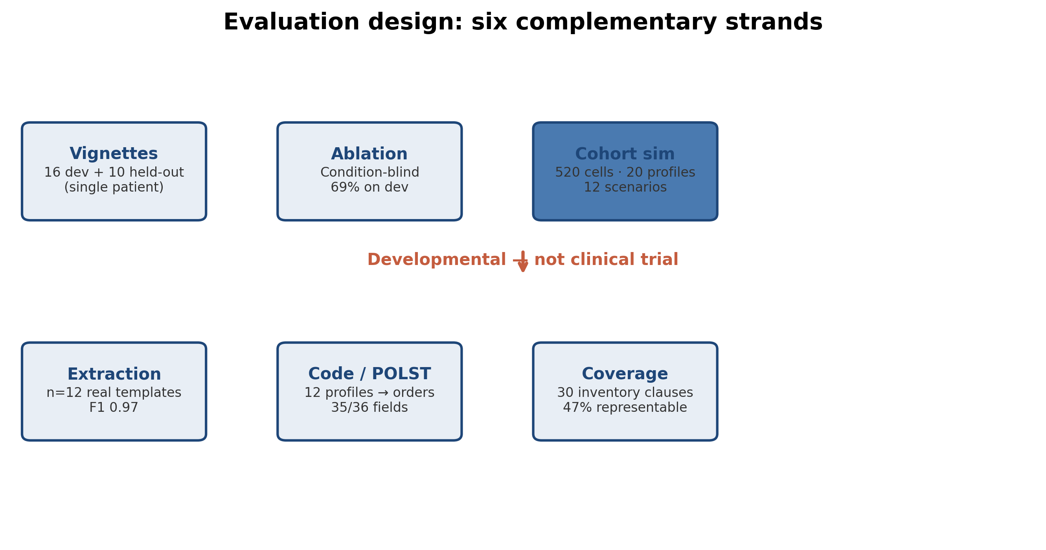
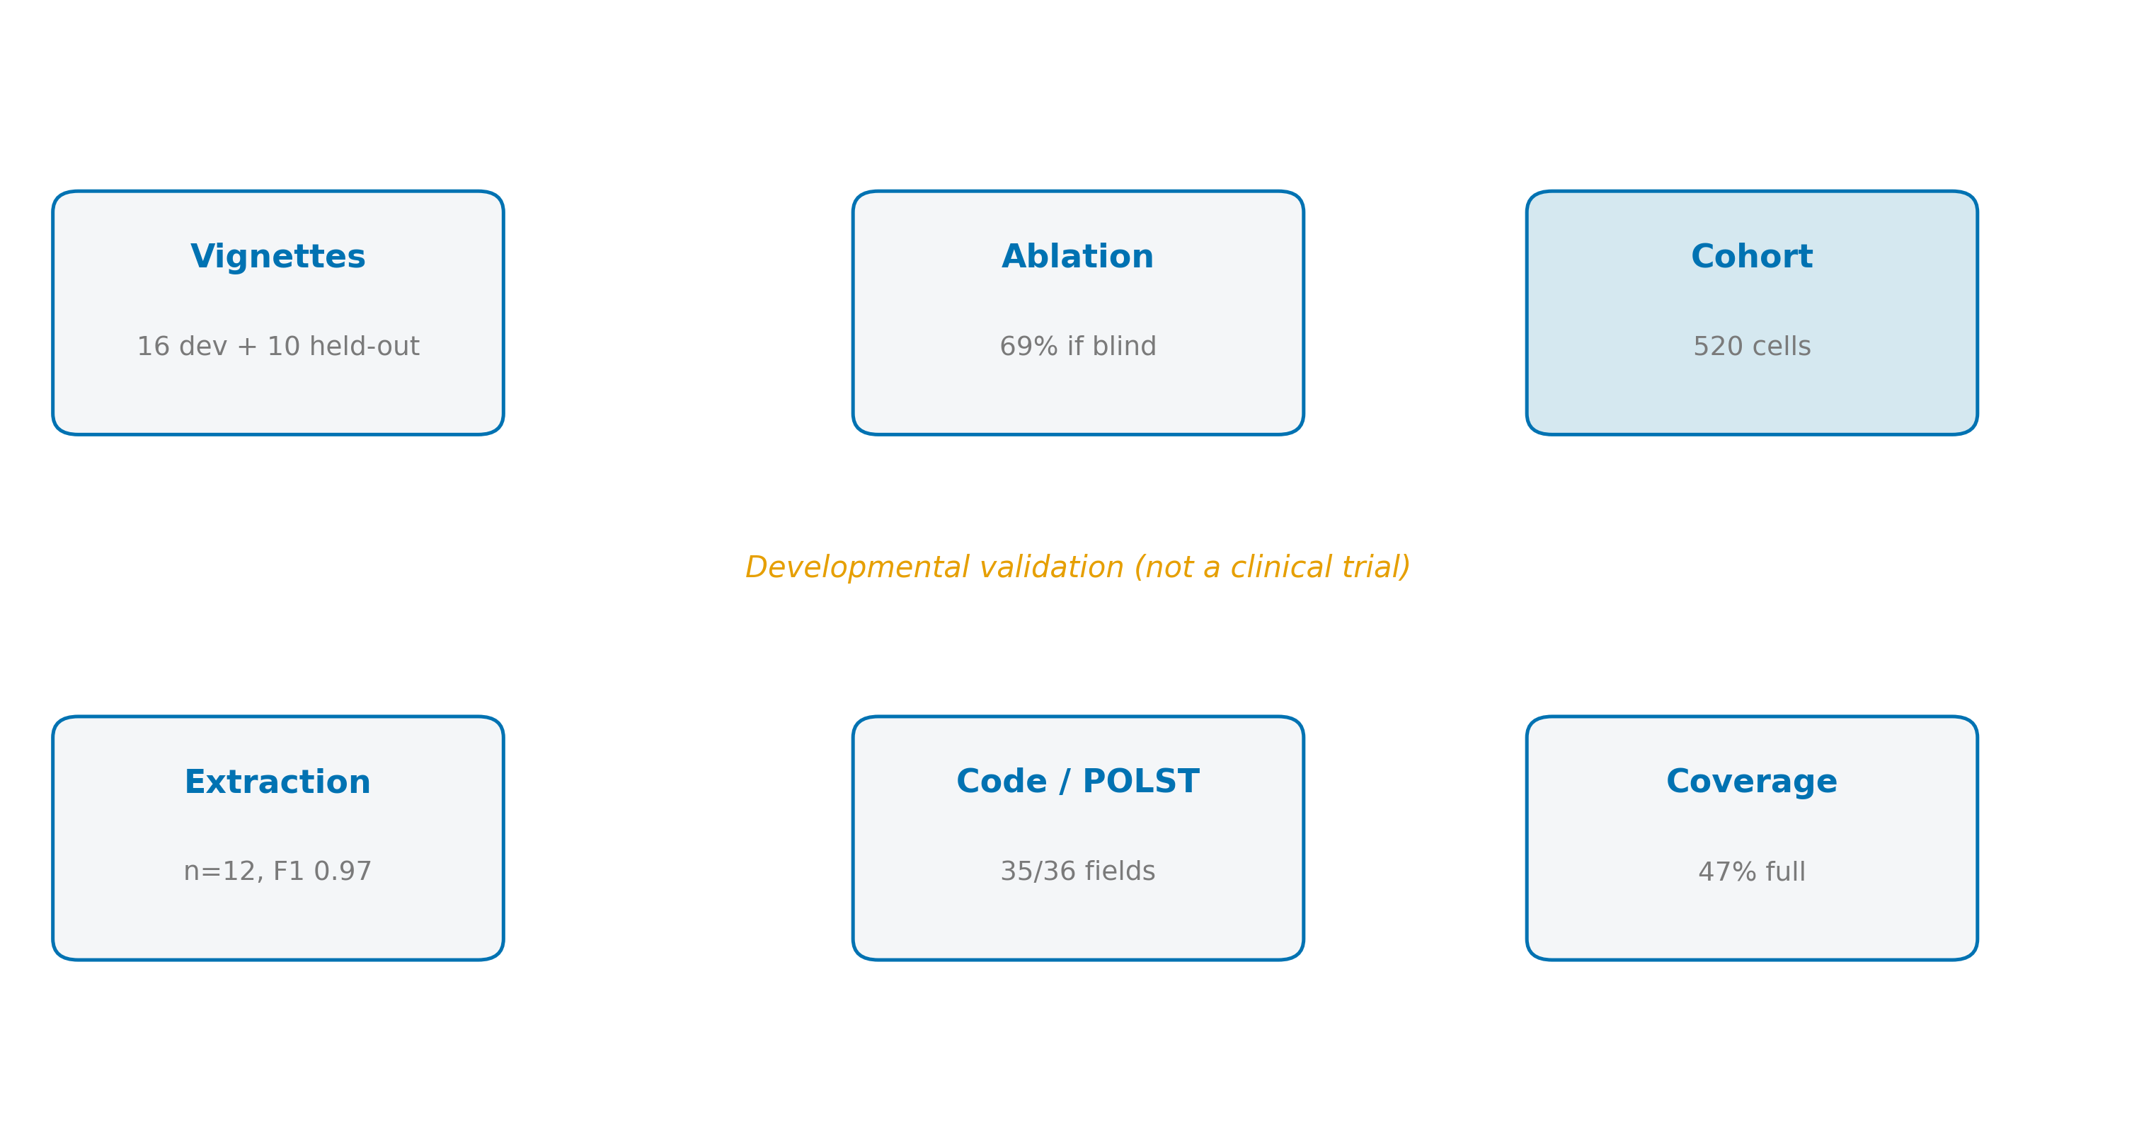
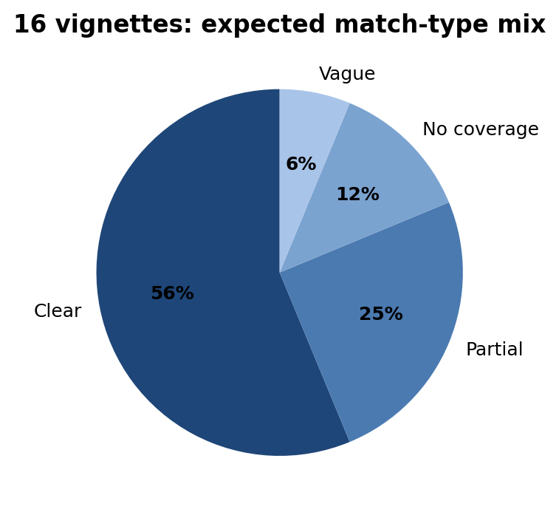

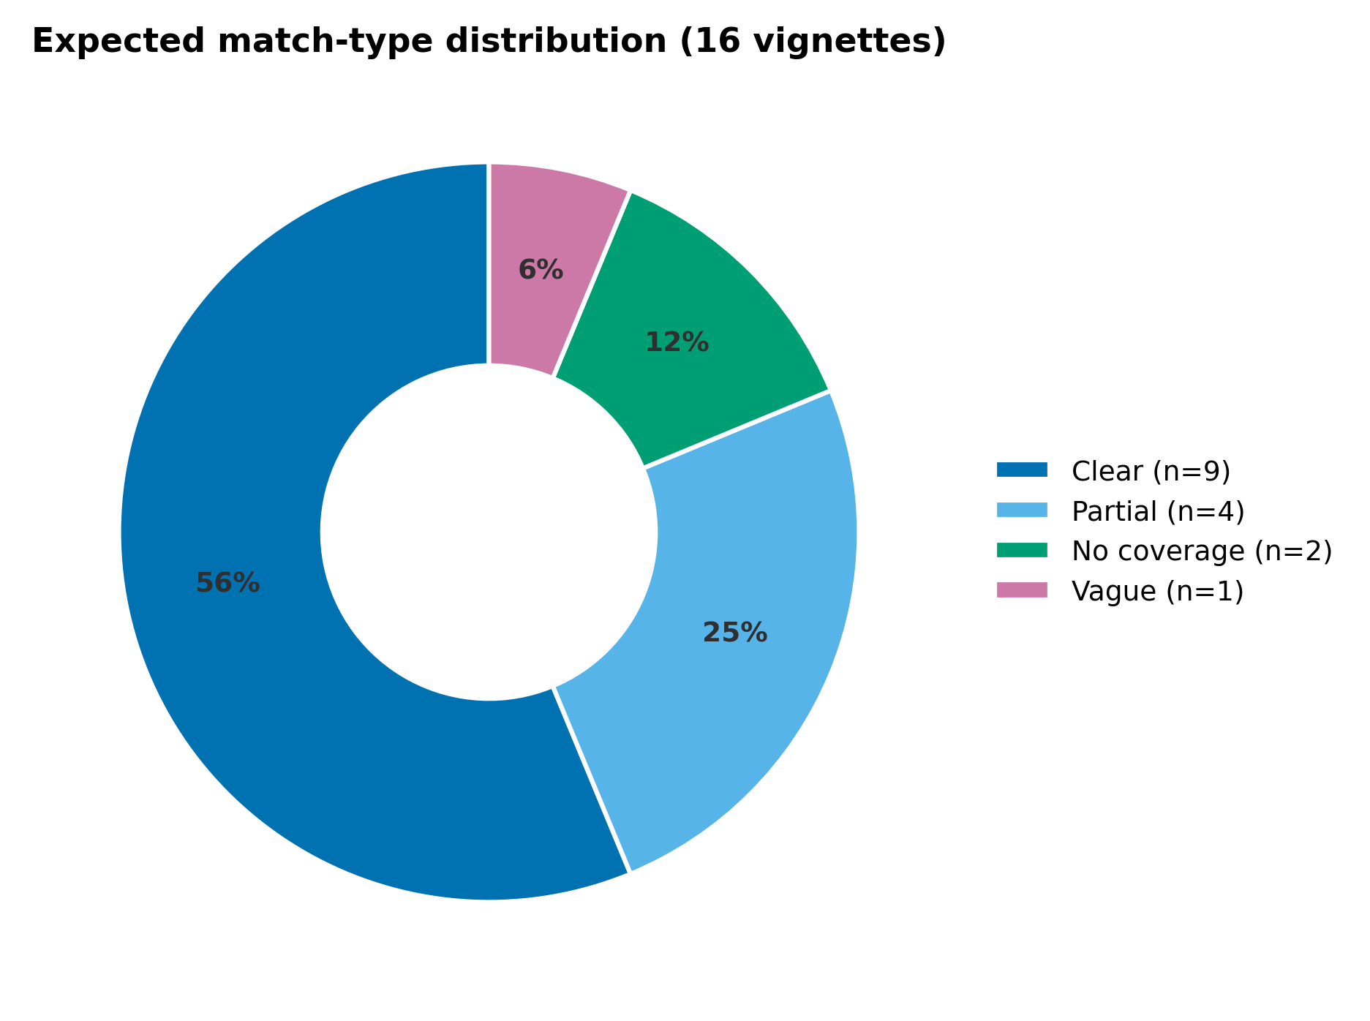
STUDY DESIGN
Evaluation asked: does ADO reason correctly and integrate plausibly?
Pipeline validation
Clinical vignettes
Ablation
LLM extraction
Mapping + expert review
1
2
3
4
5
Example patient → populated ontology
16 scenarios across all decision points
Full reasoner vs. condition-blind variant
12 real-template statements + out-of-scope tests
12 directive profiles → code status/POLST; ethics review
Gold standards were human-defined for vignette decisions and grounded in POLST semantics for code-status mapping.
The ablation isolates whether activation-condition modeling actually changes decisions.
Advance Directive Ontology (ADO) | BMDS 210 / CS 270
8
Notes:
NARRATIVE: Act III — study design (six strands).
SAY: Vignettes 16+10 held-out; ablation; cohort 520 cells (20×12); extraction n=12; POLST n=12; coverage 30 clauses. Developmental — not clinical trial.
POINT AT: study_design_strands.png
TRANSITION: "Two-layer validation."
[~50s]

Slide 9
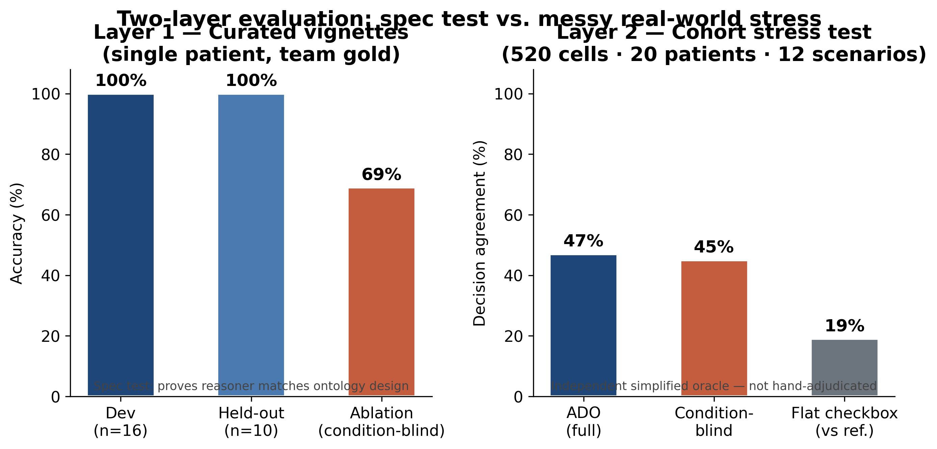
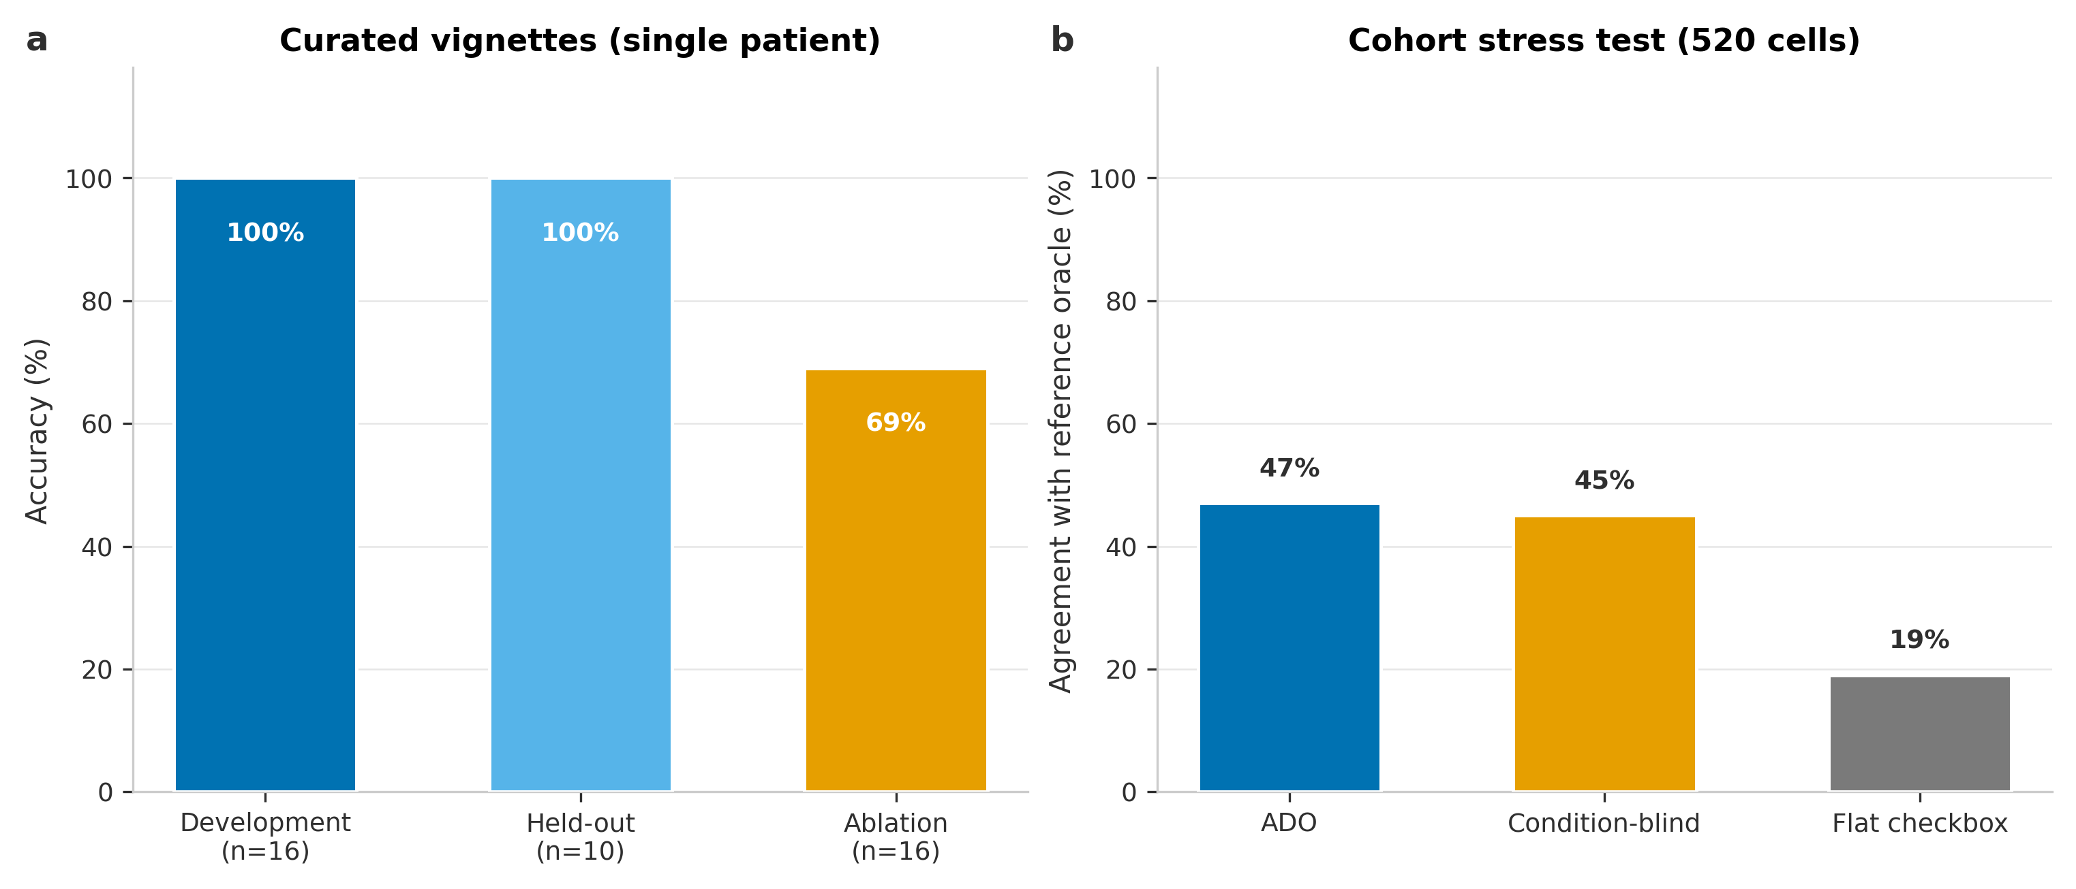
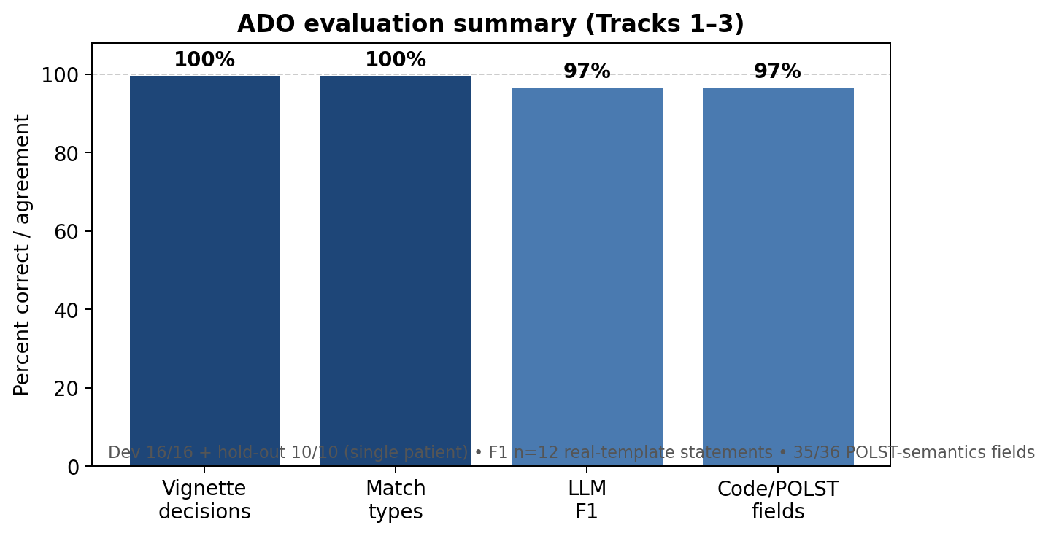
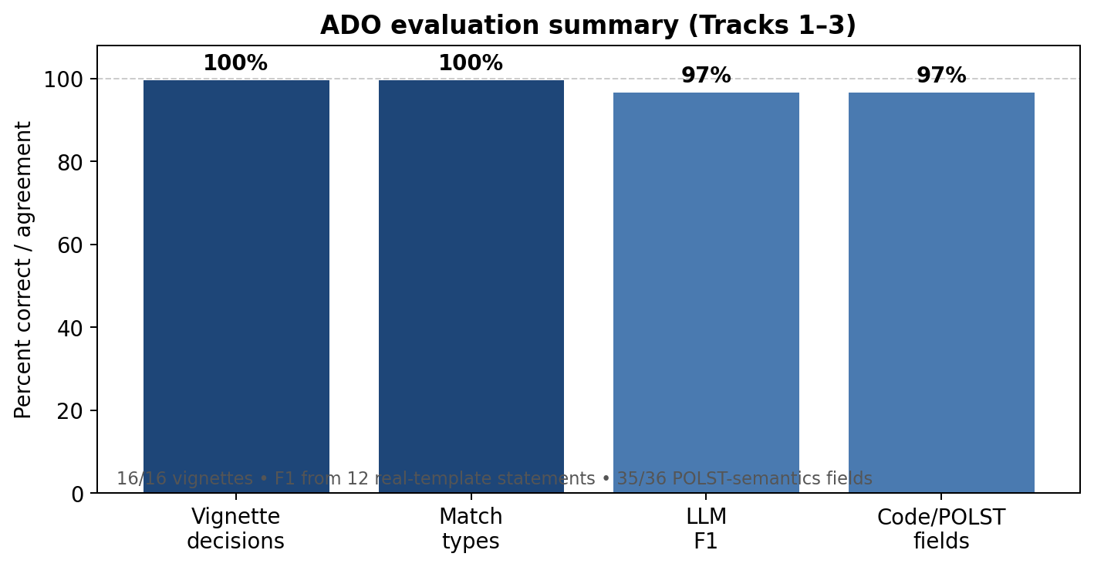
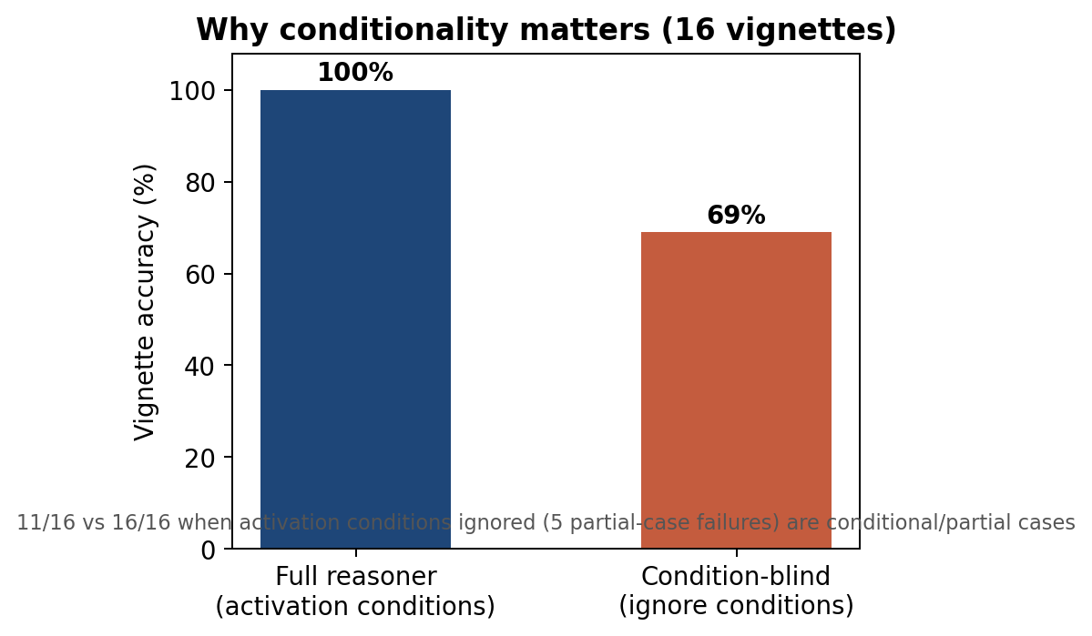
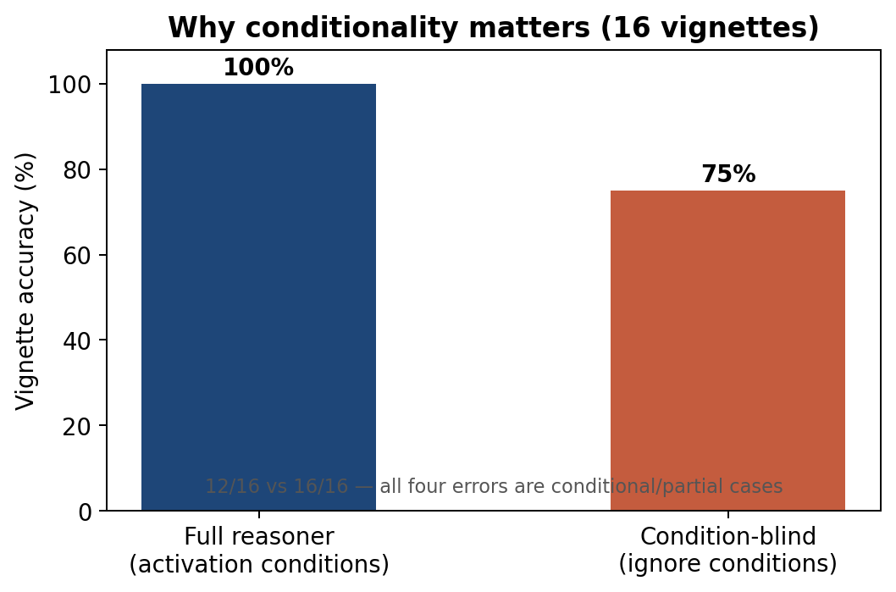
QUANTITATIVE EVALUATION
Results: high fidelity, with conditionality doing real work
16/16
16/16
0.97
35/36
κ=1.00 / 1.00 / 0.88
vignette decision accuracy
match-type accuracy
LLM extraction F1
code/POLST field agreement
code / POLST A / POLST B
Reasoner ablation
Full reasoner
Post-hoc ablation: ignore activation conditions on the same 16 vignettes → 12/16 (69%). All four errors are conditional/partial cases.
100%
Condition-blind
69%
Key finding: conditional logic prevents dangerous over-reading
Also: extraction P/R = 0.94 / 1.00 • 0 out-of-scope hallucinations • 11/12 profiles exact match on all three bedside fields
Advance Directive Ontology (ADO) | BMDS 210 / CS 270
9
Notes:
NARRATIVE: Act III — MAIN RESULTS (two-layer).
SAY: Layer 1: 16/16 dev, 10/10 held-out, 69% ablation — spec test on Jane Doe. Layer 2: cohort ~47% vs simplified oracle; checkbox fails nuanced cells. Also F1 0.97, 35/36 POLST.
POINT AT: eval_two_layer.png (full slide). DO NOT oversell 100%.
TRANSITION: "Conditionality + cohort detail."
[~60s]

Slide 10
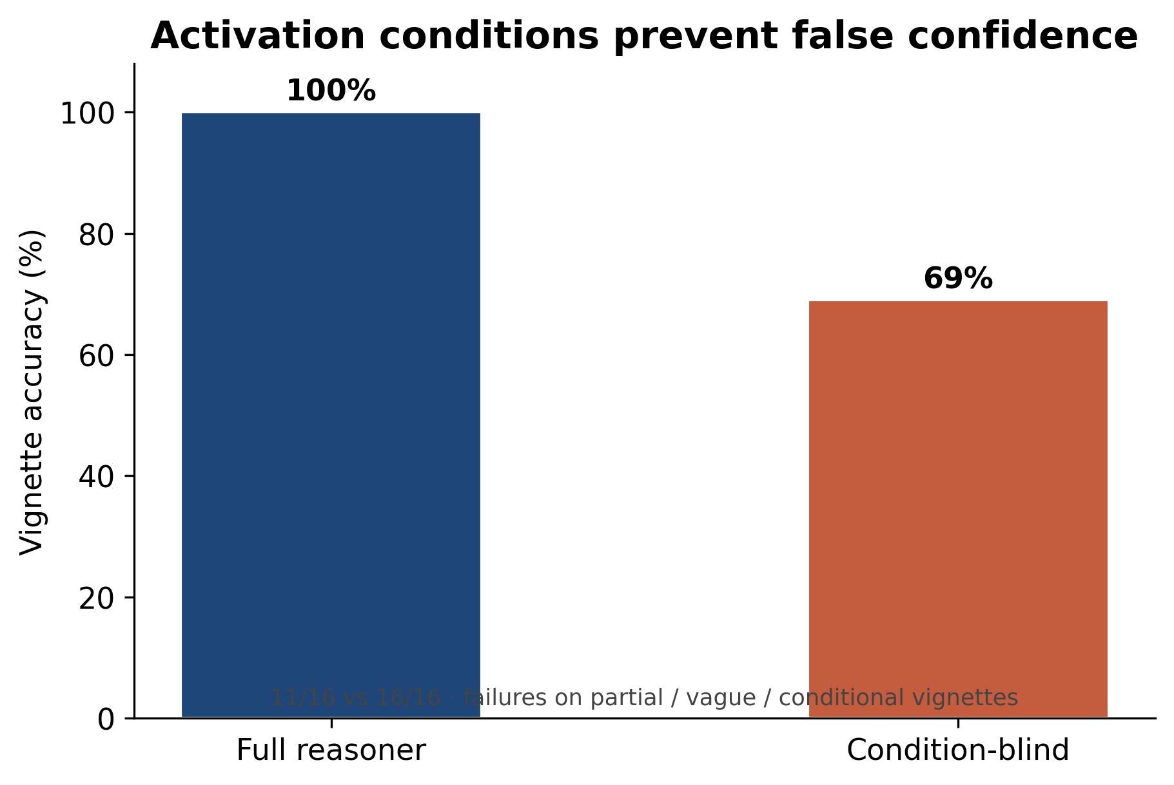
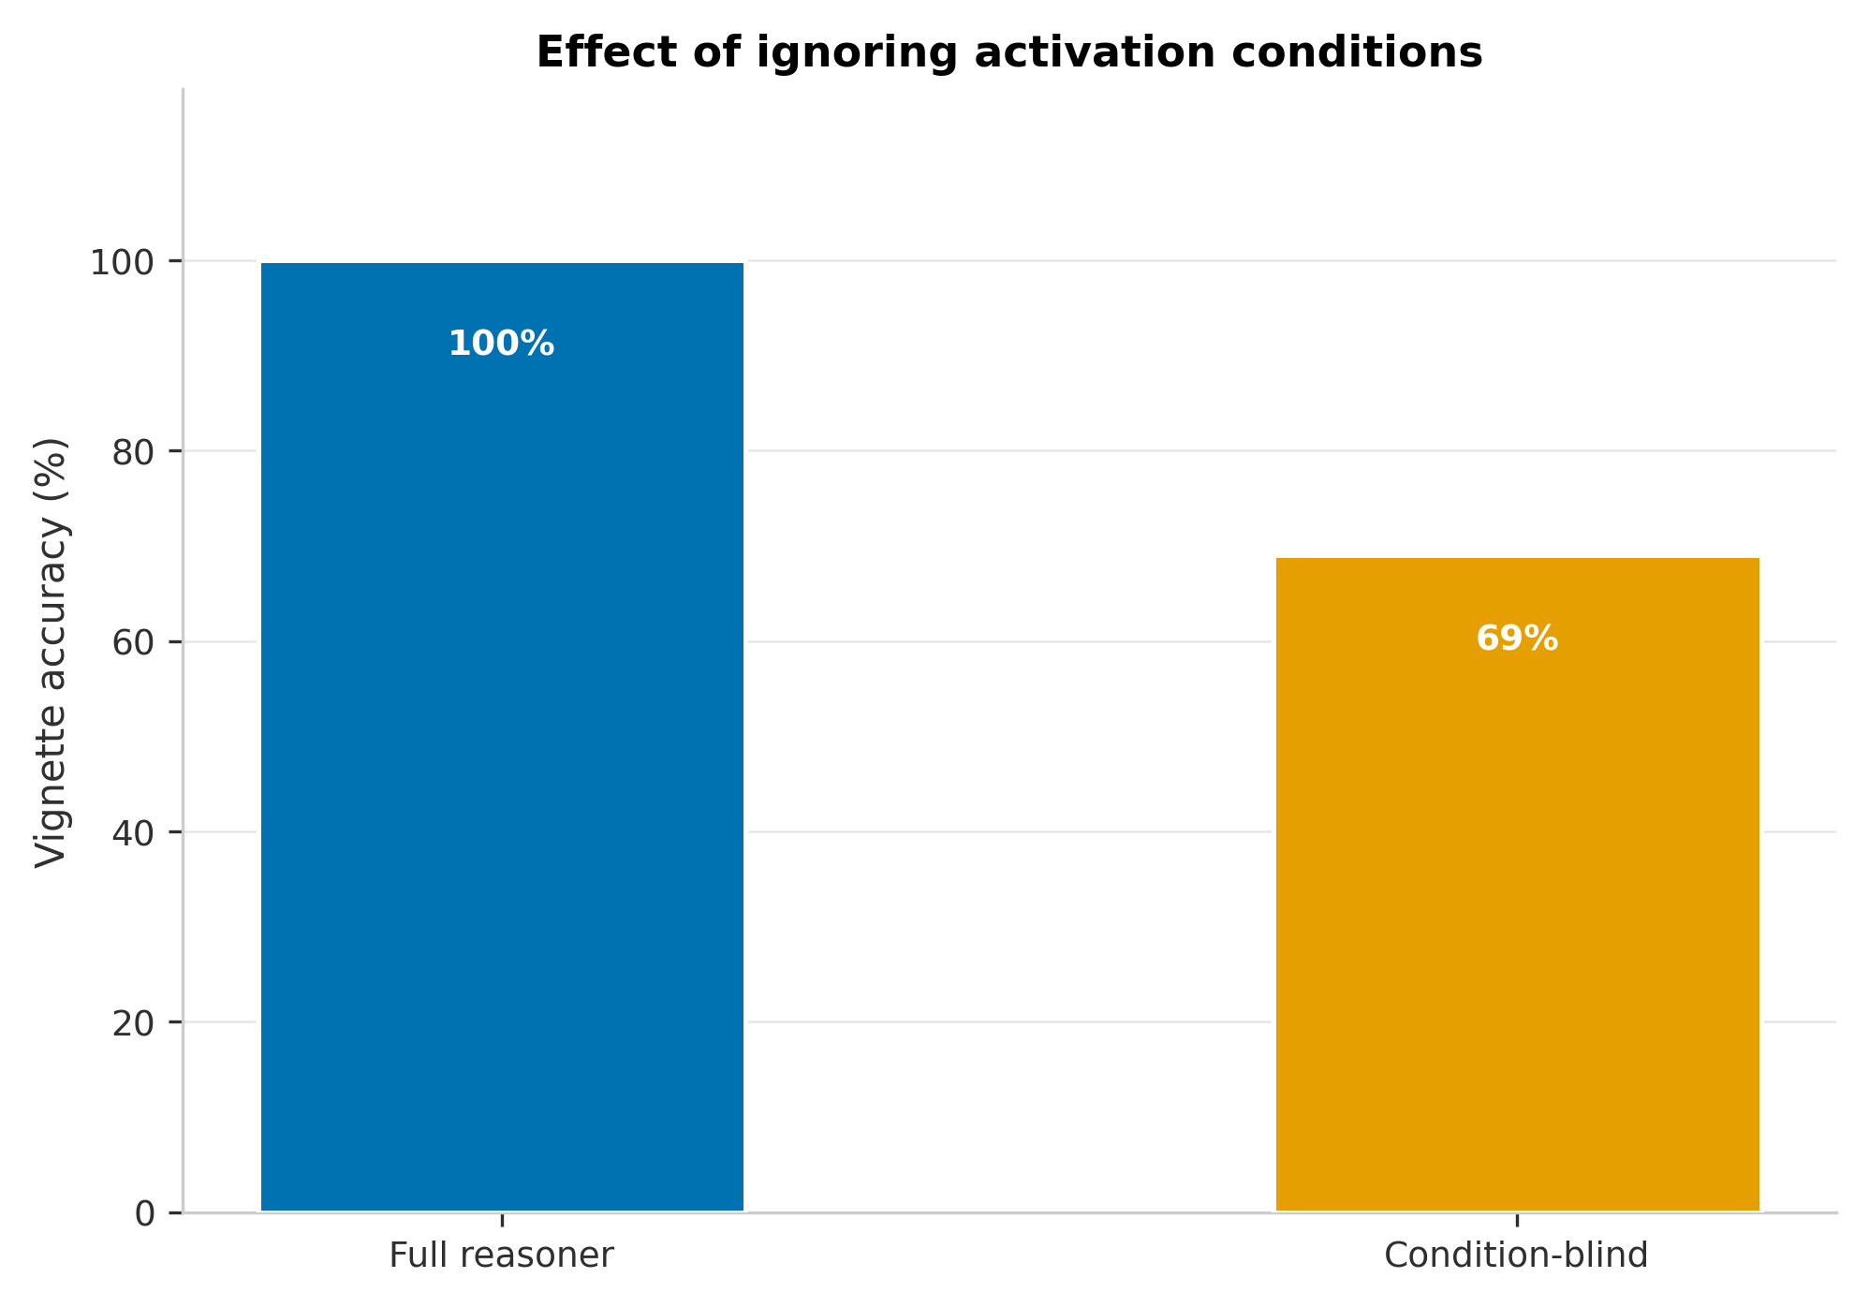
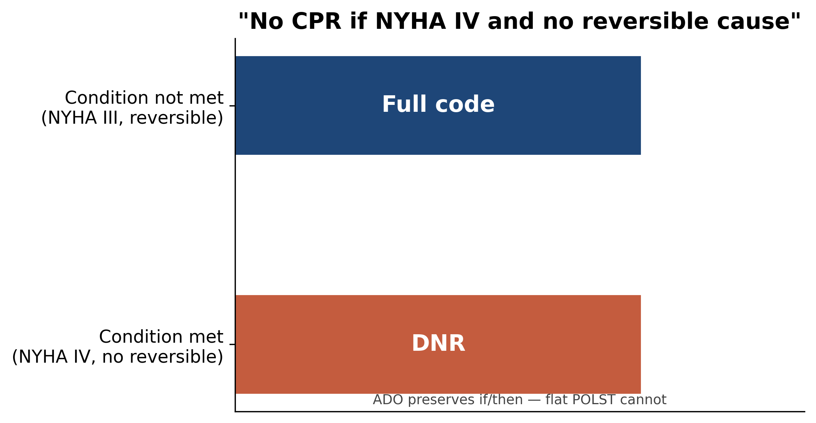
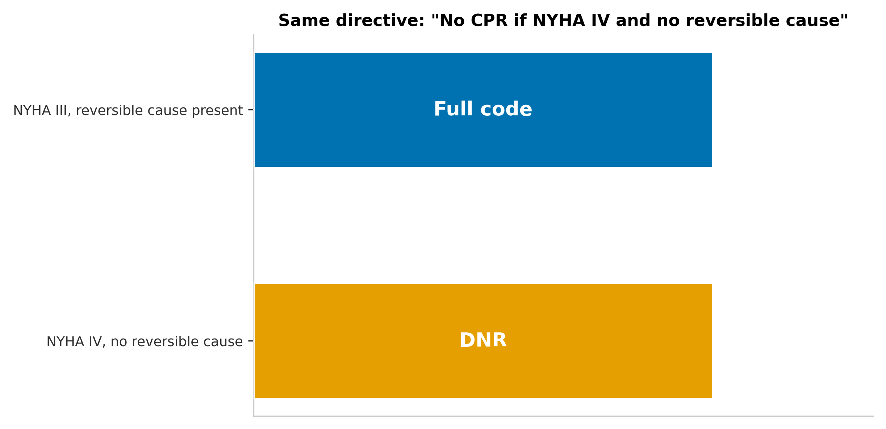
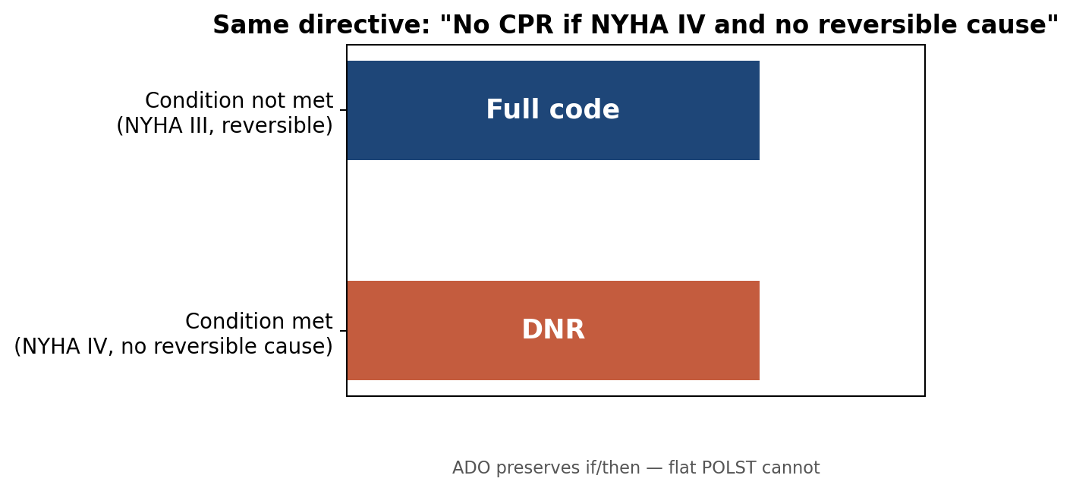
EXAMPLE DECISION LOGIC
What conditional reasoning changes
The same directive can map to different bedside outputs depending on the scenario. ADO keeps that conditionality explicit.
Directive preference
“No CPR if NYHA IV and no reversible cause.”
Scenario A
NYHA IV + no reversible cause
Scenario B
NYHA III + reversible cause
ADO output
DNR / clear match
ADO output
Full code / partial
A flat checkbox cannot carry this “if/then” structure; it must either over-apply or discard it.
Advance Directive Ontology (ADO) | BMDS 210 / CS 270
10
Notes:
NARRATIVE: Ablation + conditional aha.
SAY: Ablation 11/16 (69%) — activation conditions matter. P9/P10: DNR vs Full code same directive.
POINT AT: ablation_conditions.png, conditional_p9_p10.png
TRANSITION: "Cohort stress test."
[~45s]

Slide 11
CLINICAL INTEGRATION
Best workflow fit: pre-populating an ACP note
Expert review reframed ADO as documentation support rather than a legal directive. This preserves its value while avoiding the wrong legal claim.
Existing AD
verbatim wishes
ADO
structured preferences
Epic ACP note
pre-populated fields
Provider conversation
clarify or override
Final record
ACP + POLST/code status
Source-of-truth priority
ACP conversation can clarify or supersede AD preferences. But when a decision is not revisited, the structured AD remains the best available record of the patient’s wishes.
Advance Directive Ontology (ADO) | BMDS 210 / CS 270
11
Notes:
NARRATIVE: Magnus reframe (if slide order = integration before cohort, adjust).
SAY: ACP progress note. Directive → ADO → conversation → POLST.
[~40s]

Slide 12
LIMITS + PRIORITIES
Expert review sharpened the contribution
The critique did not eliminate the system’s value; it moved ADO to the right place in the clinical workflow and exposed the next modeling gaps.
Positioning
Decision-support aid, not a signed legal directive
Dimensionality
Current model covers what intervention; next model must cover who decides
Coverage gaps
Artificial hydration/nutrition; antibiotics; comfort-care decisions
Temporal limits
OWL lacks native temporal reasoning; ADO uses numeric time bounds
Validation limits
Team-authored gold standards; real-EHR validation remains future work
Design principle: use the reasoner to surface uncertainty, not to replace clinicians or surrogates
Advance Directive Ontology (ADO) | BMDS 210 / CS 270
12
Notes:
NARRATIVE: Limits.
SAY: No legal force; cohort oracle not clinical gold; team gold; EHR future.
TRANSITION: "Takeaways."
[~40s]

Slide 13
Takeaways
1
ADO makes conditional, graded, negatable EOL preferences computable.
2
The safest outputs include honest non-answers: no coverage, partial, and vague.
3
LLMs are useful for extraction, but the auditable ontology/reasoner should own inference.
4
The near-term product is ACP documentation support, not a legal directive.
Next steps: surrogate/override modeling • artificial nutrition/hydration • time-limited trials • real-EHR validation
Notes:
NARRATIVE: Close.
SAY: Four bullets. Repo. Questions. Optional demo scenario 1.
[~25s]

Slide 14
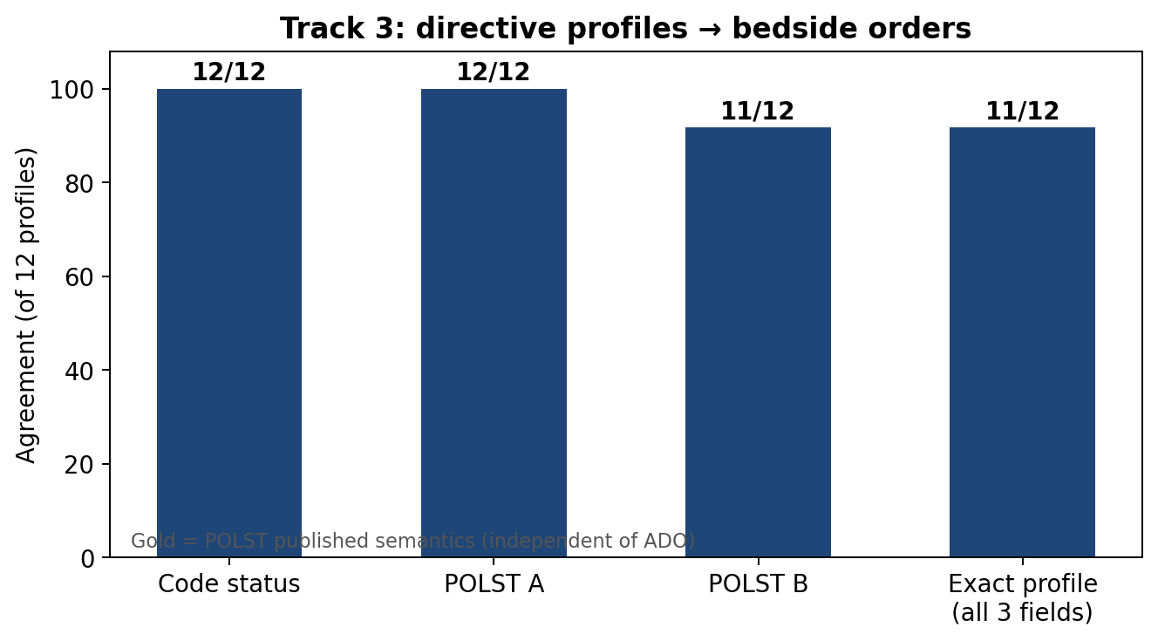
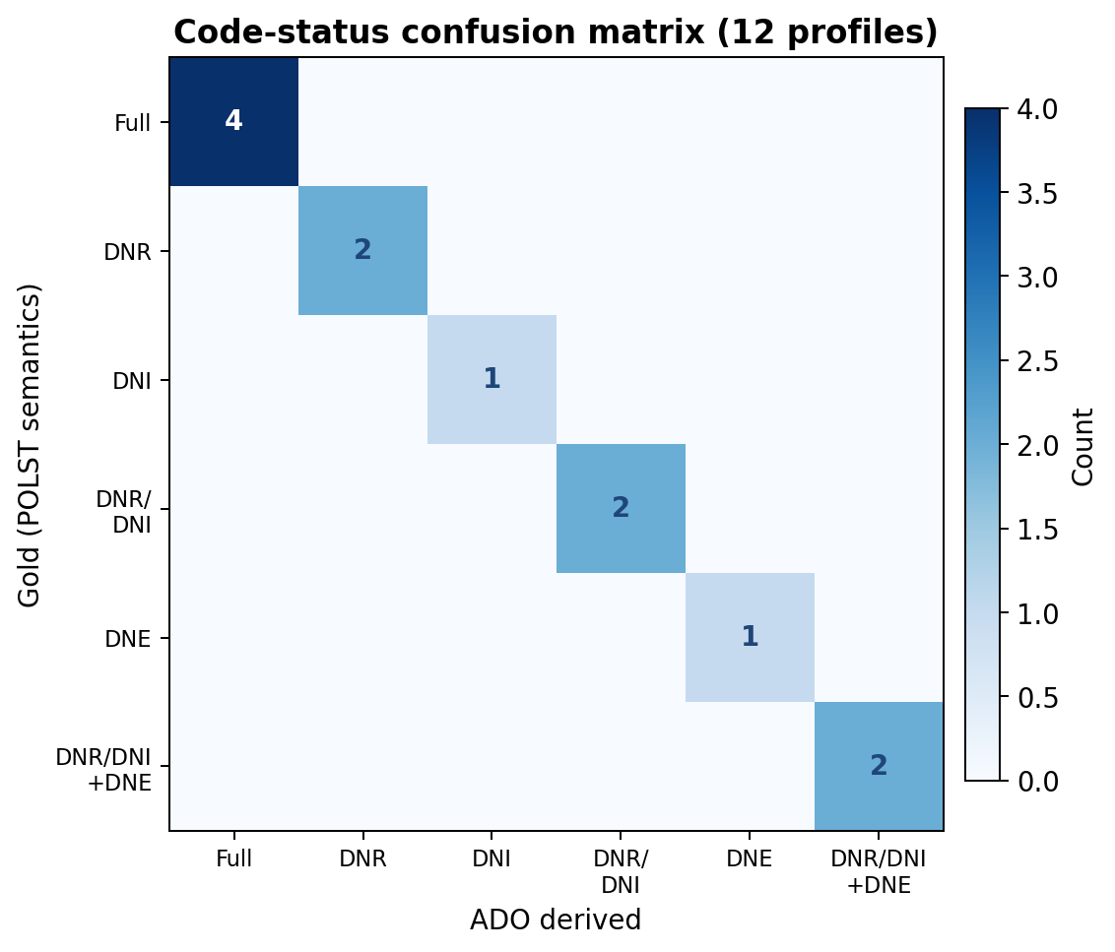
EVALUATION FIGURES — Track 3 & code-status fidelity
12 real-world template profiles • Gold = POLST semantics • Diagonal confusion matrix = agreement across all observed code-status categories

Slide 15
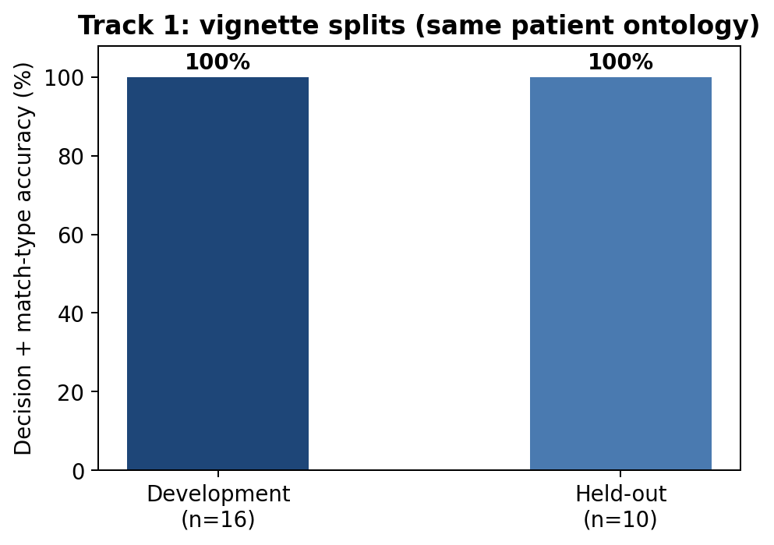
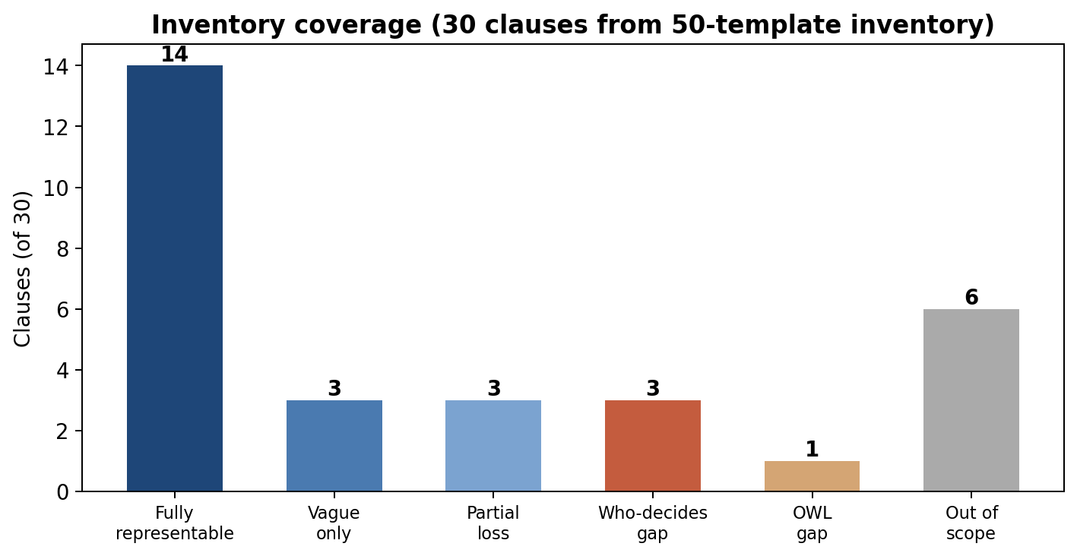
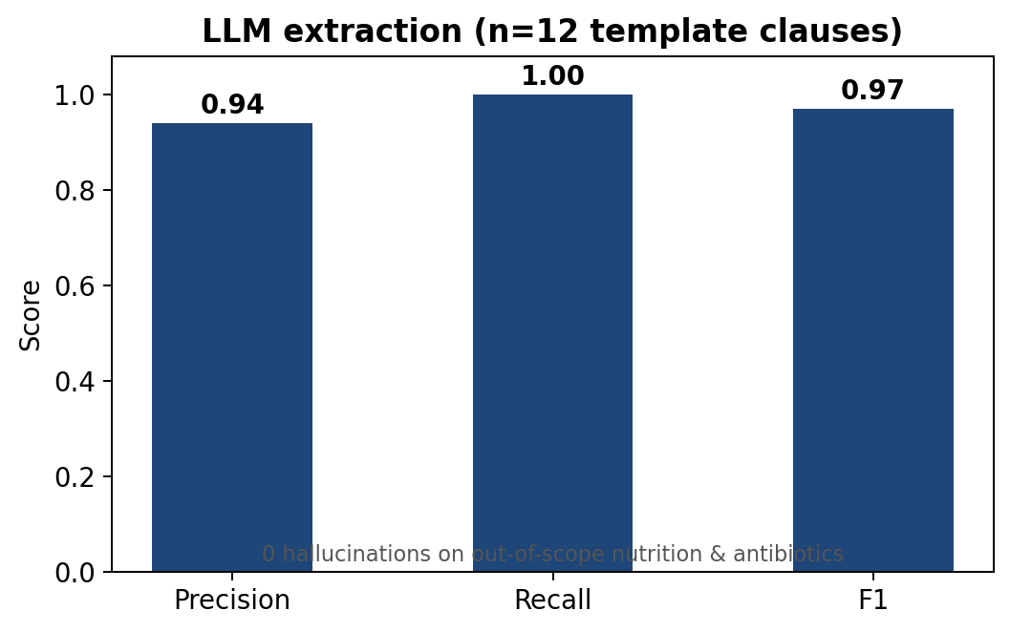
STRENGTHENED EVALUATION — developmental validation (report / June 2026)
Developmental validation — not clinical trial. Team gold; single patient ontology. Lead with ablation (69%) + coverage (47% fully representable), not only 100% vignettes.
Notes:
(Legacy slide — prefer COHORT + DASHBOARD slides.)
SAY: Lead with ablation 69% and cohort 47%, not only 100% vignettes.
[~30s]

Slide 16
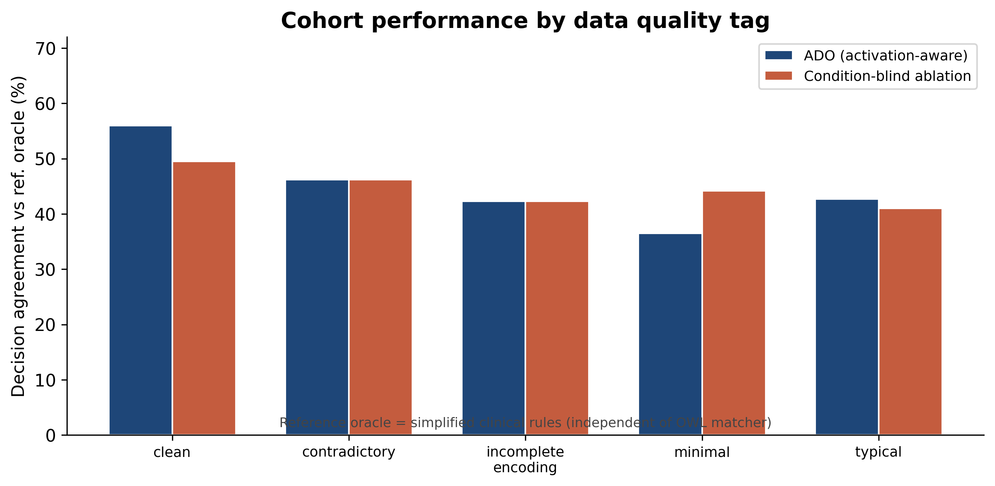
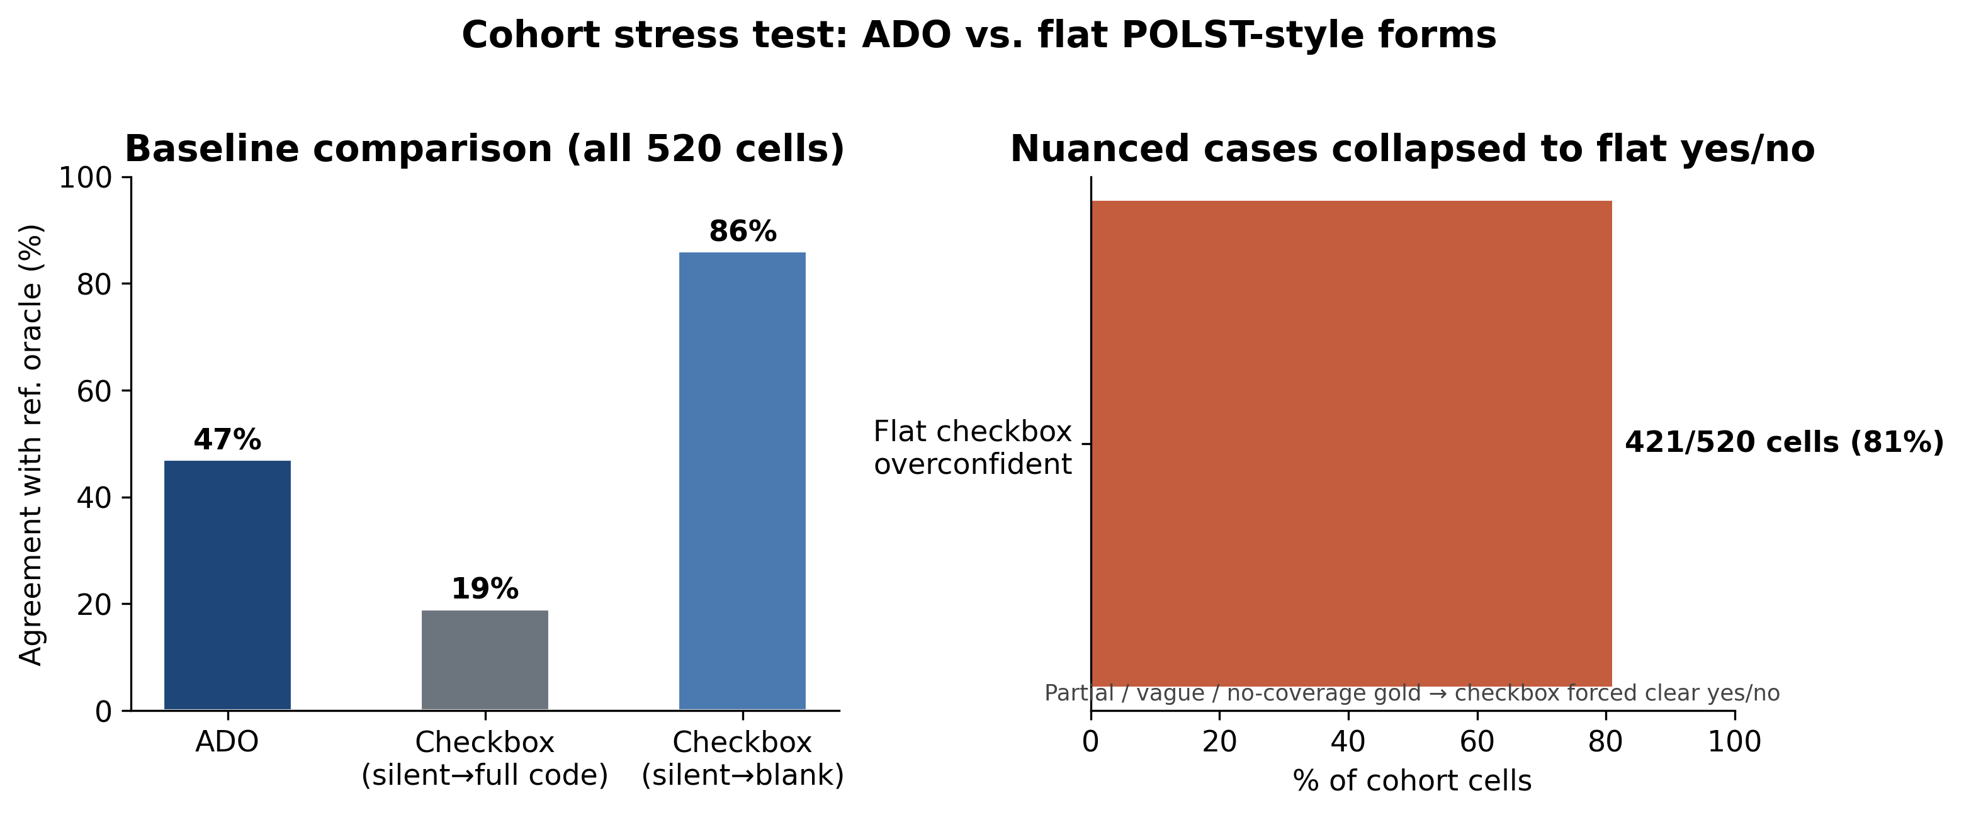
COHORT STRESS TEST — 20 messy profiles × 12 scenarios (520 cells)
~47% agreement vs simplified reference oracle (not hand-adjudicated). Flat checkbox over-asserts on 421/520 nuanced cells. Honest population stress test — complements 16/16 vignette spec test.
Notes:
NARRATIVE: Cohort honesty slide.
SAY: 20 profiles (messy_level tags) × 12 scenarios = 520 cells. ~47% vs simplified oracle. 421/520 checkbox overconfident. Clean > minimal/contradictory.
POINT AT: cohort_messy_breakdown.png, cohort_baseline_comparison.png
[~50s]

Slide 17
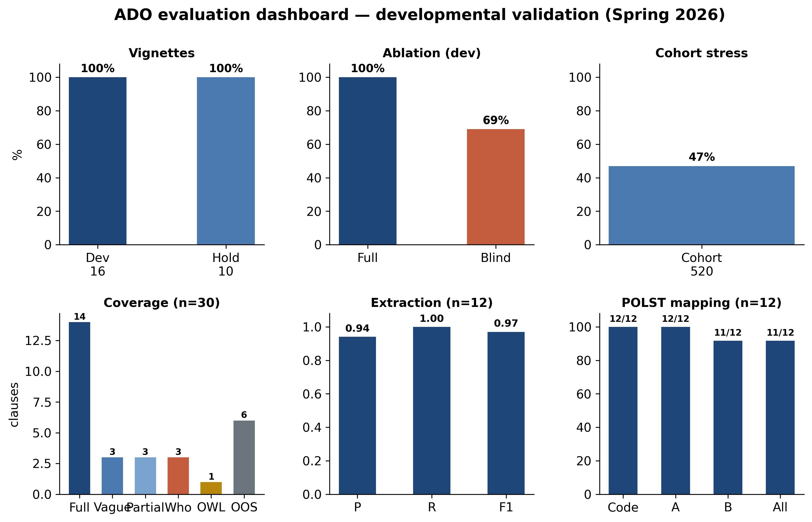
EVALUATION DASHBOARD — developmental validation (June 2026)
Notes:
NARRATIVE: Backup all-in-one numbers.
SAY: Walk six panels if asked for full summary. Optional — skip if short on time.
[~20s]

Slide 18
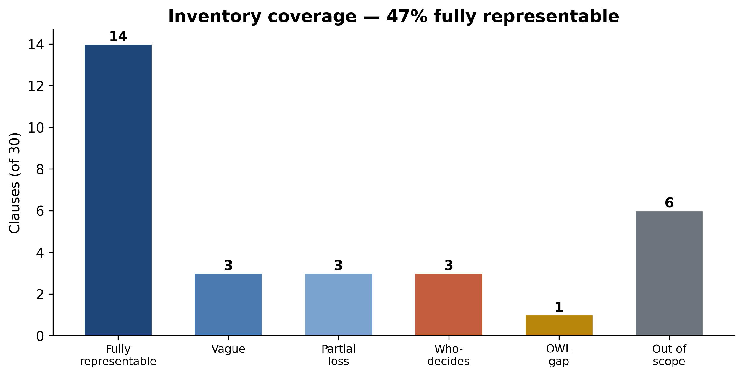
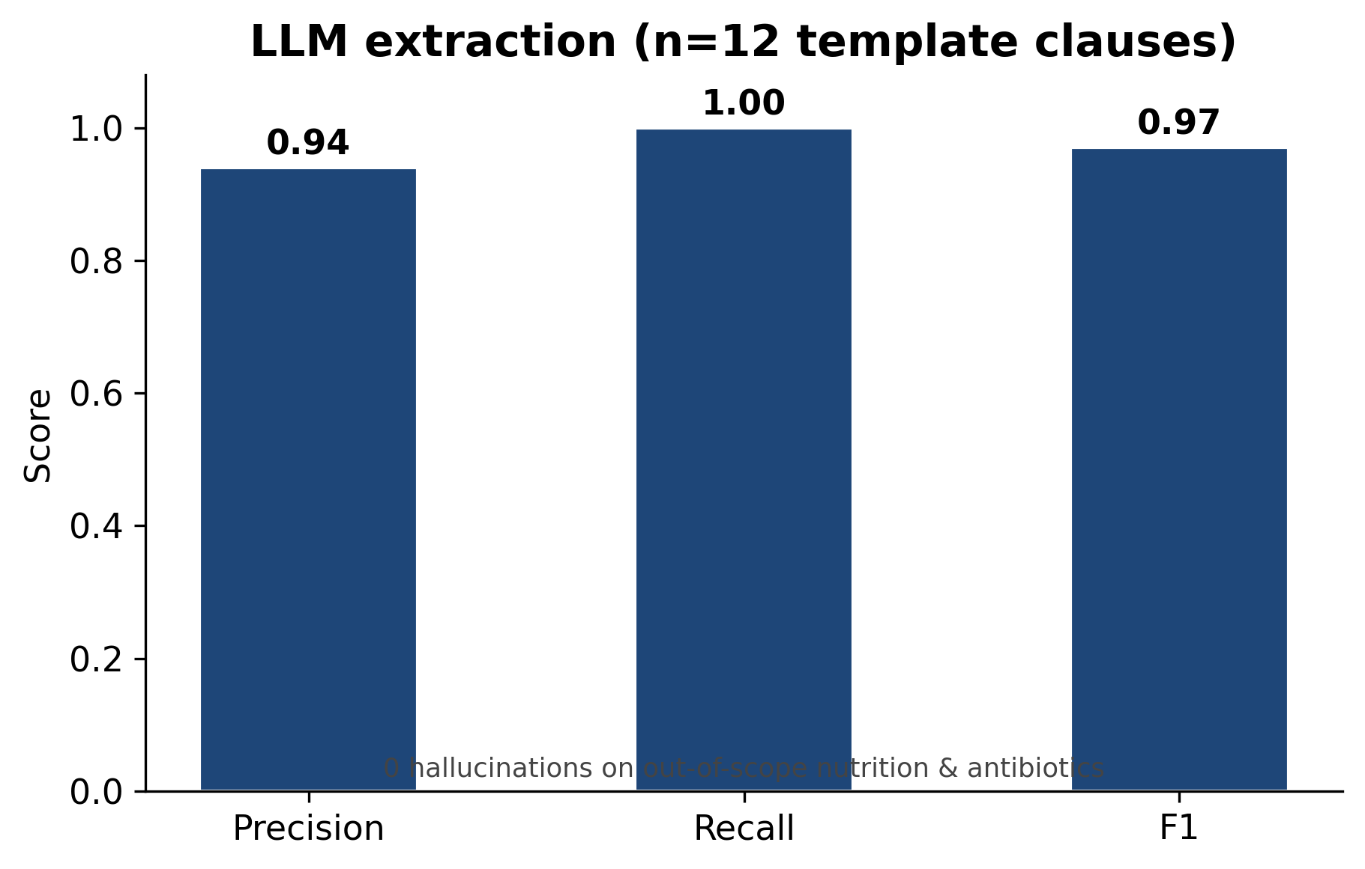
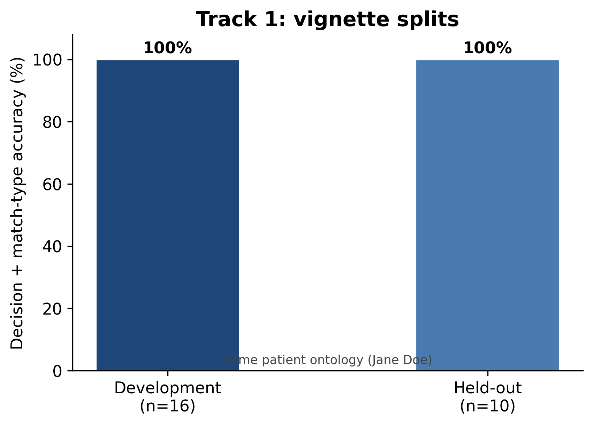
COVERAGE & EXTRACTION — scope and closed-world discipline
Notes:
NARRATIVE: Scope + extraction discipline.
SAY: 47% fully representable (14/30). F1 0.97, 0 OOS hallucinations on nutrition/antibiotics.
POINT AT: coverage_inventory.png, extraction_f1.png
[~35s]

Slide 19
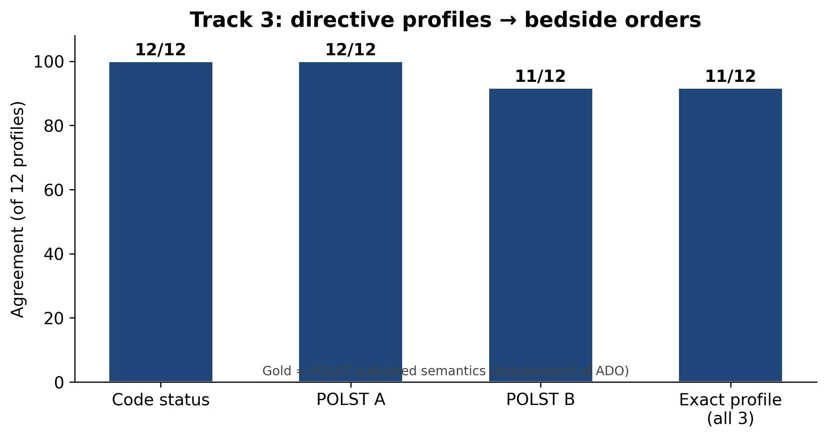
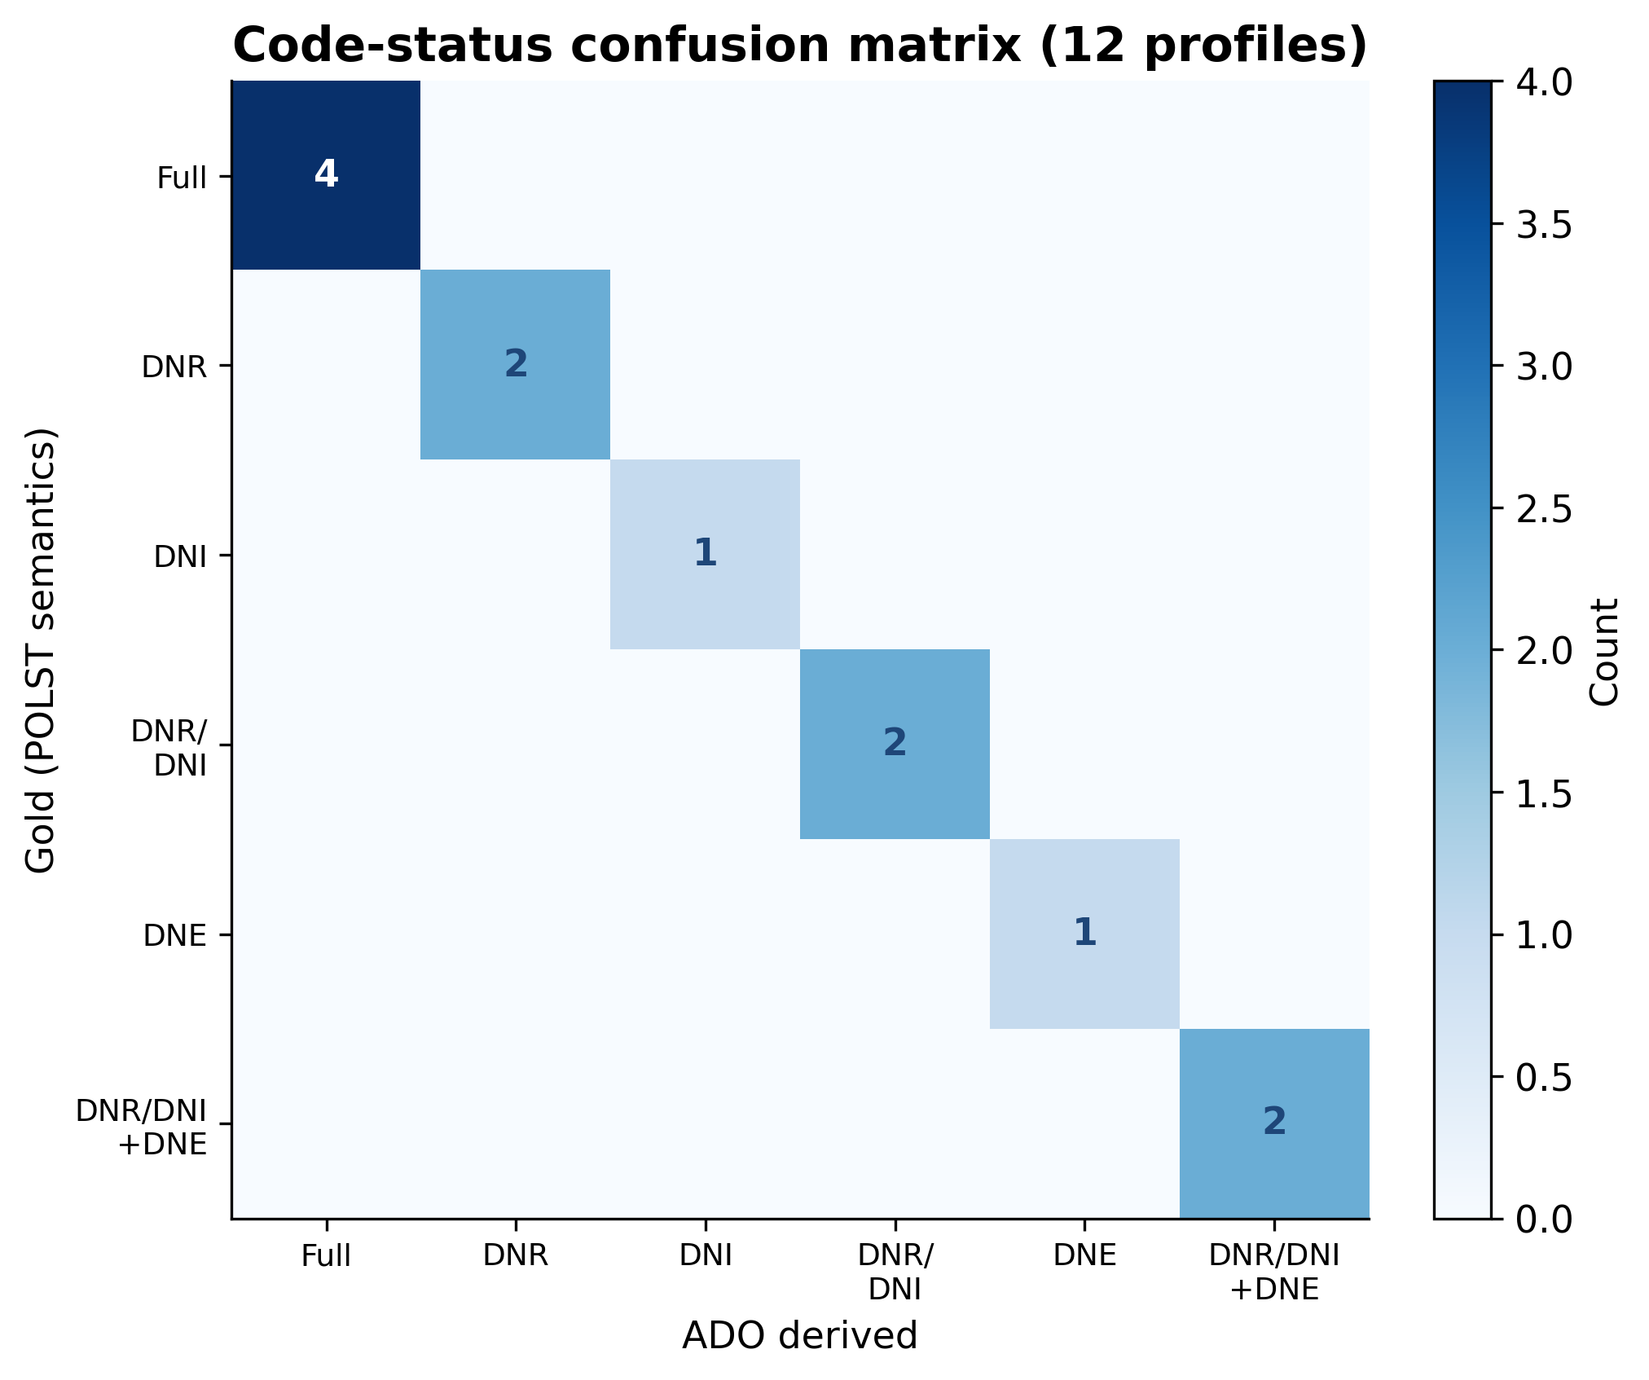
TRACK 3 — CODE STATUS & POLST MAPPING
Notes:
NARRATIVE: Bedside mapping.
SAY: 35/36 fields. P5 principled divergence. Confusion matrix diagonal.
POINT AT: track3_field_agreement.png, code_status_confusion.png
[~35s]

