Slide 1
Linguistic Linked Open Data Cloud (PanLex)
Gliederung
- Aufgabenstellung
- Done
- ToDo

Slide 2
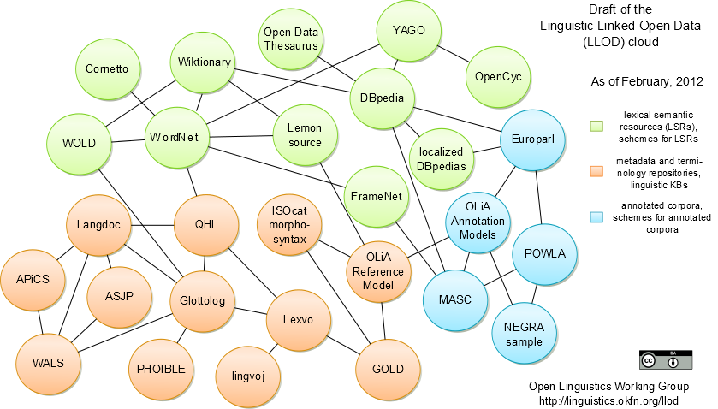
Aufgabenstellung

Slide 3
Aufgabenstellung
PanLex
„As a contribution to long-term linguistic diversity, the PanLex project works to enable the translation of any word from any language into any other language.“ [0]

Slide 4


Aufgabenstellung
Mapping
Sparql Server
PanLex

Slide 5
Aufgabenstellung
Mapping
Sparql Server
PanLex
D2R [1]/
Sparqlify [2]
[3]

Slide 6

Done
Mapping
Datenbank
- RO-Zugriff
- Dump (tabellenweise) ~2.5 GByte
- Datenimport

Slide 7
Done
Mapping
plx=> \dt
Liste der Relationen
Schema | Name | Typ | Eigentümer
--------+------+---------+------------
public | af | Tabelle | apache
public | ap | Tabelle | apache
public | aped | Tabelle | apache
public | apf | Tabelle | apache
public | apli | Tabelle | apache
public | au | Tabelle | apache
public | av | Tabelle | apache
public | cp | Tabelle | apache
public | cu | Tabelle | apache
public | df | Tabelle | apache
public | dfid | Tabelle | apache
public | dfp | Tabelle | apache
public | dm | Tabelle | apache
public | dmid | Tabelle | apache
public | dn | Tabelle | apache
public | dnid | Tabelle | apache
public | ex | Tabelle | apache
public | exap | Tabelle | apache
public | exid | Tabelle | apache
public | exq | Tabelle | apache
[…]

Slide 8
Done
Mapping
plx=> \dS ap
Tabelle »public.ap«
Spalte | Typ | Attribute
--------+--------------+------------------------------------------
ap | integer | not null
dt | date | not null Vorgabewert ('now'::text)::date
tt | text | not null
ur | text |
bn | text |
au | text |
ti | text |
pb | text |
yr | smallint |
uq | smallint | not null
ui | smallint |
ul | text |
li | character(2) |
ip | text |
co | text |
ad | text |

Slide 9
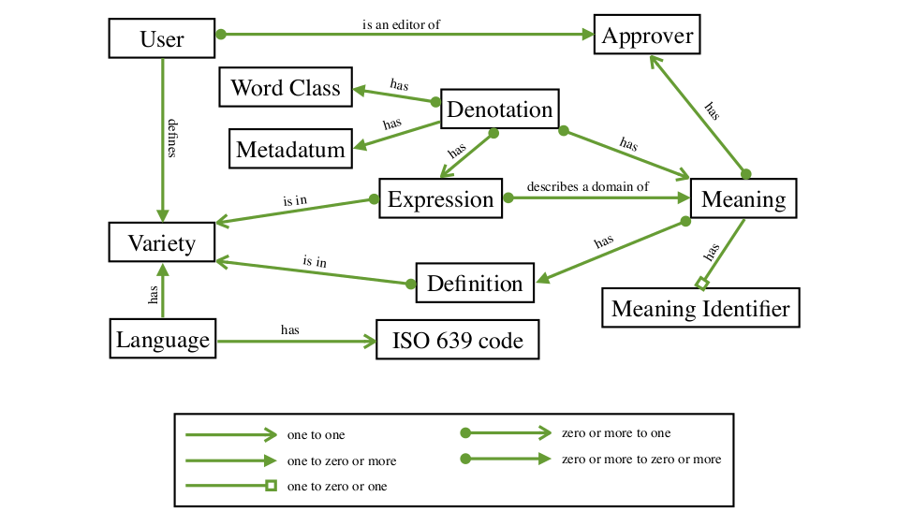
Done
Mapping
[4]

Slide 10

Done
Mapping
Sparqlify
- Java
- am AKSW von Claus Stadler entwickelt
- seit März 2012
- eigene Mapping-Sprache

Slide 11
Done
Mapping
Mapping
Prefix plx:<http://panlex.org/>
Create View ap As
Construct {
?s a plx:Publication .
}
With
?s = uri(concat(plx:publications, '/', ?ap))
From
ap

Slide 12
Done
Mapping
Mapping
Prefix plx:<http://panlex.org/>
Create View ap As
Construct {
?s a plx:Publication .
}
With
?s = uri(concat(plx:publications, '/', ?ap))
From
ap
<rdf:RDF
xmlns:rdf="http://www.w3.org/1999/02/22-rdf-syntax-ns#"
xmlns:j.0="http://panlex.org/" >
<rdf:Description rdf:about="http://panlex.org/publications/4">
<rdf:type rdf:resource="http://panlex.org/Publication"/>
</rdf:Description>
<rdf:Description rdf:about="http://panlex.org/publications/37">
<rdf:type rdf:resource="http://panlex.org/Publication"/>
</rdf:Description>
<rdf:Description rdf:about="http://panlex.org/publications/7">
<rdf:type rdf:resource="http://panlex.org/Publication"/>
</rdf:Description>
<rdf:Description rdf:about="http://panlex.org/publications/11">
<rdf:type rdf:resource="http://panlex.org/Publication"/>
</rdf:Description>
<rdf:Description rdf:about="http://panlex.org/publications/1">
<rdf:type rdf:resource="http://panlex.org/Publication"/>
</rdf:Description>
[…]

Slide 13
ToDo
Mapping
DB
- Schema durchdringen
- Dump und Import auf Dev-Server
Sparqlify
- Testing
- Doku
Mapping
- fertigstellen

Slide 14
Quellen
[0] http://panlex.org
[1] http://d2rq.org/d2r-server
[2] http://aksw.org/projects/Sparqlify
[3] http://www.postgresql.org/
[4] http://panlex.org/tech/doc/panlex-db-design.pdf
[5] http://www.opensecurityarchitecture.org/cms/library/icon-library
[6] http://www.icon-king.com/projects/nuvola/

