Slide 1
Can tariffs be beneficial to a country’s economy?

Slide 2
Plan
Introduction
WTO
Goals
Unintended negative consequences
Case Studies
Conclusion

Slide 3
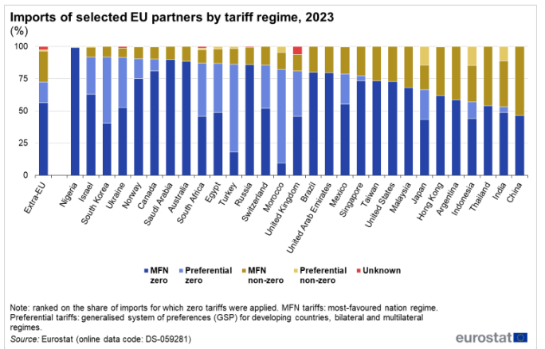
Introduction
Tariffs are taxes imposed by a government on goods and services imported from other countries.
EU’s anti-dumping measures against corrosion-resistant steel from China (17.2-27.9%)
To reduce tariffs, many countries enter into trade agreements
In 2023, around 72 % of the imports that entered the EU did so at zero tariff.

Slide 4
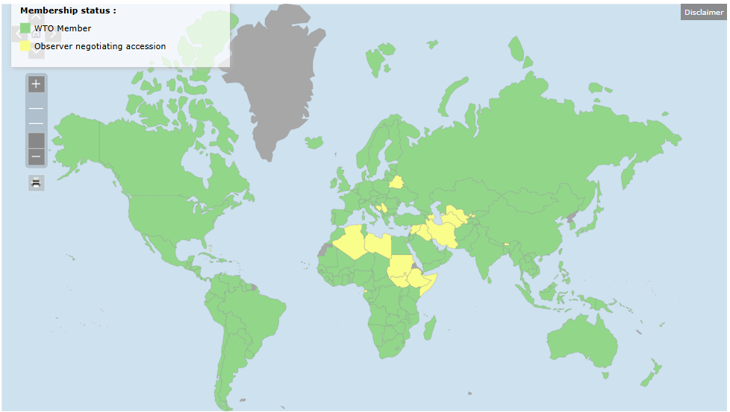
WTO
Establishes global tariff rules
Limits tariffs and encourages reductions.
Provides a mechanism for settling tariff disputes.

Slide 5
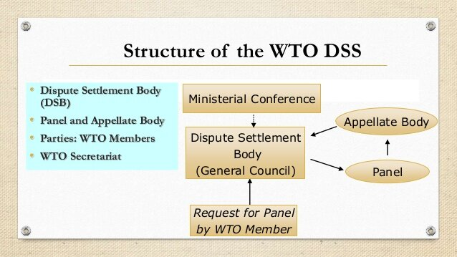
WTO
Since December 2020, all seven seats on the appellate body have been vacant
Starting in Obama administration, USA began blocking the reappointment of judges to the appellate body
In 2024, for the 75th time, the United States blocked a request from 130 members for filling the vacancies at the World Trade Organization’s Appellate Body (AB),

Slide 6
Goals
To raise revenues
To protect domestic industries
To protect domestic consumers
To protect national interests

Slide 7
Unintended negative consequences
They can make domestic industries less efficient and innovative by reducing competition
They can hurt domestic consumers since a lack of competition tends to push up prices
They can generate tensions by favoring specific industries or geographic regions over others
They can create a Trade War

Slide 8

The Harley-Davidson "success" case
In 1983, Harley-Davidson was on the brink of bankruptcy, holding only 5% of the U.S. motorcycle market, facing heavy competition from Japanese brands like Honda
Harley-Davidson requested import protection, receiving temporary relief from tariffs on heavy motorcycle imports.
Reagan raised the tariffs from 4.4% to 49.4%
The plan was to keep them for 5 years
Internal Improvements: Modernization of the factories, new engines and better quality control
But the tariffs also caused prices to rise
For the first two years after the tariffs were imposed, they maintained the same percentage price difference over their Japanese rivals
Sales increased rapidly and Harley-Davidson requested the final year of tariff protection to be cancelled
Simulation results showed that the tariff explained only 6% of Harley-Davidson's recovery
most of it was attributed to Harley-Davidson's own initiatives: the modernized factories, the new engines, etc…

Slide 9
Alves Branco Tariffs
In the 19th century, Brazil was flooded with European goods, having no industries until 1808.
1808: Brazil was permitted to establish industries
From 1828: Protectionism involved tariffs on imported goods
For example : England 15% and Portugal 16%.
1844: The Alves Branco Law was implemented, taxing 30% on products not produced in Brazil and 60% on those that were.
This law was mainly created to fund the government
It helped increase investments in Brazilian industry, marking the second phase of the country's industrialization. However, it was not solely responsible for solid industrialization, which occurred decades later.

Slide 10
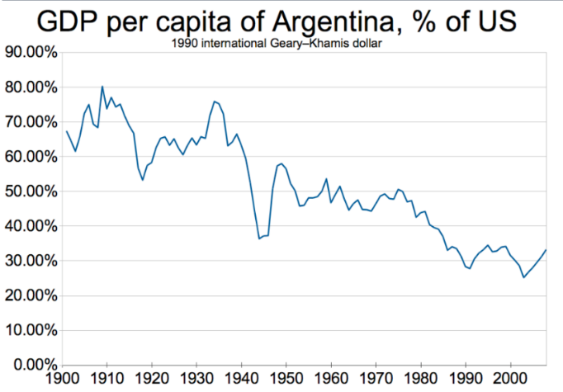
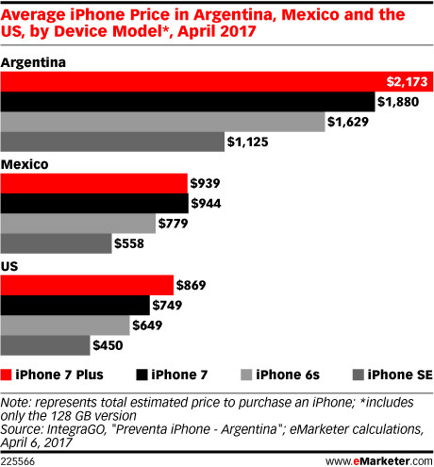
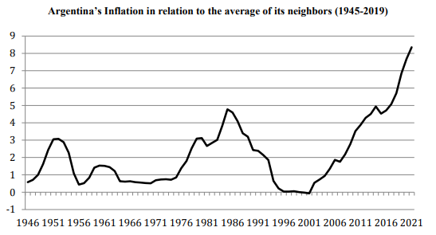
Argentina
During the Great Depression Era (1930s), general tariffs on most foreign goods were up to 50%, following an import substitution strategy.
In 2011, a 35% tariff was imposed on imported electronics, cars, and auto parts.
The government banned the import of many electronics, requiring them to be made domestically.
Prices of cars nearly doubled, and iPhones were no longer sold in the country.
BlackBerry could not compete with newer phones, smuggled through customs, and after two years of the company's installation in the country, it closed down.
Argentina went from being the 5th largest economy at the beginning of the 20th century to being the 24th today.

Slide 11
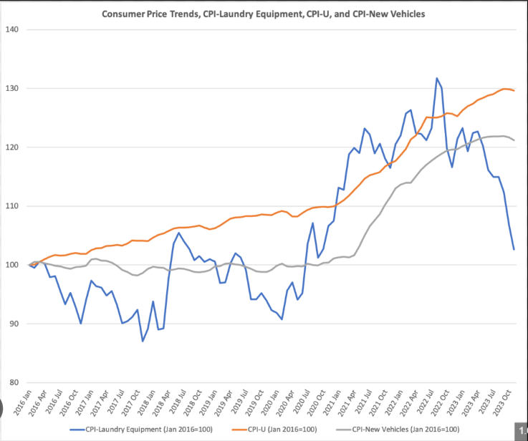
Washing machine Tariffs
In January 2018, the Trump administration imposed tariffs of 20% or 50% on large residential washing machines. The tariffs expired in February 2021.
The tariffs were considered a success, as measured by over 1,800 new jobs and economic stimulus with the construction of new factories.
The tariffs brought jobs and economic prosperity to two regions
In 2018, LG Electronics completed an investment of $360 million in a new smart factory in Clarksville, to be staffed with 700 employees.
Conversely, according to UC Chicago scholars in 2019, the increase in consumer prices translated to a total consumer cost of $1.5 billion per year, or about $820,000 per new job.
Research from 2024 suggests there is no sustained effect on washing machine prices.

Slide 12
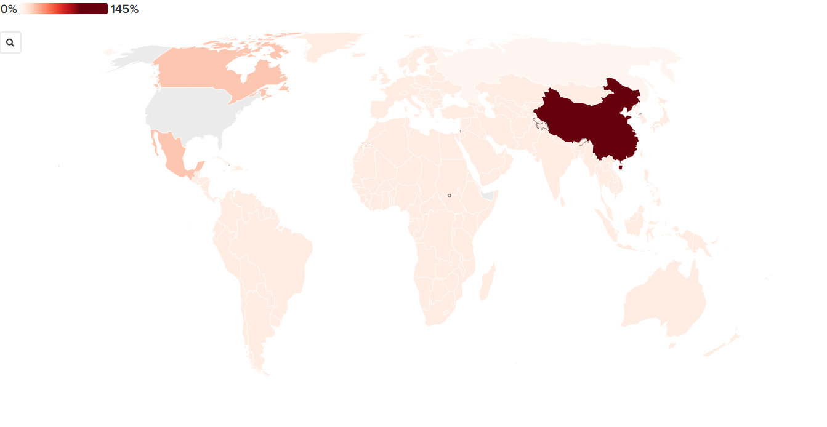
Trump's Tariffs: Timeline
Jan. 20 - Trump announces tariffs on Canada and Mexico.
Feb. 1 - Trump imposes tariffs on Canada, Mexico, and China.
Feb. 2 - Trump acknowledges potential negative consequences of tariffs.
Feb. 3 - Trump pauses tariffs on Mexico and Canada, threatens EU.
Feb. 4 - Trump's tariffs on Chinese imports begin, China retaliates.
Feb. 10 - Trump resurrects steel and aluminum tariffs.
Feb. 13 - Trump outlines plan for broad reciprocal tariffs.
Feb. 27 - Trump confirms tariffs on Canada, Mexico, and China for March 4.
March 4 - Tariffs on Canada, Mexico, and China take effect; Canada retaliates.
March 5 - Trump pauses car tariffs on Canada and Mexico.
March 6 - Trump suspends some tariffs, confirms steel and aluminum tariffs.
March 10 - China and Ontario announce retaliatory tariffs.
March 11 - Trump threatens to double steel and aluminum tariffs, then backs down.
March 12 - EU and Canada announce retaliatory tariffs, EU delays implementation.
March 13 - Trump threatens high tariffs on EU alcoholic products.
March 24 - Trump announces tariffs on countries trading with Venezuela.
April 2 - Trump implements baseline tariffs and reciprocal tariffs.
April 4 - China announces retaliatory tariffs and business bans.
April 5 - Vietnam requests tariff delay.
April 7 - Bangladesh requests tariff reprieve; Trump threatens additional tariffs on China.
April 9 - Trump's tariffs take effect; China and EU respond with tariffs; Trump pauses most reciprocal tariffs, raises tariffs on China.
April 10 - White House clarifies China tariff; EU plans to pause tariffs.
April 11 - Trump exempts some electronics from tariffs.
April 13 - Trump recasts electronics exceptions as temporary, plans new chip tariffs.

Slide 13
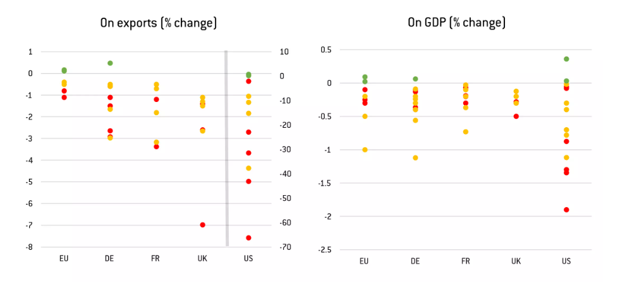
Trump's Goals
Better trade deals
Boosting American industry
Facing off with China
Raising revenue
Lower prices for US consumers

Slide 14
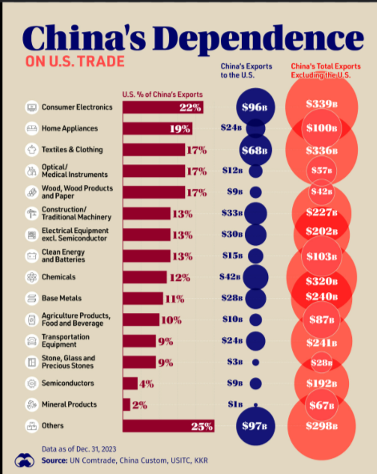
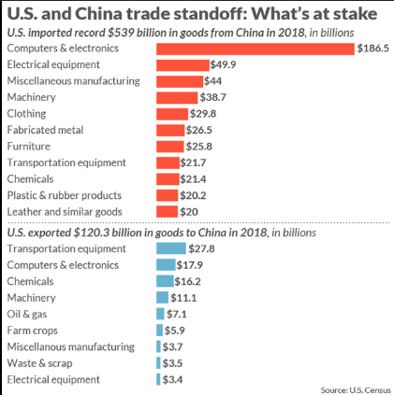
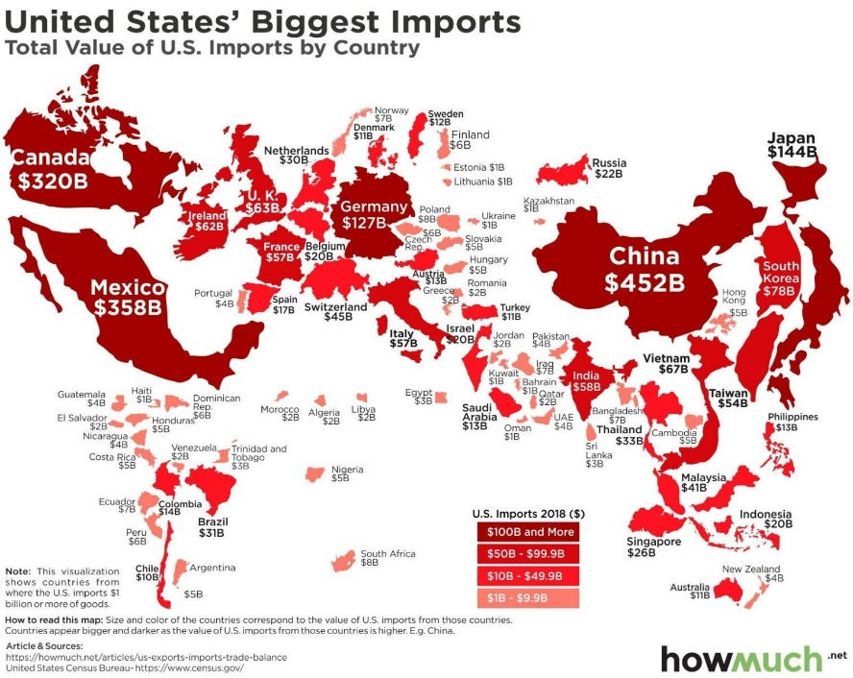
China vs USA
The US currently runs a trade deficit with China. In 2024, the US imported far more from China ($440bn) than Beijing imported from America ($145bn).
Since Trump's first term, the trade barriers helped to reduce the amount the US bought from China from 21% of America's total imports in 2016 to 13% in 2024

Slide 15
China vs USA
The USA exempted some electronic goods (smartphones and computers)
China exempted some US imports from its 125% tariffs
The China Semiconductor Industry Association (CSIA) announced the issuance of waivers on imports of eight types of microchips, while a Ministry of Commerce task force is collecting lists of items that could be exempted from tariffs and is inviting companies to submit their own requests, according to sources
Allegedly, the list includes 131 categories of products, representing $45 billion worth of U.S. exports to China last year, out of a total of $145 billion.
Chinese local industries are struggling, unable to compete with larger export-focused companies that are flooding the domestic market with their products
China relies on U.S. imports such as semiconductors, which are essential for producing its export goods

Slide 16
Conclusion
Tariffs can offer short-term benefits if implemented strategically and with appropriate pricing
While not a primary driver of economic growth, tariffs can be used as leverage in economic negotiations as a protective measure for local economies against harmful practices like dumping
However, in today's interconnected global economy, tariffs are generally detrimental, although they can still be important for mitigating economic disruptions in specific sectors and regions

Slide 17
Sources
https://wits.worldbank.org/CountryProfile/en/Country/FRA/Year/2022/TradeFlow/Import
https://ec.europa.eu/eurostat/statistics-explained/index.php?title=International_trade_in_goods_-_tariffs
https://gmk.center/en/news/eu-extends-anti-dumping-measures-against-corrosion-resistant-steel-from-china/
https://www.wto.org/english/thewto_e/whatis_e/tif_e/org6_e.htm
https://www.investopedia.com/terms/t/tariff.asp
https://www.fool.com/investing/general/2016/04/05/33-years-ago-today-tariffs-saved-harley-davidson.aspx
https://www.rieti.go.jp/jp/publications/dp/07e026.pdf
https://brasilescola.uol.com.br/historiab/a-tarifa-alves-branco.htm
https://www.city-journal.org/article/tariffs-trade-barriers-argentina-kirchner-manufacturing
https://www.omfif.org/2023/12/import-substitution-and-the-economic-downfall-of-argentina/
https://www.nytimes.com/2025/03/13/business/economy/trump-tariff-timeline.html
https://www.bbc.com/news/articles/c209x48ndjpo
https://www.atlanticcouncil.org/programs/geoeconomics-center/trump-tariff-tracker/
https://www.bbc.com/news/articles/c209x48ndjpo
https://www.industryweek.com/the-economy/trade/article/21280717/washing-machine-tariffs-come-out-clean-sparkling-for-us-manufacturing
https://news.uchicago.edu/story/what-washing-machines-can-teach-us-about-cost-tariffs
https://prosperousamerica.org/economic-view-tariff-jumping-investment-the-success-of-the-2018-washing-machine-tariffs/
https://www.reuters.com/world/china/china-considers-exempting-some-goods-us-tariffs-source-says-2025-04-25/
https://www.chathamhouse.org/2021/08/lessons-trumps-assault-world-trade-organization

