Slide 1
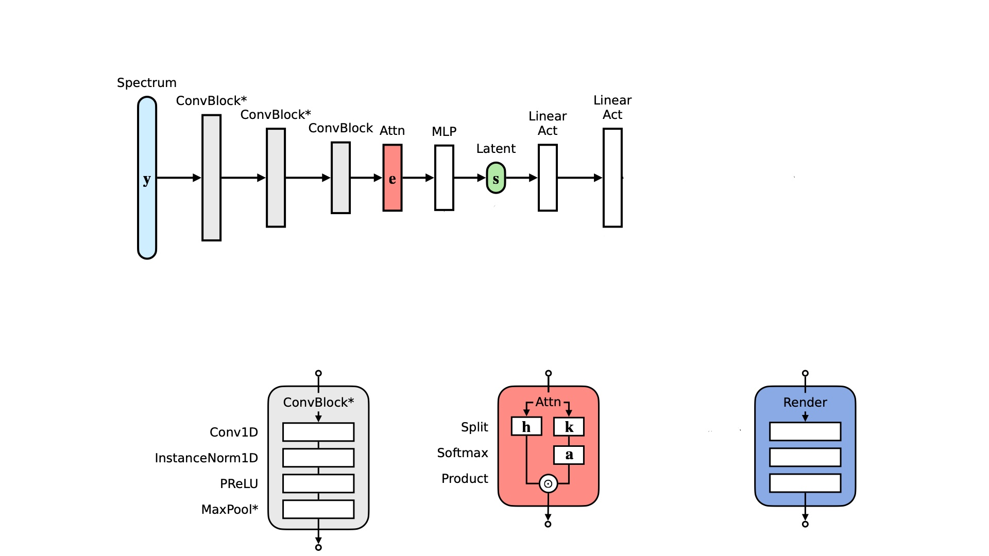
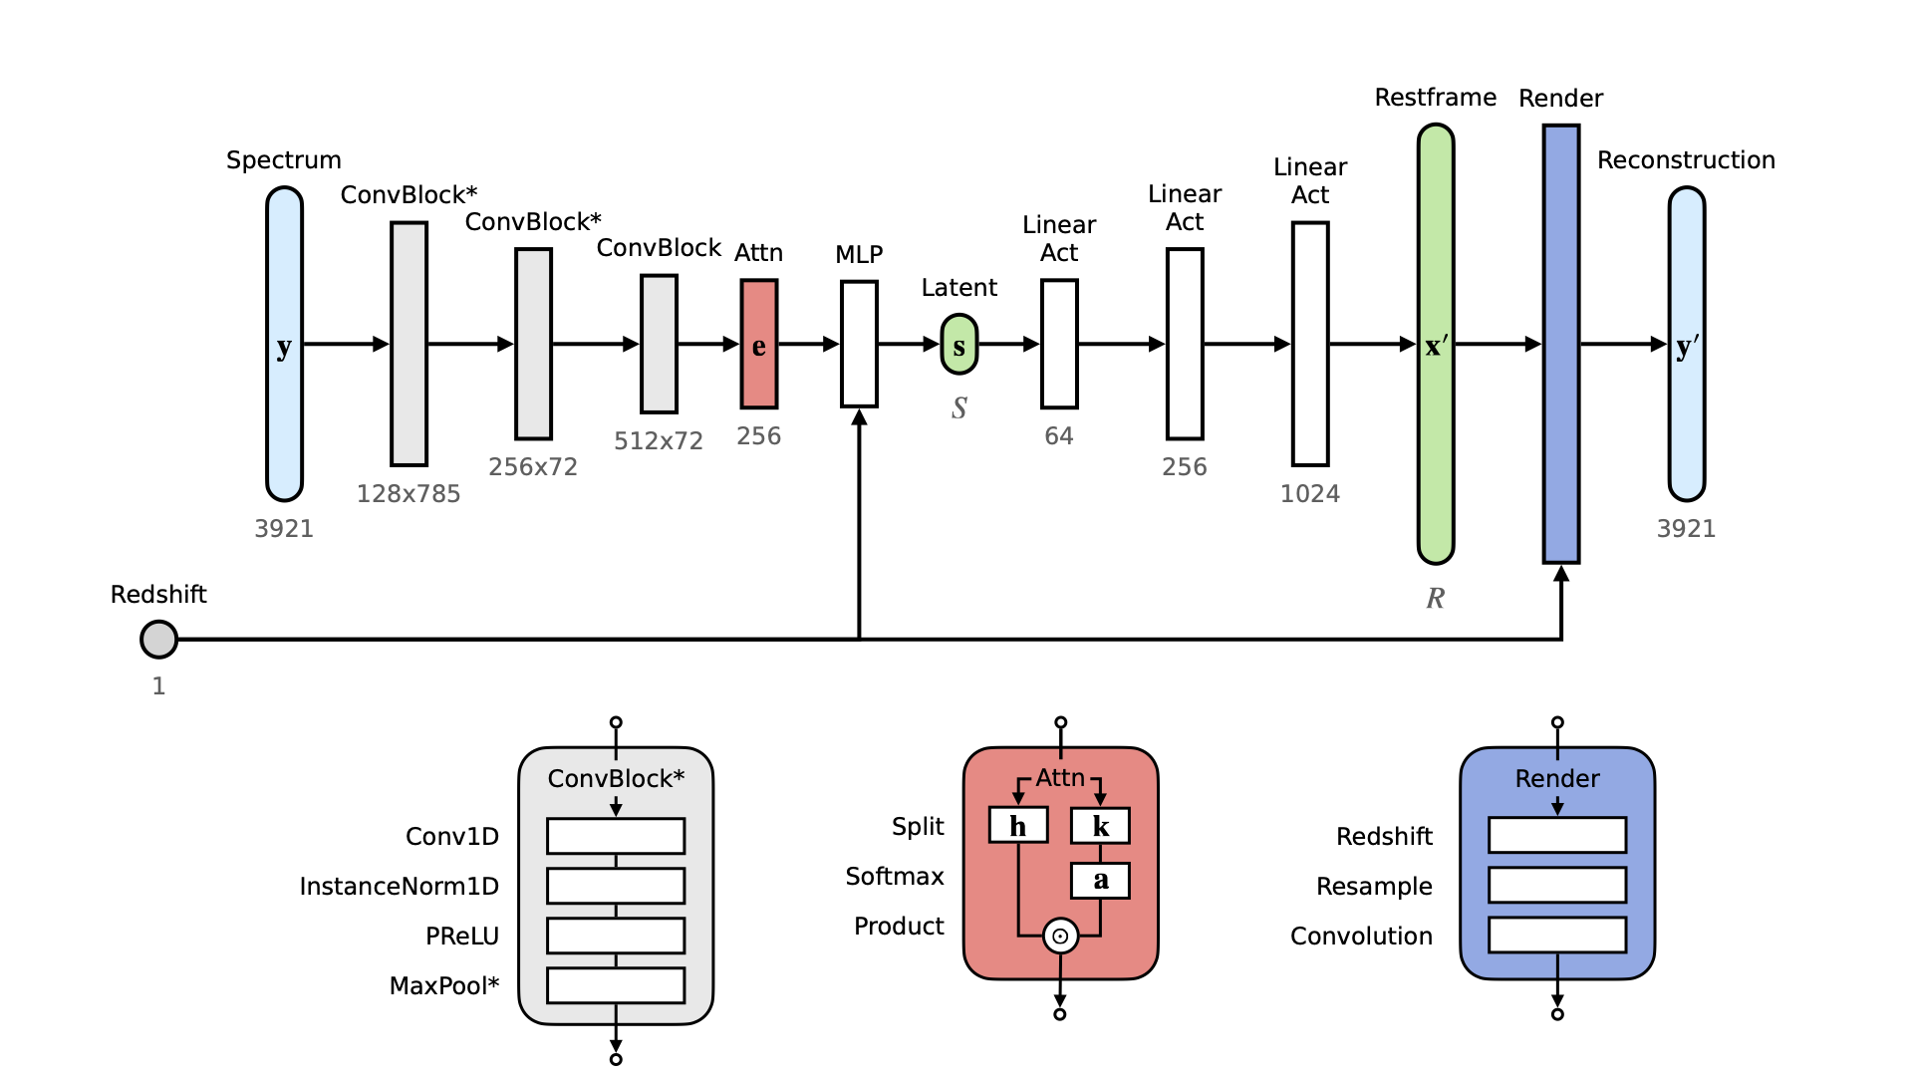
Percentiles
+ [M/H] +
[α/Fe]
3x
2x
16
512x79
256
128
16
256x79
64
32
11
128x860
32
4300
Linear
PReLU/LeakyReLU

