Slide 1

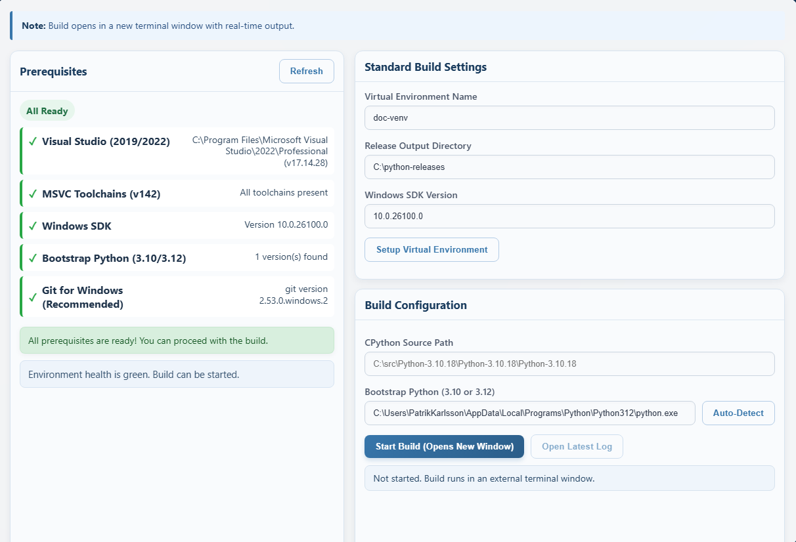
PSUB Operator Guide
Web UI
A faster, safer path for Windows Python security release builds
Validated on Python 3.10.x, 3.11.x, and 3.12.x
PSUB | Operator Guide
1

Slide 2
Why PSUB
The operator problem it solves on a Windows build machine
Operator Angle
Operators stay in one UI instead of jumping between scripts, docs, and environment probes.
UI-first
Safer
Repeatable
One operator surface
Preflight before build
CLI still available
Key Points
One entry point for prerequisite checks, build settings, and launch
Less guesswork when Visual Studio, SDK, or bootstrap Python drift
Clearer failure handling than raw batch files alone
PSUB | Operator Guide
2

Slide 3
Standard Operator Workflow
The repeatable sequence that keeps failures visible
Operator Tips
The same sequence now works cleanly with Visual Studio Professional 2022.
1
2
3
4
5
6
Open PSUB
Confirm prerequisites
Set source and bootstrap Python
Create or refresh doc-venv
Start build
Review log and collect artifacts
PSUB | Operator Guide
3

Slide 4
Prerequisites That Matter
What must be green before you trust a build run
Requirements
PSUB links missing prerequisites directly to setup guides.
Git is useful for repo workflows and metadata, but it no longer blocks readiness.
Do not use Microsoft Store alias paths or Python 3.13 as bootstrap.
Visual Studio 2019 or 2022 with Desktop development with C++
MSVC toolchains for x64, x86, and ARM64
Windows 10 SDK 10.0.19041.0 or later
Bootstrap Python 3.10 or 3.12
Git for Windows on PATH (recommended)
.NET Framework 3.5 for legacy Python 3.10 MSI flows
PSUB | Operator Guide
4

Slide 5
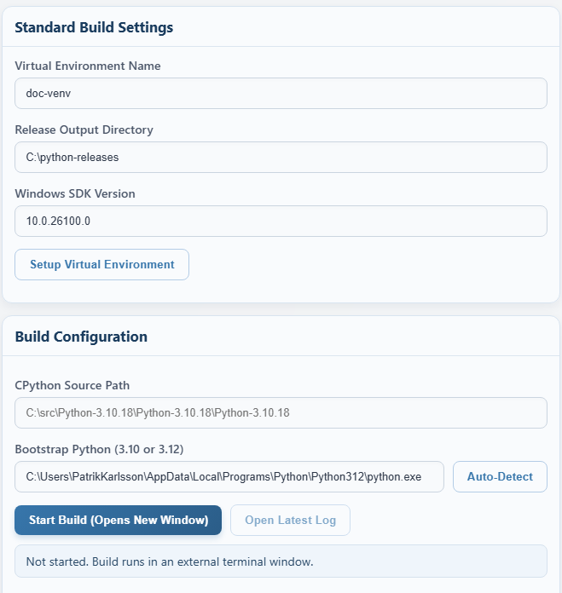
Configure The Run
These are the settings operators actually need to touch
Operator Focus
Web UI
Keep the doc-venv name stable unless you have a reason to change it
Confirm the release output folder and detected Windows SDK
Set SourcePath and Bootstrap Python before launch
Start Build opens a separate terminal with live output
The UI is doing most of the environment work for the operator.
PSUB | Operator Guide
5

Slide 6
What We Verified On A Clean Machine
Recent improvements that reduced operator friction
Operator Angle
These were practical fixes discovered during a fresh-machine setup, not just theoretical cleanup.
VS 2022 Pro
SDK field
3.10 / 3.11 / 3.12
Verified
Autofilled
Built successfully
Key Points
Visual Studio Professional 2022 now works end-to-end on a new machine
Bootstrap autodetect rejects WindowsApps aliases and finds real Python installs
The Windows SDK field now prefills from autodetect instead of a stale default
Python 3.10 MSI/doc handling and artifact naming are now more robust
Git is now treated as recommended rather than a hard blocker in the UI
PSUB | Operator Guide
6

Slide 7
Common Failure Cases
Most blocked runs still fall into a short fixable list
Common Failures
Operator Actions
Windows SDK or MSVC toolchains incomplete
Wrong bootstrap Python version or alias path
Missing doc-venv or Sphinx dependencies
Python 3.10 WiX or .NET 3.5 dependency issue
Git warnings from non-Git CPython source trees
Use the setup guides linked by the prerequisites panel.
Switch to a real Python 3.10 or 3.12 executable.
Run Setup Virtual Environment before retrying.
Enable .NET Framework 3.5 for older 3.10 MSI flows.
Treat Git warnings as informational when building from extracted python.org archives.
PSUB | Operator Guide
7

Slide 8
Takeaways
What operators should remember after the walkthrough
Operator Angle
If the machine is green and bootstrap Python is real, the rest of the workflow becomes predictable.
One UI
Preflight first
Repeatable
Less operator drift
Fewer failed runs
UI plus CLI
Key Points
Treat PSUB as the primary operator entry point for Windows Python release builds
Trust the prerequisite panel before starting a long build
Use the UI for clarity and the CLI when you need scripted repeatability
PSUB | Operator Guide
8

