Slide 1
Comparison of PD, PID and Sliding-Mode Position Controllers for V–Tail Quadcopter Stability

Slide 2
We will cover:
Introduction
Our Simulation and Results
Comparison with original paper
Summary

Slide 3
Introduction
This paper explains the stability analysis of the dynamic model of a V-tail quadcopter for a PD, PID, and SMC position controllers.
The main aspect of this paper is in the corrected design and Lyapunov stability analysis of the PD, PID, and SMC position controllers for the V-tail quadcopter.
The simulation results validate our proposed controller models and algorithms for the V-tail quadcopter.

Slide 4
Simulation Results

Slide 5
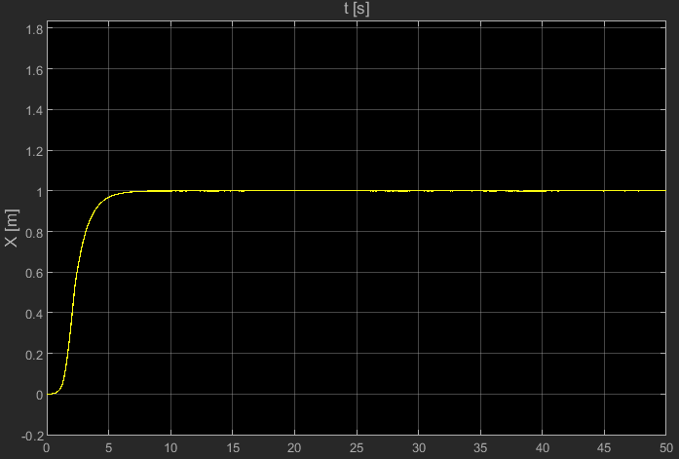
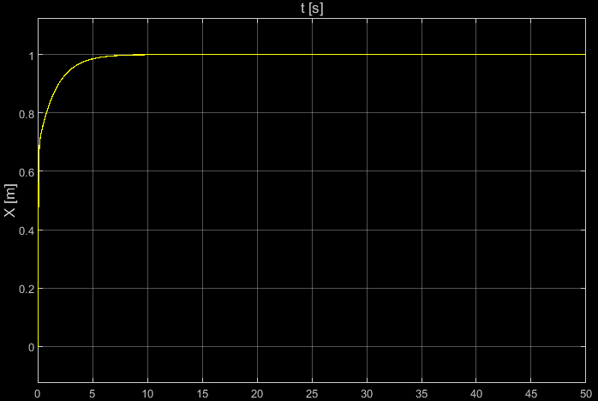
X-Position for V-Tail Quadcopter
PD and PID Controllers
SMC Controller

Slide 6
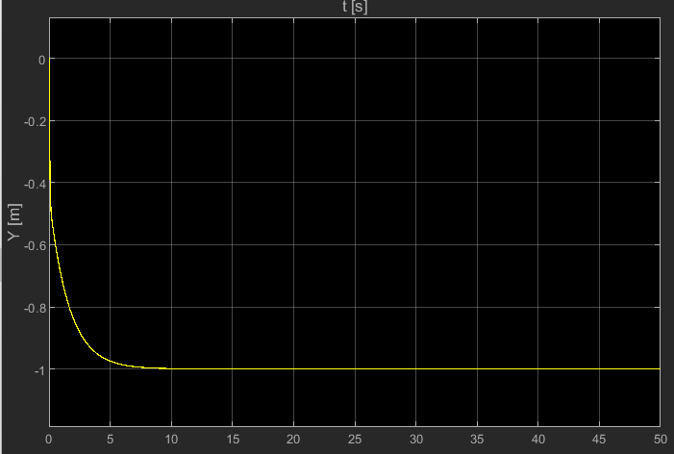
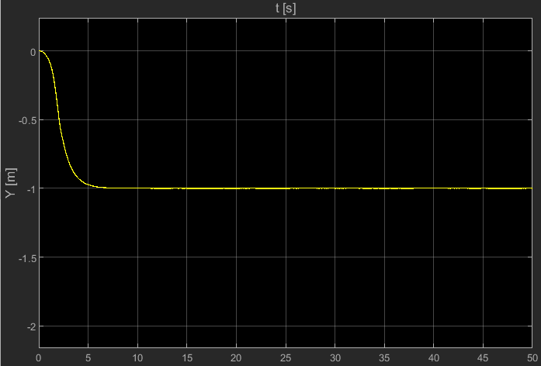
Y-Position for V-Tail Quadcopter
PD and PID Controllers
SMC Controller

Slide 7
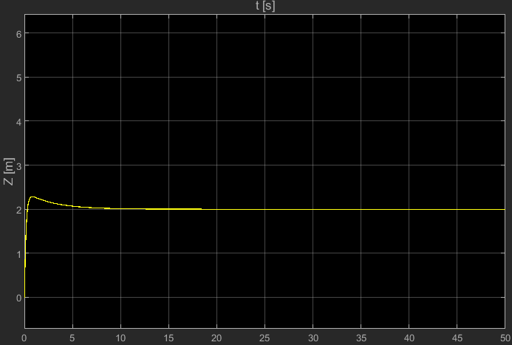
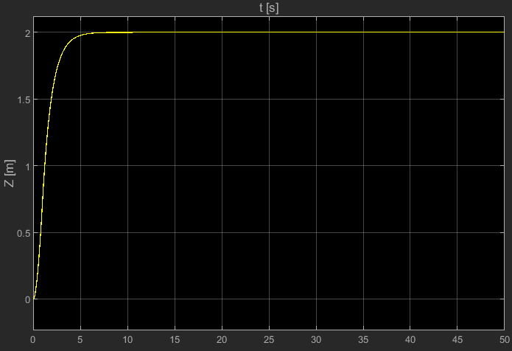
Z-Position for V-Tail Quadcopter
PD and PID Controllers
SMC Controller

Slide 8
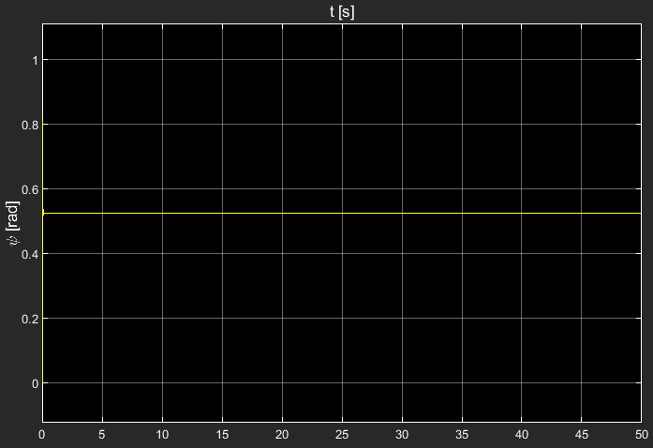
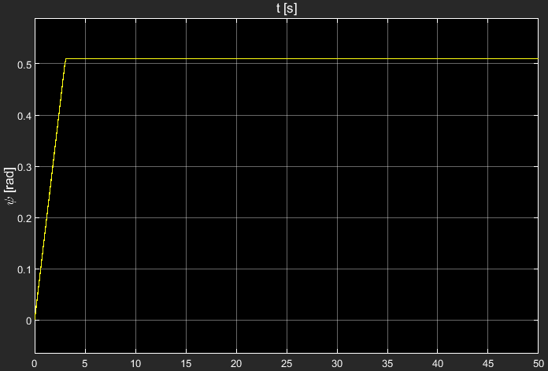
Yaw (ψ) for V-Tail Quadcopter
PD and PID Controllers
SMC Controller

Slide 9
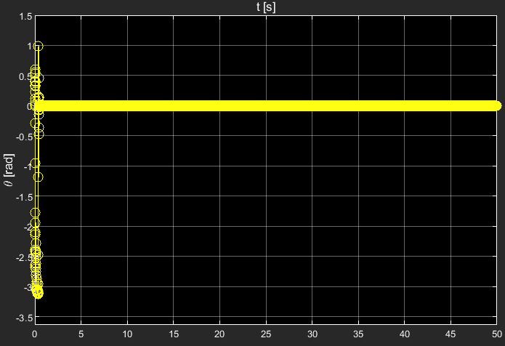
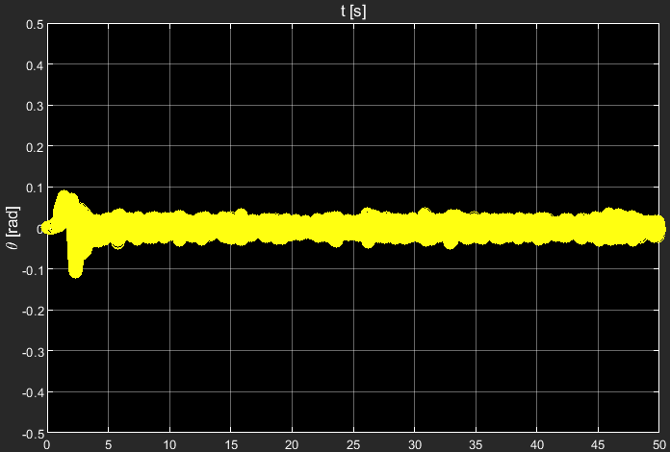
Pitch (θ) for V-Tail Quadcopter
PD and PID Controllers
SMC Controller

Slide 10
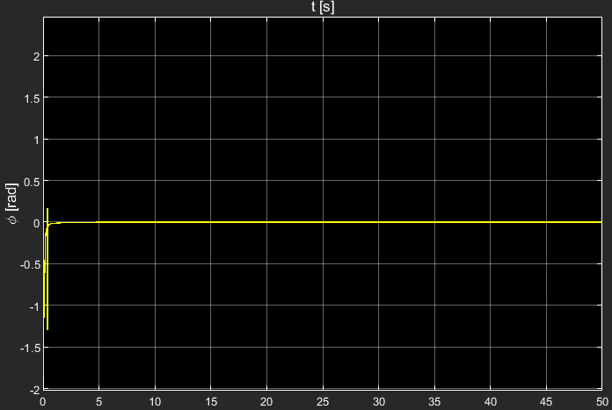
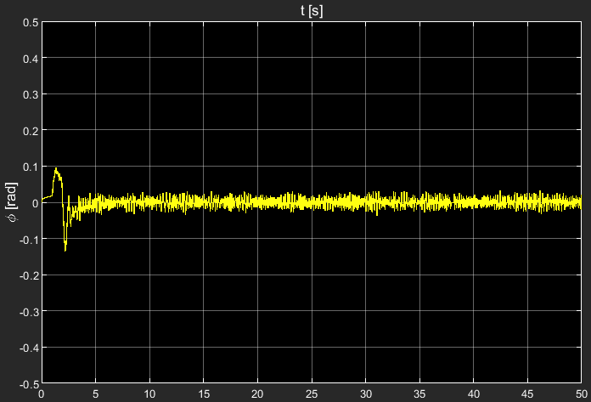
Roll (φ)for V-Tail Quadcopter
PD and PID Controllers
SMC Controller

Slide 11
It can be concluded that the PID controller can keep the quadcopter close to its stationary state with low noise.
By varying the gains, the properties can be modified to give as low of an error as possible.
The PD controller follows the PID output very closely; the difference is almost negligible.
The SMC has a simple and rapid response, which it makes the quadcopter converge to the desired point in the space.
The fact that φ and θ angles are big can bring problems in the real world (due to the simplifications made on the model), so it needs to be validated first through experiments.

Slide 12
Comparison with original paper

Slide 13
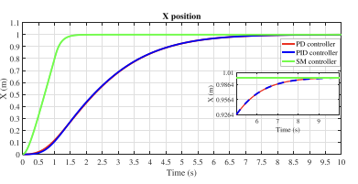
X-Position for V-Tail Quadcopter
PD and PID Controllers
SMC Controller

Slide 14
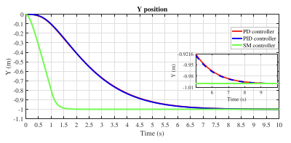
Y-Position for V-Tail Quadcopter
PD and PID Controllers
SMC Controller

Slide 15
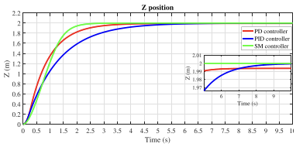
Z-Position for V-Tail Quadcopter
PD and PID Controllers
SMC Controller

Slide 16
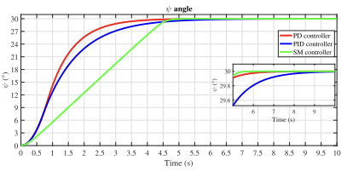
Yaw (ψ) for V-Tail Quadcopter
PD and PID Controllers
SMC Controller

Slide 17
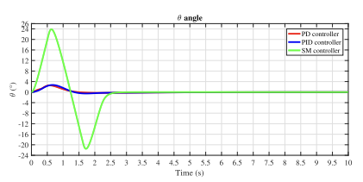
Pitch (θ) for V-Tail Quadcopter
PD and PID Controllers
SMC Controller

Slide 18
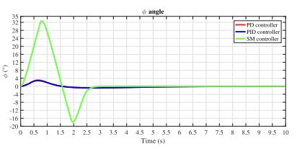
Roll (φ)for V-Tail Quadcopter
PD and PID Controllers
SMC Controller

Slide 19
Our paper orientations are similar to the original paper’s. The only difference being some unknown factors applied which was not mentioned in the paper.
Our implementation involves other assumptions and estimations which was not mentioned by the author.
The error is reduced due to the non-holonomic constraints applied during calculation.
The stability is then obtained from Lyapunov function.

Slide 20
Summary
We implemented our own method to solve for the missing errors while building this controller. The output is similar for some but different for others due to different parameters we have taken while creating it.

Slide 21
Thank you
Patrik Pordi (UID:
Chris Dsouza (UID:118417479)

