Slide 1
Playing Ping Pong on Kubernetes A Study on Kubernetes Resilience
Eduardo Patrocinio, eduardop@us.ibm.com, @patrocinio
Sahdev Zala, TBD

Slide 2
Objective
Describe how to make an application available
Validate Kubernetes resilience

Slide 3
Scenario
Goal
Two components (players) exchanging messages (balls) continuously
Keep the ball moving (despite some disruptions)

Slide 4
Rules of the Game
Each player
Takes a ball (message) from a channel
Holds the ball for one second
Releases the ball to another channel

Slide 5
Desired State
Wait
Ball
Ping
Pong

Slide 6
1st
Game
Set up

Slide 7
Architecture
Ping
(POD)
Pong
(POD)
Queue RabbitMQ
(POD)
Commentator
(POD)
Throw Ball
(Job)

Slide 8
Queue Architecture
Ping
Pong
Ping
🏓
🏓
Pong
🏓
🏓
Message
.🗯
.🗯
Commentator

Slide 9
Play time

Slide 10
2nd
Game
Let’s kill a Pod

Slide 11
Task
Kill the Ping Pod
What’s going to happen?

Slide 12
Logic Flow
Ping / Pong:
Takes a ball (message) from a channel
Holds the ball for one second
Releases the ball to another channel

Slide 13
Play time

Slide 14
3rd
Game
ReplicaSet

Slide 15
Architecture
Ping
(RSet)
Pong
(RSet)
Queue RabbitMQ
(RSet)
Commentator
(RSet)
Throw Ball
(Job)

Slide 16
Play time

Slide 17
4th
Game
Let’s kill the Pod in the ReplicaSet

Slide 18
Task
Kill the Ping Pod in the Replica Set
What’s going to happen?

Slide 19
Play time

Slide 20
Timeline
Wait
Ball
Ping
Pong
1
2

Slide 21
5th
Game
Save the state

Slide 22
Logic Flow
Flow:
Take a ball from a channel
Store in the cache
Holds the ball for one second
Releases the ball to the other channel
Clean the cache
Initialization:
Is there a ball in the cache? If so:
Releases the ball to the other channel
Clean the cache

Slide 23
Architecture
Cache
Redis
(RSet)
Ping
(RSet)
Pong
(RSet)
Queue RabbitMQ
(RSet)
Commentator
(RSet)
Throw Ball
(Job)

Slide 24
Play time

Slide 25
6th
Game
Doubles game

Slide 26
Task
2 Pings, 2 Pongs
Kill the Ping Replica Set
What’s going to happen?

Slide 27
Play time

Slide 28
Timeline
Ping1
Ping2
Pongs
1
2

Slide 29
Scenario
Ping2 has the ball
Ping2 stores the ball in the cache
I kill Ping1
Kubernetes starts another Ping1
During its initialization, Ping1 releases the ball
Ping2 also releases the ball

Slide 30
7th
Game
Check state

Slide 31
Logic Flow
Initialization:
Is there a ball in the cache? If so:
Releases the ball to the other channel
Clean the cache
Flow:
Take a ball from a channel
Store in the cache
Holds the ball for one second
Is there a ball in the cache? If so:
Releases the ball to the other channel
Clean the cache

Slide 32
Play time

Slide 33
8th
Game
Time for platform disruption

Slide 34
Task
Stop a Kubernetes node
What’s going to happen?

Slide 35
Play time

Slide 36
9th
Game
Across clusters

Slide 37
Instructions for use
EDIT IN GOOGLE SLIDES
Click on the button under the presentation preview that says "Use as Google Slides Theme".
You will get a copy of this document on your Google Drive and will be able to edit, add or delete slides.
You have to be signed in to your Google account.
EDIT IN POWERPOINT®
Click on the button under the presentation preview that says "Download as PowerPoint template". You will get a .pptx file that you can edit in PowerPoint.
Remember to download and install the fonts used in this presentation (you’ll find the links to the font files needed in the Presentation design slide)
More info on how to use this template at www.slidescarnival.com/help-use-presentation-template
This template is free to use under Creative Commons Attribution license. You can keep the Credits slide or mention SlidesCarnival and other resources used in a slide footer.

Slide 38
Hello!
I am Jayden Smith
I am here because I love to give presentations.
You can find me at @username

Slide 39
1.
TRANSITION HEADLINE
Let’s start with the first set of slides

Slide 40
Quotations are commonly printed as a means of inspiration and to invoke philosophical thoughts from the reader.

Slide 41
This is a slide title
Here you have a list of items
And some text
But remember not to overload your slides with content
Your audience will listen to you or read the content, but won’t do both.

Slide 42
Big concept
Bring the attention of your audience over a key concept using icons or illustrations

Slide 43
You can also split your content
White
Is the color of milk and fresh snow, the color produced by the combination of all the colors of the visible spectrum.
Black
Is the color of coal, ebony, and of outer space. It is the darkest color, the result of the absence of or complete absorption of light.

Slide 44
In two or three columns
Yellow
Is the color of gold, butter and ripe lemons. In the spectrum of visible light, yellow is found between green and orange.
Blue
Is the colour of the clear sky and the deep sea. It is located between violet and green on the optical spectrum.
Red
Is the color of blood, and because of this it has historically been associated with sacrifice, danger and courage.

Slide 45
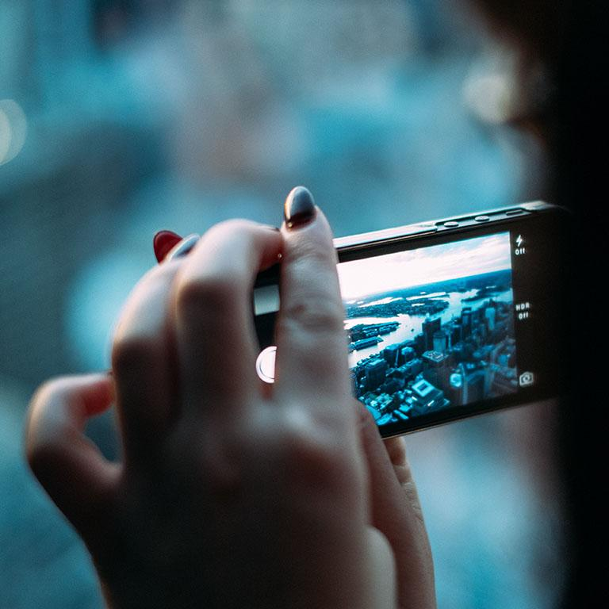
A picture is worth a thousand words
A complex idea can be conveyed with just a single still image, namely making it possible to absorb large amounts of data quickly.

Slide 46
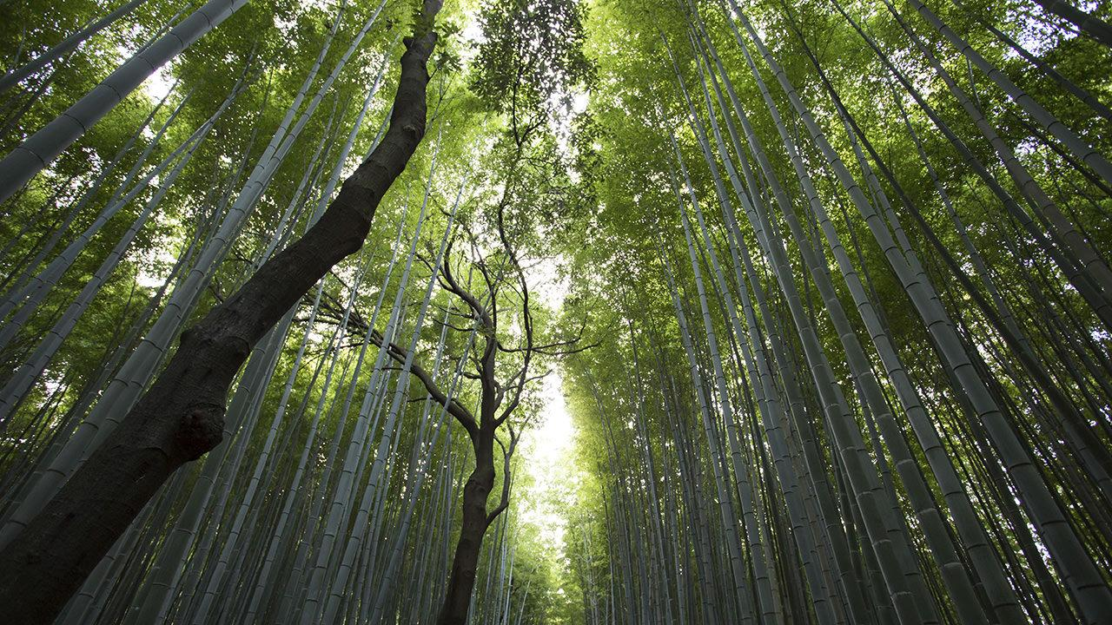
Want big impact? Use big image.

Slide 47
Use charts to explain your ideas
Gray
White
Black

Slide 48
And tables to compare data
 | A | B | C
Yellow | 10 | 20 | 7
Blue | 30 | 15 | 10
Orange | 5 | 24 | 16

Slide 49
Maps
our office

Slide 50
89,526,124
Whoa! That’s a big number, aren’t you proud?

Slide 51
89,526,124$
185,244 users
100%
That’s a lot of money
And a lot of users
Total success!

Slide 52
Our process is easy
first
second
last

Slide 53
Let’s review some concepts
Yellow
Is the color of gold, butter and ripe lemons. In the spectrum of visible light, yellow is found between green and orange.
Blue
Is the colour of the clear sky and the deep sea. It is located between violet and green on the optical spectrum.
Red
Is the color of blood, and because of this it has historically been associated with sacrifice, danger and courage.
Yellow
Is the color of gold, butter and ripe lemons. In the spectrum of visible light, yellow is found between green and orange.
Blue
Is the colour of the clear sky and the deep sea. It is located between violet and green on the optical spectrum.
Red
Is the color of blood, and because of this it has historically been associated with sacrifice, danger and courage.

Slide 54
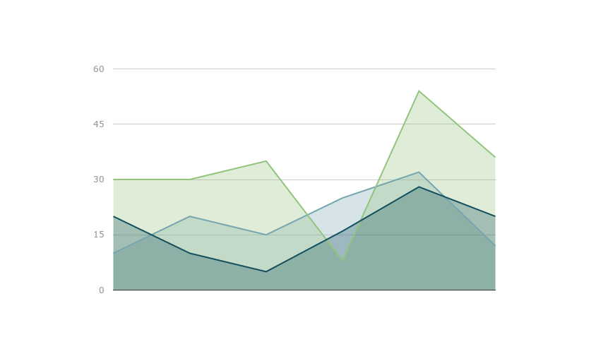
You can copy&paste graphs from Google Sheets

Slide 55
Android project
Show and explain your web, app or software projects using these gadget templates.
Place your screenshot here

Slide 56
iPhone project
Show and explain your web, app or software projects using these gadget templates.
Place your screenshot here

Slide 57
Tablet project
Show and explain your web, app or software projects using these gadget templates.
Place your screenshot here

Slide 58
Desktop project
Show and explain your web, app or software projects using these gadget templates.
Place your screenshot here

Slide 59
Thanks!
Any questions?
You can find me at @username & user@mail.me

Slide 60
Credits
Special thanks to all the people who made and released these awesome resources for free:
Presentation template by SlidesCarnival
Photographs by Unsplash

Slide 61

Presentation design
This presentation uses the following typographies and colors:
Titles: Raleway
Body copy: Karla
You can download the fonts on this page:
https://www.google.com/fonts#UsePlace:use/Collection:Raleway:400,700|Karla:400,700,400italic,700italic
Click on the “arrow button” that appears on the top right
Dark green #004c52 / Aqua green #00ae9d / Lime green #abe33f
You don’t need to keep this slide in your presentation. It’s only here to serve you as a design guide if you need to create new slides or download the fonts to edit the presentation in PowerPoint®

Slide 62
SlidesCarnival icons are editable shapes.
This means that you can:
Resize them without losing quality.
Change fill color and opacity.
Change line color, width and style.
Isn’t that nice? :)
Examples:

Slide 63
😉
Now you can use any emoji as an icon!
And of course it resizes without losing quality and you can change the color.
How? Follow Google instructions https://twitter.com/googledocs/status/730087240156643328
✋👆👉👍👤👦👧👨👩👪💃🏃💑❤😂😉😋😒😭👶😸🐟🍒🍔💣📌📖🔨🎃🎈🎨🏈🏰🌏🔌🔑 and many more...

