Slide 1


TECHNICAL DEFENSE — FIRST PRESENTATION
EAM Platform for Intelligent Predictive Maintenance
Design and development of an Enterprise Asset Management (EAM) system augmented with seven Machine Learning models, an evidence-fusion engine, and a conversational RAG assistant.
Hamza Mbarki · End-of-Studies Internship — ESPRIT × SagemCom · 2025–2026

Slide 2
AGENDA
Presentation Outline
Context & host company
Actors & requirements
01
05
Problem statement
Working methodology
02
06
Study of existing solutions
Architecture & design
03
07
Proposed solution
Technologies & progress
04
08
02

Slide 3
HOST COMPANY
SagemCom — Communication Equipment
The internship at a glance
7
months of internship
Industrial group specializing in the design and manufacturing of high-value communication equipment: set-top boxes, internet boxes, and smart meters.
7
ML models (P1–P7)
•
Production lines — SMT assembly, functional testing, and automated quality control
4
independent services
•
Host department — Software Engineering & Innovation
•
Department's mission — Internal digital tools for equipment maintenance
4
user roles
03

Slide 4
GENERAL CONTEXT
From scheduled to predictive maintenance
1
2
3
Reactive
Preventive (calendar)
Predictive (project's target)
Intervention only after the failure: line stoppage, emergency parts ordering, maximum total cost.
Intervention at fixed intervals, regardless of actual condition: parts replaced too early, or failures between two scheduled visits.
Continuous reading of machine signals (temperature, torque, wear) to anticipate failure before it happens.
Key insight — in most cases, a machine's degradation is visible in its sensor data well before the actual stoppage. This is the premise the whole ML pipeline is built on.
04

Slide 5
PROBLEM STATEMENT
How to cover, in a single platform,
both operational management AND predictive maintenance?
Classic operational management
1
Users, machines, work orders, intervention orders, scheduling — the EAM foundation.
ML-based predictive maintenance
2
Failure probability, failure type, remaining useful life, anomalies, prioritization, scheduling, parts coordination.
Intelligent field support
3
Contextualized alerts, explainability ("why this alert?"), a conversational assistant combining documentation and real-time status.

Slide 6
STUDY OF EXISTING SOLUTIONS
Existing solutions identified
Solution
Positioning
SAP PM
EAM module of a general-purpose ERP, very complete on work order and asset management.
IBM Maximo
Mature EAM suite with a predictive add-on module (Maximo APM), strong document management.
GE Digital APM / Predix
Industrial platform focused on IoT sensors and large-scale reliability analytics.
Generic CMMS / Excel
Lightweight tools or spreadsheets, used when budget doesn't allow a full EAM suite.
06

Slide 7
STUDY OF EXISTING SOLUTIONS
Critique of existing solutions
Observed strengths
Justification of the proposed solution
+
Proven EAM functional coverage (WOs, assets, scheduling)
✓
A single platform tailored to SagemCom's fleet, no heavy licensing
+
Mature ecosystems, large communities
+
Analytics modules available as add-ons
Predictions explained in plain language, no ML jargon
✓
Limits in this context
–
Predictive ML as a costly add-on, poorly explained to technicians
✓
Documentation assistant + real-time machine context
–
No conversational assistant tied to real-time machine status
✓
Automation always "guarded": nothing fires without human approval
–
High licensing and integration cost for a single site
07

Slide 8
PROPOSED SOLUTION
An EAM Platform Augmented by ML
1
2
3
Full EAM foundation
7 predictive models (P1–P7)
Evidence fusion (DST)
Users, machines, work orders and intervention orders, scheduling, archiving.
Failure, failure type, remaining useful life, anomaly, priority, scheduling, parts.
Combines 4 advanced signals (Wave 2) into one honest, unified health score.
4
5
6
Systematic explainability
Conversational RAG assistant
Guarded automation
Every prediction shipped with a plain-language explanation.
Documentation + real-time machine status merged into every answer.
Parts purchase proposals generated, never ordered without human approval.
08

Slide 9
ACTORS & REQUIREMENTS
The Four Platform Roles
AD
OP
HE
TE
Administrator
Operations Manager
Head Technician
Technician
Manages users, machines, and the document base; overall view of the system.
Consultation and overview of machine labels and statuses.
Plans interventions, arbitrates priorities, approves procurement proposals.
Executes intervention orders, checks health status, queries the AI assistant.
09

Slide 10
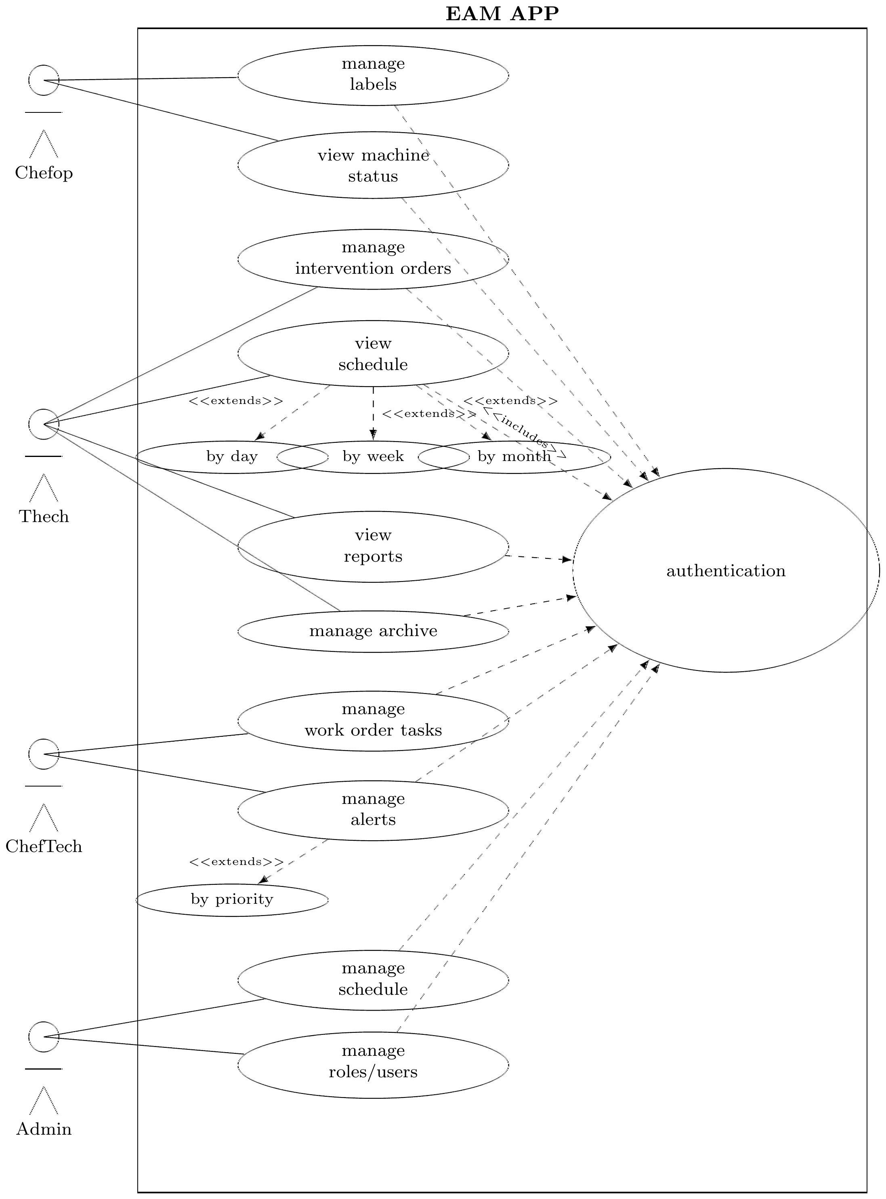
ACTORS & REQUIREMENTS
Use Case Diagram
10

Slide 11
REQUIREMENTS
Functional Requirements — 9 Areas Covered
1
2
3
4
5
Authentication & authorization
Machine management
Order management
Scheduling
ML predictions (P1–P7)
6
7
8
9
Alerts & notifications
Conversational assistant
Dashboards
Archiving & traceability
Two cross-cutting requirements: every prediction ships with a plain-language explanation; the system degrades honestly (reports missing telemetry rather than inventing a value).
11

Slide 12
REQUIREMENTS
Non-Functional Requirements
1
2
3
Performance
Availability
Maintainability
< 2 s for common operations; < 5 s for full ML inference.
Classic EAM features stay fully operational even if the ML service is unavailable.
Strict separation of presentation / business logic / data access; versioned migrations (Alembic).
4
5
6
Portability
Usability
Data integrity & confidentiality
Full deployment via Docker Compose, configuration centralized in a single .env file.
Interface adapted to the user's role and device (desktop workstation or field tablet).
Data access scoped by role; intervention history cannot be modified retroactively.
7
Application security
OWASP Top 10 hardened; secrets scanned every commit via a 5-stage DevSecOps pipeline (SAST, DAST, dependency & image scans).
12

Slide 13
METHODOLOGY
An Iterative Approach Inspired by Scrum
Product Owner
Scrum Master
Development team
SagemCom supervisor — prioritizes business needs and validates every deliverable.
Intern — drives the specify → plan → build → verify cycle.
Intern, paired with an AI assistant for implementation and testing.
Sprints & artifacts
›
Sprints: 7 monthly iterations aligned with the roadmap (see Gantt chart).
›
Artifacts: a written specification document + a detailed implementation plan for every feature, before any code is written.
›
Every feature follows the same disciplined loop: specify → plan → build → verify, ensuring full traceability of technical decisions.
13

Slide 14
DESIGN
Logical Architecture — Component Diagram
User
HTTP/HTTPS
Docker network — asset_management_network
Frontend (Next.js)
:3000
Backend (FastAPI)
:8000
ML Microservice (Flask)
:8001
RAG Service (FastAPI)
:8003
RabbitMQ
:5672
External APIs
Groq LLM · SMTP (Gmail)
HTTPS
pgvector
PostgreSQL + pgvector
:5432
MinIO (S3)
:9000 / :9001
Celery worker + beat
Every service is an independent container on one Docker network. The backend also reads and writes PostgreSQL and MinIO directly, not shown to keep the diagram readable.
14

Slide 15
DESIGN
Logical Architecture — Request Flow
1
Frontend requests the machine's status
GET /machines/{id}/unified-health
2
Backend reads the latest real sensor data
Synthetic rows filtered out; none found → returns telemetry_available: false and stops here
3
Backend calls the ML microservice
Runs P1–P7 in parallel on the sensor snapshot; models stay cached in memory after first load
4
Wave 2 models process the history
Runs concurrently with P1–P7, reading the machine's telemetry trend, not just this instant
5
DST fusion combines every signal
Produces the unified health score and verdict
6
The prediction is logged
Written to ml_prediction_logs for audit and future retraining
7
Frontend renders the result
The ML Intelligence panel updates with the new score and explanation
Graceful degradation — no telemetry on record never means a fabricated prediction; the platform falls back to a maintenance-history-only score instead.
15

Slide 16
DESIGN
Physical Architecture — Deployment Diagram
User
Docker Hub
(base images)
HTTP/HTTPS
docker pull
Docker host — docker compose
Application stack
SonarQube stack (SAST)
Frontend :3000 · Backend :8000 · ML :8001 · RAG :8003
PostgreSQL :5432 · RabbitMQ :5672 · MinIO :9000/:9001
Celery worker + beat
SonarQube CE server
SonarQube database
self-hosted, on demand
Monitoring stack
Notebooks stack
Prometheus
Grafana
Pushgateway
Jupyter (ML research)
trains/evaluates models offline
not part of the running app
Four stacks, one Docker host — each starts, stops, and rebuilds independently, without touching the running application.
16

Slide 17
DESIGN
Physical Architecture — Security Pipeline
1 · Gitleaks
2 · SCA
3 · SonarQube
4 · Trivy
5 · OWASP ZAP
Secret scanning
pip-audit / pnpm audit
Static analysis (SAST)
Image & IaC scan
Dynamic testing (DAST)
Scans every commit and Git history for hard-coded credentials, keys, tokens.
Cross-references every dependency against known CVEs and license risk.
Flags injection flaws, weak crypto, broad exception handling, data exposure.
Checks all 5 Docker images and Compose files for CVEs and misconfiguration.
Logs in as all 4 roles and probes running services for the OWASP Top 10.
Quality gate — fully green
0
100%
2.6%
74.8%
new violations
hotspots reviewed
duplication (was 10.3%)
coverage (≥ 70% target)
All 5 stages run non-blocking (allow_failure: true) on every push — full visibility into findings without ever blocking delivery.
17

Slide 18
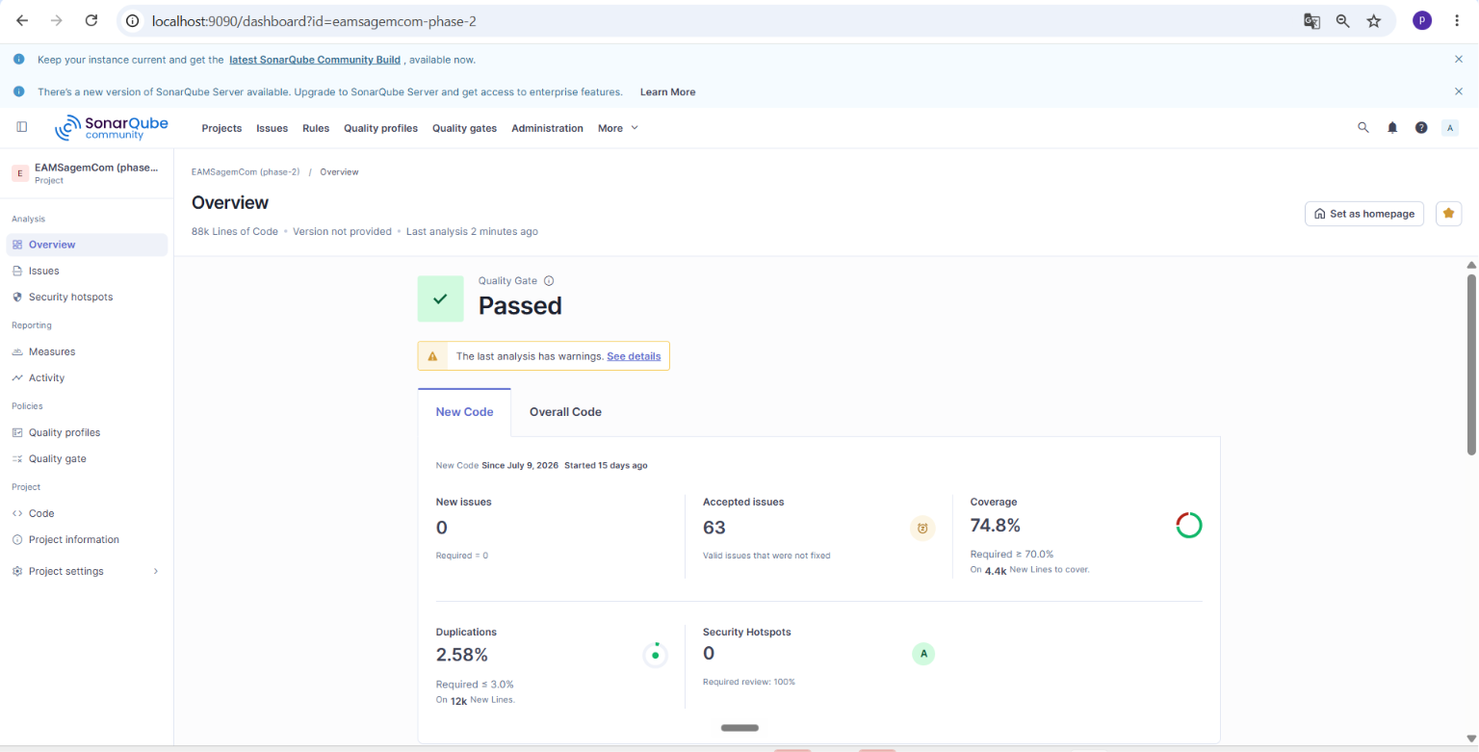
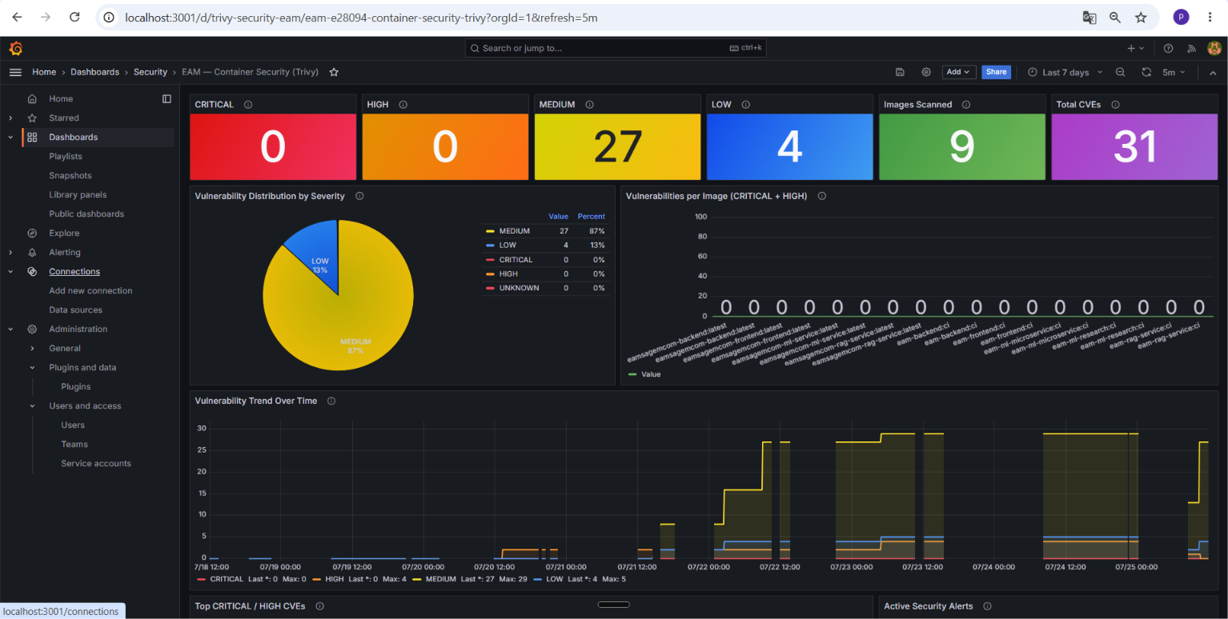
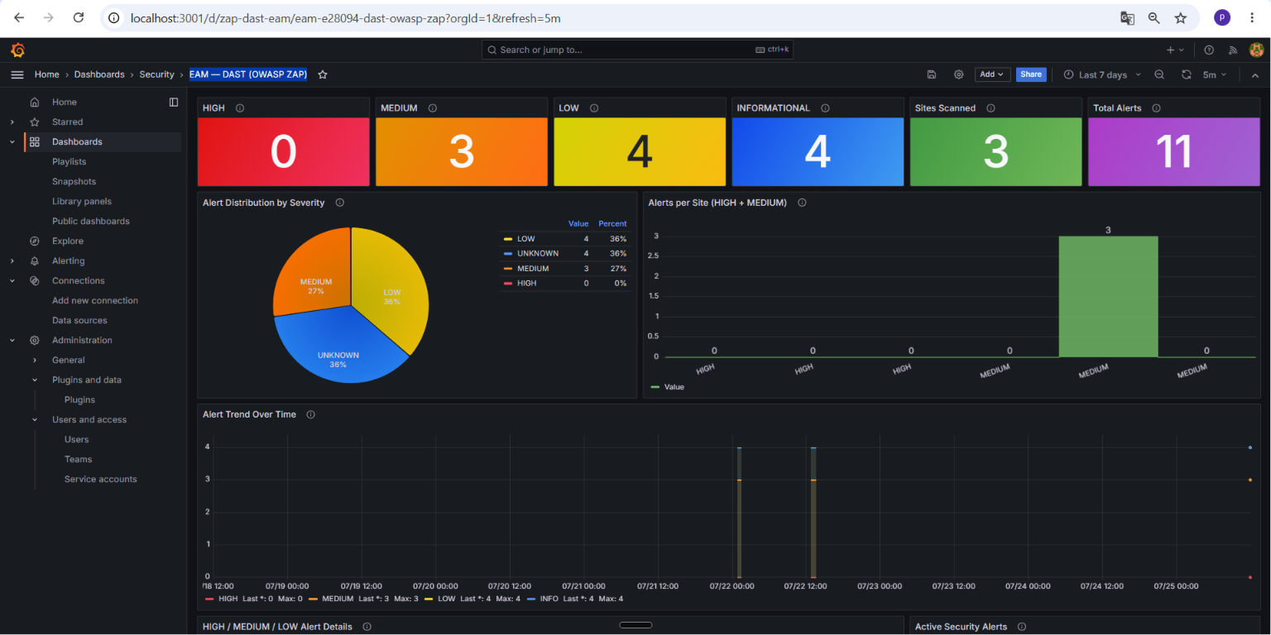
DESIGN
Security Pipeline — Live Evidence
SonarQube Quality Gate — Passed (74.8% coverage, 0 new issues)
Trivy — Container Image Scan (0 critical / 0 high CVEs)
OWASP ZAP — DAST Scan (0 high-severity alerts, 11 total)
Live dashboards from the running SonarQube, Grafana/Trivy, and Grafana/OWASP ZAP instances for this project (EAMSagemCom, Phase_2).

Slide 19
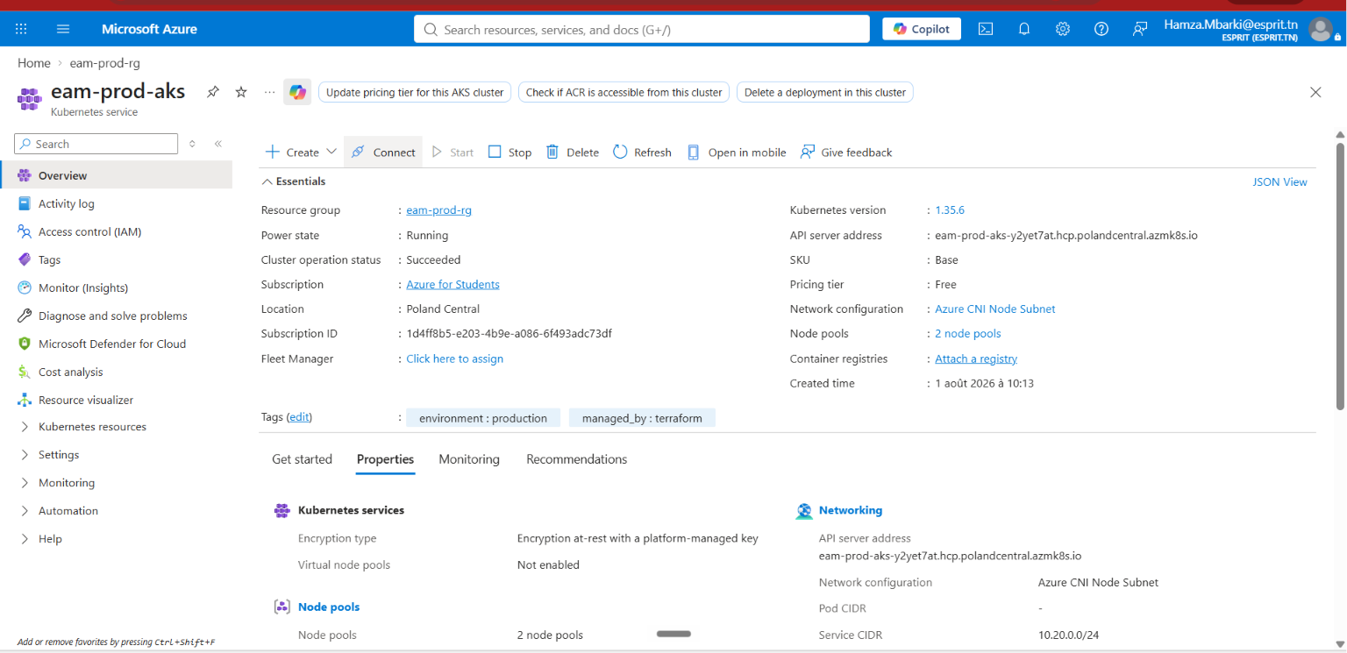
DESIGN
Physical Architecture — Production on AKS
Azure, provisioned via Terraform
•
AKS cluster in Poland Central — 1 system node + autoscaling user nodes
•
Azure Database for PostgreSQL Flexible Server, pgvector enabled
•
Key Vault holds the database admin secret
•
Terraform state hosted on HCP Terraform for a live dashboard
Staging live: eam-staging namespace, 8/8 pods verified internally. Public load balancer blocked by a subscription-level quota — one open item.
18

Slide 20
DESIGN
Machine Learning Pipeline
Sensor telemetry: air temperature · process temperature · rotational speed · torque · tool wear
turns raw numbers into useful clues
Feature pipeline — works out how much heat is building up and how hard the machine is working
same data, seven different questions asked at once
P1
P2
P3
P4
P5
P6
P7
Failure chance
Failure type
Life left
Odd behavior
Urgency
Best timing
Parts needed
a second set of checks runs at the same time, using the machine's history
PINN
Cox PH survival
Mahalanobis
CUSUM + Kalman
Keeps estimates realistic
How long it can run
Off from its own normal
Slow decline over time
four opinions get combined into one answer
Dempster-Shafer evidence fusion — weighs every signal together, and says 'not sure' if they disagree
only shows a score when it's confident
Machine health score (0–100) + verdict
19

Slide 21
DESIGN
ML Model Definitions
Model
Type
Description
Key details
P1 Failure prob.
Binary classifier
Will it fail soon?
XGBoost · 5 features · SMOTE
P2 Failure type
Multi-label
What kind of failure?
Multi-output XGBoost · 5 modes
P3 Remaining life
Regressor + quantile
Days left before service
XGBoost · MAE 14.95 · C-idx 0.62
P4 Anomaly
Unsupervised ensemble
Acting strange right now?
IF 30% + Z 20% + cluster 10% + AE 40%
P5 Priority
Multi-class
How urgent is the repair?
XGBoost · 4 priority classes
P6 Schedule
3-class
Best time to do maintenance?
XGBoost · replaced earlier Prophet design
P7 Parts demand
Survival + forecast
Which parts, and when?
Survival model + Croston's method
PINN
Physics-informed net
Keeps estimates realistic
Wave 2 signal · reads history
Cox PH survival
Survival regression
How long can it keep running?
Wave 2 signal · C-index 0.712
Mahalanobis index
Distance metric
Off from its own normal?
Wave 2 signal · ignores wear resets
CUSUM + Kalman
Change-point detector
Slowly getting worse over time?
Wave 2 signal · smoothed drift
DST fusion
Evidence-combination rule
Combines every signal into one verdict
Dempster's rule, or Yager's on conflict
20

Slide 22
DESIGN
Why These Models — Comparison
Problem
Model used
Alternatives considered
Why this one
P1 Failure probability
XGBoost
Random Forest (initial), logistic regression
Better on non-linear, imbalanced sensor data
P2 Failure type
Multi-output XGBoost
Multi-output Random Forest
Higher F1 on rare failure modes
P3 Remaining life
XGBoost + quantile heads
Hand-coded linear regression (legacy)
Adds a calibrated uncertainty range
RUL, censoring-aware
Weibull AFT / Cox PH
Naive, censoring-blind regression
C-index 0.714/0.712 vs 0.644 naive
P4 Anomaly detection
4-method ensemble
Isolation Forest alone, autoencoder alone
Catches anomaly shapes a single method misses
P5 Work order priority
XGBoost multi-class
Rule-based heuristic, Random Forest
Learns patterns instead of fixed thresholds
P6 Maintenance schedule
XGBoost classifier
Prophet, ARIMA, LSTM forecast
More robust on sparse per-machine data
P7 Parts demand
Survival + Croston's method
Reorder point, moving average
Built for bursty, intermittent demand
Wave 2 fusion
Dempster-Shafer fusion
Weighted average, majority vote
Reports uncertainty instead of forcing consensus
21

Slide 23
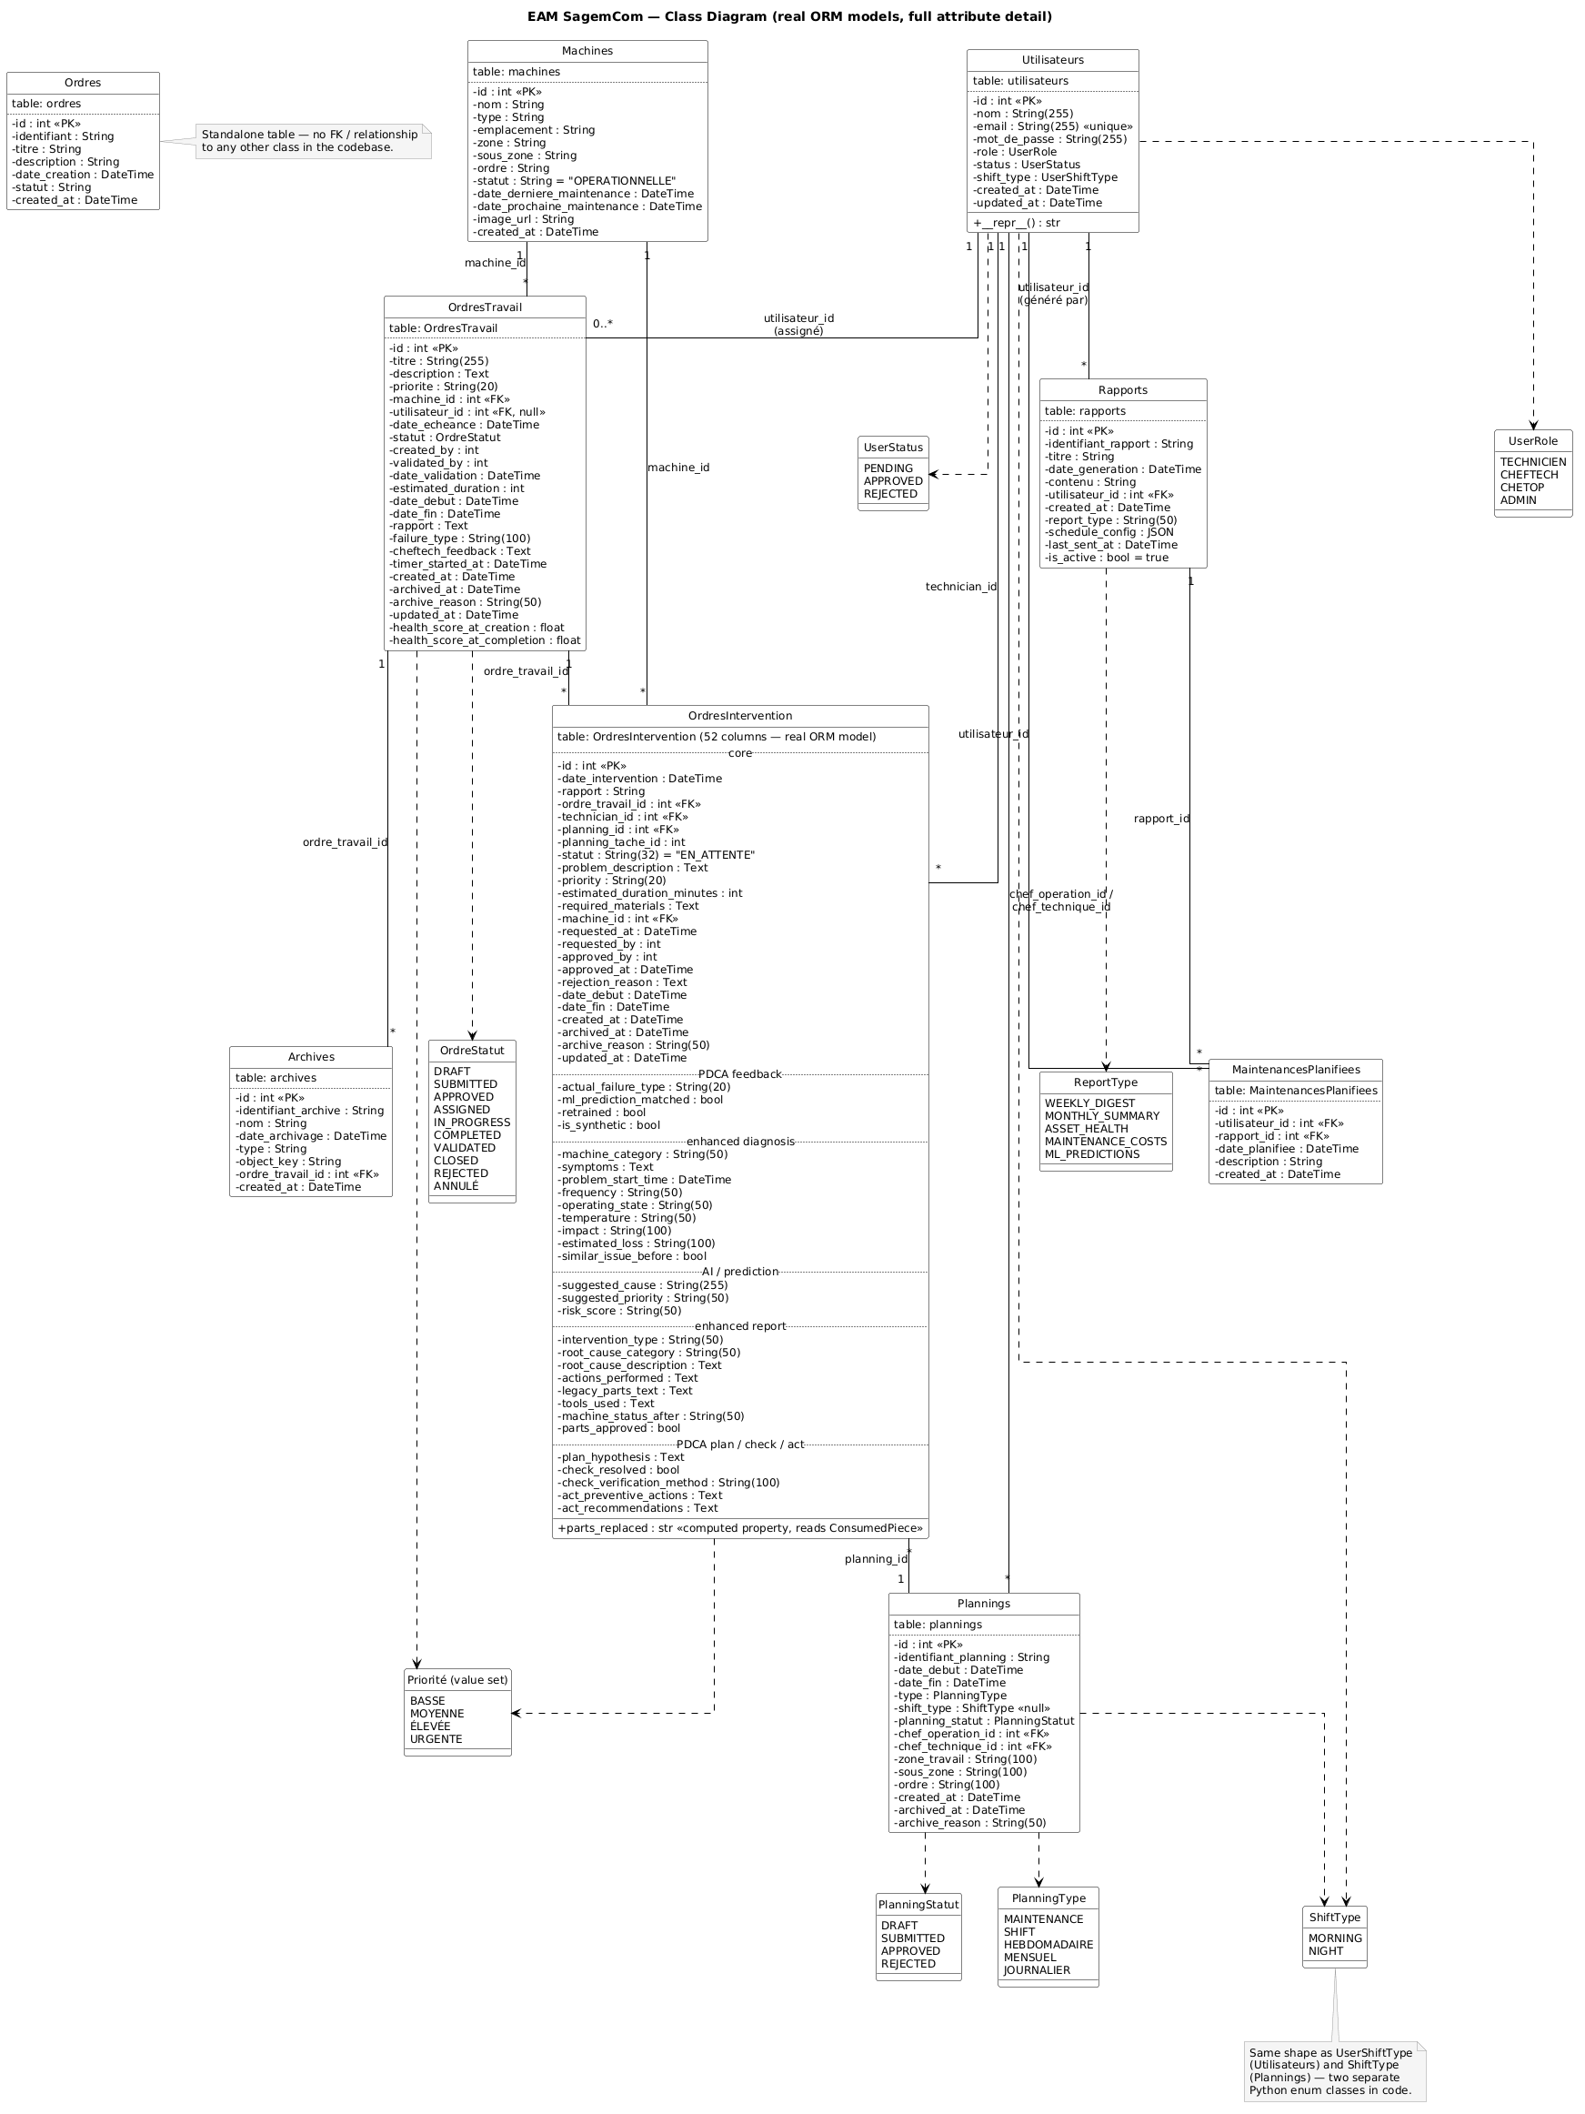
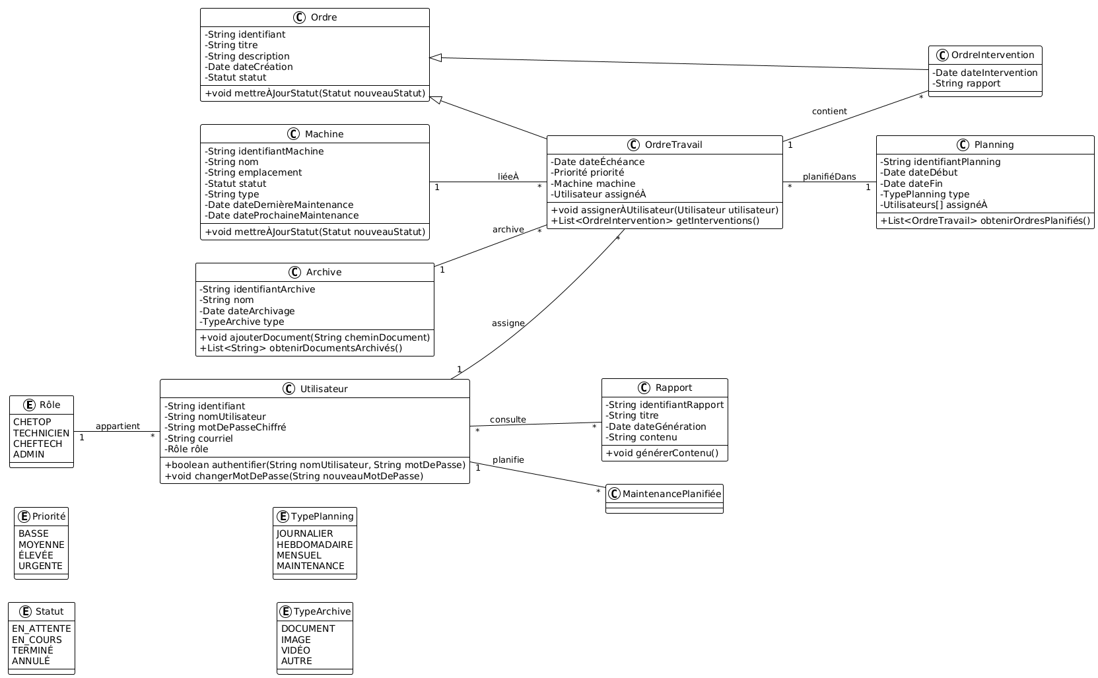
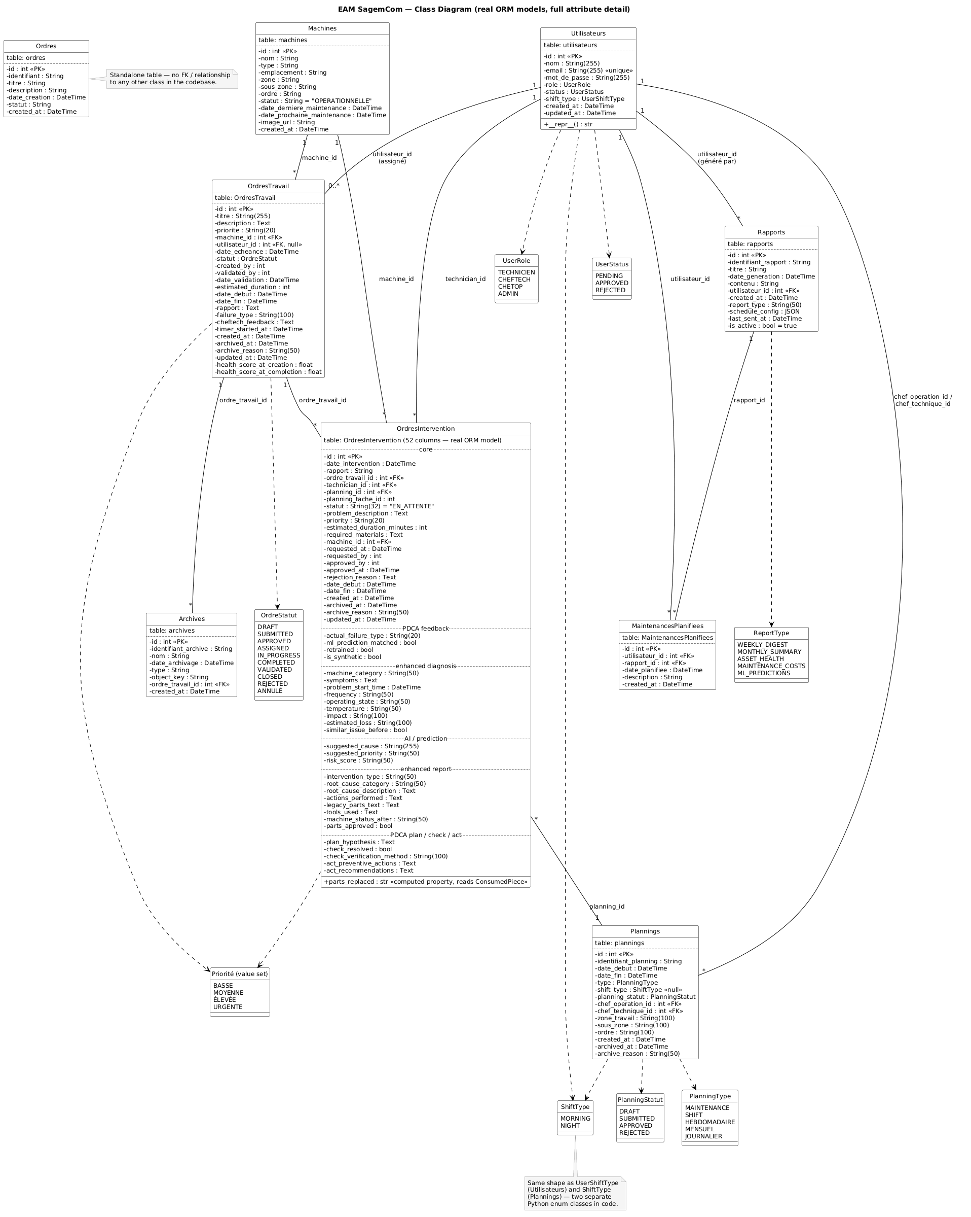
DESIGN
Class Diagram
22

Slide 24
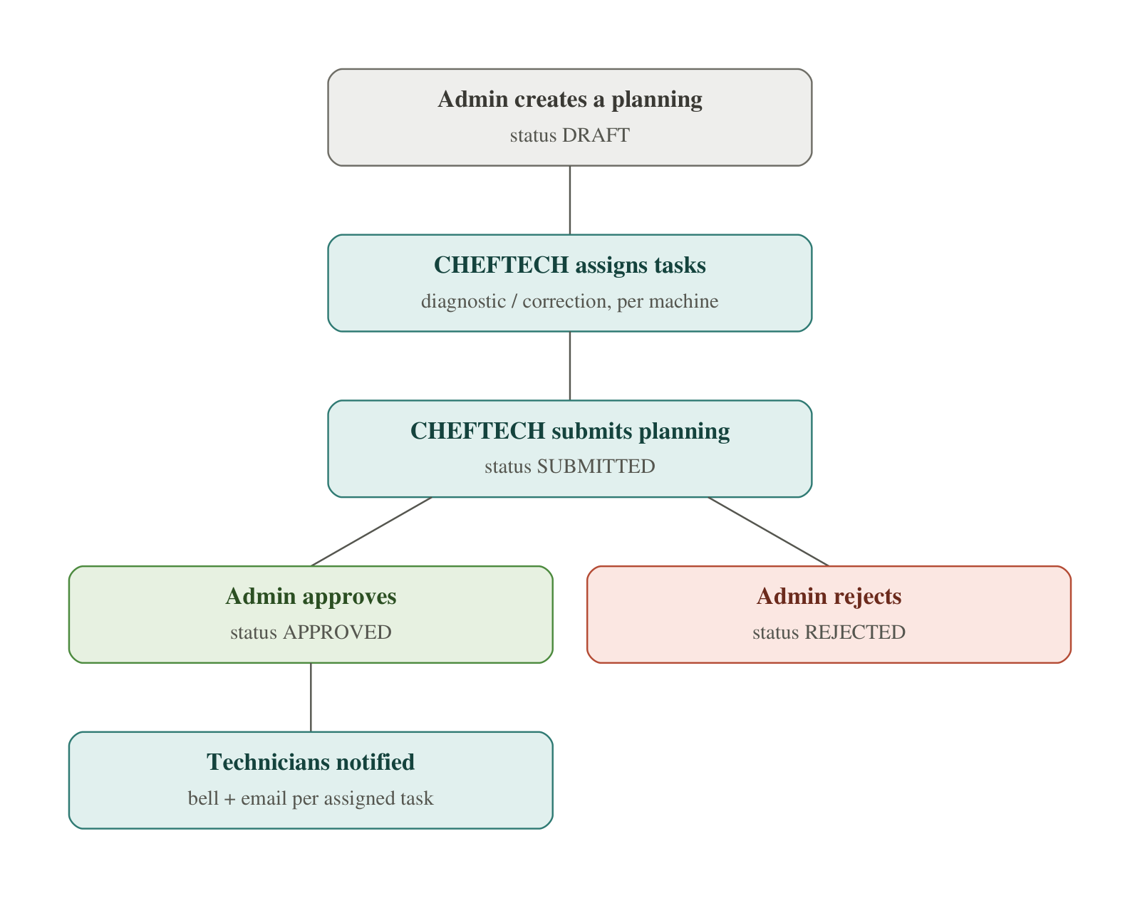
METHODOLOGY
Gantt Chart — Internship Schedule
23

Slide 25
IMPLEMENTATION
Technologies Used
Frontend
Backend
Machine Learning
Next.js · TypeScript · React
FastAPI · SQLAlchemy · PostgreSQL · Alembic
Flask · XGBoost · scikit-learn · TensorFlow
RAG & AI
Infrastructure
DevSecOps
pgvector · BAAI/bge-m3 · Groq LLM
Docker · MinIO · RabbitMQ · Celery · Terraform · AKS
GitLab CI · Gitleaks · SonarQube · Trivy · OWASP ZAP
24

Slide 26




PROGRESS
Features Delivered
Head Technician dashboard
Per-machine ML intelligence
Conversational RAG assistant
Secure authentication
25

Slide 27
CONCLUSION
A solid EAM foundation, an honest predictive AI
1
A complete platform delivered: operational management + 7 ML models + RAG assistant, tested and secured by a 5-stage DevSecOps pipeline.
2
Consistent methodological discipline: every feature specified, planned, built, then verified — full traceability of technical decisions.
3
Honest rigor on model quality: label leakage was detected and reported, not hidden.
Next steps — accumulating real ground-truth data to resolve the "leaked" labels (P1/P2/P5), and continuing the production migration to AKS.
Thank you for your attention — questions welcome.

