Slide 1

Dragases Zayed Federation DTP: A Financial Market Network
This report introduces the Dragases Zayed Federation DTP, the world's first financial market network. It employs Proof of Stake (POS) Sharding Quantitative investment software suite with a currency algorithm designed by Mr. Jonathan B. Samuel. The network will enable commerce overseas using the internet, acting as a financial bridge for digital capital market economies. Both sovereign and internet native. This infrastructure project aims to benefit the global economy, and we address world governments through various international organizations to make this happen.
by Jonathan Samuel

Slide 2

Introduction: Meet the Father of Dragases Zayed Federation DTP
“My name is Jonathan B. Samuel and I am a self-taught Financial Engineer, Data Scientist, Writer, Entrepreneur,
Consultant, and avid learner. I have developed an algorithm and software design for a digital financial trade pipeline, providing private market access as investors carry capital into our own cuts of markets cornered by the algorithm.”

Slide 3

The Algorithm Base Code: How It Works
Credit Worthiness
Investment Worthiness
Foreign-Direct Investment
The algorithm determines the legitimacy of those who are going to borrow credit from creditors using credit worthiness. This way, we ensure that borrowers don't default on their loans, keeping the creditors' interests protected while enabling economic growth.
Opportunities
Historical financial health analysis specific to leading emerging
The administration of any nation drives towards creating business opportunities that support its
market nations within the dataset, mobility of credit and liquidity to the nations of our analysis, and
economy internally as well as for its citizenry, but this becomes more profitable if used to create a driving force to welcome Foreign-Direct Investment (FDIs) into its financial markets. By improving access and mobility, Dragases DTP aims to
understanding a nation's financial past are the core steps to
determine a nation's investment worthiness.
increase FDIs' flow improving our economy in the process.

Slide 4
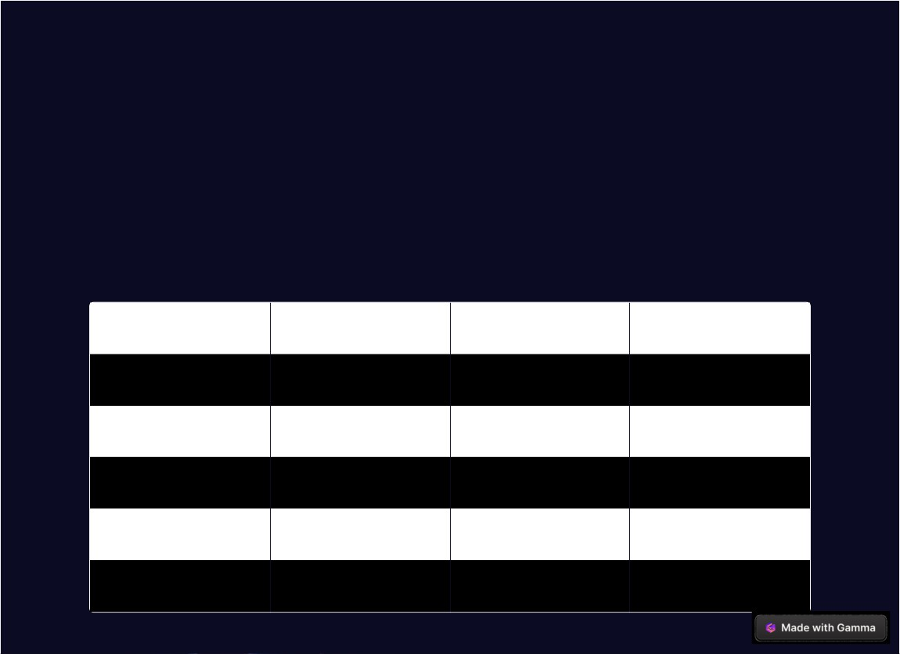
The Dataset: Africa, Economic, Banking and Systemic Data
We used a dataset provided by Kaggle under the title "Africa Economic, Banking and Systemic Data (Data on the
Economic and Financial Crises in 13 African countries from 1860 to 2014)." Where we analyzed thirteen African states
and compiled the values assigned to the following variables. These variables helped us to determine the original source of low credit mobility and took precautions to avoid it in our soon-to-be-implemented financial market network.
Year
Banking_Crisis
Inflation
GDP_weighted_default
1860
No
-0.04645
0
1861
No
-0.04645
0
1862
No
-0.04645
0
1863
No
-0.04645
0

Slide 5

Statistical Methods: Analyzing the Data
Our hypothesis is that there is a significant statistical relationship between the number of recorded instances of a
nation going through a currency crisis and inflation, which influences the flow of capital invested in a nation. We
imported libraries, read the dataset, and conducted exploratory data analysis and features engineering where we
converted string values to int values. We also edited the Africa dataframe to only include country, year, and crises type. Furthermore, we organized countries into their own data frames and showed statistical values of the finalized df. We performed an OLS model between inflation and currency crisis for the Results df and understood the relationship between inflation and currency crises.

Slide 6

Dragases Zayed Federation (Zero-Base Currency) Protocol: Digital Fiat Currency
Zero Base Currency
DZF
ZB-Currency (ZBC) Protocol is a digital fiat currency that is 1:1 of any currency in the global economy. It'll be used to facilitate transactions and will grow in value proportional to the economic and investment capital built on the market network.
[%]DZF is another market token that'll survey all market volumes in and out of the market economy. This'll help us understand the flow of our economy better hence aid in our digitization efforts. Driving the DZF to the next frontier of each iteration with each Nation-State in our endeavors.

Slide 7
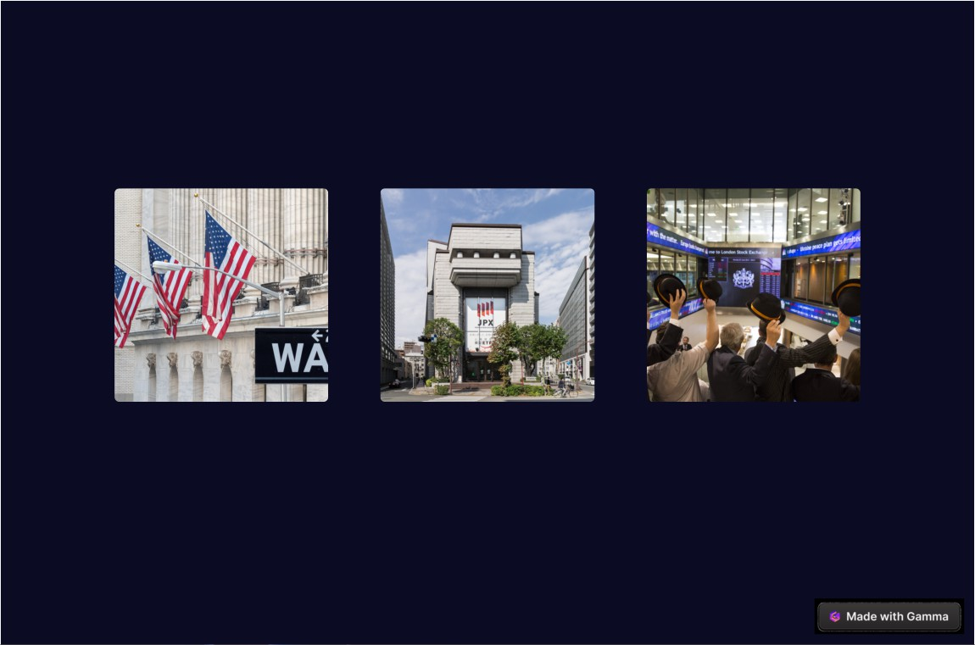
Exchange Locations: Building Our Own Financial Trade Route
United States Wall Street Tokyo Stock Exchange London Stock Exchange
Exchange
Tokyo Stock Exchange in Japan.
London Stock Exchange in England.
Wall Street Exchange in the U.S.
Together with 24 financial exchanges, we'll be building our financial trade route that connects the world to the United States and all Global Partners of the Dragases Zayed Federation (DZF) via our digital financial trade pipeline.

Slide 8
Conclusion: Ozhumanil DTP Benefits
Ozhumanil DTP provides infrastructure that'll facilitate commerce and ensure that all market shareholders who own market share units can benefit from the same economic privileges. We seek to partner with global organizations to make this happen.

