Slide 1


Hawk Eye

Slide 2
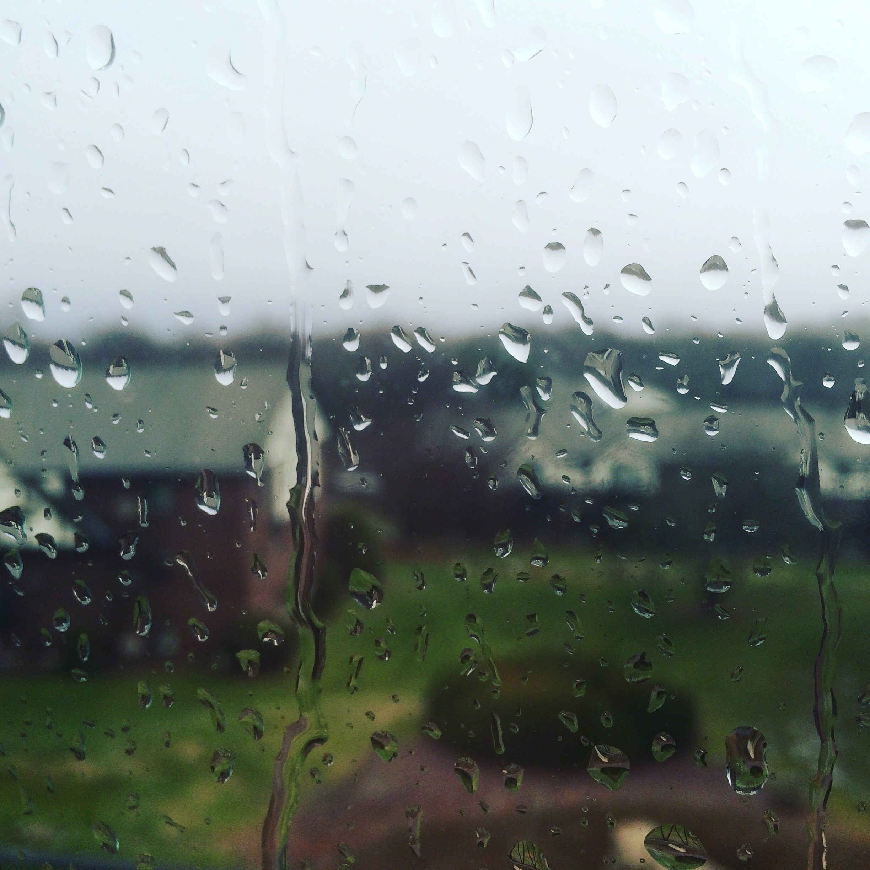

Call for Code 2019 Challenge
PATRO, Ranjan
DIDIER, Yves
GUEMAR, Haifa
SEN, Sujoy
MORENO, ALEXANDRE

Slide 3





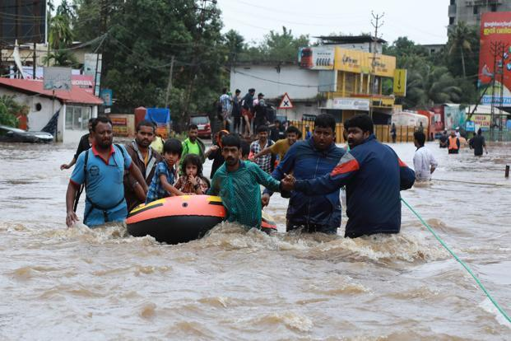
CHALLENGE
    Real Time Flood Level Monitoring and Navigation during floods
    Alerts
    Volunteers Navigation
Notes:
A description of the problem statement you are trying to resolve.

Slide 4
TECHNOLOGY SUGGESTIONS
Watson IoT Platform (to share data between different points)
Watson Visual Recognition (to analyze the flood level)
Python (to calculate and store)
OpenMaps/ViaMichelin (for Flood Level Plotting and Navigation)
Watson Chatbot on Facebook (to get Source and Destination and send the map)
MQTT as IOT protocol. To secure and speed data (pictures, messages) transfer
Database (Optional, to store data)
Notes:
A raw list of technology that can be used to implement the solution, as well as alternatives. Mention any base code pattern, IBM Cloud service offerings, open source technologies, infrastructure etc.

Slide 5
SOLUTION APPROACH
During disasters, we want to
Get images from
  Fixed sources like
    Traffic Cameras
    Security Cameras, e.g. Mall Cameras
    ATM Cameras
  Non Fixed sources like People, drones
  Online sources like Facebook, Twitter, Google, etc.
Analyze the images for flood level
Share the data with Govt Official/Media/Volunteers
Provide navigation advice to Victims/Volunteers
Notes:
Describe the approach of resolving the challenge identified & the outcomes

Slide 6












HIGH LEVEL ARCHITECTURE
IOT
EVENT
HUB
VISUAL
RECOGNITION
EVENT
HUB
NAVIGATION
APP
Social
Networks
CHAT
BOT
MESSENGER
APP
Flood
Capture
Flood
Level
Flood
Alert/Information

Slide 7
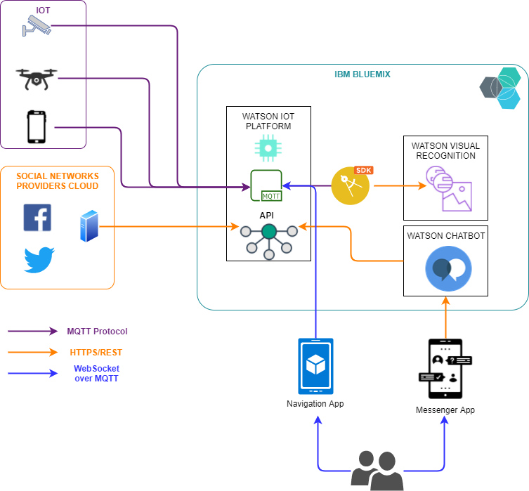
DETAILED ARCHITECTURE

Slide 8
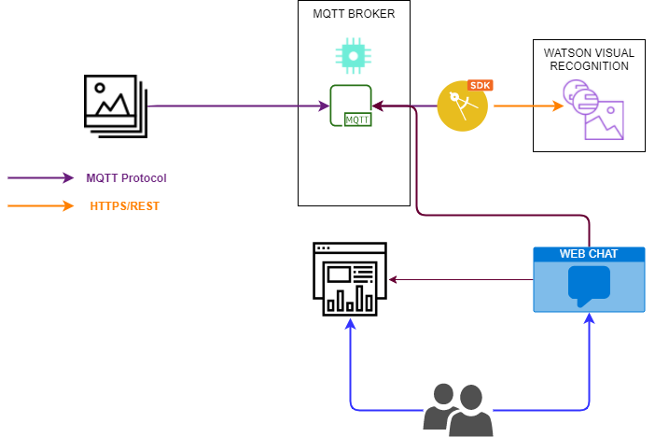
PROTOTYPE ARCHITECTURE
Current features in the prototype
images are sent in the mqtt broker from:
  A directory, with hardcoded geolocation
Python script:
  Get images from mqtt broker
  Send them to Waston Visual Recognition
  Get the analysis of the Flood Level
Share the data with Govt Official/Media/Volunteers via a chat providing a map URL
The corresponding map show the local area with foods
2
1
4
3
MAP

Slide 9
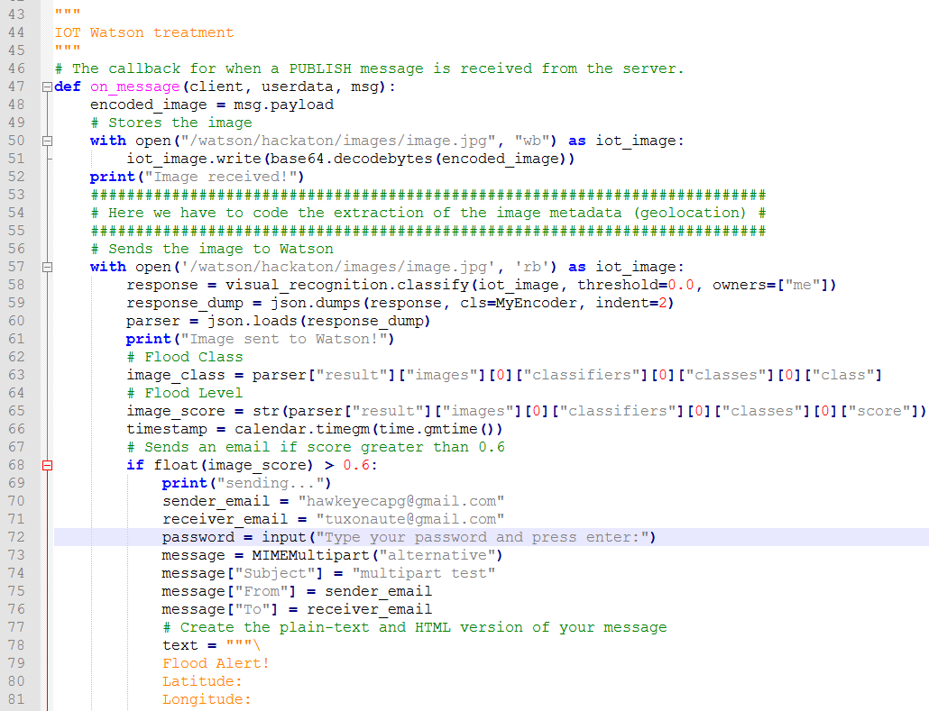
SOURCE CODE
Notes:
Add GIT link

Slide 10
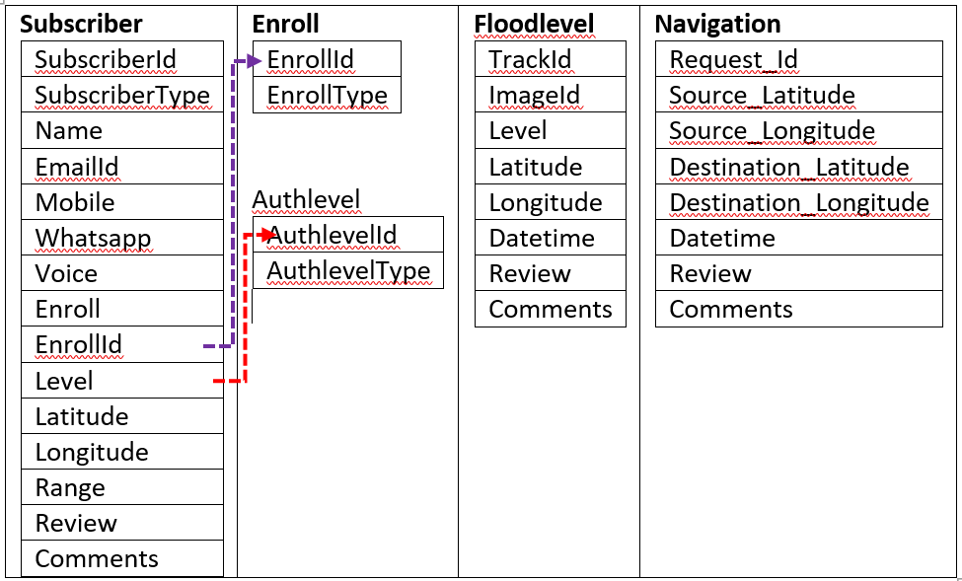
DATA MODEL
Notes:
Describe the approach of resolving the challenge identified & the outcomes

Slide 11
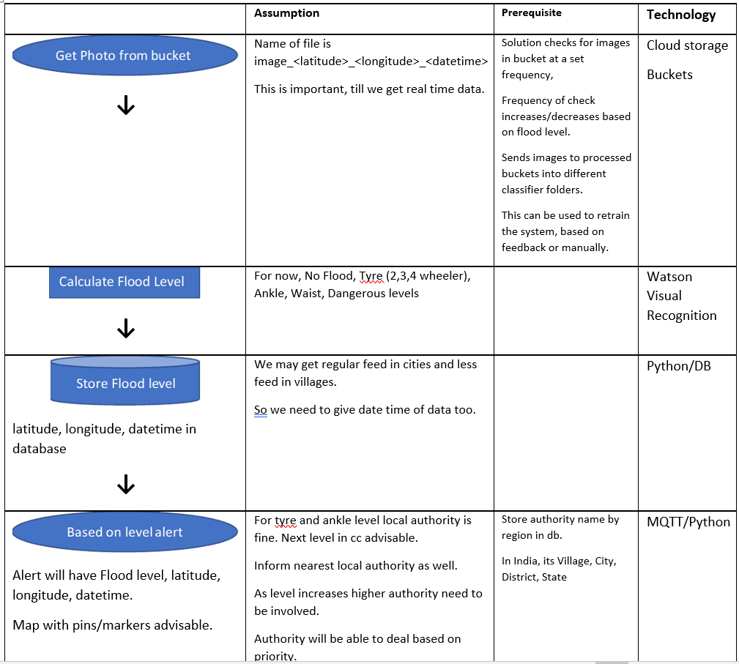
Analysis and Processing Flow
Notes:
Describe the approach of resolving the challenge identified & the outcomes

Slide 12
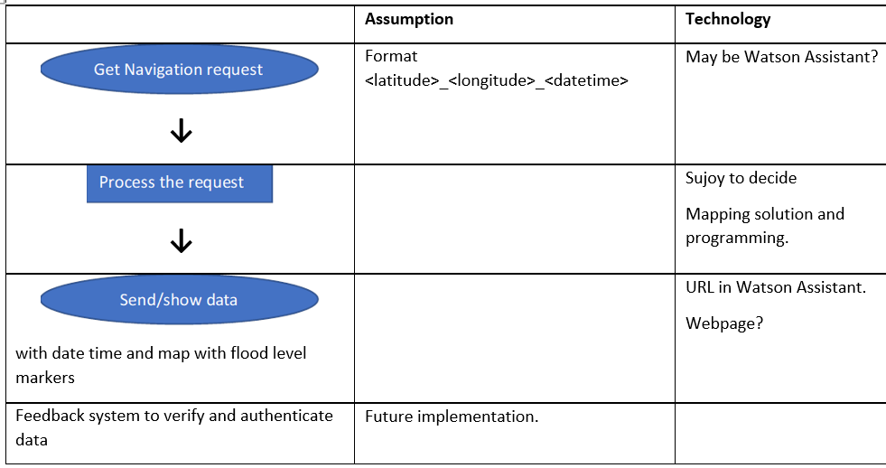
Assistant Flow
Notes:
Describe the approach of resolving the challenge identified & the outcomes

Slide 13
RECOMMENDED RESOURCES
Documents
https://developer.ibm.com/articles/iot-trs-secure-iot-solutions1/
https://dzone.com/articles/build-custom-visual-recognition-model-using-watson
Data sets
Flood and no flood pictures from internet
Opinion pieces
https://iotbyhvm.ooo/coap-vs-mqtt/
Notes:
Add GIT link

Slide 14
Route Map
Phase 1: i. Identify Flood Level ii. Send alerts (/Email/SMS/Whatsapp) iii. Build a mapping solution iv. Provide Navigation Assistance on Facebook Messenger. Next Steps Improving map interactions using websockets over MQTT Improving watson visualisation recognition training using more datas Adding security in exchanges and IOT watson platform Contact authorities to build a POC with them (using cameras) Make test with drones Connect do social networks to gather more pictures
Phase 2: Additional Data Integrations i. Find/Track Rescue centers/temporary rehabilitation camps and provide info on chat. ii. Monitor Social Media and New platforms iii. Identify open ATMs/Commercial Places iv. Integrate Satellite/Radar/Drone info. v. Analyze Image for background objects like famous buildings/structures.
Phase 3: Missing People Tracker

Slide 15
Other Docs/Links
Idea in details
Videos
Please click on the description to launch the videos.
Introduction video of 3 mins
https://youtu.be/FysReNaKB0U
Introduction Video
https://youtu.be/CgMHSGOgnBg
Project & Technical Demo and Short Demo
https://youtu.be/b27EbEaVbZc https://www.youtube.com/watch?v=1JtI4xT7ii8&feature=youtu.be
Image Analysis Demo using Python
https://youtu.be/yD0ZUwU4pRU
Watson Assistant and Facebook in Action part 1 and part 2
https://youtu.be/U40FcEYIrlg https://youtu.be/Vir_ZGqQ_g4

