Slide 1
AZ-104T00A Administer Identity
Notes:
These Learn modules are part of the AZ-104: Manage identities and governance in Azure (https://docs.microsoft.com/learn/paths/az-104-manage-identities-governance/) path.

Slide 2
Learning Objectives
Understand Microsoft Entra ID
Configure User and Group Accounts
Lab 01 - Manage Microsoft Entra ID Identities

Slide 3
Administer Identity whiteboard
Sync
Microsoft Entra ID
B2B
External identity providers
guest users
creates a profile
On-premises identities
users
- licenses
- administrative units
- bulk updates
groups
profiles
Group types
– Security
– Microsoft 365
Assignment types
– Assigned
– Dynamic
Notes:
Optional whiteboard slide to introduce the module or review the content. Use the whiteboard diagram directly or recreate the image during the class.

Slide 4
Understand Microsoft Entra ID

Slide 5
Learning Objectives – Understand Microsoft Entra ID
Examine Microsoft Entra ID
Describe Microsoft Entra ID Concepts
Compare Microsoft Entra ID to Active Directory Domain Services
Compare Microsoft Entra ID P1 and P2 plans
Implement Self-Service Password Reset
Learning Recap
Manage Azure identities and governance (20–25%): Manage Microsoft Entra ID users and groups
Manage licenses
Configure self-service password reset (SSPR)

Slide 6
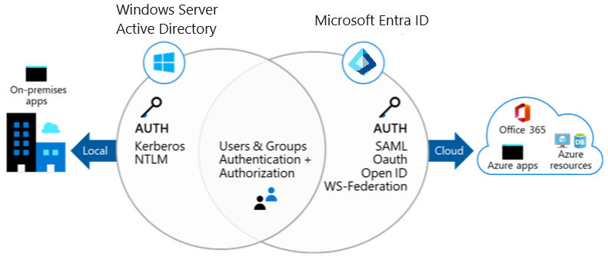
Examine Microsoft Entra ID
Configure access to applications, including single sign-on
Manage and provision users and groups
Providing an identity management solution, including federation
Implement security features like multi-factor authentication and conditional access
Notes:
What is Microsoft Entra ID? - https://docs.microsoft.com/azure/active-directory/fundamentals/active-directory-whatis

Slide 7
Describe Microsoft Entra ID Concepts
Concept | Description
Identity | An object that can be authenticated
Account | An identity that has data associated with it
Microsoft Entra ID account | An identity created through Microsoft Entra ID or another Microsoft cloud service
Tenant/directory | A dedicated and trusted instance. A tenant is automatically created when your organization signs up for a Microsoft cloud service subscription​. ​ Additional instances can be created​ Microsoft Entra ID is the underlying product providing the identity service​ The term Tenant means a single instance representing a single organization​ The terms Tenant and Directory are often used interchangeably​
Azure subscription | Used to pay for Azure cloud services
Notes:
There is not a specific unit in Learn for this, but follow-on from the previous slide to introduce concepts.
Terminology - https://docs.microsoft.com/azure/active-directory/fundamentals/active-directory-whatis#terminology

Slide 8
Compare Microsoft Entra ID to Active Directory Domain Services
Microsoft Entra ID is primarily an identity solution
Queried using the REST API over HTTP and HTTPS
Uses HTTP and HTTPS protocols such as SAML, WS-Federation, and OpenID Connect for authentication (and OAuth for authorization)
Includes federation services, and many third-party services (such as Facebook)
Microsoft Entra ID users and groups are created in a flat structure, and there are no Organizational Units (OUs) or Group Policy Objects (GPOs)
Notes:
Compare Active Directory to Microsoft Entra ID- https://docs.microsoft.com/azure/active-directory/fundamentals/active-directory-compare-azure-ad-to-ad
✔️ Microsoft Entra ID is a managed service. You only manage the users, groups, and policies. Deploying AD DS with virtual machines using Azure means that you manage the deployment, configuration, virtual machines, patching, and other backend tasks. Do you see the difference? How are they similar?

Slide 9
Compare Microsoft Entra ID P1 and P2 plans
Feature | Free | P1 | P2 | Governance
Single Sign-On (unlimited) | Π | Π | Π
Cloud and Federated authentication | Π | Π | Π
Advanced group management |  | Π | Π
Self-service account management portal | Π | Π | Π
Multifactor authentication (MFA) | Π | Π | Π
Conditional access |  | Π | Π
Risk-based Conditional Access (sign-in risk, user risk) |  |  | Π
Automated user and group provisioning to apps |  | Π | Π | Π
Privileged identity management (PIM) |  |  | Π | Π
Notes:
Just picked a few items for this slide. Please use the links for more information.
Microsoft Entra Plans & Pricing - https://azure.microsoft.com/pricing/details/active-directory/
Advanced group management - https://www.microsoft.com/security/business/identity-access/azure-active-directory-pricing
Select the best option - https://www.microsoft.com/en-us/security/business/microsoft-entra-pricing
✔️ Did you look through the pricing list to determine which features your organization needs and to compare edition capabilities?

Slide 10
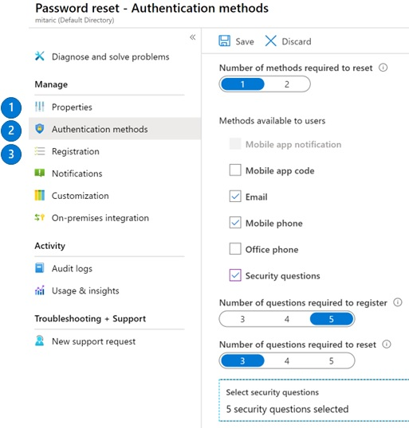
What is self-service password reset in Microsoft Entra ID?
Determine who can use self-service password reset
Choose the number of authentication methods required and the methods available (email, phone, questions)
You can require users to register for SSPR (same process as MFA)
Notes:
Plan an Microsoft Entra ID self-service password reset deployment - https://docs.microsoft.com/azure/active-directory/authentication/howto-sspr-deployment

Slide 11
Configure User and Group Accounts

Slide 12
Learning Objectives - User and Group Accounts
Create User Accounts
Manage User Accounts
Create Bulk Accounts (optional)
Create Group Accounts
Assign Licenses to Users and Groups (extra topic)
Create Administrative Units (optional)
Demonstration – Users and Groups
Summary and Resources
Manage Azure identities and governance (20–25%): Manage Microsoft Entra ID users and groups
Create users and groups
Manage user and group properties
Manage external users
Manage licenses

Slide 13
Demonstration – Users and Groups
Review license and domain information
Explore user accounts
Explore group accounts
Notes:
Configure user and group accounts - https://microsoftlearning.github.io/AZ-104-MicrosoftAzureAdministrator/Instructions/Demos/01%20-%20Administer%20Identity.html#configure-user-and-group-accounts

Slide 14
Assign Licenses to Users and Groups
Azure is a cloud service that provides many built-in services for free.
Microsoft Entra ID comes as a free service
Gain additional functionality with a P1 or P2 license
View license plans and plan details
Set the Usage Location parameter
Assign licenses to users and groups
Change license plans for users and groups
Remove a license
Additional Services (like O365 are paid cloud services)
Microsoft paid cloud services require licenses
Licenses are assigned to those who need access to the services
Each user or group requires a separate paid license
Administrators use management portals and PowerShell cmdlets to manage licenses
Notes:
Assign or remove licenses in the Azure portal - https://docs.microsoft.com/azure/active-directory/fundamentals/license-users-groups
Take a minute to show in the Portal the basic licensing tasks. This topic is not in the student content.

Slide 15
Lab – Manage Entra ID Identities

Slide 16
Lab 01 – Manage Microsoft Entra ID Identities
Job Skills
In this lab, you learn about users and groups.
Users and groups are the basic building blocks for an identity solution.
You create a new user and invite a guest user.
You also create a group and add a member and owner.
Task 1: Create and configure user accounts.
Task 2: Create groups and add members.
Next slide for an architecture diagram
Notes:
This is the shortest lab in the course. Take this opportunity to introduce the lab environment, how to access the portal, and where the login information is located. Also review how the labs are organized emphasizing the day-to-day job skills and scenarios that are covered. Review additional labs that may be available in your hosting environment.
If you are using the Skillable environment, instructions have been added to create a new tenant. This is the only lab that requires additional lab setup. Creating a new tenant is necessary to add the new user. If the students cannot create a new tenant (captcha error), just review an existing user account.
Lab 01 - https://microsoftlearning.github.io/AZ-104-MicrosoftAzureAdministrator/Instructions/Labs/LAB_01-Manage_Entra_ID_Identities.html

Slide 17


Lab 01 – Manage Entra ID Identities (architecture diagram)
Task 1
User1
IT Lab Administrator
Invited guest
IT Lab Administrator
Task 2
IT Lab Administrators

Slide 18


Lab 01 – Manage Entra ID Identities (interactive lab simulation)
Adatum Corporation (default)
Adatum Lab
Task 2
IT Lab Administrators
IT Lab Administrators
Task 3
IT Cloud Administrators
IT System Administrators
Task 4
IT System Administrators
Task 1
User1
Cloud Administrator
User2
System Administrator
LabUser1
Notes:
This is the architecture diagram for the interactive lab simulation.

Slide 19
End of presentation

