Slide 1
AZ-104T00A Administer PaaS Compute Options

Slide 2
Administer PaaS Compute Options Introduction
Configure Azure App Service Plans
Configure Azure App Services
Configure Azure Container Instances
Lab 09a - Implement Web Apps
Lab 09b - Implement Azure Container Instances
Lab 09c – Implement Azure Container Apps
Notes:
These Learn modules are part of the AZ-104: Deploy and manage Azure compute resources (https://docs.microsoft.com/learn/paths/az-104-manage-compute-resources/) learning path.

Slide 3
Configure Azure App Service Plans

Slide 4
Learning Objectives - Configure Azure App Service Plans
Implement Azure App Service Plans
Determine App Service Plan Pricing
Scale Up and Scale Out the App Service Plan
Configure App Service Plan Scaling
Demonstration – Configure Azure App Service Plans
Learning Recap
Implement and manage Azure compute resources (20-25%)
Create and configure Azure App Service
Provision an App Service plan
Configure scaling for an App Service plan

Slide 5

Implement Azure App Service Plans
Determines performance, price, and features
Defines a set of compute resources for a web app to run
Region where compute resources will be created
Number of virtual machine instances
Size of virtual machine instances
Pricing tier (next slide)
One or more apps can be configured to run in the same App Service plan
Notes:
Azure App Service plan overview - https://docs.microsoft.com/azure/app-service/overview-hosting-plans

Slide 6
Determine App Service Plan Pricing
Selected Features | Free | Shared (dev/test) | Basic (dedicated dev/test) | Standard (production workloads) | Premium (enhanced scale and performance) | Isolated (high-performance, security and isolation)
Web, mobile, or API apps | 10 | 100 | Unlimited | Unlimited | Unlimited | Unlimited
Disk space | 1 GB | 1 GB | 10 GB | 50 GB | 250 GB | 1 TB
Auto Scale | – | – | – | Supported | Supported | Supported
Deployment Slots | 0 | 0 | 0 | 5 | 20 | 20
Max Instances | – | – | Up to 3 | Up to 10 | Up to 30 | Up to 100
Shared compute (Free and Shared). Run apps on the same Azure VM as other App Service apps, and the resources cannot scale out
Dedicated compute (Basic, Standard, Premium). Run apps in the same plan in dedicated Azure VMs
Isolated. Runs apps on dedicated Azure VMs in dedicated Azure virtual networks
Notes:
App Service pricing - https://azure.microsoft.com/pricing/details/app-service/windows/

Slide 7
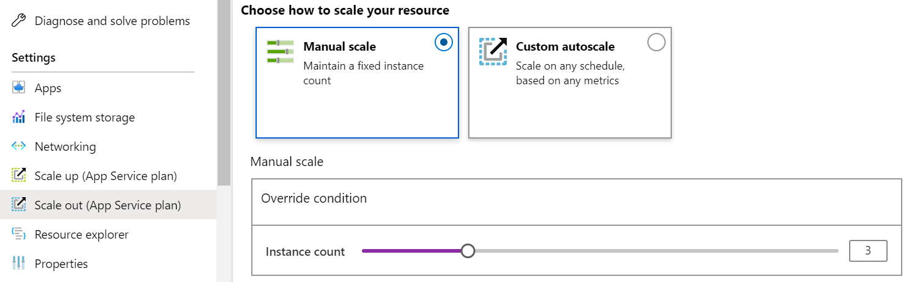
Scale Up and Scale Out the App Service Plan
Scale up (change the App Service plan):
More hardware (CPU, memory, disk)
More features (dedicated virtual machines, staging slots, autoscaling)
Scale out (increase the number of VM instances):
Manual (fixed number of instances)
Auto scale (based on predefined rules and schedules)
Notes:
Scale up an app in Azure App Service - https://docs.microsoft.com/azure/app-service/manage-scale-up

Slide 8
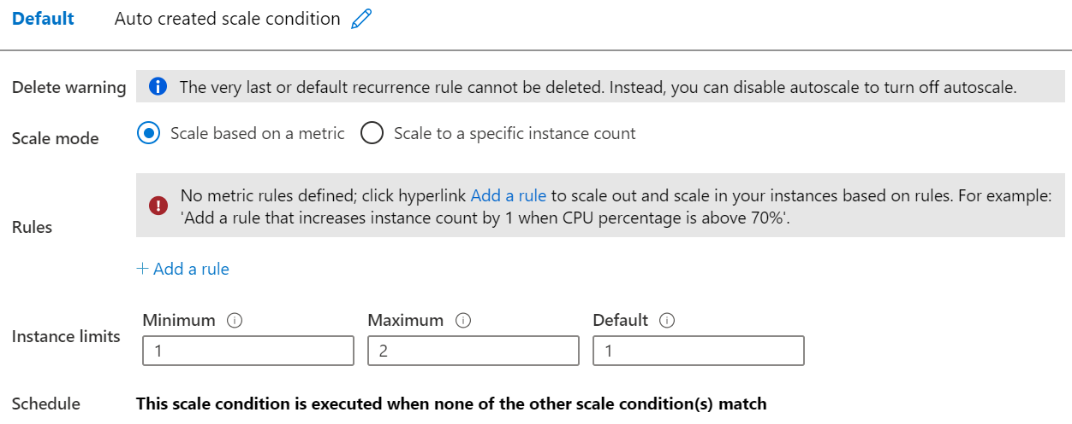
Configure App Service Plan Scaling
Adjust available resources based on the current demand
Improves availability and fault tolerance
Scale based on a metric (CPU percentage, memory percentage, HTTP requests)
Scale according to a schedule (weekdays, weekends, times, holidays)
Can implement multiple rules – combine metrics and schedules
Don’t forget to scale in
Notes:
Get started with Autoscale in Azure - https://docs.microsoft.com/azure/azure-monitor/platform/autoscale-get-started?toc=/azure/app-service/toc.json

Slide 9
Demonstration – Configure App Service plans
Create and deploy a simple App Service Plan
Review scaling options
Notes:
Demonstration App Service Plans - https://microsoftlearning.github.io/AZ-104-MicrosoftAzureAdministrator/Instructions/Demos/09%20-%20Administer%20PaaS%20Compute%20Options.html#configure-azure-app-service-plans

Slide 10
Configure Azure App Services

Slide 11
Learning Objectives - Configure Azure App Services
Implement Azure App Service
Create an App Service
Create Deployment Slots
Add Deployment Slots
Secure an App Service
Create Custom Domain Names
Backup an App Service
Demonstration – Azure App Services
Learning Recap
Implement and manage Azure compute resources (20-25%)
Create and configure Azure App Service
Create an App Service
Configure certificates and TLS
Map an existing custom DNS name
Configure backup
Configure networking settings
Configure deployment slots

Slide 12
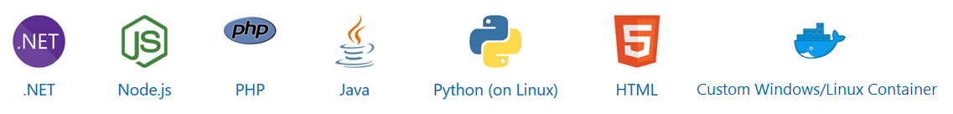
Implement Azure App Service
Includes Web Apps, API Apps, Mobile Apps, and Function Apps
Fully managed environment enabling high productivity development
Platform-as-a-service (PaaS) offering for building and deploying highly available cloud apps for web and mobile
Platform handles infrastructure so developers focus on core web apps and services
Developer productivity using .NET, .NET Core, Java, Python and a host of others
Provides enterprise-grade security and compliance
Notes:
App Service - https://azure.microsoft.com/services/app-service/

Slide 13
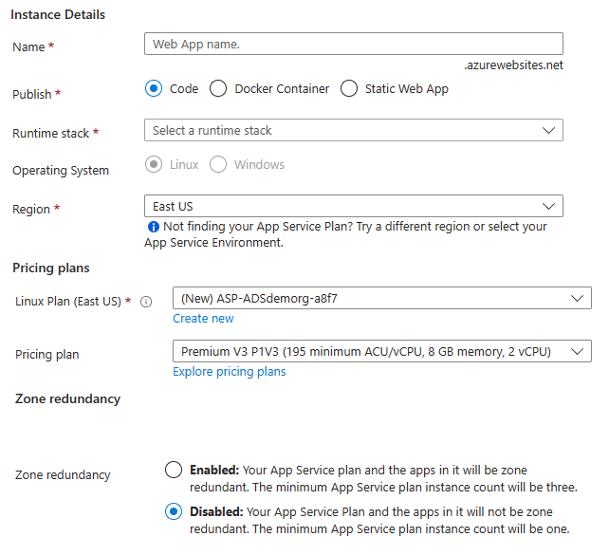
Create an App Service
Name must be unique
Access using azurewebsites.net – can map to a custom domain
Publish Code (Runtime Stack)
Publish Docker Container
Linux or Windows
Region closest to your users
App Service Plan
Notes:
Manage an App Service plan in Azure - https://docs.microsoft.com/azure/app-service/app-service-plan-manage

Slide 14



Create Deployment Slots
Continuous Deployment with Stage Slot
Service Plan | Slots
Free, Shared, Basic | 0
Standard | Up to 5
Premium | Up to 20
Isolated | Up to 20
Developer 1
GitHub
Swap
Staging
Production
Developer 2
Deploy to a different deployment slots (depends on service plan)
Validate changes before sending to production
Deployment slots are live apps with their own hostnames
Avoids a cold start – eliminates downtime
Fallback to a last known good site
Auto Swap when pre-swap validation is not needed
Notes:
Five deployment slots could be: Test, Dev, Q&A, Staging, and Production
Set up staging environments - https://docs.microsoft.com/azure/app-service/web-sites-staged-publishing?toc=%2Fazure%2Fapp-service%2Ftoc.json#add-a-deployment-slot
App Service Web App – block web access to non-production deployment slots - http://ruslany.net/2014/04/azure-web-sites-block-web-access-to-non-production-deployment-slots/
✔ Each App Service plan mode supports a different number of deployment slots. To find out the number of slots your app’s mode supports, see App Service Limits.

Slide 15
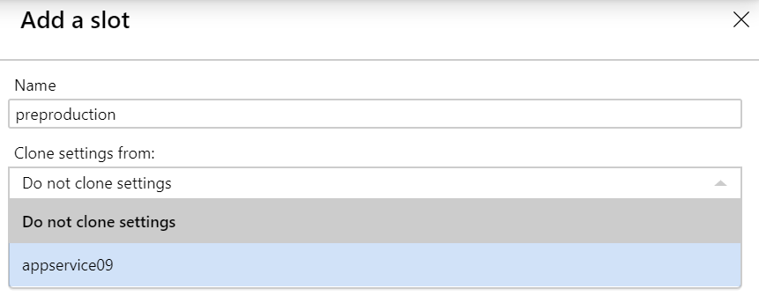
Add Deployment Slots
Select whether to clone an app configuration from another deployment slot
When you clone, pay attention to the settings:
Slot-specific app settings and connection strings
Continuous deployment settings
App Service authentication settings
Not all settings are sticky (endpoints, custom domain names, SSL certificates, scaling)
Review and edit your settings before swapping
Notes:
✔ You can configure app settings and connections to stick to a slot and not be swapped. This done in the App Settings blade. A developer can create new settings for the web app.

Slide 16
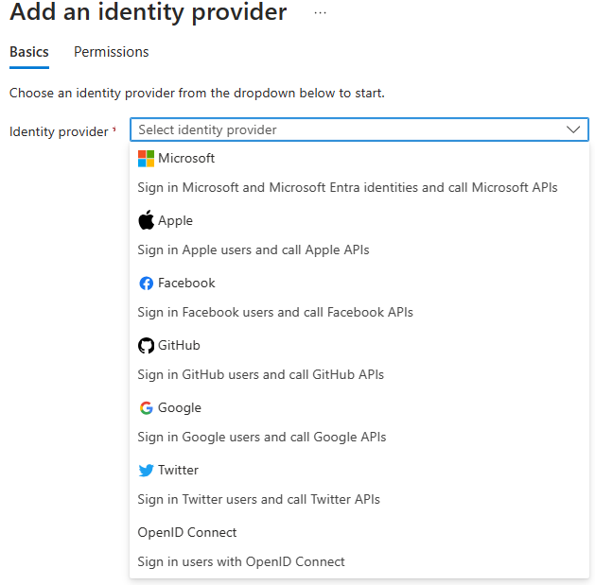
Secure an App Service
Authentication:
Enable authentication – default anonymous
Log in with a third-party identity provider
Security:
Troubleshoot with Diagnostic Logs – failed requests, app logging
Add an SSL certificate – HTTPS
Define a priority ordered allow/deny list to control network access to the app
Store secrets in the Azure Key Vault
Notes:
Security recommendations for App Service - https://docs.microsoft.com/azure/app-service/security-recommendations

Slide 17
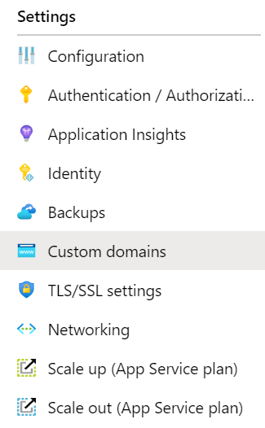
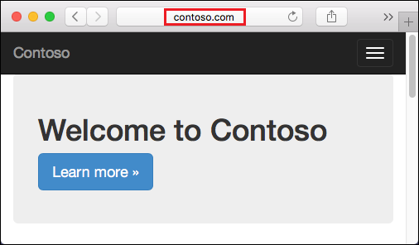
Create Custom Domain Names
Redirect the default web app URL
Validate the custom domain in Azure
Use the DNS registry for your domain provider – create a CNAME or A record with the mapping
Ensure App Service plan supports custom domains

Slide 18
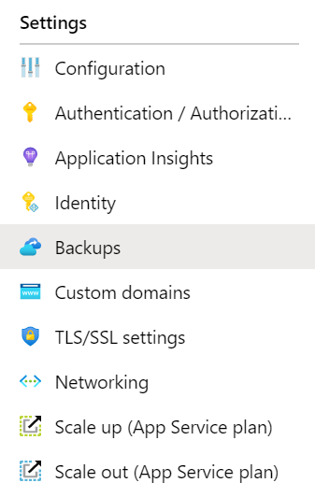
Backup an App Service
Create app backups manually or on a schedule
Backup the configuration, file content, and database connected to the app
Requires Standard or Premium plan
Backups can be up to 10 GB of app and database content
Configure partial backups and exclude items from the backup
Restore your app on-demand to a previous state, or create a new app
Notes:
Back up your App in Azure - https://docs.microsoft.com/azure/app-service/web-sites-backup
Configure partial backups - https://docs.microsoft.com/azure/app-service/web-sites-backup

Slide 19
Demonstration – Configure Azure App Services
Create a Web App in the Azure Portal
Verify the web app is running
Explore deployment slots
Notes:
Demonstration Create a Web App - https://learn.microsoft.com/training/modules/host-a-web-app-with-azure-app-service/3-exercise-create-a-web-app-in-the-azure-portal?pivots=csharp

Slide 20
Configure Azure Container Instances

Slide 21
Learning Objectives - Configure Azure Container Instances
Compare Containers to Virtual Machines
Understand Container Images
Review Azure Container Instances
Implement Container Groups
Demonstration – Configure Azure Container Instances
Manage Containers with Azure Container Apps
Compare container management solutions
Demonstration – Configure Azure Container Apps
Learning Recap
Implement and manage Azure compute resources (20-25%): Create and configure containers in Azure portal
Create and manage an Azure container registry
Provision a container by using Azure Container Instances (ACI)
Provision a container by using Azure Container Apps (ACA)
Manage sizing and scaling for containers, including ACI and ACA
Notes:
Note this section of slides covers ACA as well as ACI. There isn't a separate ACA Learn module, rather it is within the ACI Learn module.

Slide 22
Compare Containers to Virtual Machines
Container
Container
VM
VM
Isolation
Operating System
Deployment
Persistent storage
Fault tolerance
App A
App B
App A
App A
App B
App B
Bins/Libs
Bins/Libs
Bins/Libs
Bins/Libs
Guest OS
Guest OS
Docker Engine
Hypervisor
Host OS
Server
Notes:
Containers vs. virtual machines - https://learn.microsoft.com/virtualization/windowscontainers/about/containers-vs-vm

Slide 23
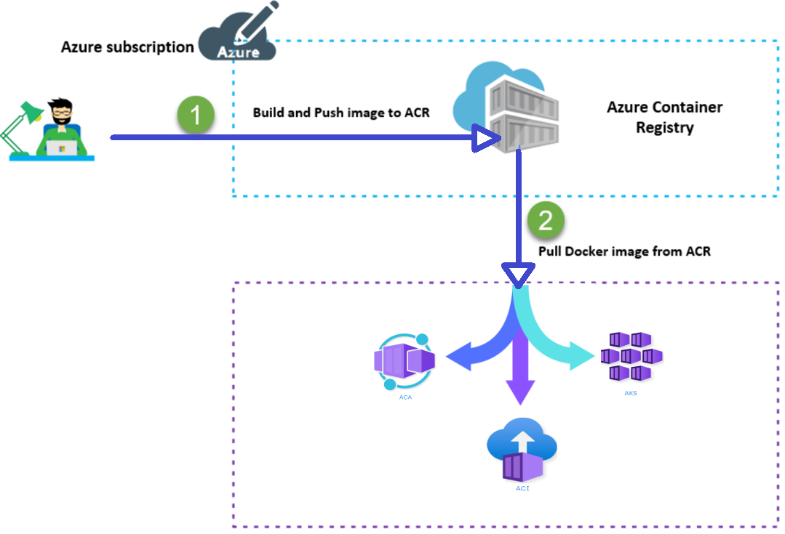
Understand Container Images
A container image is a lightweight, standalone, executable package of software that encapsulates everything needed to run an application.
Notes:
Introduction to Container Registries in Azure - https://learn.microsoft.com/azure/container-registry/container-registry-intro

Slide 24
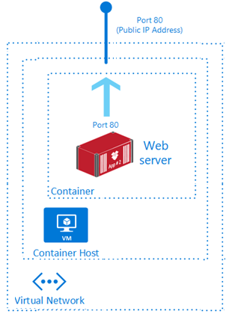
Review Azure Container Instances
PaaS Service
Fast startup times
Public IP connectivity and DNS name
Isolation features
Custom sizes
Persistent storage
Linux and Windows Containers
Co-scheduled Groups
Virtual network Deployment
Fastest way to run a container in Azure without provisioning a VM
Notes:
What is Azure Container Instances? - https://docs.microsoft.com/azure/container-instances/container-instances-overview

Slide 25
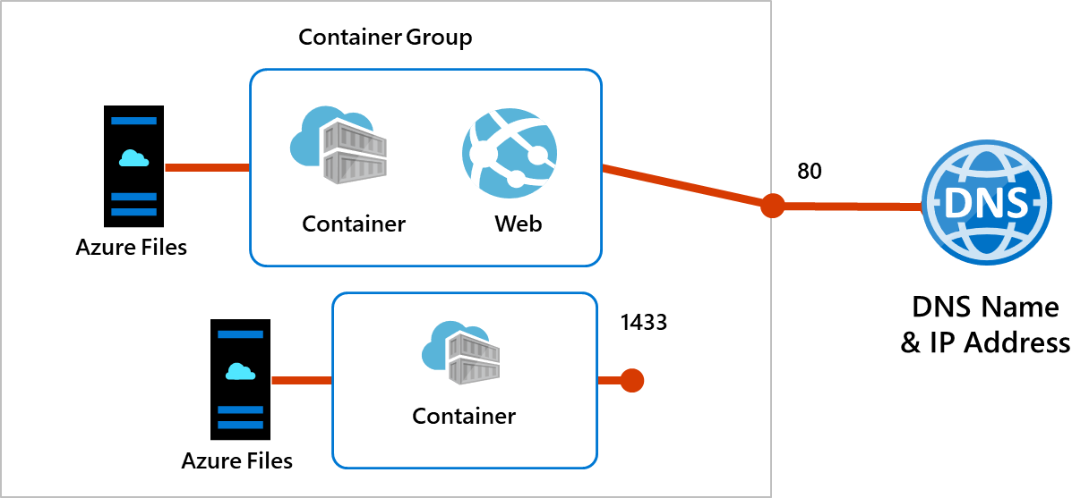
Implement Container Groups
Top-level resource in Azure Container Instances
A collection of containers that get scheduled on the same host
The containers in the group share a lifecycle, resources, local network, and storage volumes
Notes:
Quickstart: Deploy a container instance in Azure using the Azure portal - https://docs.microsoft.com/azure/container-instances/container-instances-quickstart-portal

Slide 26
Demonstration - Configure Azure Container Instances
Create and configure a container instance
Verify deployment of the container instance
Notes:
Demonstration ACI - https://microsoftlearning.github.io/AZ-104-MicrosoftAzureAdministrator/Instructions/Demos/09%20-%20Administer%20PaaS%20Compute%20Options.html#configure-azure-container-instances

Slide 27
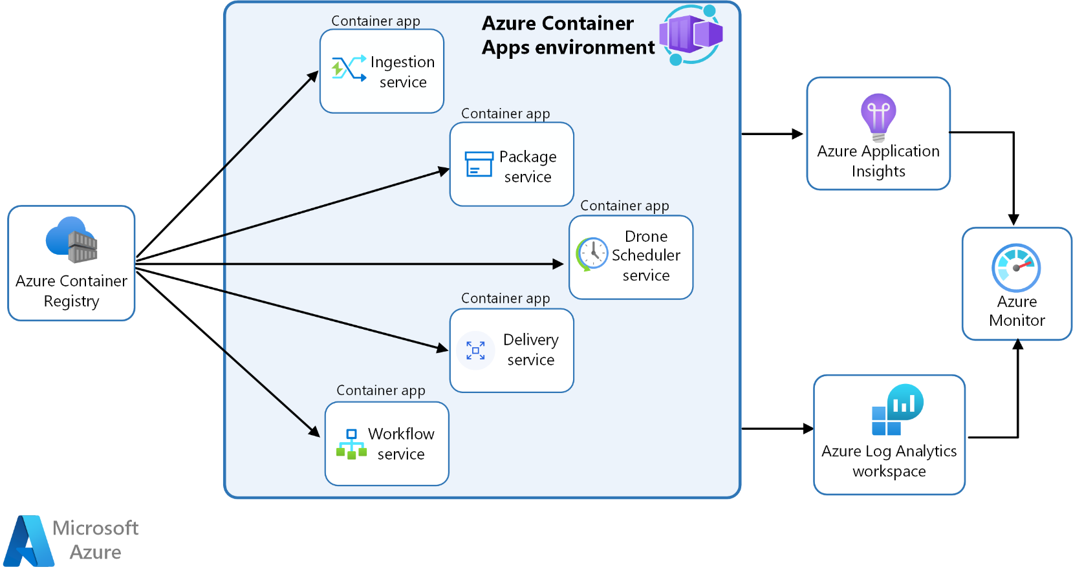
Manage Containers with Azure Container Apps
Alternative to Azure Kubernetes Service – manages container orchestration
The Container App environment creates a secure boundary around the apps and jobs
The Container App runtime manages the environment (OS upgrades, scaling, versioning, and failover)
Notes:
Deploy microservices with Azure Container Apps - https://learn.microsoft.com/azure/architecture/example-scenario/serverless/microservices-with-container-apps
Azure Container Apps documentation - https://learn.microsoft.com/azure/container-apps/
Learn module: Implement Azure Container Apps - https://learn.microsoft.com/training/modules/implement-azure-container-apps/

Slide 28
Compare container management solutions
 | Azure Container Apps | Azure Kubernetes Service
Overview | Simplifies the deployment and management of microservices-based applications by abstracting away the underlying infrastructure. | Simplifies deploying a managed Kubernetes cluster in Azure by offloading the operational overhead to Azure.
Deployment | PaaS experience. | Offers more control and customization.
Management | Fully managed by Azure. | Partially managed by Azure (control plane).
Scalability | HTTP-based autoscaling and event-driven scaling. | Horizontal pod autoscaling and cluster autoscaling.
Use Cases | Rapid scaling and simplified management. | Complex, long-running applications that require full Kubernetes features.
Integration | Azure Logic Apps, Functions, and Event Grid for event-driven architecture. | Azure Policy for Kubernetes, Azure Monitor for containers, and Azure Defender for Kubernetes for comprehensive security and governance.
Notes:
Comparing Container Apps with other Azure container options - https://learn.microsoft.com/azure/container-apps/compare-options

Slide 29
Demonstration - Configure Azure Container Apps
Create and deploy a container app
Verify the application URL displays the welcome message
Notes:
Demonstration Container Apps - https://microsoftlearning.github.io/AZ-104-MicrosoftAzureAdministrator/Instructions/Demos/09%20-%20Administer%20PaaS%20Compute%20Options.html#configure-azure-container-apps

Slide 30
Lab 09a – Implement Web Apps Lab 09b – Implement Azure Container Instances Lab 09c – Implement Azure Container Apps

Slide 31
Lab 09a – Implement web apps
Job Skills
Task 1: Create and configure an Azure web app.
Task 2: Create and configure a deployment slot.
Task 3: Configure web app deployment settings.
Task 4: Swap deployment slots.
Task 5: Configure and test autoscaling of a web app.
In this lab, you learn about Azure web apps.
You learn to configure a web app to display a Hello World application in an external GitHub repository.
You learn to create a staging slot and swap with the production slot.
You also learn about autoscaling to accommodate demand surges.
Next slide for an architecture diagram
Notes:
There are 3 labs in Module 09. 09a is Web Apps. 09b is ACI. 09c is ACA.
Lab 09a - https://microsoftlearning.github.io/AZ-104-MicrosoftAzureAdministrator/Instructions/Labs/LAB_09a-Implement_Web_Apps.html

Slide 32






Lab 09a – Web App Architecture Diagram
az104-09a-rg9a
Production slot
Task 4
Task 1
Task 2
Swap
Staging slot
Task 5
App Service
App Service Plan
Task 3
Autoscale rule
Web App
External git
Hello world!

Slide 33
Lab 09b – Implement Azure Container Instances
Job Skills
Task 1: Deploy an Azure Container Instance using a Docker image.
Task 2: Test and verify deployment of an Azure Container Instance.
In this lab, you learn how to implement Azure Container Instances.
You learn to deploy an Azure Container Instance to display a Hello World app.
Next slide for an architecture diagram
Notes:
Lab 09b - https://microsoftlearning.github.io/AZ-104-MicrosoftAzureAdministrator/Instructions/Labs/LAB_09b-Implement_Azure_Container_Instances.html

Slide 34


Lab 09b – Azure Container Instances Diagram
Azure Container Instances
Task 1
Task 2
Container Instance
Test and verify

Slide 35
Lab 09c – Implement Azure Container Apps
Job Skills
Task 1: Create and configure an Azure Container App and environment.
Task 2: Test and verify deployment of the Azure Container App.
In this lab, you learn how to implement Azure Container Apps.
You learn to deploy the default Azure Container App.
Next slide for an architecture diagram
Notes:
Lab 09c - https://microsoftlearning.github.io/AZ-104-MicrosoftAzureAdministrator/Instructions/Labs/LAB_09c-Implement-Azure-Container-Apps.html

Slide 36


Lab 09c – Azure Container Architecture Diagram
Azure Container Apps
Task 1
Task 2
Container Apps Environment
Test and verify
Container App

Slide 37
End of presentation

Slide 38
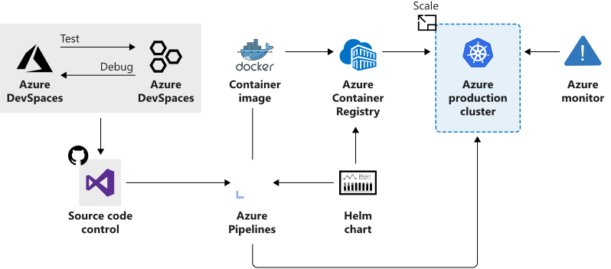
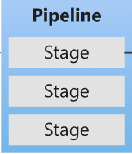
Azure Kubernetes Service
Manages health monitoring and maintenance
Performs simple cluster scaling
Enables nodes to be fully managed by Microsoft
You’re responsible only for managing the agent nodes
You pay only for the agent nodes
Notes:
What is Kubernetes - https://azure.microsoft.com/topic/what-is-kubernetes/

Slide 39
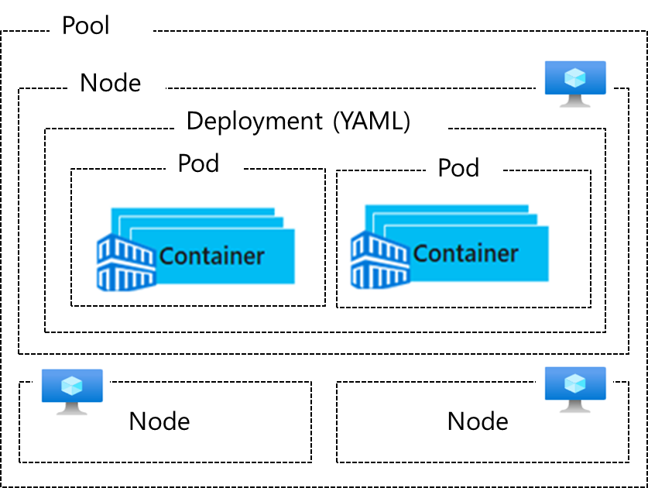
Understand AKS Terminology
Term | Description
Pools | Groups of nodes with identical configurations
Nodes | Individual VMs running containerized applications
Pods | Single instance of an application. A pod can contain multiple containers
Deployment | One or more identical pods managed by Kubernetes​
Manifest | YAML file describing a deployment
Notes:
Kubernetes core concepts for Azure Kubernetes Service (AKS) - https://docs.microsoft.com/azure/aks/concepts-clusters-workloads

Slide 40
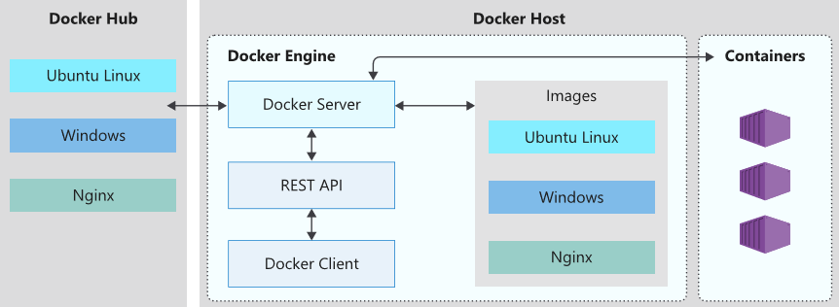
Understand the Docker Platform (optional)
Enables developers to host applications within a container
A container is a standardized “unit of software“ that contains everything required for an application to run
Available on both Linux and Windows and can be hosted on Azure
Notes:
Docker on Azure - https://azure.microsoft.com/services/kubernetes-service/docker/

Slide 41
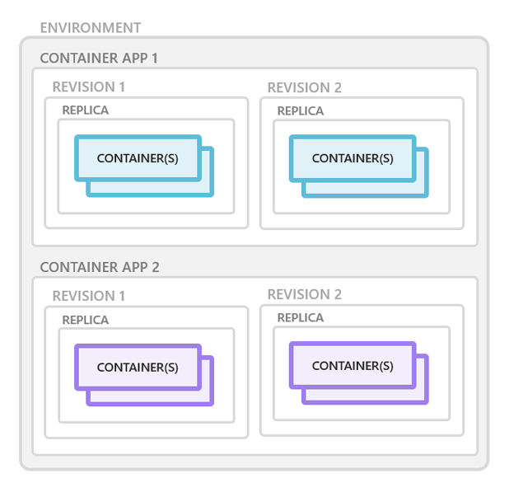
Explore containers in Azure Container Apps
Containers for an Azure Container App are grouped together in pods inside revision snapshots.
Can define multiple containers in a single container app to implement the sidecar pattern.
Deploy images hosted on private registries by providing credentials in the Container Apps configuration.
Notes:
Azure Container Apps manages the details of Kubernetes and container orchestration for you. Containers in Azure Container Apps can use any runtime, programming language, or development stack of your choice.

