Slide 1
AZ-104T00A Administer Data Protection

Slide 2
Learning Objectives - Administer Network Protection
Introduction to Azure Backup
Configure Virtual Machine Backups
Lab 10 – Implement Data Protection
Notes:
This content is part of the AZ-104: Monitor and back up Azure resources (https://docs.microsoft.com/learn/paths/az-104-monitor-backup-resources/) learning path.

Slide 3
Introduction to Azure Backup

Slide 4
Learning Objectives – Introduction to Azure Backup
What is Azure Backup?
How Azure Backup works
Implement Azure Backup Center
Demonstration – Backup Azure File Shares
Learning Recap
Monitor and maintain Azure resources (10–15%): Implement backup and recovery
Create a Recovery Services vault
Create an Azure Backup vault
Create and configure a backup policy
Perform backup and restore operations by using Azure Backup
Configure and interpret reports and alerts for backups

Slide 5


What is Azure Backup?
Backup agents
Azure Backup Service
Built-in backup
Recovery Point Management
Resiliency and Availability
Azure Virtual Machines
Azure Managed Disks
Azure Files Shares
SQL Server in Azure VMs
SAP HANA databases in Azure VMs
Azure Database for PostgreSQL servers
Azure Blobs
On-premises files, folders, and system state
Storage Management
Data Tiering
Multi-user Authorization
Policy Management
Monitoring & Reporting
Multi-factor Authentication
Access Control
Notes:
Why use Azure Backup? - https://docs.microsoft.com/azure/backup/backup-introduction-to-azure-backup#why-use-azure-backup
✔️ What are some of the reasons your organization might choose Azure Backup?

Slide 6
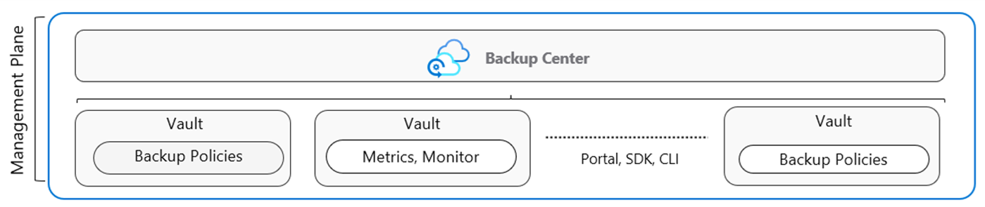
How Azure Backup works (vaults and policies)
Vaults store backup copies, recovery points, and backup policies
Two types of vaults: Backup vault and Recovery Service vault
Backup Policies define the data source, storage vault, and backup schedule
The Backup Center provides a single unified management experience (next slide)
Notes:
Focus this discussion on the administrator tasks like types of vaults and the need to create backup policies. Introduce the Backup Center which is the next slide.
Backup Architecture - https://learn.microsoft.com/azure/backup/guidance-best-practices

Slide 7
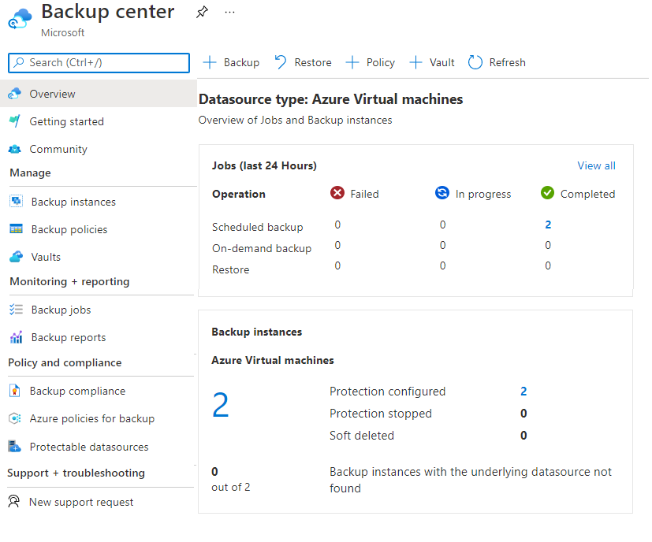
Implement Azure Backup Center
Single pane of glass to manage backups across a large and distributed Azure environment
Datasource-centric management focused on what you are backing up
Connected experiences with native integrations that enables management at scale
Notes:
The next section will go into the details for virtual machine backups.
Overview of Backup Center - https://docs.microsoft.com/azure/backup/backup-center-overview

Slide 8
Demonstration – Backup Azure File Shares
Configure a storage account with file share
Create a Recovery Services vault
Configure file share backup
Verify and restore (optional) the backup
Notes:
Demonstration Backup Azure File Shares - https://microsoftlearning.github.io/AZ-104-MicrosoftAzureAdministrator/Instructions/Demos/10%20-%20Administer%20Data%20Protection.html#backup-azure-file-shares

Slide 9
Configure Virtual Machine Backups

Slide 10
Learning Objectives – Configure Virtual Machine Backups Introduction
Explore options to protect virtual machine data
​Create virtual machine snapshots in Azure Backup
Setup Recovery Services Vault backup options
Backup Virtual Machines
Restore Virtual Machines
Demonstration – Virtual Machine Backups
Manage soft delete (optional)
Implement Azure Site Recovery
Learning Recap
Monitor and maintain Azure resources (10–15%): Implement backup and recovery
Perform backup and restore operations by using Azure Backup
Configure Azure Site Recovery for Azure resources
Perform a failover to a secondary region by using Site Recovery
Configure and interpret reports and alerts for backups

Slide 11
Explore options to protect virtual machine data
Snapshots
Azure Backup
Azure Site Recovery
Managed snapshots provide a quick and simple option for backing up VMs that use Managed Disks
Azure Backup supports application-consistent backups for both Windows and Linux VMs
Azure Site Recovery protects your VMs from a major disaster scenario when a whole region experiences an outage
Notes:
An overview of Azure VM backup - https://docs.microsoft.com/azure/backup/backup-azure-vms-introduction
✔️ Have you tried any of these backup methods? Do you have a backup plan?

Slide 12
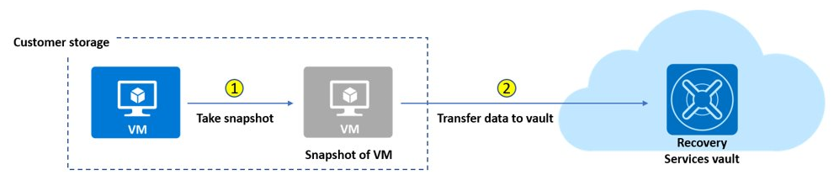
Create virtual machine snapshots in Azure Backup
Use snapshots taken as part of a backup job
Reduces recovery wait times – don’t wait for data transfer to the vault to finish
Configure Instant Restore retention (standard or enhanced)
Notes:
Create a snapshot - https://docs.microsoft.com/azure/virtual-machines/windows/snapshot-copy-managed-disk

Slide 13
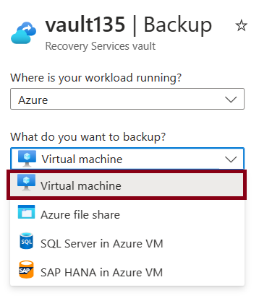
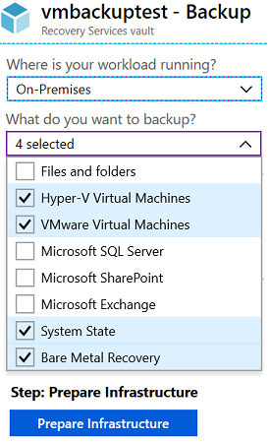
Set up Azure Recovery Services vault backup options
Multiple servers can be protected using the same Recovery Services vault
Azure Workloads
On-Premises Workloads

Slide 14
Backup Virtual Machines
Create a recovery services vault
Use the Portal to define the backup
Backup the virtual machine
1
2
3
Use a Recovery Services Vault in the region where you are performing your Virtual Machine backups and choose a replication strategy for Vault
Take snapshots (recovery points) of your data at defined intervals. These snapshots are stored in recovery services vaults
For the Backup extension to work, the Azure VM Agent must be installed on the Azure virtual machine
Notes:
Plan your VM backup infrastructure in Azure - https://docs.microsoft.com/azure/backup/backup-azure-vms-introduction
Tutorial: Back up and restore files for Windows virtual machines in Azure - https://docs.microsoft.com/azure/virtual-machines/windows/tutorial-backup-vms

Slide 15
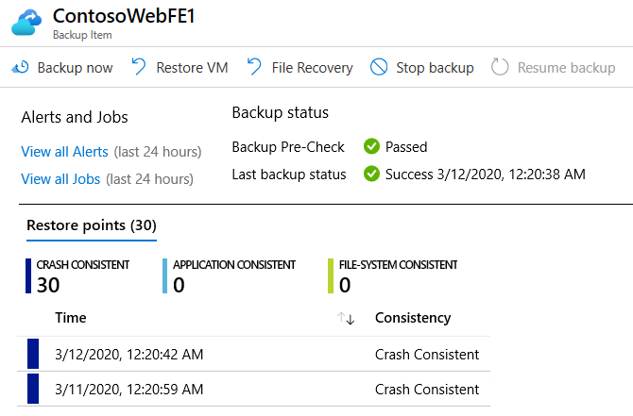
Restore Virtual Machines
Once you trigger the restore operation, the Backup service creates a job for tracking the restore operation
The Backup service also creates and temporarily displays notifications, so you monitor how the backup is proceeding

Slide 16
Demonstration – Virtual Machine Backups
Create a backup for virtual machines
Configure and review the backup policy
Notes:
Demonstration Backup Azure virtual machines - https://microsoftlearning.github.io/AZ-104-MicrosoftAzureAdministrator/Instructions/Demos/10%20-%20Administer%20Data%20Protection.html#backup-azure-virtual-machines

Slide 17
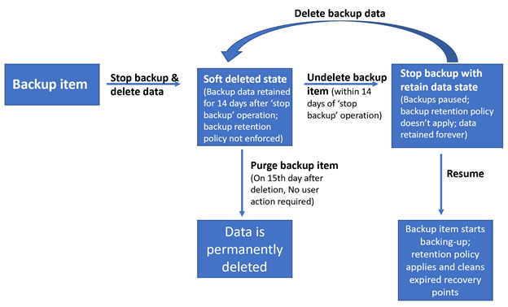
Manage Soft Delete
Backup data is retained for 14 additional days*
Recover soft deleted backup items using an ‘Undelete’ operation
Also available for storage account containers and file shares
Natively built-in for all the recovery services vaults
Notes:
Soft delete for virtual machines in Azure Backup - https://azure.microsoft.com/updates/soft-delete-virtual-machine-backup/
* Now soft delete number of days can be extended beyond 14 days, although it will have a fee associated to it.

Slide 18
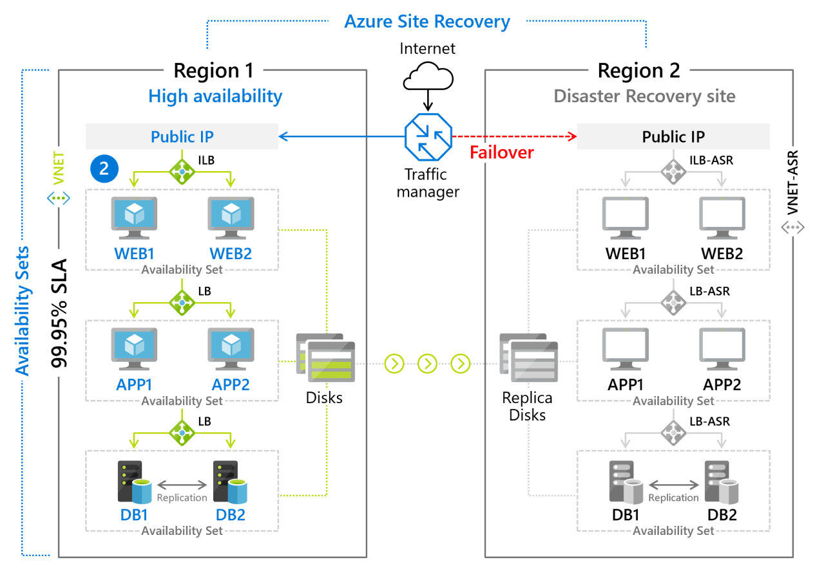
Implement Azure Site Recovery
Manages the orchestration of disaster recovery
Replicates workloads continuously from a primary location or region to a secondary location
Failover to shift to the secondary location; failback to return to the primary location
Notes:
Azure Site Recovery documentation - https://docs.microsoft.com/azure/site-recovery/
Concentrate on replication within Azure and not migration scenarios from on-premises.

Slide 19
Lab – Implement Data Protection

Slide 20
Lab 10 – Implement Data Protection
Job Skills
Task 1: Use a template to provision an infrastructure.
Task 2: Create and configure a Recovery Services vault.
Task 3: Configure Azure virtual machine-level backup.
Task 4: Monitor Azure Backup.
Task 5: Enable virtual machine replication.
In this lab, you learn about backup and recovery of Azure virtual machines.
You learn to create a Recovery Service vault and a backup policy for Azure virtual machines.
You learn about disaster recovery with Azure Site Recovery for virtual machines.
Next slide for an architecture diagram
Notes:
This lab is focused on Azure virtual machines, backup and disaster recovery. It introduces Azure Backup, which can be used for many other resources.
Lab 10 - https://microsoftlearning.github.io/AZ-104-MicrosoftAzureAdministrator/Instructions/Labs/LAB_10-Implement_Data_Protection.html

Slide 21




Lab 10 – Architecture diagram
Region 1
Region 2
az104-rg-region1
az104-rg-region2
Task 1
Task 5
az104-10-vm0
replication
az104-rsv-region2
Task 2
az104-rsv-region1
Task 4
Task 3
Azure Backup
Monitor

Slide 22
End of presentation

Slide 23
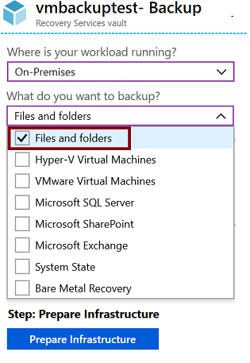
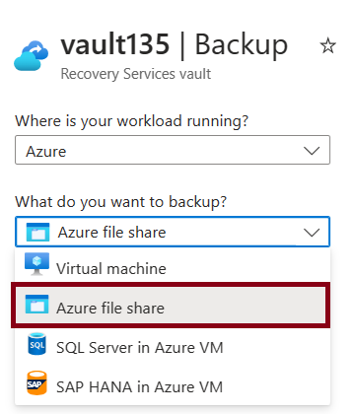
Setup Recovery Services Vault Backup Options - Files
Azure Workloads
On-Premises Workloads
Notes:
Recovery Services vaults overview - https://docs.microsoft.com/azure/backup/backup-azure-recovery-services-vault-overview
Create a Recovery Services vault - https://docs.microsoft.com/azure/backup/backup-create-rs-vault
Soft delete for virtual machines - https://docs.microsoft.com/azure/backup/soft-delete-virtual-machines

Slide 24
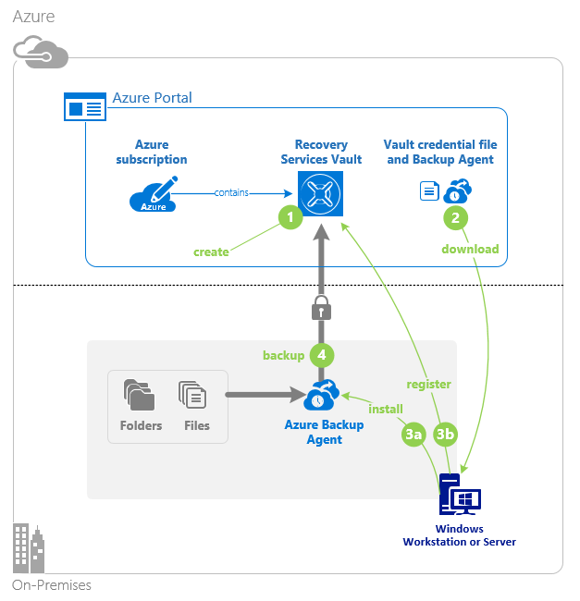
Configure On-Premises File and Folder Backup
Create the recovery services vault
Download the agent and credential file
Install and register agent
Configure the backup
Notes:
About Azure file share backup - https://docs.microsoft.com/azure/backup/azure-file-share-backup-overview
Back up Azure file shares - https://docs.microsoft.com/azure/backup/backup-afs

Slide 25
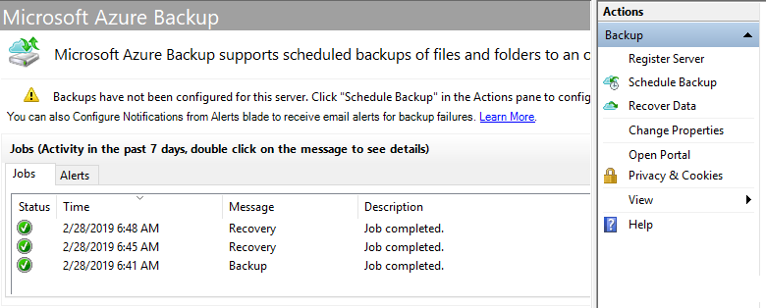
Manage the Microsoft Azure Recovery Services Agent
Backup or recover files and folders on physical or virtual Windows OS (VMs can be on-premises or in Azure)
No separate backup server required
Not application aware; file, folder, and volume-level restore only
No support for Linux
Notes:
Back up Windows Server files and folders to Azure -https://docs.microsoft.com/azure/backup/backup-windows-with-mars-agent

Slide 26

Implement Azure Backup Server
Azure
Specialized Workloads
Virtual Machines
Files/Folders/Volumes
System Center DPM
Or Azure Backup Server
App-aware backups, file/folder/volume backups, and machine state backups (bare-metal, system state)
Each machine runs the DPM/MABS protection agent, and the MARS agent runs on the MABS/DPM
Flexibility and granular scheduling options
Manage backups for multiple machines in a protection group

Slide 27
Compare Backup Options
Component | Benefits | Limits | Protects | Backup Storage
Azure Backup (MARS) agent | Backup files and folders on physical or virtual Windows OS No separate backup server required | Backup 3x per day Not application aware File, folder, and volume-level restore only No support for Linux | Files Folders | Recovery services vault
Azure Backup Server (MABS) | App aware snapshots Full flex for when to backups Recovery granularity Linux support on Hyper-V and VMware VMs Backup and restore VMware VMs Doesn’t require a System Center license | Cannot backup Oracle workloads Always requires live Azure subscription No support for tape backup | Files Folders Volumes VMs Applications Workloads | Recovery services vault Locally attached disk

