Slide 1
Module 02: Implement Azure Functions

Slide 2
Module Agenda
Explore Azure Functions
Develop Azure Functions
Implement Durable Functions

Slide 3












Discover Azure Functions (2 / 4)
Notification Hubs
Event Grid
Event Hubs
Cosmos DB
Twilio
Azure
Functions
Storage
Service Bus
Queue
Blob
Table
Topics
Queues
Notes:
Azure Functions integrates with various Azure and third-party services. These services can trigger your function and start execution, or they can serve as input and output for your code.
The following service integrations are supported by Azure Functions:
Azure Cosmos DB
Azure Event Hubs
Azure Event Grid
Azure Notification Hubs
Azure Service Bus (queues and topics)
Azure Storage (blob, queues, and tables)
On-premises (using Service Bus)
Twilio (SMS messages)

Slide 4
Lesson 3: Implement Durable Functions

Slide 5
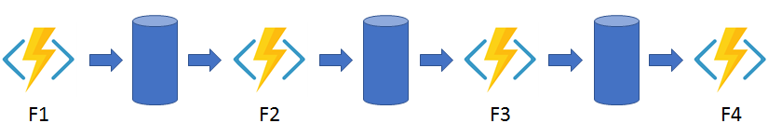
Explore Durable Functions app patterns (3 / 7)
Function chaining
Notes:
In the function chaining pattern, a sequence of functions executes in a specific order. In this pattern, the output of one function is applied to the input of another function.
The values F1, F2, F3, and F4 are the names of other functions in the function app. You can implement control flow by using normal imperative coding constructs.

Slide 6
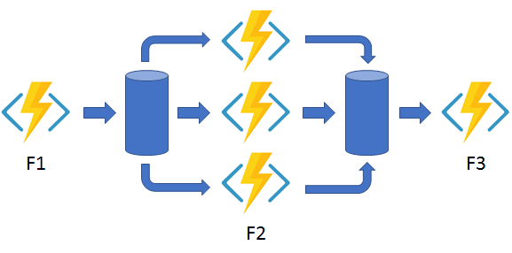
Explore Durable Functions app patterns (4 / 7)
Fan out/fan in
Notes:
In the fan out/fan in pattern, you execute multiple functions in parallel and then wait for all functions to finish. Often, some aggregation work is done on the results that are returned from the functions.
With normal functions, you can fan out by having the function send multiple messages to a queue. To fan in you write code to track when the queue-triggered functions end, and then store function outputs.

Slide 7
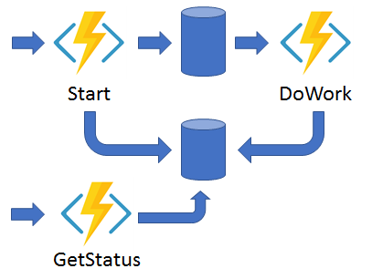
Explore Durable Functions app patterns (5 / 7)
Async HTTP APIs
Notes:
Durable Functions provides built-in support for this pattern, simplifying or even removing the code you need to write to interact with long-running function executions. After an instance starts, the extension exposes webhook HTTP APIs that query the orchestrator function status.
The async HTTP API pattern addresses the problem of coordinating the state of long-running operations with external clients.
A common way to implement this pattern is by having an HTTP endpoint trigger the long-running action.
Then, redirect the client to a status endpoint that the client polls to learn when the operation is finished.

Slide 8
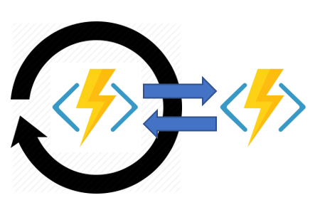
Explore Durable Functions app patterns (6 / 7)
Monitor
Notes:
The monitor pattern refers to a flexible, recurring process in a workflow. An example is polling until specific conditions are met. You can use a regular timer trigger to address a basic scenario, such as a periodic cleanup job, but its interval is static and managing instance lifetimes becomes complex. You can use Durable Functions to create flexible recurrence intervals, manage task lifetimes, and create multiple monitor processes from a single orchestration.
In a few lines of code, you can use Durable Functions to create multiple monitors that observe arbitrary endpoints. The monitors can end execution when a condition is met, or another function can use the durable orchestration client to terminate the monitors. You can change a monitor's wait interval based on a specific condition (for example, exponential backoff).

Slide 9
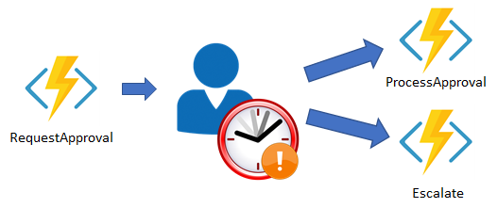
Explore Durable Functions app patterns (7 / 7)
Human interaction
Notes:
Many automated processes involve some kind of human interaction. An automated process might allow for this interaction by using timeouts and compensation logic.
You can implement the pattern in this example by using an orchestrator function. The orchestrator uses a durable timer to request approval. The orchestrator escalates if timeout occurs. The orchestrator waits for an external event, such as a notification that's generated by a human interaction.

Slide 10
Discover the four function types (1 / 3)
Overview
There are currently four durable function types in Azure Functions:
Orchestrator
Activity
Entity
Client
Orchestrator functions
Describe how actions are executed and the order in which actions are executed.
Describe the orchestration in code (C# or JavaScript).
Can have many different types of actions.
Can also interact with entity functions.
Notes:
Orchestrator functions can have many different types of actions, including activity functions, sub-orchestrations, waiting for external events, HTTP, and timers.
Note: The Orchestrator function code constraints article has detailed information on this requirement. https://docs.microsoft.com/azure/azure-functions/durable/durable-functions-code-constraints

Slide 11
Discover the four function types (2 / 3)
Activity functions
Activity functions are the basic unit of work in a durable function orchestration.
For example, you might create an orchestrator function to process an order. The tasks involve checking the inventory, charging the customer, and creating a shipment.
Each task would be a separate activity function.
These activity functions may be executed serially, in parallel, or some combination of both.
Entity functions
Entity functions define operations for reading and updating small pieces of state. We often refer to these stateful entities as durable entities. Some things to note:
Entities are accessed via a unique identifier, the entity ID. An entity ID is simply a pair of strings that uniquely identifies an entity instance.
Operations on entities require that you specify the Entity ID of the target entity, and the Operation name, which is a string that specifies the operation to perform.
Notes:
Activity functions
Unlike orchestrator functions, activity functions aren't restricted in the type of work you can do in them. Activity functions are frequently used to make network calls or run CPU intensive operations. An activity function can also return data back to the orchestrator function.
An activity trigger is used to define an activity function. .NET functions receive a DurableActivityContext as a parameter. You can also bind the trigger to any other JSON-serializeable object to pass in inputs to the function. In JavaScript, you can access an input via the <activity trigger binding name> property on the context.bindings object. Activity functions can only have a single value passed to them. To pass multiple values, you must use tuples, arrays, or complex types.
Entity functions
Like orchestrator functions, entity functions are functions with a special trigger type, entity trigger. They can also be invoked from client functions or from orchestrator functions. Unlike orchestrator functions, entity functions do not have any specific code constraints. Entity functions also manage state explicitly rather than implicitly representing state via control flow.

Slide 12
Discover the four function types (3 / 3)
Client functions
Orchestrator and entity functions are triggered by their bindings and both of these triggers work by reacting to messages that are enqueued in a task hub.
The primary way to deliver these messages is by using an orchestrator client binding, or an entity client binding, from within a client function. Any non-orchestrator function can be a client function.
Unlike other function types, orchestrator and entity functions cannot be triggered directly using the buttons in the Azure portal. If you want to test an orchestrator or entity function in the Azure portal, you must instead run a client function that starts an orchestrator or entity function as part of its implementation.

Slide 13
Closing slide

