Slide 1
Module 04: Develop solutions that use Azure Cosmos DB
Notes:
The number of physical partitions in your container depends on the following:
The amount of throughput provisioned (each individual physical partition can provide a throughput of up to 10,000 request units per second). The 10,000 RU/s limit for physical partitions implies that logical partitions also have a 10,000 RU/s limit, as each logical partition is only mapped to one physical partition.
The total data storage (each individual physical partition can store up to 50GB data).
There is no limit to the total number of physical partitions in your container. As your provisioned throughput or data size grows, Azure Cosmos DB will automatically create new physical partitions by splitting existing ones.

Slide 2
Module Agenda
Explore Azure Cosmos DB
Implement partitioning in Azure Cosmos DB
Work with Azure Cosmos DB

Slide 3
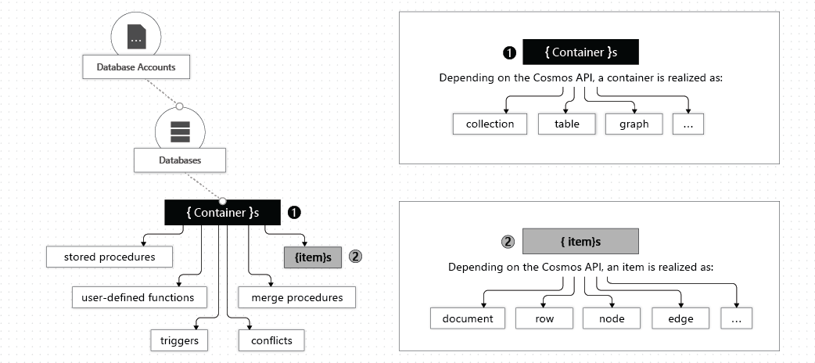
Explore the resource hierarchy (2 / 2)

Slide 4
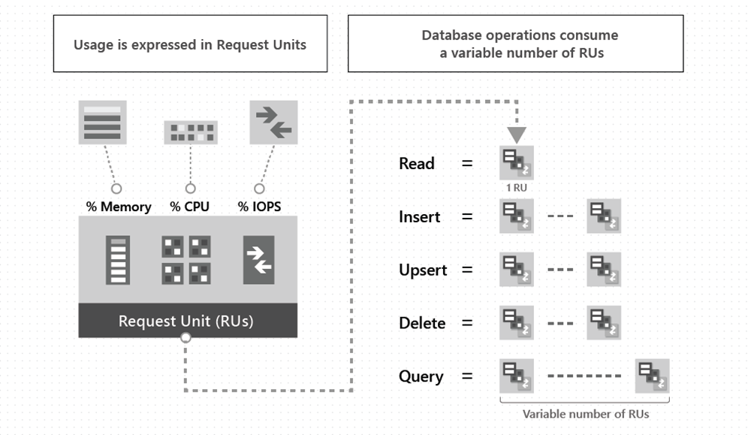
Discover request units
Notes:
Request unit: A request unit represents the system resources such as CPU, IOPS, and memory that are required to perform the database operations supported by Azure Cosmos DB.
1RU komt overeen met 1kb data.
The type of Azure Cosmos account you're using determines the way consumed RUs get charged. There are three modes in which you can create an account:
Provisioned throughput mode: In this mode, you provision the number of RUs for your application on a per-second basis in increments of 100 RUs per second. To scale the provisioned throughput for your application, you can increase or decrease the number of RUs at any time in increments or decrements of 100 RUs. You can make your changes either programmatically or by using the Azure portal. You can provision throughput at container and database granularity level.
Serverless mode: In this mode, you don't have to provision any throughput when creating resources in your Azure Cosmos account. At the end of your billing period, you get billed for the amount of request units that has been consumed by your database operations.
Autoscale mode: In this mode, you can automatically and instantly scale the throughput (RU/s) of your database or container based on its usage. This mode is well suited for mission-critical workloads that have variable or unpredictable traffic patterns, and require SLAs on high performance and scale.

Slide 5
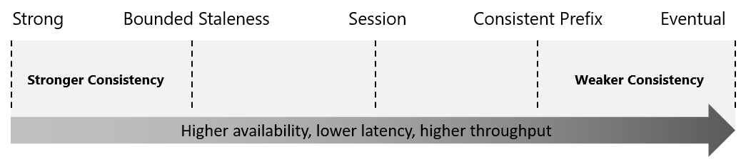
Explore consistency levels (1 / 2)
Azure Cosmos DB approaches data consistency as a spectrum of choices instead of two extremes.
Notes:
Strong consistency and eventual consistency are at the ends of the spectrum, but there are many consistency choices along the spectrum.
The consistency levels are region-agnostic and are guaranteed for all operations regardless of the region from which the reads and writes are served,

Slide 6
Explore consistency levels (2 /2)
Consistency Level | Description
Strong | When a write operation is performed on your primary database, the write operation is replicated to the replica instances. The write operation is committed (and visible) on the primary only after it has been committed and confirmed by all replicas.
Bounded Staleness | This level is similar to the Strong level with the major difference that you can configure how stale documents can be within replicas. Staleness refers to the quantity of time (or the version count) a replica document can be behind the primary document.
Session | This level guarantees that all read and write operations are consistent within a user session. Within the user session, all reads and writes are monotonic and guaranteed to be consistent across primary and replica instances.
Consistent Prefix | This level has loose consistency but guarantees that when updates show up in replicas, they will show up in the correct order (that is, as prefixes of other updates) without any gaps.
Eventual | This level has the loosest consistency and essentially commits any write operation against the primary immediately. Replica transactions are asynchronously handled and will eventually (over time) be consistent with the primary. This tier has the best performance, because the primary database does not need to wait for replicas to commit to finalize its transactions.
Notes:
The consistency levels range from very strong consistency—where reads are guaranteed to be visible across replicas before a write is fully committed across all replicas—to eventual consistency, where writes are readable immediately, and replicas are eventually consistent with the primary.

Slide 7
Closing slide

