Slide 1
Module 05: Implement infrastructure as a service solutions

Slide 2
Module Agenda
Provision virtual machines in Azure
Create and deploy Azure Resource Manager templates
Manage container images in Azure Container Registry
Run container images in Azure Container Instances

Slide 3
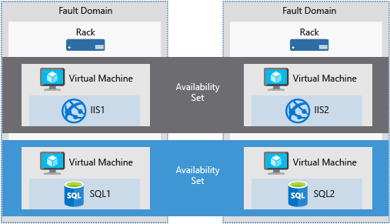
Compare virtual machine availability options (2 / 3)
Availability sets
Fault domains
A fault domain is a logical group of underlying hardware that share a common power source and network switch, similar to a rack within an on-premises datacenter.
Notes:
What is a fault domain?
A fault domain is a logical group of hardware in Azure that shares a common power source and network switch. You can think of it as a rack within an on-premises datacenter. The first two VMs in an availability set will be provisioned into two different racks so that if the network or the power failed in a rack, only one VM would be affected. Fault domains are also defined for managed disks attached to VMs.

Slide 4
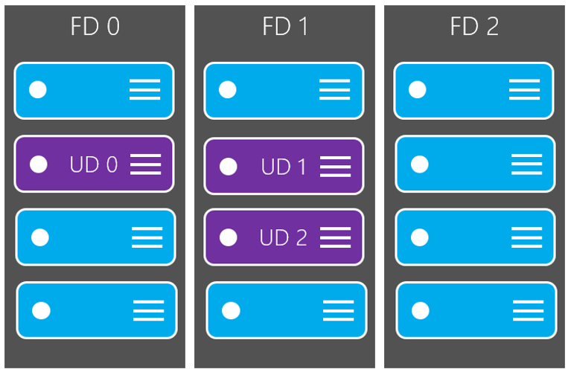
Compare virtual machine availability options (3 / 3)
Availability sets
Update domains
Update domains enable targeting specific sets of hardware for maintenance or rebooting.
Notes:
Each virtual machine in your availability set is assigned an update domain and a fault domain by the underlying Azure platform.
For a given availability set, five non-user-configurable update domains are assigned by to indicate groups of virtual machines and underlying physical hardware that can be rebooted at the same time.

Slide 5
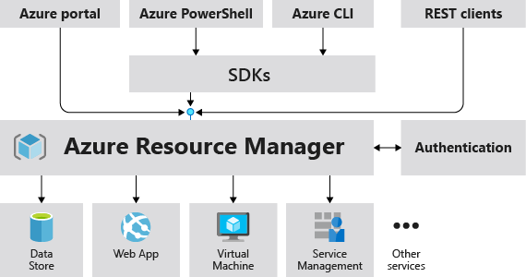
Explore Azure Resource Manager (1 / 2)
Notes:
When a user sends a request from any of the Azure tools, APIs, or SDKs, Resource Manager receives the request.
It authenticates and authorizes the request. Resource Manager sends the request to the Azure service, which takes the requested action.
Because all requests are handled through the same API, you see consistent results and capabilities in all the different tools.

Slide 6
Closing slide

