Slide 1
Module 08: Implement API Management

Slide 2

Module Agenda
Explore API Management

Slide 3
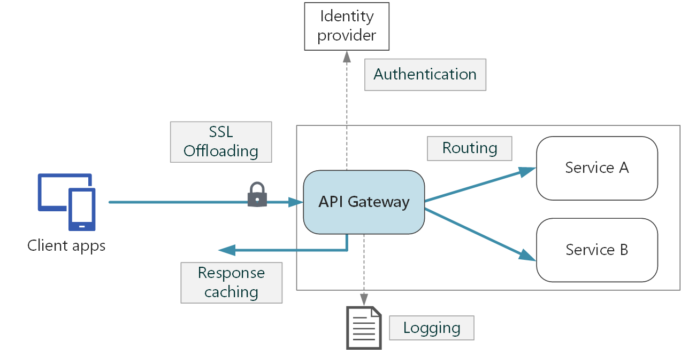
Explore API gateways (1 / 2)
API gateway role
An API gateway sits between clients and services.
It acts as a reverse proxy, routing requests from clients to services.
It may also perform tasks such as authentication, SSL termination, and rate limiting.
Explore API gateways

Slide 4
Closing slide

