Slide 1
Module 11: Instrument solutions to support monitoring and logging

Slide 2
Module Agenda
Monitor app performance

Slide 3
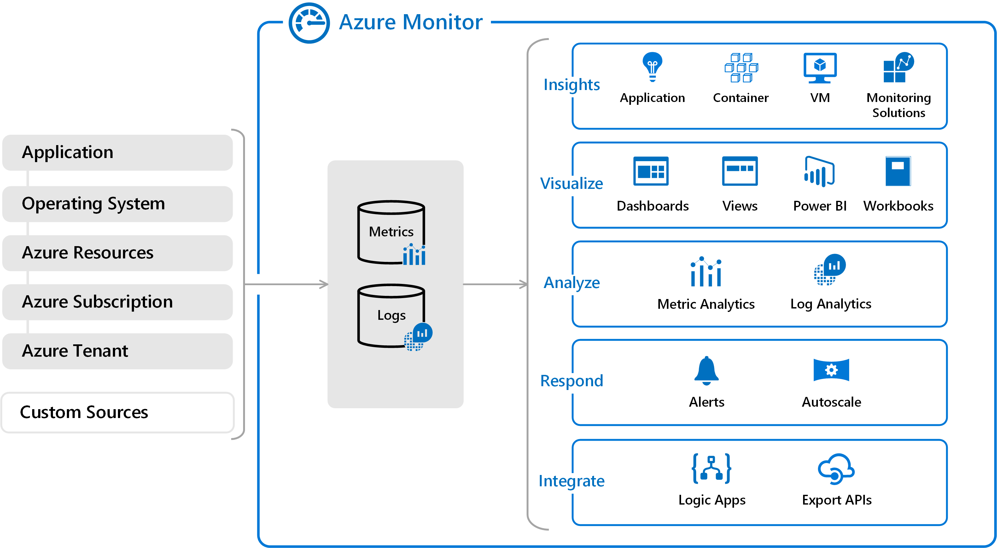
Explore Azure Monitor (1 / 3)
Notes:
Above diagram gives a high-level view of Azure Monitor. At the center of the diagram are the data stores for metrics and logs, which are the two fundamental types of data used by Azure Monitor. On the left are the sources of monitoring data that populate these data stores. On the right are the different functions that Azure Monitor performs with this collected data. This includes such actions as analysis, alerting, and streaming to external systems.

Slide 4



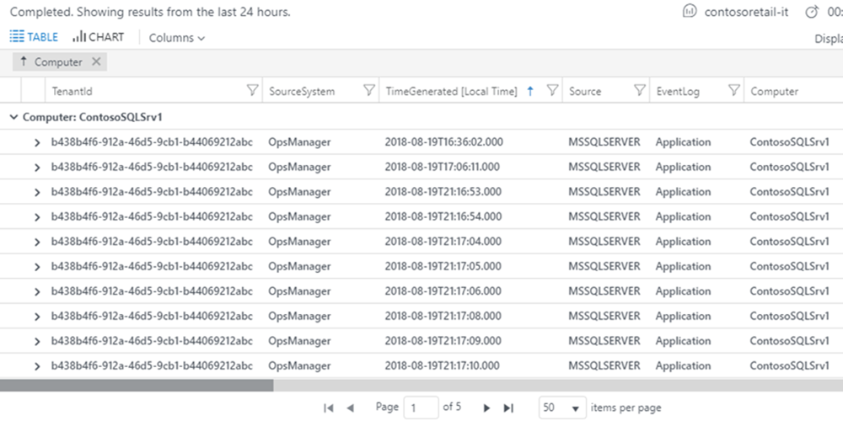
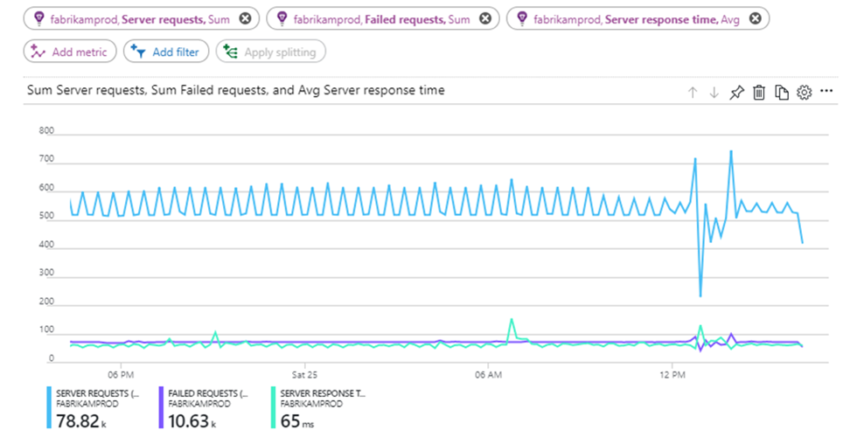

Explore Azure Monitor (3 / 3)
Monitoring data platform
Logs
Metrics
Log Analytics
Metrics Explorer
Notes:
All data collected by Azure Monitor fits into one of two fundamental types, metrics and logs. Metrics are numerical values that describe some aspect of a system at a particular point in time. They are lightweight and capable of supporting near real-time scenarios. Logs contain different kinds of data organized into records with different sets of properties for each type. Telemetry such as events and traces are stored as logs in addition to performance data so that it can all be combined for analysis.
Log data collected by Azure Monitor can be analyzed with queries to quickly retrieve, consolidate, and analyze collected data. You can create and test queries using Log Analytics in the Azure portal.

Slide 5
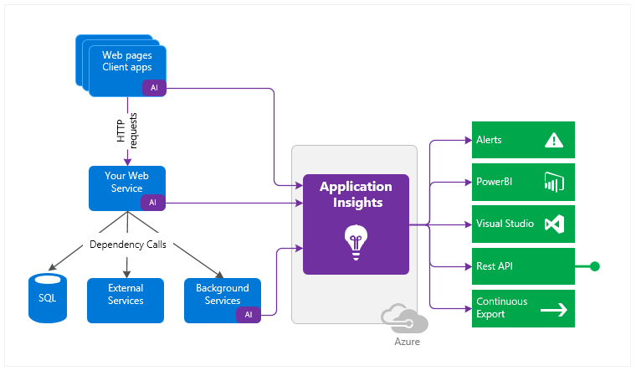
Explore Application Insights (1 / 2)
Notes:
How Application Insights works
You install a small instrumentation package (SDK) in your application or enable Application Insights using the Application Insights Agent when supported. The instrumentation monitors your app and directs the telemetry data to an Azure Application Insights Resource using a unique GUID that we refer to as an Instrumentation Key.
You can instrument not only the web service application, but also any background components, and the JavaScript in the web pages themselves. The application and its components can run anywhere - it doesn't have to be hosted in Azure.
https://docs.microsoft.com/azure/azure-monitor/app/pre-aggregated-metrics-log-metrics
In addition, you can pull in telemetry from the host environments such as performance counters, Azure diagnostics, or Docker logs. You can also set up web tests that periodically send synthetic requests to your web service.

Slide 6
Closing slide

